Slide 1
What is HTTP
Hypertext transfer protocol
HTTP is connectionless
HTTP is media independent
HTTP is stateless

Slide 2
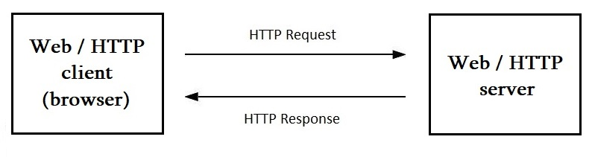
Interaction between client and server using HTTP

Slide 3
TCP/IP
IPAdress:port
socket
HTTP
TCP
(Transmission Control Protocol)
IP
(Internet Protocol)

Slide 4
URI/URL/URN
URL URN
(Uniform Resource Locator) (Uniform Resource Name)
https://www.tutorialspoint.com/http/http_messages.html
URI
(Uniform Resource Identifier)
https://www.tutorialspoint.com/http/http_messages.html
https://192.229.221.69:443/http/http_messages.html

Slide 5
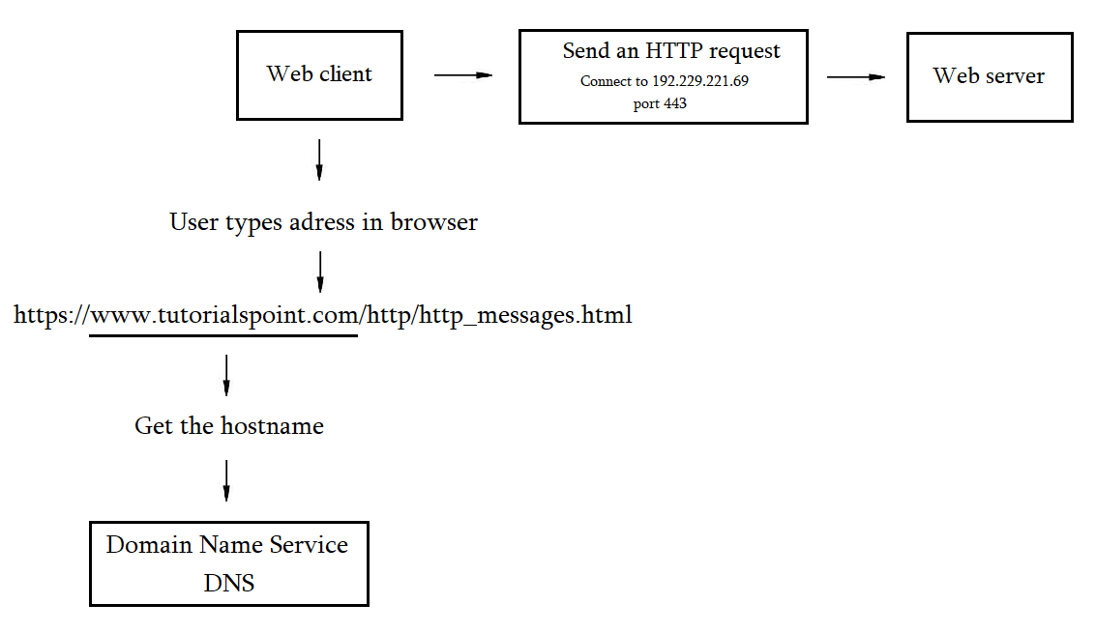
Basic server connection process

Slide 6
HTTP messages
Start line
Header fields (0 or more)
An empty line
Message – body (optional)

Slide 7
Request message
Response message
Start line
Headers
Empty line
Body
GET /messages.htm HTTP/1.1
user-agent: Chrome/105.0.0.0 :authority: www.tutorialspoint.com :path: /http/http_messages.htm accept-language: en
HTTP/1.1 200 OK
accept-ranges: bytes age: 1726128 cache-control: max-age=2592000 date: Tue, 27 Sep 2022 11:35:26 GMT expires: Thu, 27 Oct 2022 11:35:26 GMT last-modified: Wed, 07 Sep 2022 12:06:38 GMT server: ECAcc (amc/BC21)
<HTML> some HTML code </HTML>

Slide 8
Requests
Request-Line = Method Request-URI HTTP-Version
Method = GET / POST / PUT …
Request-URI = “*” | absoluteURI | abs_path | authority

Slide 9
Responses
Status-Line = HTTP-Version Status-Code Reason-Phrase
HTTP-Version = HTTP/1.1
Status-Code = 1--/2--/3--/4--/5--

Slide 10
Methods
GET
HEAD
POST
PUT
DELETE
CONNECT
OPTIONS
TRACE

