Slide 1

What is JDBC

Slide 2
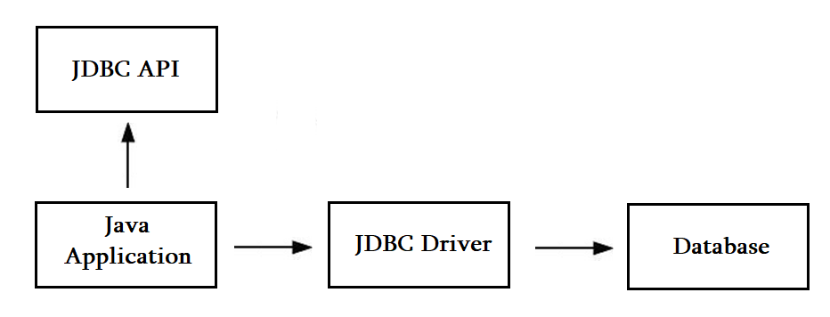
JDBC Driver

Slide 3
Types of JDBC drivers
JDBC-ODBC Bridge Driver
Native Driver
Network Protocol Driver
Thin Driver

