Slide 1
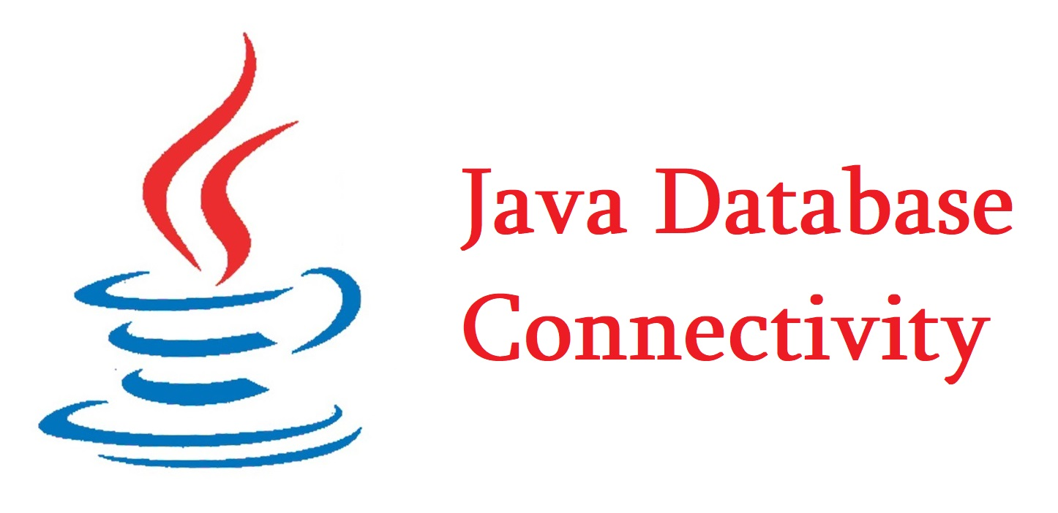
What is JDBC

Slide 2
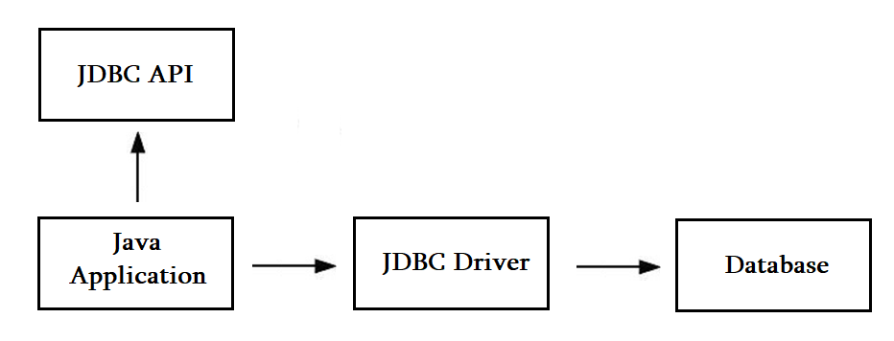
JDBC Driver

Slide 3
Types of JDBC drivers
JDBC-ODBC Bridge Driver
Native Driver
Network Protocol Driver
Thin Driver

Slide 4
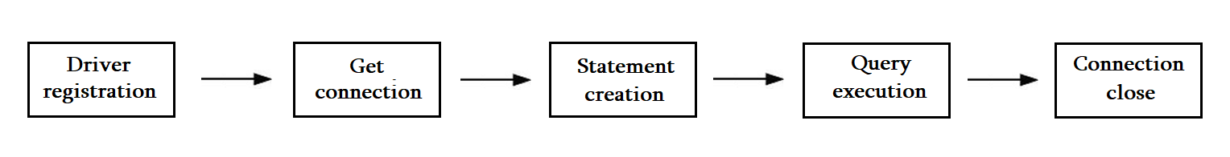
Java Database Connectivity Steps

Slide 5
DriverManager class
public static synchronized void registerDriver(Driver driver)
public static synchronized void deRegisterDriver(Driver driver)
public static Connection getConnection(String url)
public static Connection getConnection(url, user, password)
public static Driver getDriver(String url)
pubic static int getLoginTimeout()
pubic static void setLoginTimeout(int sec)
public static Connection getConnection(String URL, Properties prop) throws SQLException

Slide 6
Connection interface

