Slide 1
What is HTTP
Hypertext transfer protocol
HTTP is connectionless
HTTP is media independent
HTTP is stateless

Slide 2
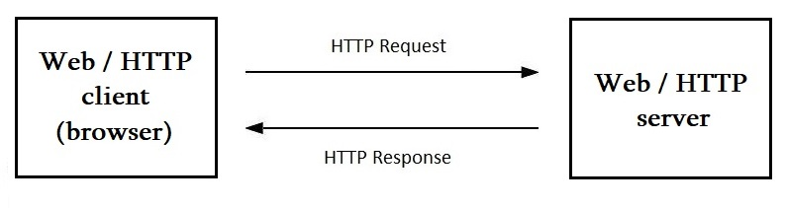
Interaction between client and server using HTTP

Slide 3
TCP/IP
IPAdress:port
socket
HTTP
TCP
(Transmission Control Protocol)
IP
(Internet Protocol)

Slide 4
URI / URL / URN
URL URN
(Uniform Resource Locator) (Uniform Resource Name)
https://www.tutorialspoint.com/http/http_messages.html
URI
(Uniform Resource Identifier)
https://www.tutorialspoint.com/http/http_messages.html
https://192.229.221.69:443/http/http_messages.html

Slide 5
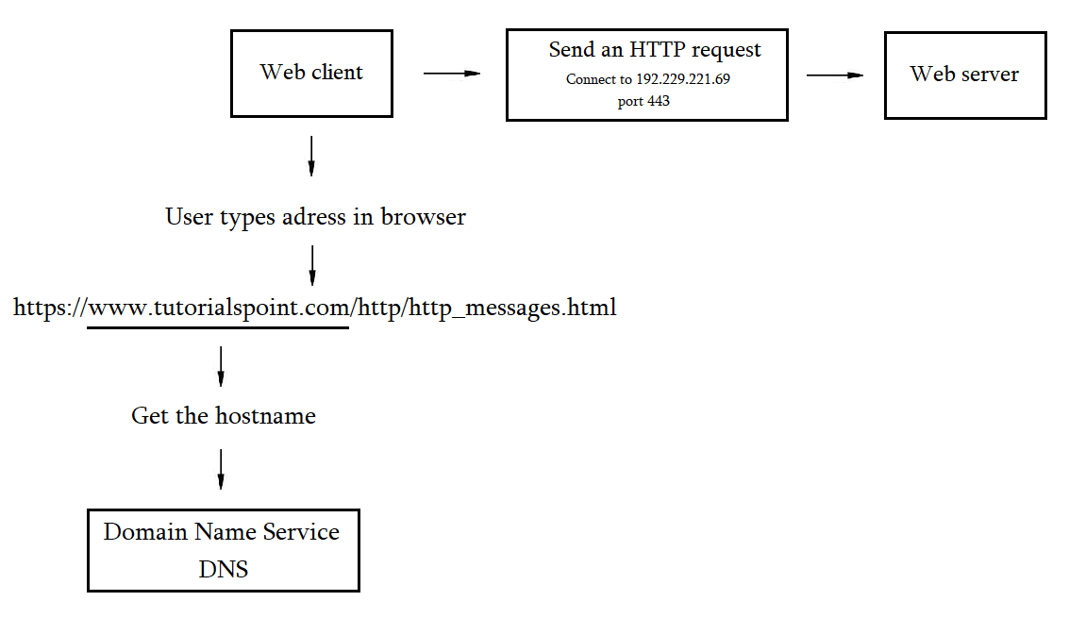
Basic server connection process

Slide 6
HTTP Messages
Start line
Header fields (0 or more)
An empty line
Message – body (optional)

Slide 7
Request message
Response message
Start line
Headers
Empty line
Body
GET /messages.htm HTTP/1.1
user-agent: Chrome/105.0.0.0 :authority: www.tutorialspoint.com :path: /http/http_messages.htm accept-language: en
HTTP/1.1 200 OK
accept-ranges: bytes age: 1726128 cache-control: max-age=2592000 date: Tue, 27 Sep 2022 11:35:26 GMT expires: Thu, 27 Oct 2022 11:35:26 GMT last-modified: Wed, 07 Sep 2022 12:06:38 GMT server: ECAcc (amc/BC21)
<HTML> some HTML code </HTML>

Slide 8
Requests
Request-Line = Method Request-URI HTTP-Version
Method = GET / POST / PUT …
Request-URI = “*” | absoluteURI | abs_path | authority

Slide 9
Responses
Status-Line = HTTP-Version Status-Code Reason-Phrase
HTTP-Version = HTTP/1.1
Status-Code = 1--/2--/3--/4--/5--

Slide 10
HTTP Methods
GET
HEAD
POST
PUT
DELETE
CONNECT
OPTIONS
TRACE

Slide 11
Idempotency
GET
HEAD
PUT
DELETE
CONNECT
OPTIONS
TRACE
POST
GET /page HTTP/1.1
GET /page HTTP/1.1
GET /page HTTP/1.1
DELETE /page HTTP/1.1 //200 OK
DELETE /page HTTP/1.1 //404 Not Found
DELETE /page HTTP/1.1 //404 Not Found
POST /add_row HTTP/1.1 //adds 1-ts row
POST /add_row HTTP/1.1 //adds 2-nd row
POST /add_row HTTP/1.1 //adds 3-rd row
Idempotent
Non-Idempotent

Slide 12
HTTP Status Codes
1 - - : Informational
2 - - : Success
3 - - : Redirection
4 - - : Client Error
5 - - : Server Error
100 – 101
200 – 206
300 – 307
400 – 417
500 - 505

Slide 13
HTTP Header Fields
General header
Client request-header
Server response-header
Entity-header

Slide 14
General Headers
Cache - Control
HTTP request headers
no-cache
no-store
max-age = seconds
max-stale [=seconds]
min-fresh = sconds
no-transform
only-if-cached
HTTP response headers
public / private
no-cache
no-store
no-transform
must-revalidate
proxy-revalidate
max-age = seconds
S-maxage = seconds

Slide 15
General Headers
Cache-Control:
Pragma:
Connection:
Date:
Trailer:
Transfer-Encoding:
Upgrate:
VIA:
Warning:

Slide 16
Request Headers
Informational headers
Accept headers
Security headers
Conditional headers
Proxy headers

Slide 17
Request Informational Headers
Client-IP
From: email
Host: host:port
Referer։ absoluteURI | relativeURI
User-Agent: product

Slide 18
Request Accept Headers
Accept: type/subtype q=value
Accept-Charset: character_set q=value
Accept-Encoding: encoding_types
Accept-Language: language q=value

Slide 19
Request Security Headers
Authorization: credentials
Cookie: name=value

Slide 20
Conditional Request Headers
Expect: expectation-extension
If-Match: tag
If-None-Match: tag
If-Modified-Since: date
If-Unmodified-Since: date
If-Range: tag | date
Range: bytes=0-499

Slide 21
Proxy Request Headers
Max-Forwards: n
Proxy-Authorization: credentials

Slide 22
Response Informational Headers
Age: seconds
Retry-After: date | seconds
Server։ product

Slide 23
Response Negotiation Headers
Accept-Ranges

