Slide 1
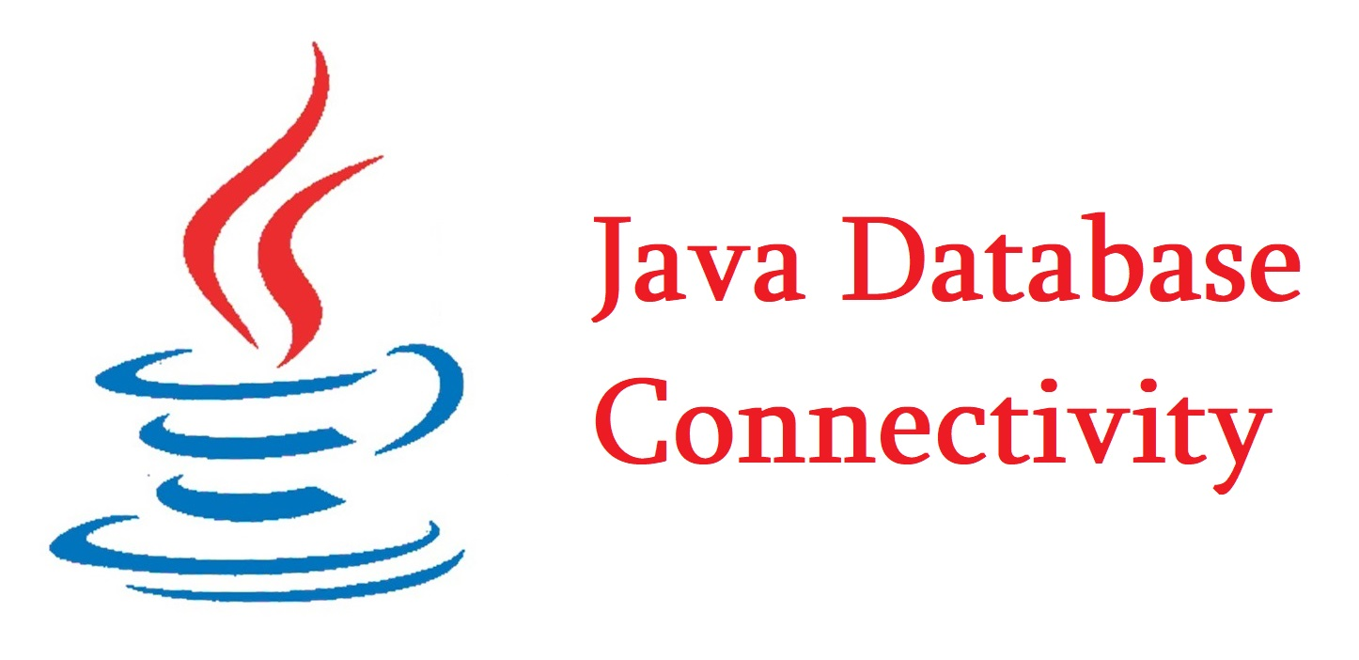
What is JDBC

Slide 2
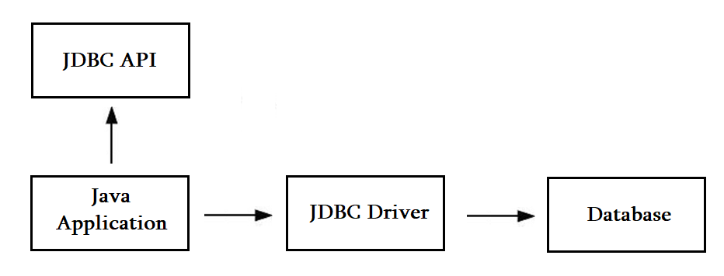
JDBC Driver

Slide 3
Types of JDBC drivers
JDBC-ODBC Bridge Driver
Native Driver
Network Protocol Driver
Thin Driver

Slide 4
Java Database Connectivity Steps
Driver registration
Get connectivity
Statement creation
Query execution
Close connection

Slide 5
DriverManager class
public static synchronized void registerDriver(Driver driver)
public static synchronized void deRegisterDriver(Driver driver)
public static Connection getConnection(String url)
public static Connection getConnection(url, user, password)
public static Driver getDriver(String url)
pubic static int getLoginTimeout()
pubic static void setLoginTimeout(int sec)
public static Connection getConnection(String URL, Properties prop) throws SQLException

Slide 6
Connection interface
public Statement createStatement()

Slide 7
Statement interface
public ResultSet executeQuery(String sql)
public int executeUpdate(String sql)
public boolean execute(String sql)

Slide 8
ResultSet interface
public boolean next ()
public boolean previous ():
public boolean first ()
public boolean last ()
public boolean absolute (int row)
public boolean relative (int row)
public int getInt (int columnIndex)
public int getInt (String columnName)
public String getString (int columnIndex)
public String getString (String columnName)

Slide 9
PreparedStatement interface
public void setInt(int paramIndex, int value)
public void setString(int paramIndex, String value)
public void setFloat(int paramIndex, float value)
public void setDouble(int paramIndex, double value)
public int executeUpdate()
public ResultSet executeQuery()

Slide 10
RsultSetMetadata interface
public int getColumnCount()throws SQLException
public String getColumnName(int index)throws SQLException
public String getColumnTypeName(int index)throws SQLException
public String getTableName(int index)throws SQLException

Slide 11
RsultSetMetadata interface
PreparedStatement
setBinaryStream(int paramIndex, InputStream stream)
BLOB (binary large object)
public Blob getBlob()

