Slide 1


Slide 2
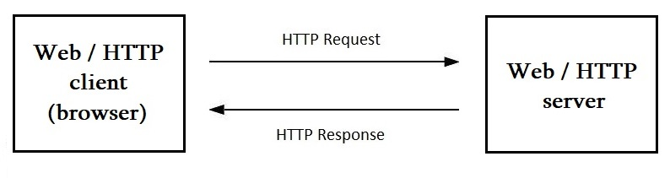
Interaction between client and server using HTTP
Hypertext transfer protocol

Slide 3
HTTP Basic Features
HTTP is connectionless
HTTP is media independent
HTTP is stateless

Slide 4
TCP/IP model
Application layer | HTTP
Transport layer | TCP (Transmission Control Protocol)
Internet layer | IP (Internet Protocol)
Network interfaces | Wi-Fi
IPAdress:port
socket

Slide 5
URI / URL / URN
URL URN
(Uniform Resource Locator) (Uniform Resource Name)
http://www.tutorialspoint.com/http/http_messages.html
URI
(Uniform Resource Identifier)
http://www.tutorialspoint.com/http/http_messages.html
http://192.229.221.69:80/http/http_messages.html

Slide 6
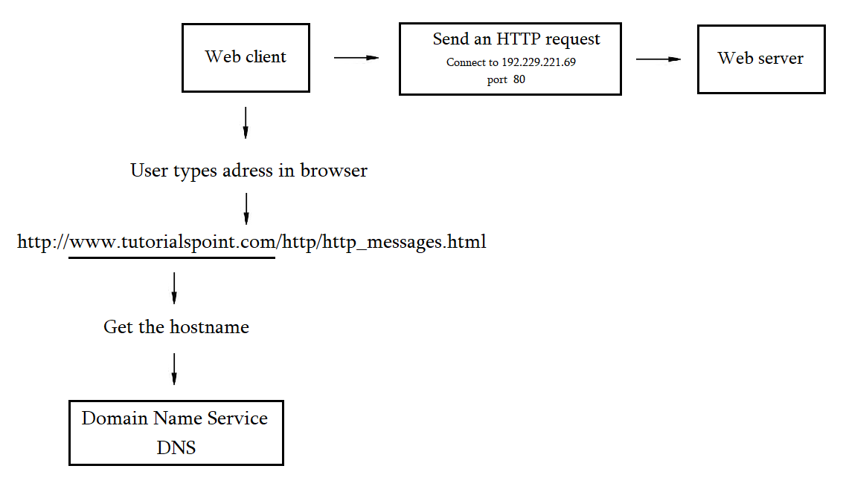
Basic server connection process

Slide 7
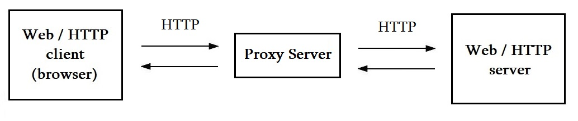
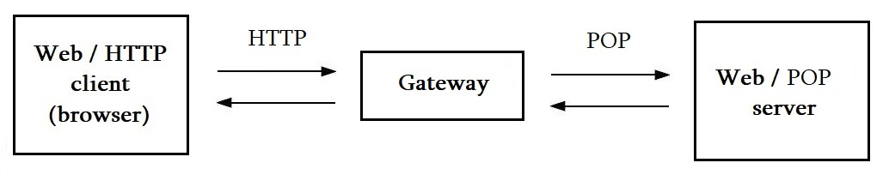
Web Intermediaries, Proxy Servers, Gateways

Slide 8
HTTP Messages
Start line
Header fields (0 or more)
An empty line
Body (optional)

Slide 9
Request message
Response message
Start line
Headers
Empty line
Body
GET /messages.htm HTTP/1.1
user-agent: Chrome/105.0.0.0 accept: text/html accept-encoding: gzip accept-language: en cache-control: max-age=0 :authority: www.tutorialspoint.com :path: /http/http_messages.htm
HTTP/1.1 200 OK
accept-ranges: bytes age: 1726128 cache-control: max-age=2592000 date: Tue, 27 Sep 2022 11:35:26 GMT expires: Thu, 27 Oct 2022 11:35:26 GMT last-modified: Wed, 07 Sep 2022 12:06:38 GMT server: ECAcc (amc/BC21)
<HTML> some HTML code </HTML>

Slide 10
Requests
Request-Line = Method Request-URI HTTP-Version
Method = GET / POST / PUT …
Request-URI = “*” | absoluteURI | abs_path | authority
HTTP-Version = HTTP/1.1

Slide 11
HTTP Methods
GET
HEAD
POST
PUT
DELETE
CONNECT
OPTIONS
TRACE

Slide 12
Idempotency
GET
HEAD
PUT
DELETE
CONNECT
OPTIONS
TRACE
POST
GET /page HTTP/1.1
GET /page HTTP/1.1
GET /page HTTP/1.1
DELETE /page HTTP/1.1 //200 OK
DELETE /page HTTP/1.1 //404 Not Found
DELETE /page HTTP/1.1 //404 Not Found
POST /add_row HTTP/1.1 //adds 1-ts row
POST /add_row HTTP/1.1 //adds 2-nd row
POST /add_row HTTP/1.1 //adds 3-rd row
Idempotent
Non-Idempotent

Slide 13
Responses
Status-Line = HTTP-Version Status-Code Reason-Phrase
HTTP-Version = HTTP/1.1
Status-Code = 1--/2--/3--/4--/5--

Slide 14
HTTP Status Codes
1 - - : Informational
2 - - : Success
3 - - : Redirection
4 - - : Client Error
5 - - : Server Error
100 – 101
200 – 206
300 – 307
400 – 417
500 - 505

Slide 15
Most Common HTTP Status Codes
200 OK
301 Permanent Redirect
302 Temporary Redirect
304 Not Modified
400 Bad Request
401 Unauthorized Error
403 Forbodden
404 Not Found
500 Internal Server Error
501 Not Implemented
503 Service Unavailable
504 Gateway Timeout

Slide 16
HTTP Header Fields
General header
Client request-header
Server response-header
Entity-header

Slide 17
General Headers
Cache-Control
Pragma
Connection
Date
Trailer
Transfer-Encoding
Upgrate
VIA
Warning

Slide 18
Request Headers
Informational headers
Accept headers
Security headers
Conditional headers
Proxy-Authorization headers

Slide 19
Request Informational Headers
Client-IP
From: email
Host: host:port
Referer։ absoluteURI | relativeURI
User-Agent: product

Slide 20
Request Accept Headers
Accept: type/subtype q=value
Accept-Charset: character_set q=value
Accept-Encoding: encoding_types
Accept-Language: language q=value

Slide 21
Request Security Headers
Authorization: credentials
Cookie: name=value

Slide 22
Conditional Request Headers
Expect: expectation-extension
If-Match: tag
If-None-Match: tag
If-Modified-Since: date
If-Unmodified-Since: date
If-Range: tag | date
Range: bytes=0-499

Slide 23
Proxy-Authorization Request Headers
Max-Forwards: n
Proxy-Authorization: credentials

Slide 24
Response Headers
Security headers
Proxy-Authenticate
Set-Cookie։ name=value; options
Informational headers
Age: seconds
Retry-After: date | seconds
Server։ product
Negotiation headers
Accept-Ranges։ range-unit | none
Vary:

Slide 25
Entity Headers
Informational headers
Content headers
Entity caching headers

Slide 26
Entity Informational Headers
Informational headers
Allow: method
Entity Caching headers
Expires: date
Last-Modified: date

Slide 27
Entity Content headers
Content-Encoding։ content-coding
Content-Language: language-tag
Content-Length: digits
Content-Location: absoluteURI | relativeURI
Content-MD5: md5-digest
Content-Range: bytes

Slide 28
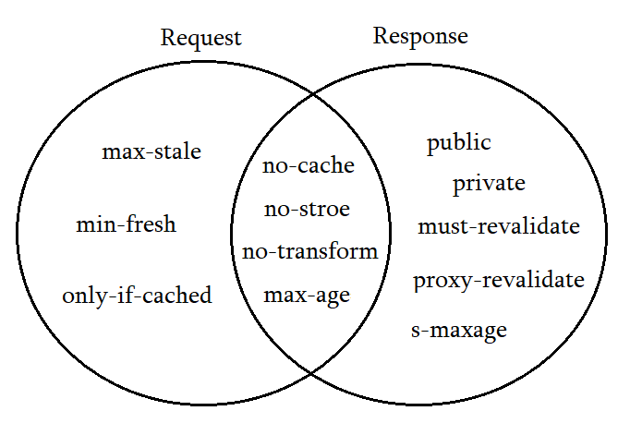
Cache-Control

Slide 29
URL Encoding
! → %21
# → %23
$ → %24
& → %26
{ → %7B
| → %7C
} → %7D
~ → %7D

Slide 30
HTTP Security
Personal Information Leakage
File and Path Names Based Attack
DNS Spoofing
Location Headers and Spoofing
Authentication Credentials
Proxies and Caching

Slide 31
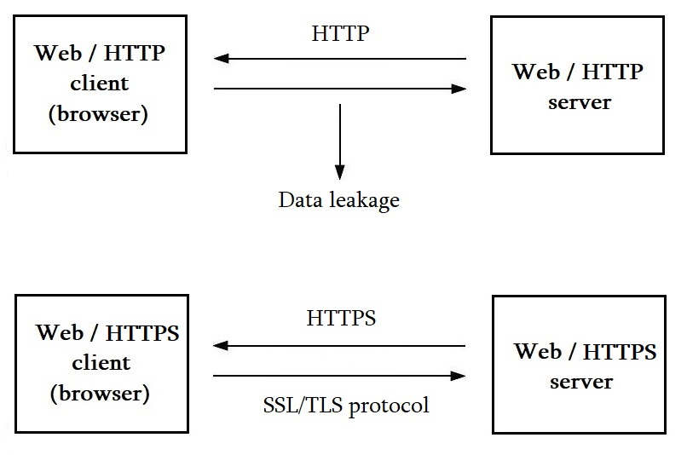
HTTPS

