Slide 1

What is JDBC

Slide 2
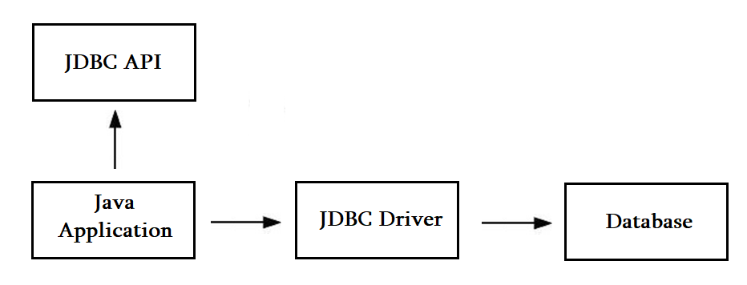
JDBC Driver

Slide 3
Types of JDBC drivers
JDBC-ODBC Bridge Driver
Native Driver
Network Protocol Driver
Thin Driver

Slide 4
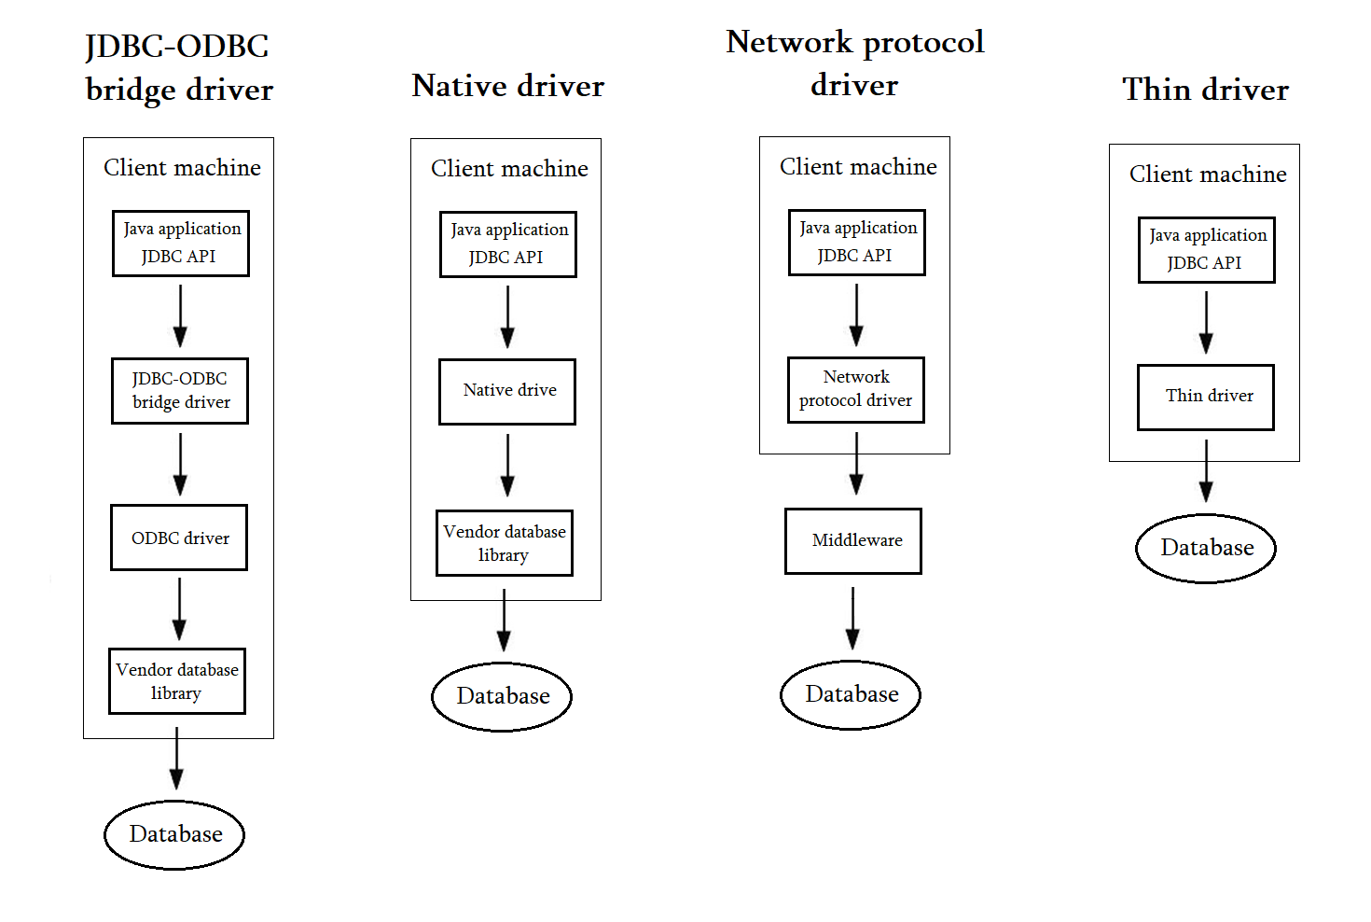

Slide 5
Java Database Connectivity Steps
Driver registration
Get connectivity
Statement creation
Query execution
Close connection

Slide 6
DriverManager class
public static synchronized void registerDriver(Driver driver)
public static synchronized void deRegisterDriver(Driver driver)
public static Connection getConnection(String url)
public static Driver getDriver(String url)
pubic static int getLoginTimeout()
pubic static void setLoginTimeout(int sec)

Slide 7
Connection interface
public Statement createStatement()
public PreparedStatement preparedStatement(String query)
public DatabaseMetadata getMetadata()
public void close()
public void setAutoCommit(boolean status)
public void commit()
public void rollback()

Slide 8
Statement interface
Statement statement = connection.create.Statement()
public ResultSet executeQuery(String sql)
public int executeUpdate(String sql)
public boolean execute(String sql)

Slide 9
ResultSet interface
ResultSet.TYPE_SCROLL_INSENSITIVE
ResultSet.CONCUR_UPDATABLE
public boolean next () / previous () / first () / last ()
public boolean absolute (int row)
public boolean relative (int row)
public int getInt / getString / … (int columnIndex / String columnName)

Slide 10
PreparedStatement interface
PreparedStatement extends Statement
public void setInt / setString / setFloat … (int paramIndex, int value)
public ResultSet executeQuery()
public int executeUpdate()

Slide 11
RsultSetMetadata interface
public int getColumnCount()
public String getColumnName(int index)
public String getColumnTypeName(int index)

Slide 12
DatabaseMetadata interface
public String getDriverName()
public String getDriverVersion()
public String getUserName()
public String getDatabaseProductName()
public String getDatabaseProductVersion()

Slide 13
Binary information store and retrieve
PreparedStatement
setBinaryStream(int paramIndex, InputStream stream);
preparedStatement.setBinaryStream(1, new FileInpuStream(filePath);
Blob blob = resultSet.getBlob(columnName);

Slide 14
File store and retrieve
PreparedStatement
setCharacterStream(int paramIndex, InputStream stream);
FileReader fileReader = new FileReader(new File(filePath))
preparedStatement.setCharacterStream(1, fileReader);
Clob clob = resultSet.getClob(columnName);

Slide 15
CallableStatement interface
CallableStatement extends PreparedStatement
public CallableStatement prepareCall("{ call procedurename(?,?)}");
callableStatement.setInt(1, 25);
callableStatement.setString(2, “value”);
callableStatement.execute();

Slide 16
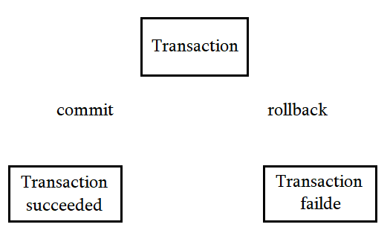
Transaction Management
void setAutoCommit(boolean status)
void commit()
void rollback()
Connection savepoints
setSavePoint()

Slide 17
Batch Processing
void addBatch(String query)
int[] executeBatch()
void clearBatch()

Slide 18
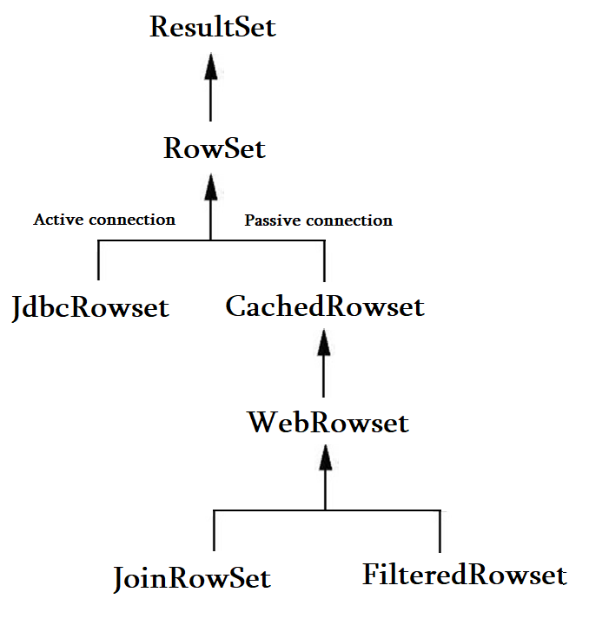
RowSet interface
RowsetFactory factory =
RowsetProvider.newFactory();
RowSet rowSet =
factory.createCachedRowSet();
RowSetListener
rowSet.addRowSetListener();
public void cursorMoved();
public void rowChanged();
public void rowSetChanged();

