Slide 1

What is servlets and JSP

Slide 2
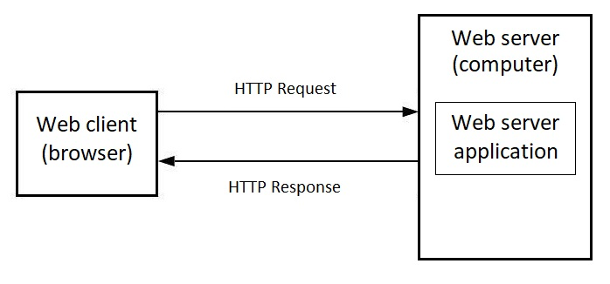
Interaction between client and server

Slide 3
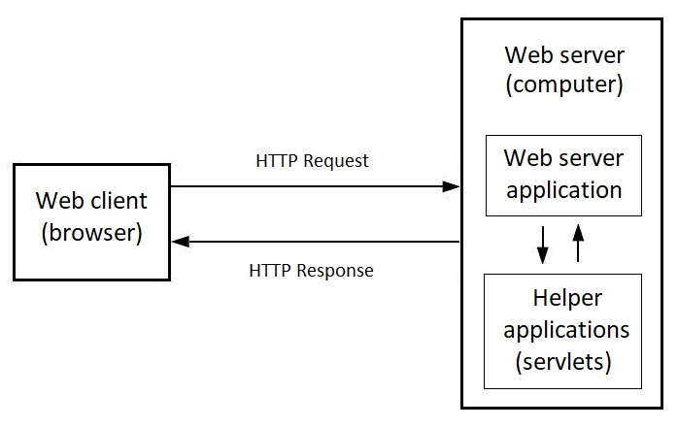
Web application needs an helper applications

Slide 4
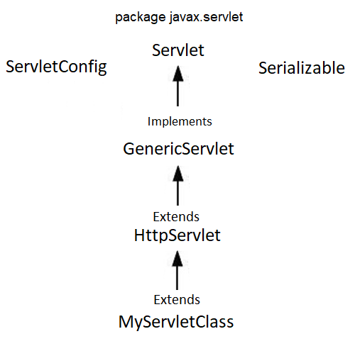

Servlet class hierarchy

Slide 5
Servlet methods for handling requests
HttpServlet
doGet()
doPost()
doPut()
doDelete()
doHead()
HttpServletRequest
HttpServletResponse

Slide 6
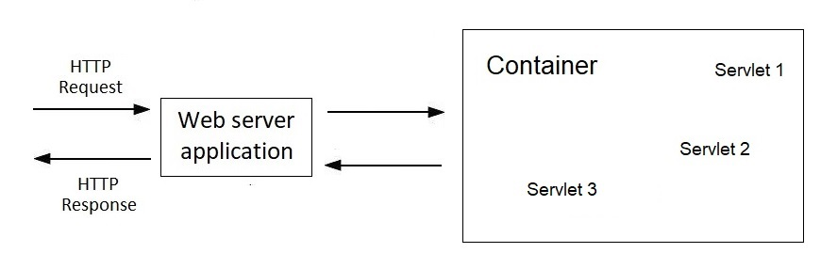

Interaction between web server application and container

Slide 7
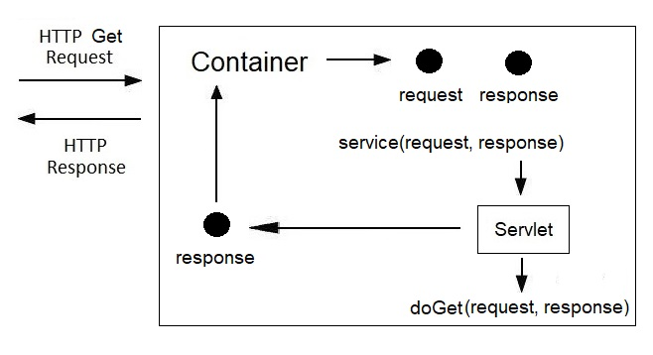
Request processing inside the container

Slide 8
Application configuration and servlet mapping
web.xml
Anotations
Servlet mapping

Slide 9
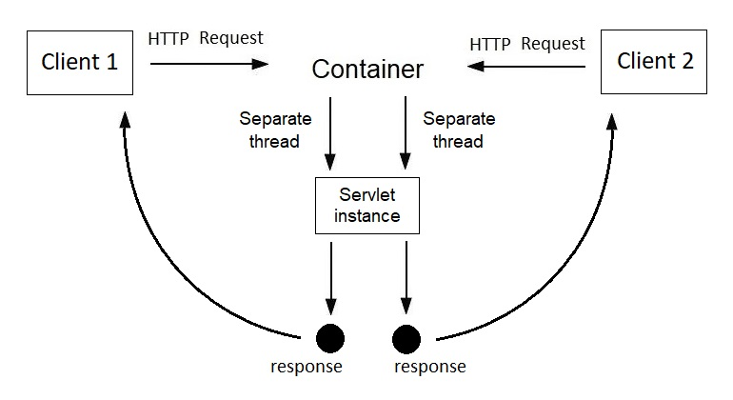
The container creates only one instance of the servlet

Slide 10
Getting Data in a Servlet
HttpServletRequest
String getParameter(String param)
String [] getParameterValues(String param)
resource_name?parameter1=value1&parameter2=value2
name attribute of HTML input element

Slide 11
Servlet initialization options
ServletContext
getServletContext()
getInitParameter(String name)
ServletConfig
getServletConfig()
getInitParameter(String name)
@WebInitParam
<context-param>
<param-name>message</param-name>
<param-value>Hello Servlets</param-value>
</context-param>
<servlet>
<servlet-name>HelloServlet</servlet-name>
<servlet-class>HelloServlet</servlet-class>
<init-param>
<param-name>message</param-name>
<param-value>Hello Servlets</param-value>
</init-param>
</servlet>

Slide 12
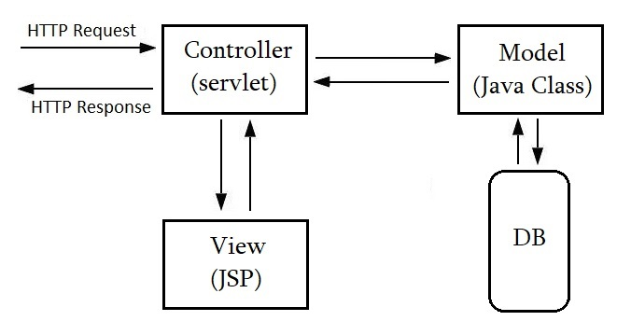
Model View Controller concept (MVC)

Slide 13
Redirect and Forward
Redirect Redirect happen on the client side
Redirect changes url in browser
Resource can be internal or external
Forward
Forward happen on the server
Forward doesn’t change url in browser
Resource can be only internal

Slide 14
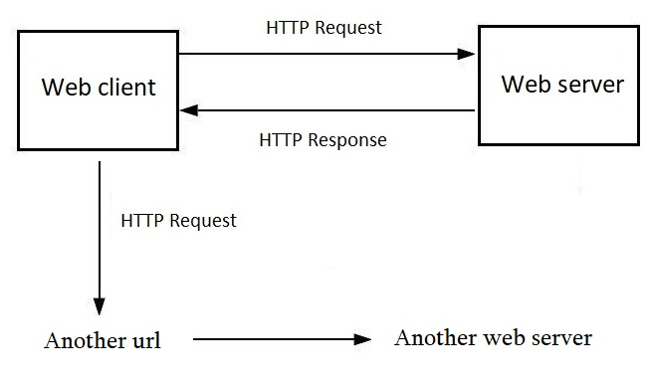
Redirect

Slide 15
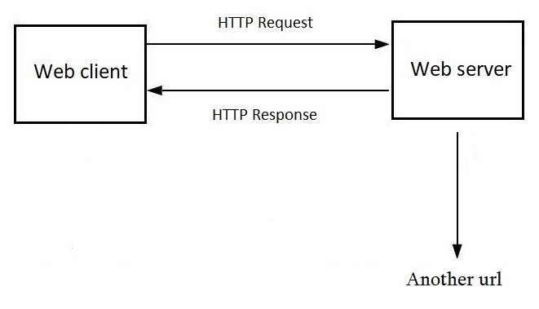
Forward

Slide 16
Session
setAttribute(String name, Object o)
getAttribute(String name)
removeAttribute(String name)
getAttributeNames()
getId()
isNew()
setMaxInactiveInterval(int seconds)
invalidate()
HttpSession interface
request.getSession()
Session Id

Slide 17
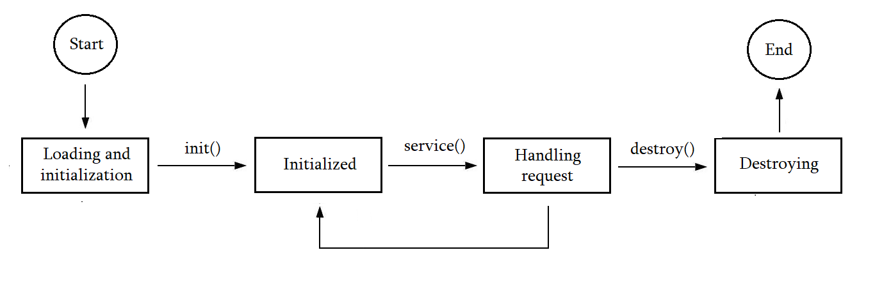
Servlet lifecycle

Slide 18
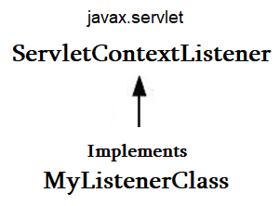
Listeners
@WebListener
ServletRequestListener
ServletRequestAttributeListener
ServletContextListener
ServletContextAttributeListener
HttpSessionListener
HttpSessionAttributeListener
HttpSessionBindingListener
HttpSessionActivationListener

Slide 19
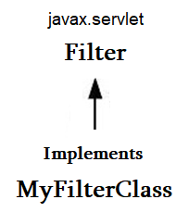
Filters
@WebFilter
default void init (FilterConfig onfig);
default void destroy ();
void doFilter (ServletRequest req,
ServletResponse res,
FilterChain chain);

Slide 20
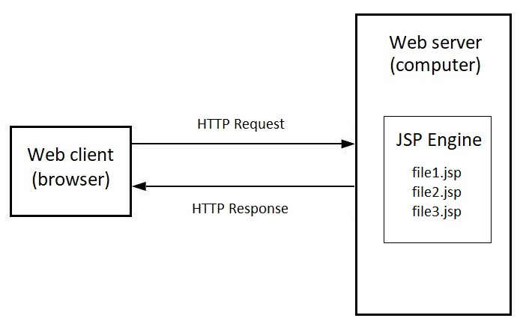
Java Server Page (JSP)
A technology that allows for the creation of dynamic web pages

Slide 21
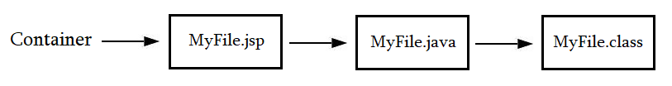
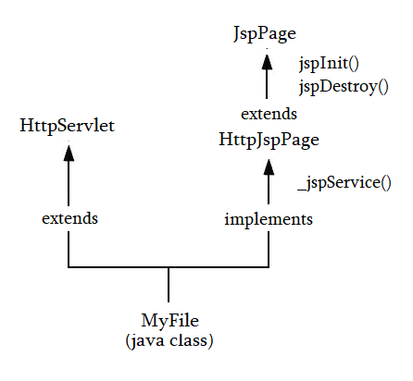
The container turns JSP it into a full-fledged servlet class

Slide 22
Inserting Java code into JSP
<%@ %> | Directive
<% %> | Skriplet
<%= %> | Expression
<%! %> | Declaration
<%-- --%> | Comments

Slide 23
What happens to JSP code
public class MyJspServlet extends HttpServlet {
String str = “Hello”;
public void _jspService (HttpServletRequest request,
HttpServletResponse response) {
PrintWriter out = response.GetWriter();
response.setResponseType(“html”);
int number = 10;
out.printLn(number);
}
}
<html>
<body>
<%! String str = “Hello”; %>
<% int number = 10; %>
<%= number %>
</body>
</html>

Slide 24
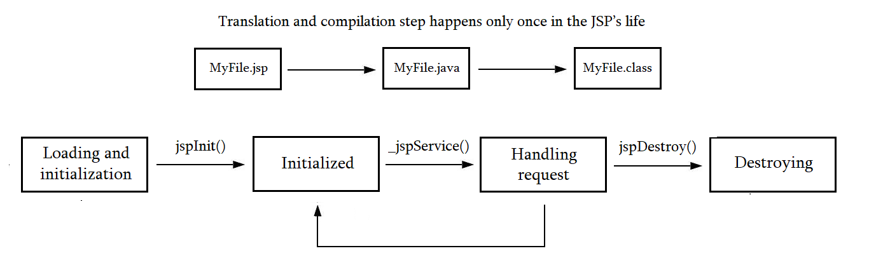
JSP lifecycle

Slide 25
Implicit objects inside JSP
JspWriter | out
HttpServletRequest | request
HttpServletResponse | response
HttpSession | session
ServletContext | application
ServletConfig | config
Throwable | exception
PageContext | pageContext
Object | page

Slide 26
Passing data from servlet to JSP
HttpServletRequest | request
HttpSession | session
ServletContext | application
PageContext | pageContext
setAttribute(String name, Object value)
getAttribute(String name)

Slide 27
Expression language (EL)
${ attributeName }
${ myBean.field }
${ myBean[“field”] }
${ array[“1”] }
${ list[1] }
${ map[“key”] }
${ 1 + 2 * 3 / 2 }
${ list[1] == “one”}
${ null + 1 }
Page context Request context Session context Application context
${ pageScope.attributeName }
${ requestScope.attributeName }
${ sessionScope.attributeName }
${ applicationScope.attributeName }
\ ${ expression}
isElIgnored=“true”

Slide 28
Implicit objects inside EL
pageScope
requestScope
sessionScope
applicationScope
param
paramValues
map of request
parameters
map of scope
attributes
header
headerValues
map of request
headers
map of cookiees
cookie
map of
init params
initParam
pageContext

Slide 29
Jsp and Java beans
<jsp:useBean id=“person” class=“Person” scope=“request” />
<jsp:useBean id=“person” class=“Person” type=“Human” scope=“request” />
<jsp:useBean> body </ jsp:useBean>
<jsp:setProperty name="person" property="name" value=“John" />
<jsp:setProperty name="person" param=“*" />
<jsp:getProperty name=“person” property=“firstName” />
<jsp:include page=“MyPage.jsp” />

