Slide 1

What are servlets and JSP

Slide 2
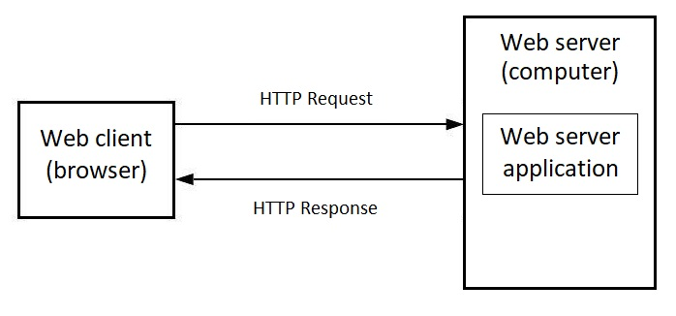
Interaction between client and server

Slide 3
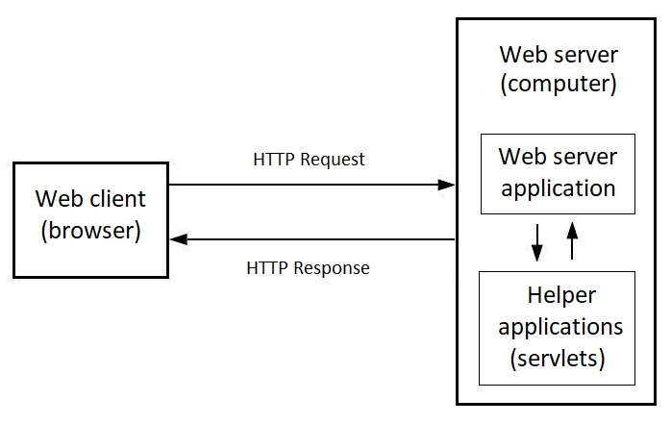
Web application needs an helper applications

Slide 4
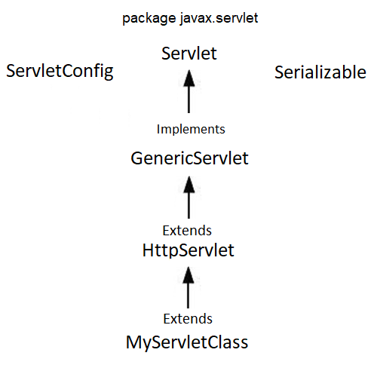

Servlet class hierarchy

Slide 5
Servlet methods for handling requests
HttpServlet
doGet()
doPost()
doPut()
doDelete()
doHead()
HttpServletRequest
HttpServletResponse

Slide 6
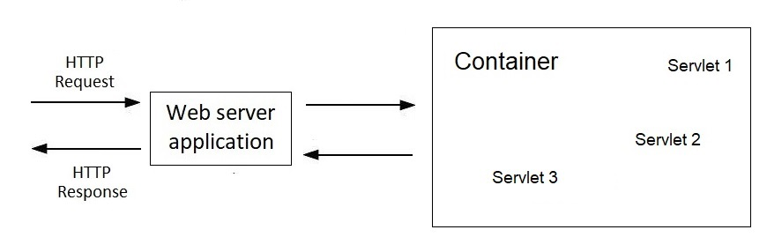

Interaction between web server application and container

Slide 7
How the container finds the required servlet
Application configuration with web.xml file

Slide 8
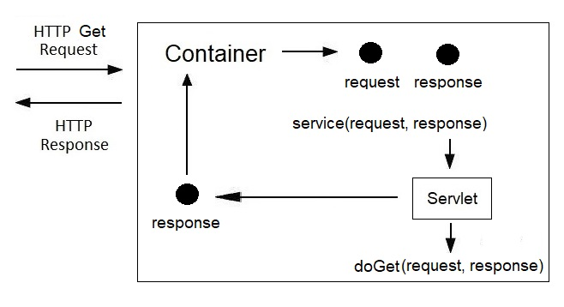
Request processing inside the container

Slide 9
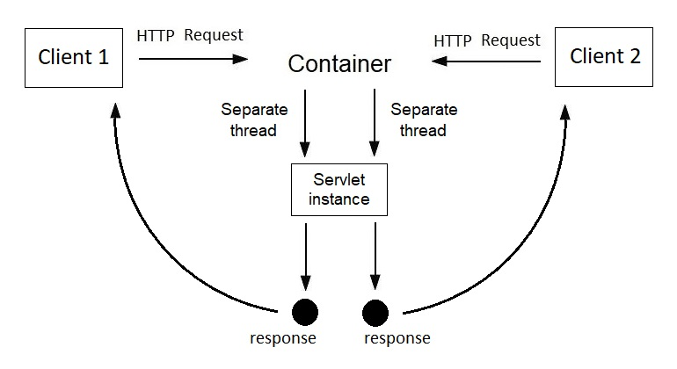
The container creates only one instance of the servlet

Slide 10
Getting Data in a Servlet
HttpServletRequest
getParameter(String param)
getParameterValues(String param)
resource_name?parameter1=value1& parameter2=value2
name attribute of HTML input element

Slide 11
Servlet lifecycle

