Slide 1
Project 8 – Implementation DATA BUFFER for CPU/IP cores Communication
Emanuele Garolla
Gina Jiang
Evelina Forno
Francesco Buttafuoco
Salvatore Bellino

Slide 2
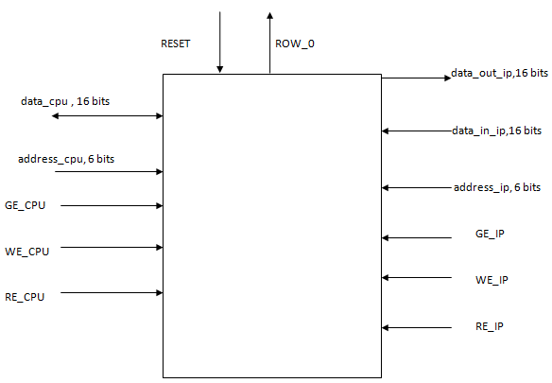
Interface of DataBuffer
CPU side
IP cores side

Slide 3
DATA BUFFER External Interface: Access signals
A unit accessible both CPU side and IP cores side;
Three input signals to access to it :
GE_CPU/GE_IP : To enable the access to Data Buffer;
WE_CPU/WE_IP : To perform a Write Operation;
RE_CPU/RE_IP : To perform a Read Operation;

Slide 4
DATA BUFFER External Interface: Adress and Data signals
From CPU side :
address_cpu, input signal of 6 bits;
data_cpu; bidirectional bits of 16 bits;
From IP cores side:
address_ip, input signal of 6 bits;
data_in_ip, input signal of 16 bits;
data_out_ip, input signal of 16 bits;
ROW_0, directly connected to IP Manager;

Slide 5
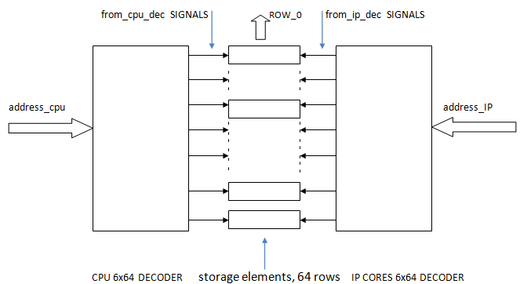
DATA BUFFER Internal Structure: How to access to DATA BUFFER

Slide 6
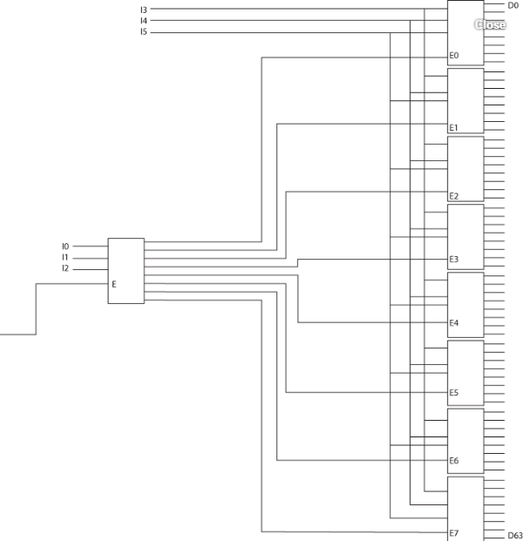
6to64 Address Decoder : implemented with 9 3to8 decoders with Enable signals

Slide 7
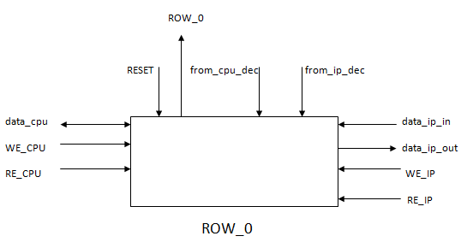
DATA BUFFER Internal Structure: Storage rows

Slide 8
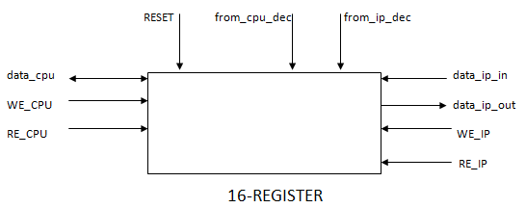
DATA BUFFER Internal Structure: Storage rows

Slide 9
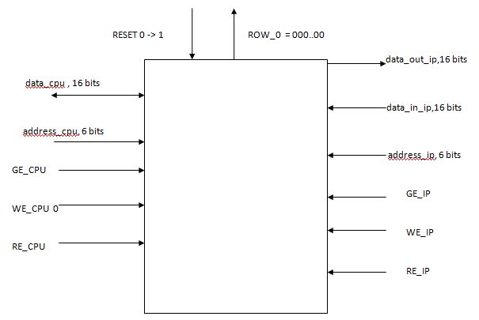
Manipulate Storage rows : Write Process (Reset)
GE_CPU = 0; GE_IP= 0 ;
(NO operation
allowed for
Both sides)

Slide 10
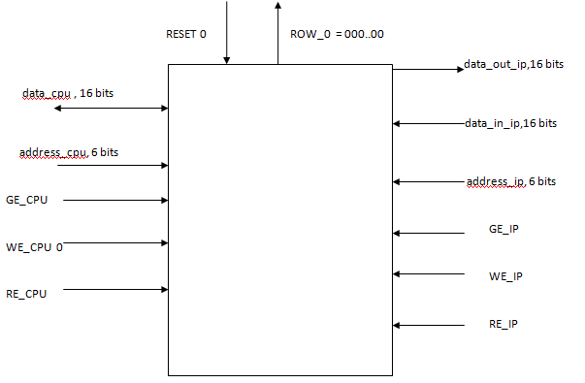
Manipulate Storage rows : Write Process (CPU writes last row)
GE_CPU = 1
GE_IP = 0
WE_CPU = 1
Data_cpu =
1111111100000000
address_cpu =
111111

Slide 11
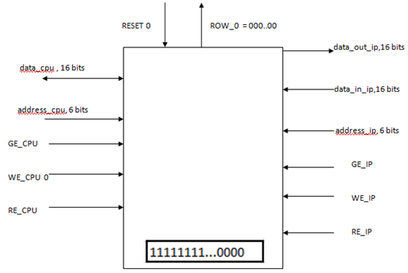
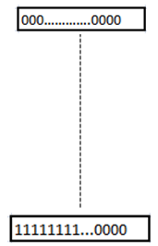
Manipulate Storage rows : Read Process (IP core reads last row)
GE_CPU = 0
GE_IP = 1
RE_IP = 1
Address_ip =
111111

Slide 12
Thanks for your attention!

