Slide 1
IP cores
IP-core Manager for FPGA-based Designs (RT level)
Emanuele Garolla, Gina Jiang, Evelina Forno, Francesco Buttafuoco, Salvatore Bellino

Slide 2
Developing IP cores for testing
In order to verify the correct behavior of the system, we develop a few simple IP cores.
We can test that the management of transactions follows specifications and that the whole system is synthesizable.

Slide 3
Regular operation: Adder IP
Test regular transactions through the data buffer (no interrupts)
Core: a simple adder
3 reserved data positions in the buffer:
OPERAND1 (CPU out, IP core in)
OPERAND2 (CPU out, IP core in)
RESULT (CPU in, IP core out)
The core works as a FSM cycling through a few states

Slide 4
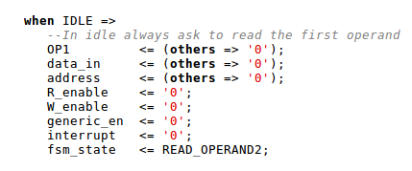
1: IDLE
This state is entered at reset
The adder stays in IDLE whenever enable = 0
In this state, the core requests to read OP1 from address row 1

Slide 5
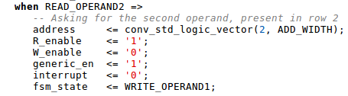
2: READ_OPERAND2
The state is entered as soon as enable becomes 1
The core requests to read OP2 from address row 2

Slide 6
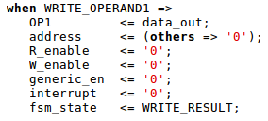
3: WRITE_OPERAND1
Since the IPM stands between the core and the data buffer, effectively pipelining the signals, there is a 1-clock cycle latency between the request to read OP1 and the reception of the data.
1 cc after sending the request for OP2, we should receive OP1 on data_out
We store it in a local register while waiting for OP2 to arrive

Slide 7
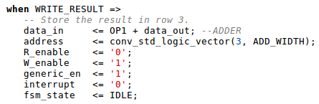
4: WRITE_RESULT
On this cycle we finally receive OP2 from the data buffer
The behavioral adder directly computes the result and we write it to the buffer’s data_in
We return to IDLE after this state, and the cycle repeats…

Slide 8
Some timing details…
In order to complete the sum, the CPU must keep the transaction open (i.e. adder’s enable = 1) for 4 clock cycles
If the adder is enabled for more than 4 clock cycles, the core cycles back to idle and reads OP1. If it is still enabled after that, it can compute a new sum without interruptions or additional delay.
If the transaction is enabled for less than 3 cycles, the core stops operation and goes back to idle. No result is written back.

