Slide 1
Project 8 Reports
Emanuele Garolla
Gina Jiang
Evelina Forno
Francesco Buttafuoco
Salvatore Bellino

Slide 2
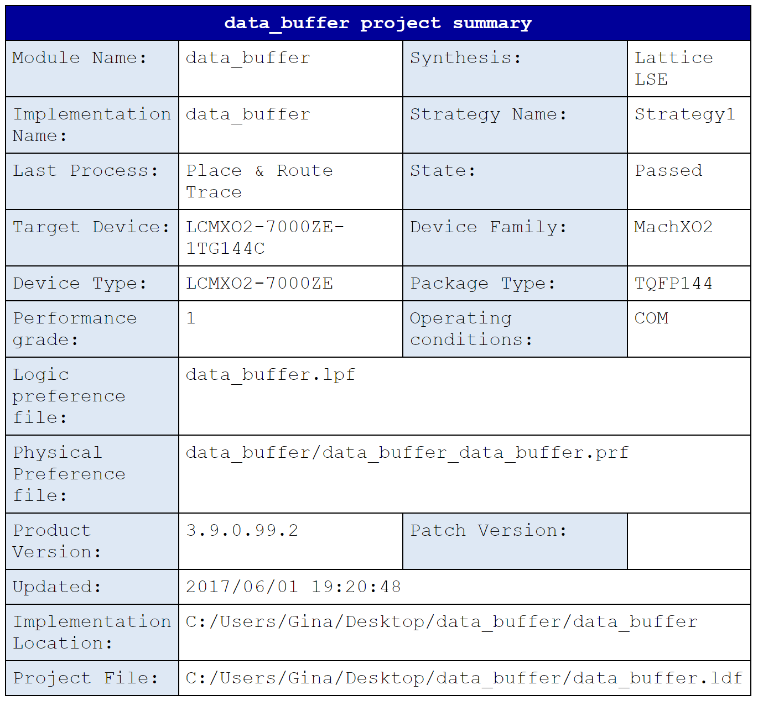
Data Buffer (structural)

Slide 3
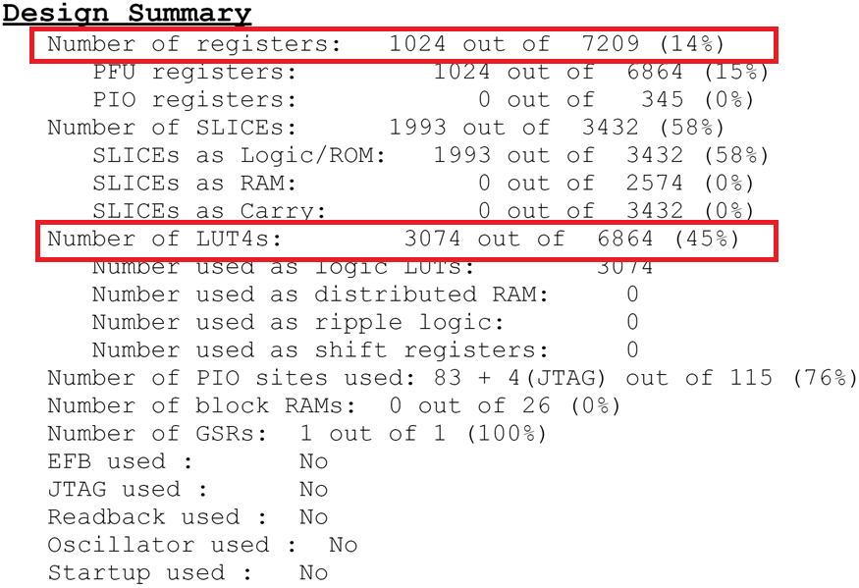

Slide 4
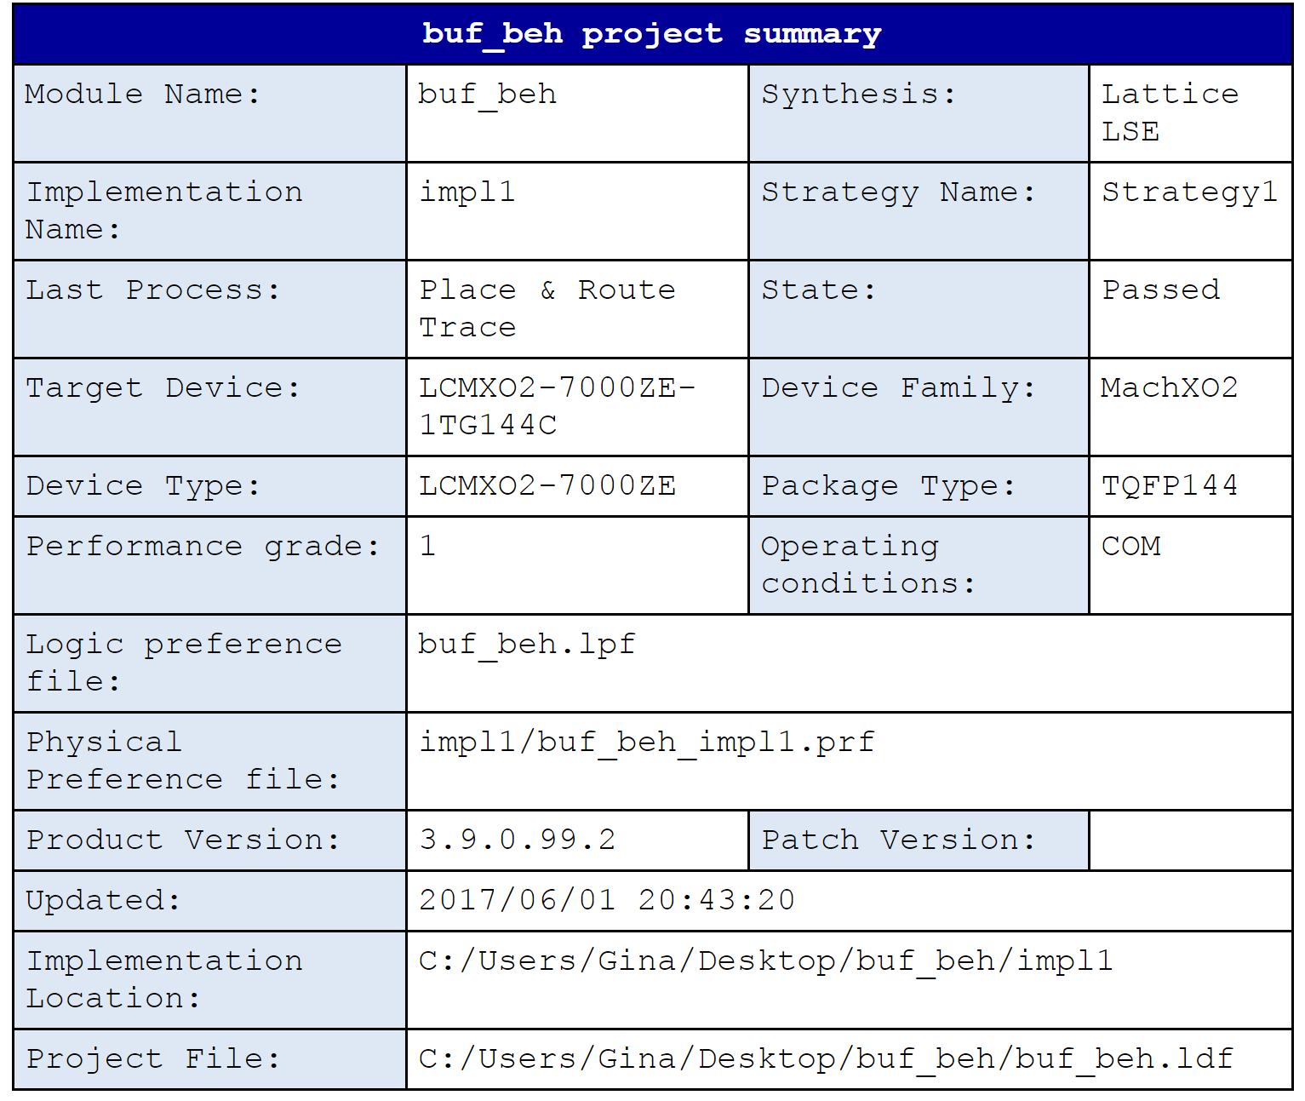
Data Buffer (behavioral)

Slide 5
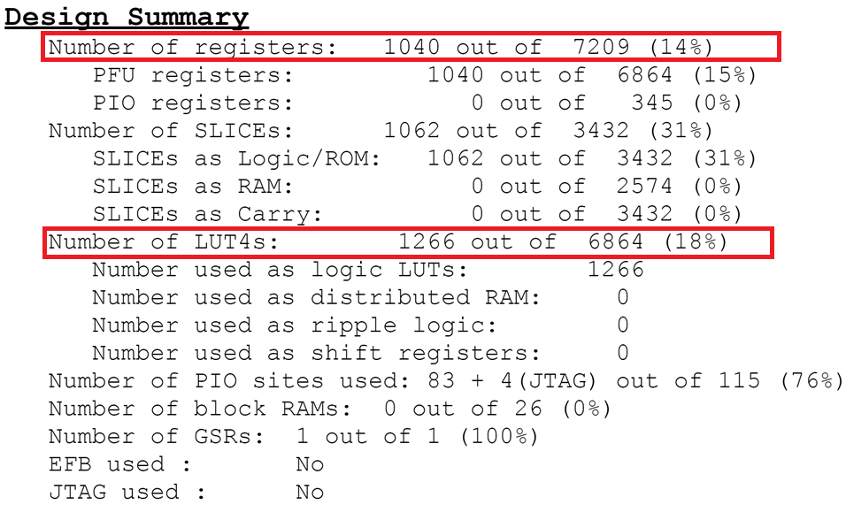

Slide 6
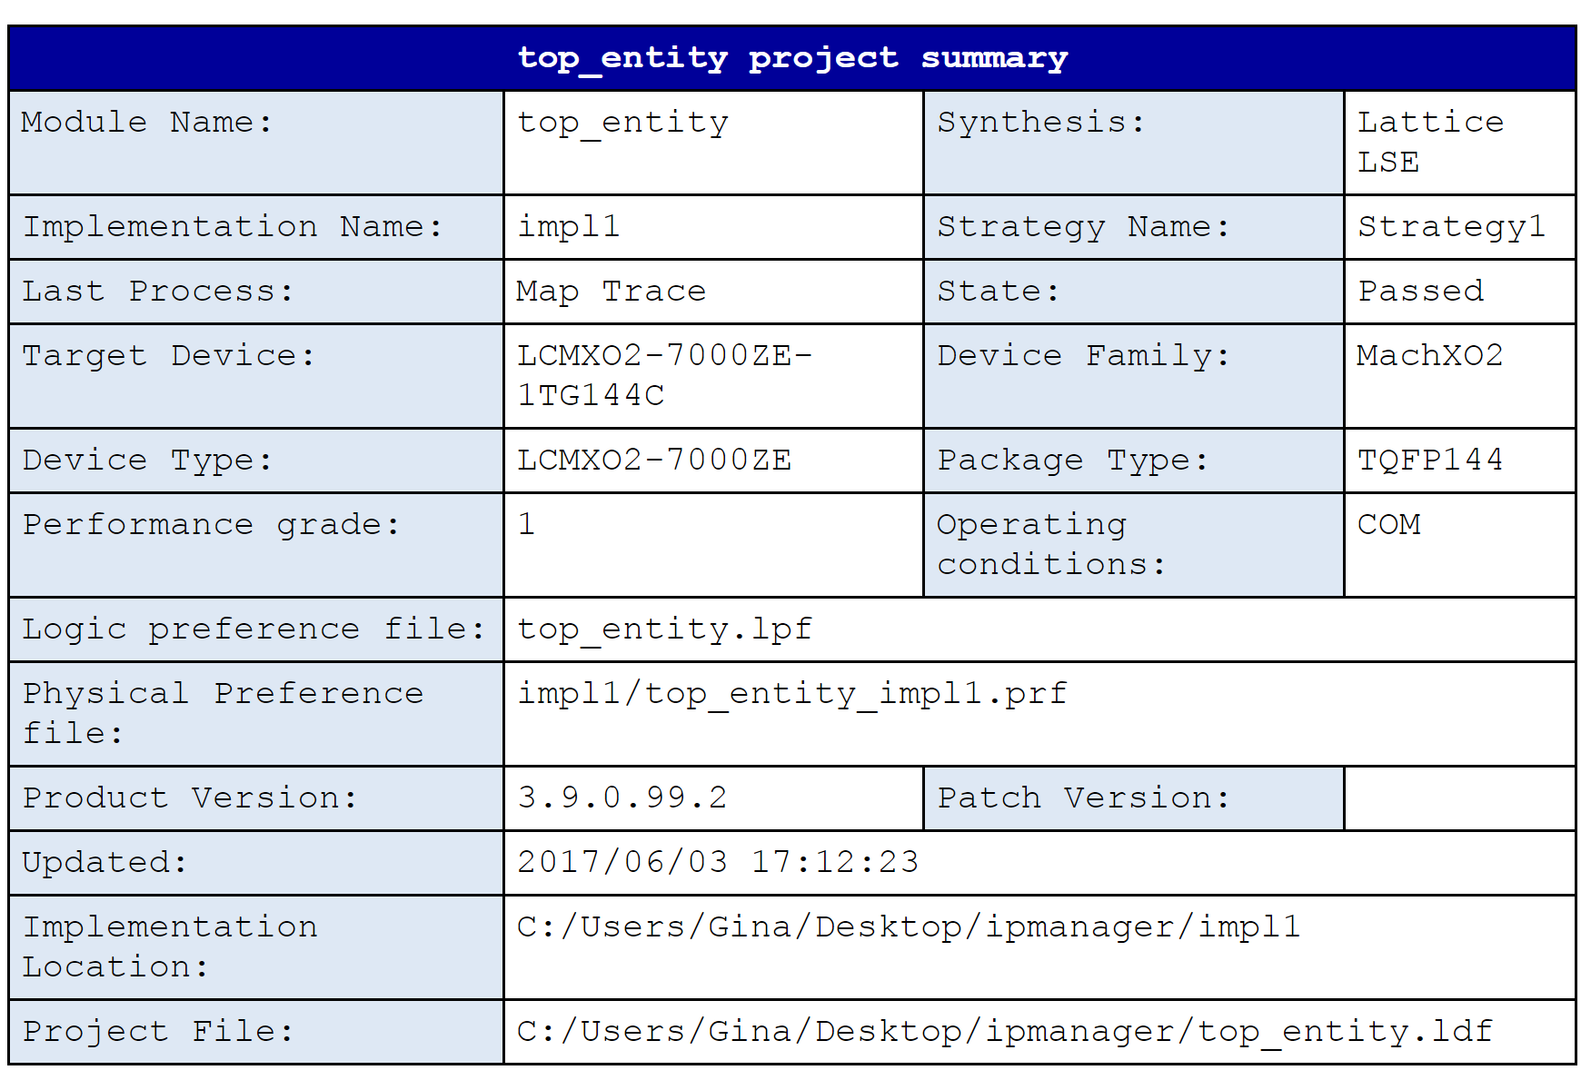
Overall Architecture

Slide 7
