Slide 1
Project 8 – IMPLEMENTATION DATA BUFFER
Emanuele Garolla
Gina Jiang
Evelina Forno
Francesco Buttafuoco
Salvatore Bellino

Slide 2
DATA BUFFER External Interface
The Data Buffer is unit that can be accessed by both CPU and IP cores to write and read the rows composing it.
To access to Data Buffer, both CPU and Ip cores have three input signals:
GE_CPU/GE_IP : To enable the access to Data Buffer;
WE_CPU/WE_IP : To perform a Write Operation;
RE_CPU/RE_IP : To perform a Read Operation;

Slide 3
In both sides, address busses and data busses are available to specify in which row perfom read/write operations and, in case of write, specify the data to be written.
From CPU side :
address_cpu, input signal of 6 bits;
data_cpu; bidirectional bits of 16 bits;
From IP cores side:
address_ip, input signal of 6 bits;
data_in_ip, input signal of 16 bits;
data_out_ip, input signal of 16 bits;
A particular output is ROW_0 signal that corresponds to the first row of Data Buffer that is directly connected to IP Manager through this output signal.

Slide 4
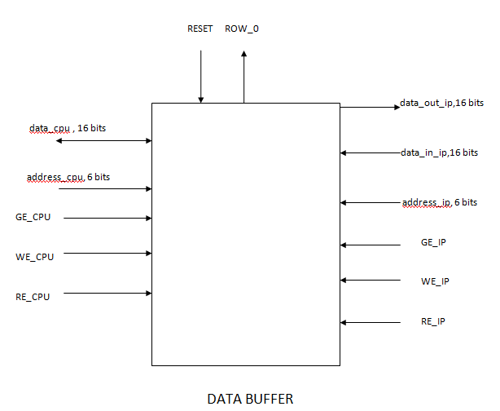

Slide 5
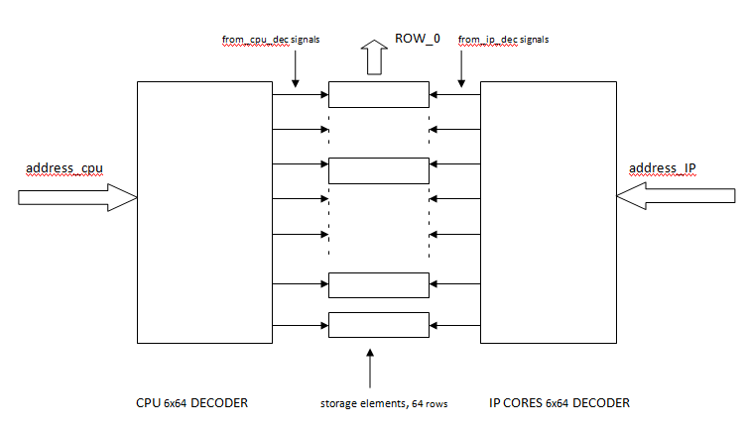
DATA BUFFER Internal Structure: How to access to DATA BUFFER

Slide 6
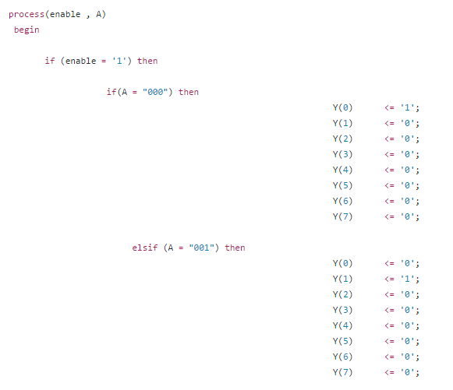
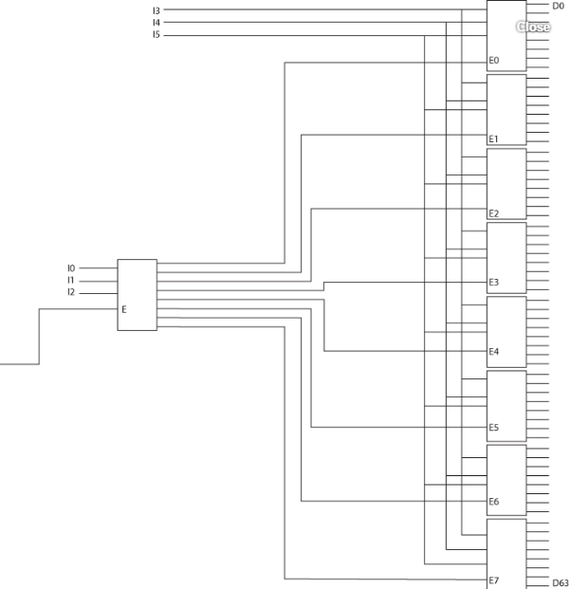
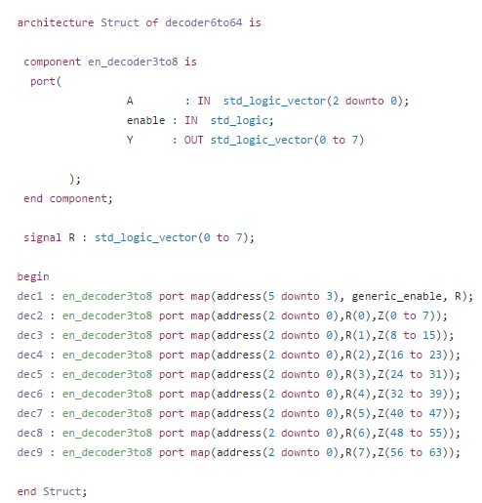
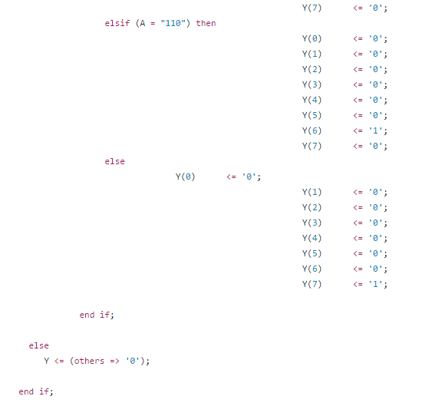
Both CPU decoder and IP cores decoder are 6to64 decoders and are made through 3to8 decoders, each implemented exploiting the If - Else Statement in VHDL Language.

Slide 7
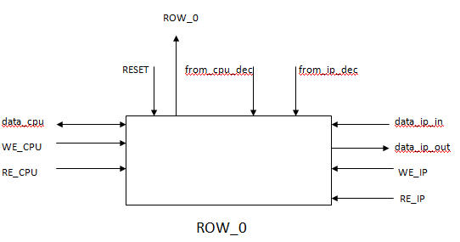
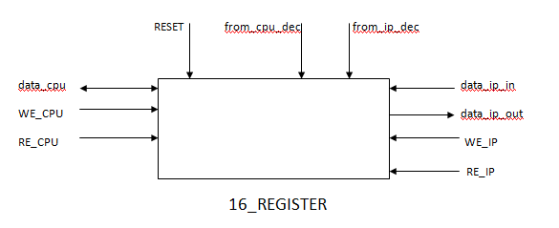
DATA BUFFER Internal Structure: Manipulate Storage rows

Slide 8
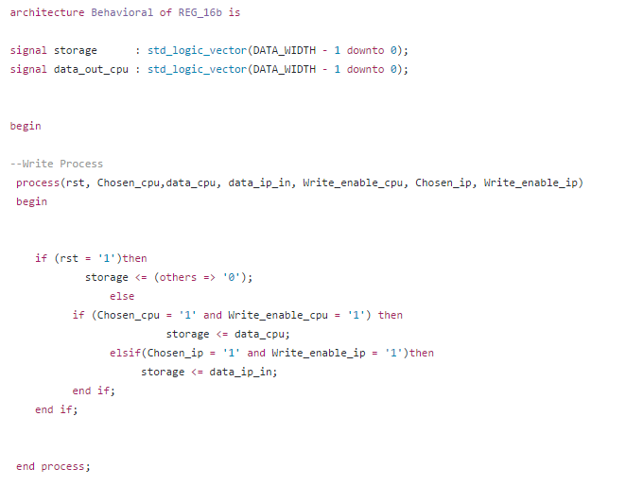
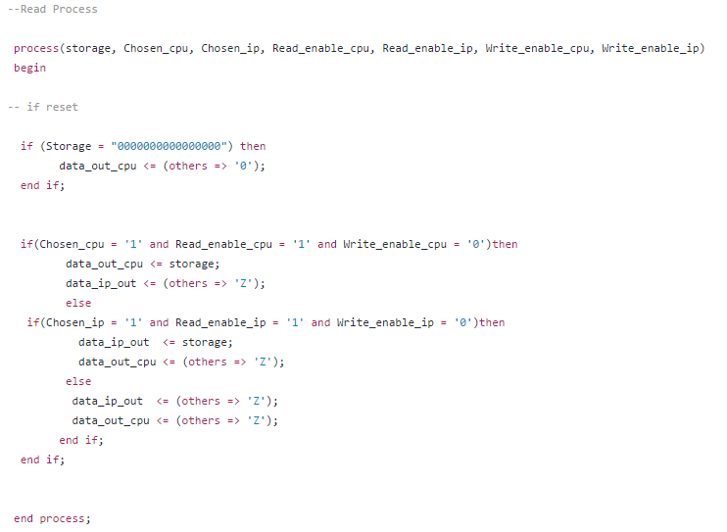
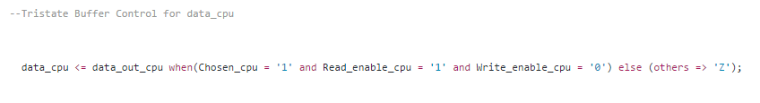
Manipulate Storage rows : Write Process, Read Process and Tristate Buffer Control for data_cpu

Slide 9
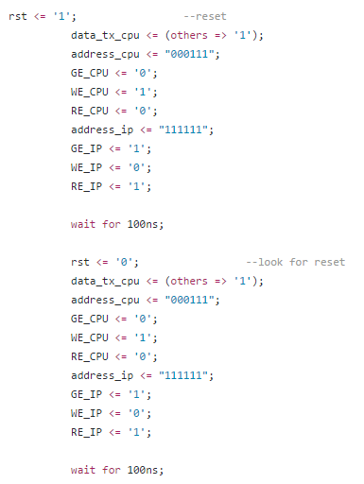
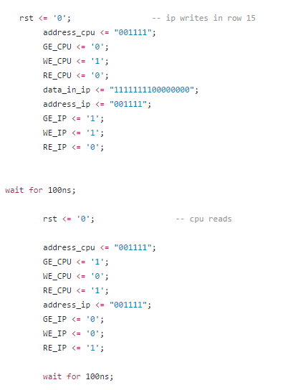
Test Bench for Simulation

Slide 10
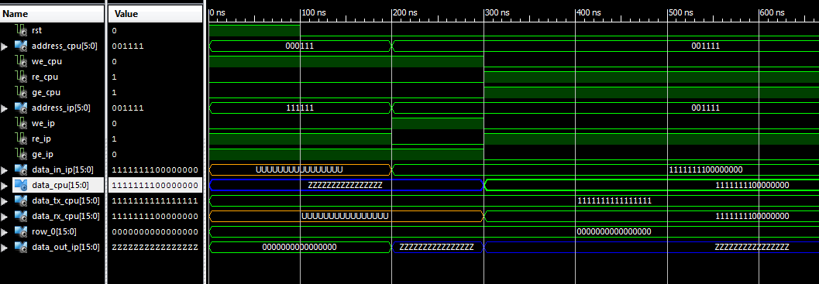
Simulation Waveforms

