Slide 1
Project 8 – IMPLEMENTATION IPM
Emanuele Garolla
Gina Jiang
Evelina Forno
Francesco Buttafuoco
Salvatore Bellino

Slide 2
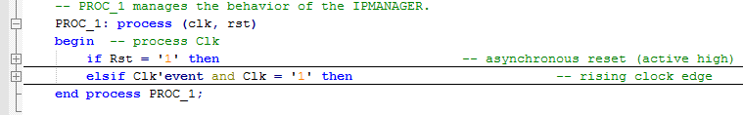
Generic Organization
The IPM is handled by a process that is sensitive to the clk and the rst. Both of them are shared with the CPU and the IPs.
The reset is asynchronous (active high)

Slide 3
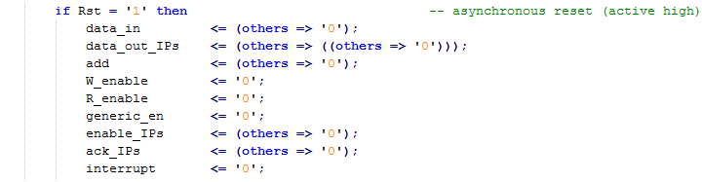
Reset
When the rst signal is high, all the output signals are set to ‘0’.

Slide 4

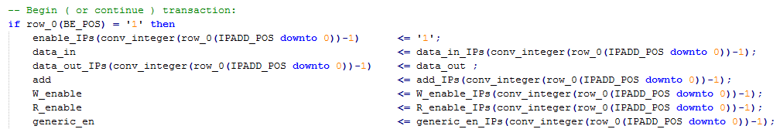
Begin Transaction
The IPM enables a transaction between the CPU and a IP reading the bit B\E in the ROW_0.
If it is set to ‘1’, the IPM connects the signals between the CPU and the IP selected in the IP ADDR field.

Slide 5
Interrupt request
If some IPs raises the interrupt and there is no a current transaction (B\E is set to ‘0’),
the IPM scans the interrupt request of every IPs from the lower to the higher priority. This avoid to insert a break statement, that is not synthesizable.
The IPM writes in ROW_0 the address of the IP with the highest priority that requests a communication with the CPU.
The IPM sets to ‘1’ the interrupt signal. It informs the CPU that a request must be served asap.

Slide 6
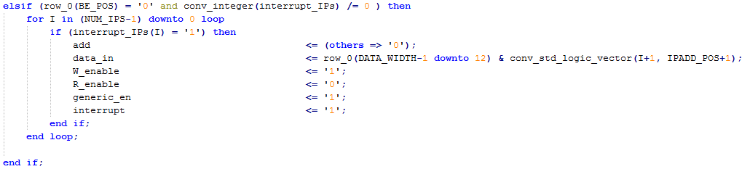
Interrupt request

Slide 7

Interrupt response
If in the ROW_0 the bits INT and B\E are set to 1,
the CPU wants to start a transaction due to a previous interrupt request. The IPM disables the interrupt signal and sends the ack signal to the IP that sent the interrupt request. The communication acts like a normal transaction.

Slide 8
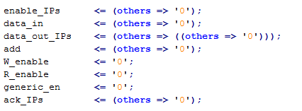
End Transaction
Before the IPM starts any control on the ROW_0, all signals are set to ‘0’. In this way if the CPU doesn’t start any transaction, the IPM blocks any connections between CPU and IPs.

