Slide 1
Project 8 Reports
Emanuele Garolla
Gina Jiang
Evelina Forno
Francesco Buttafuoco
Salvatore Bellino

Slide 2
Synthesys
Report

Slide 3
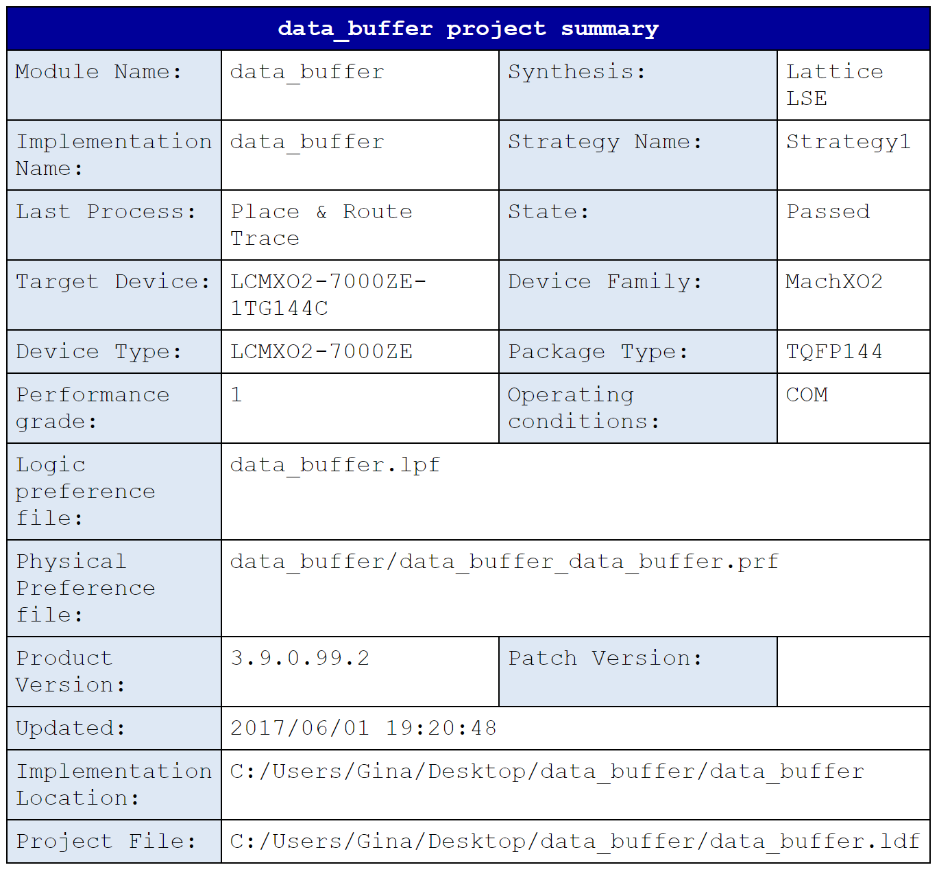
Data Buffer (structural)

Slide 4
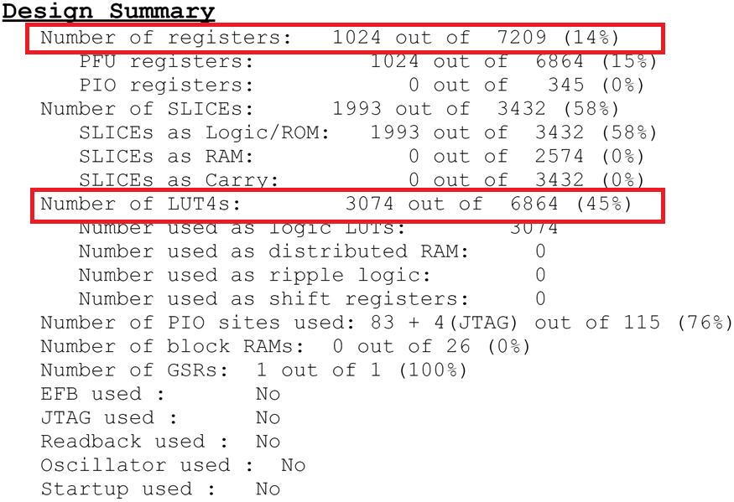

Slide 5
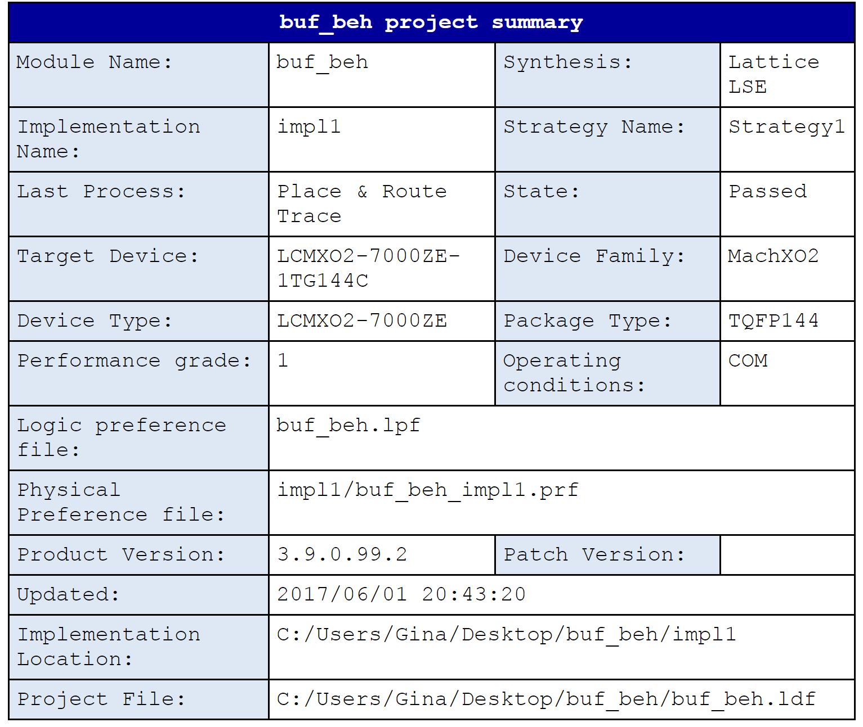
Data Buffer (behavioral)

Slide 6
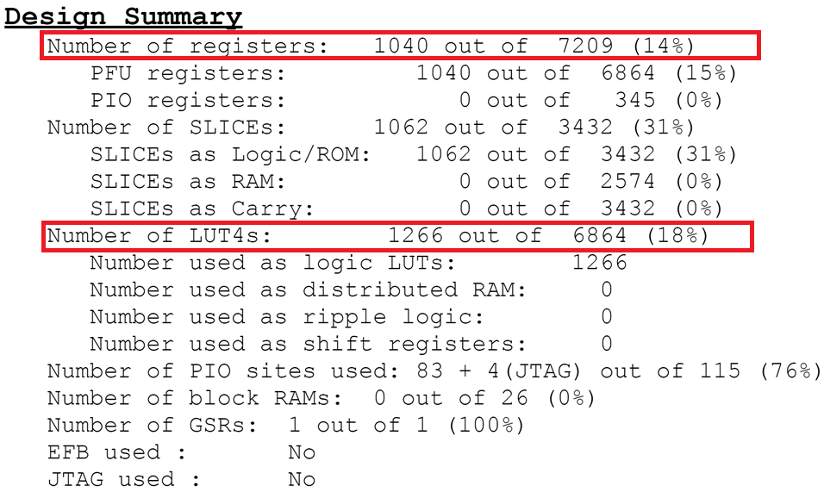

Slide 7
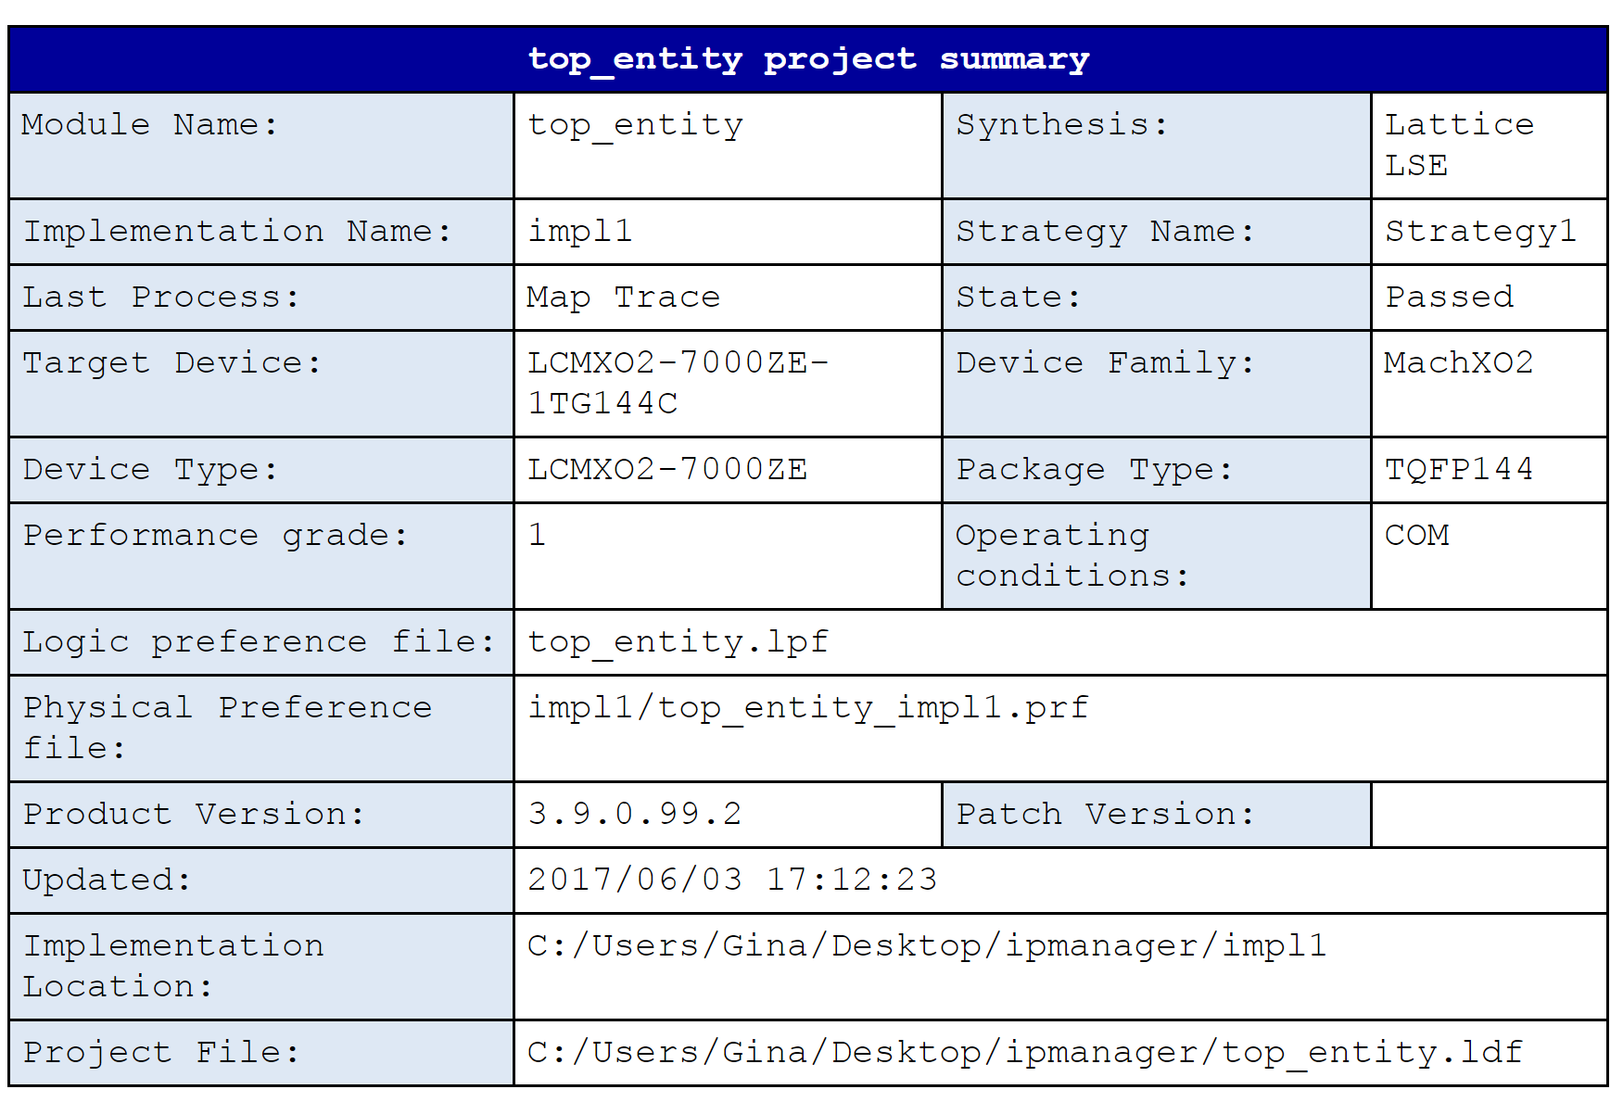
Overall Architecture

Slide 8
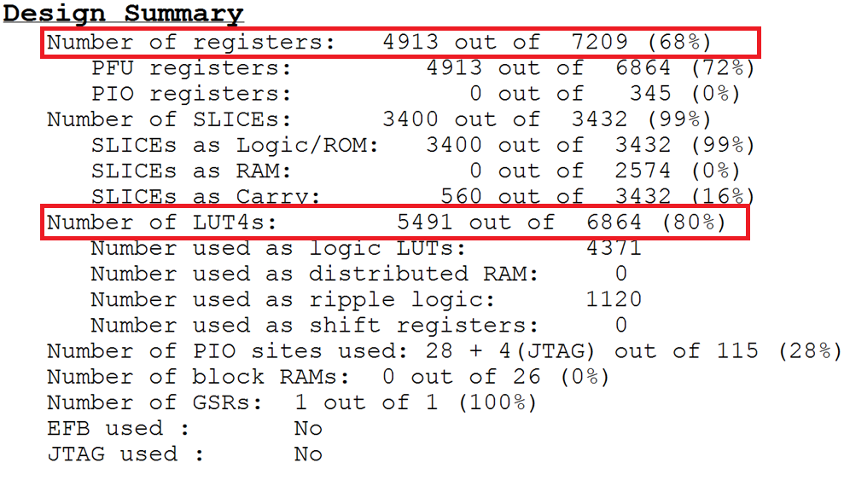

Slide 9
Project
Organization

Slide 10


Communications
In person meeting
Skype, Whatsapp, Telegram, email
GIT and Redmine platform

Slide 11
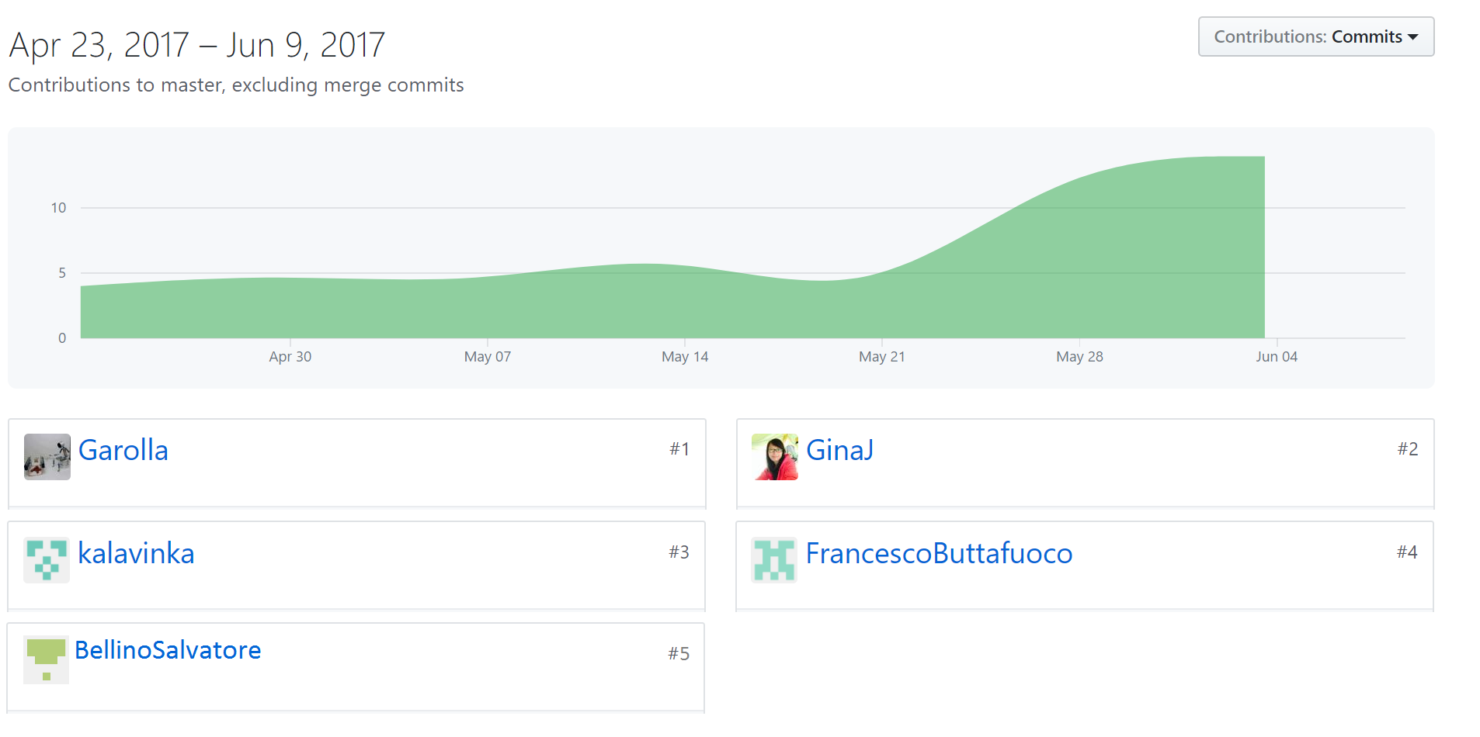
GITHUB

Slide 12
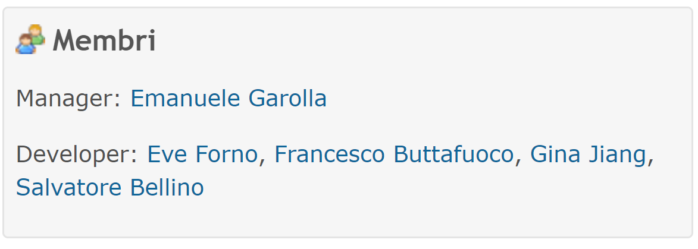
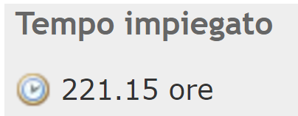
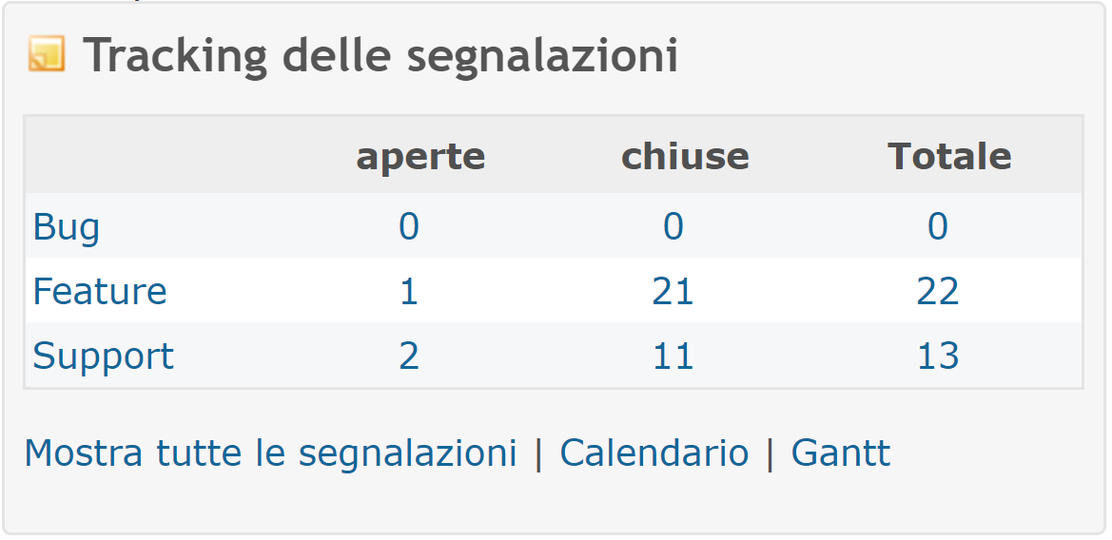
Redmine

Slide 13
Gantt

Slide 14
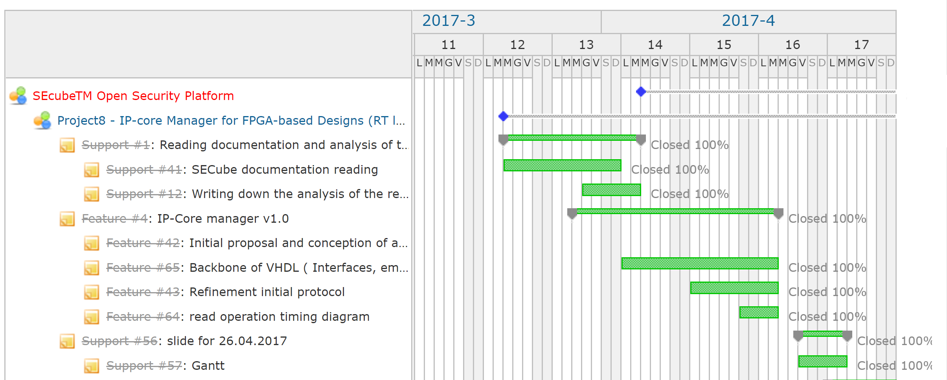
Gantt, IP-core Manager v1.0

Slide 15
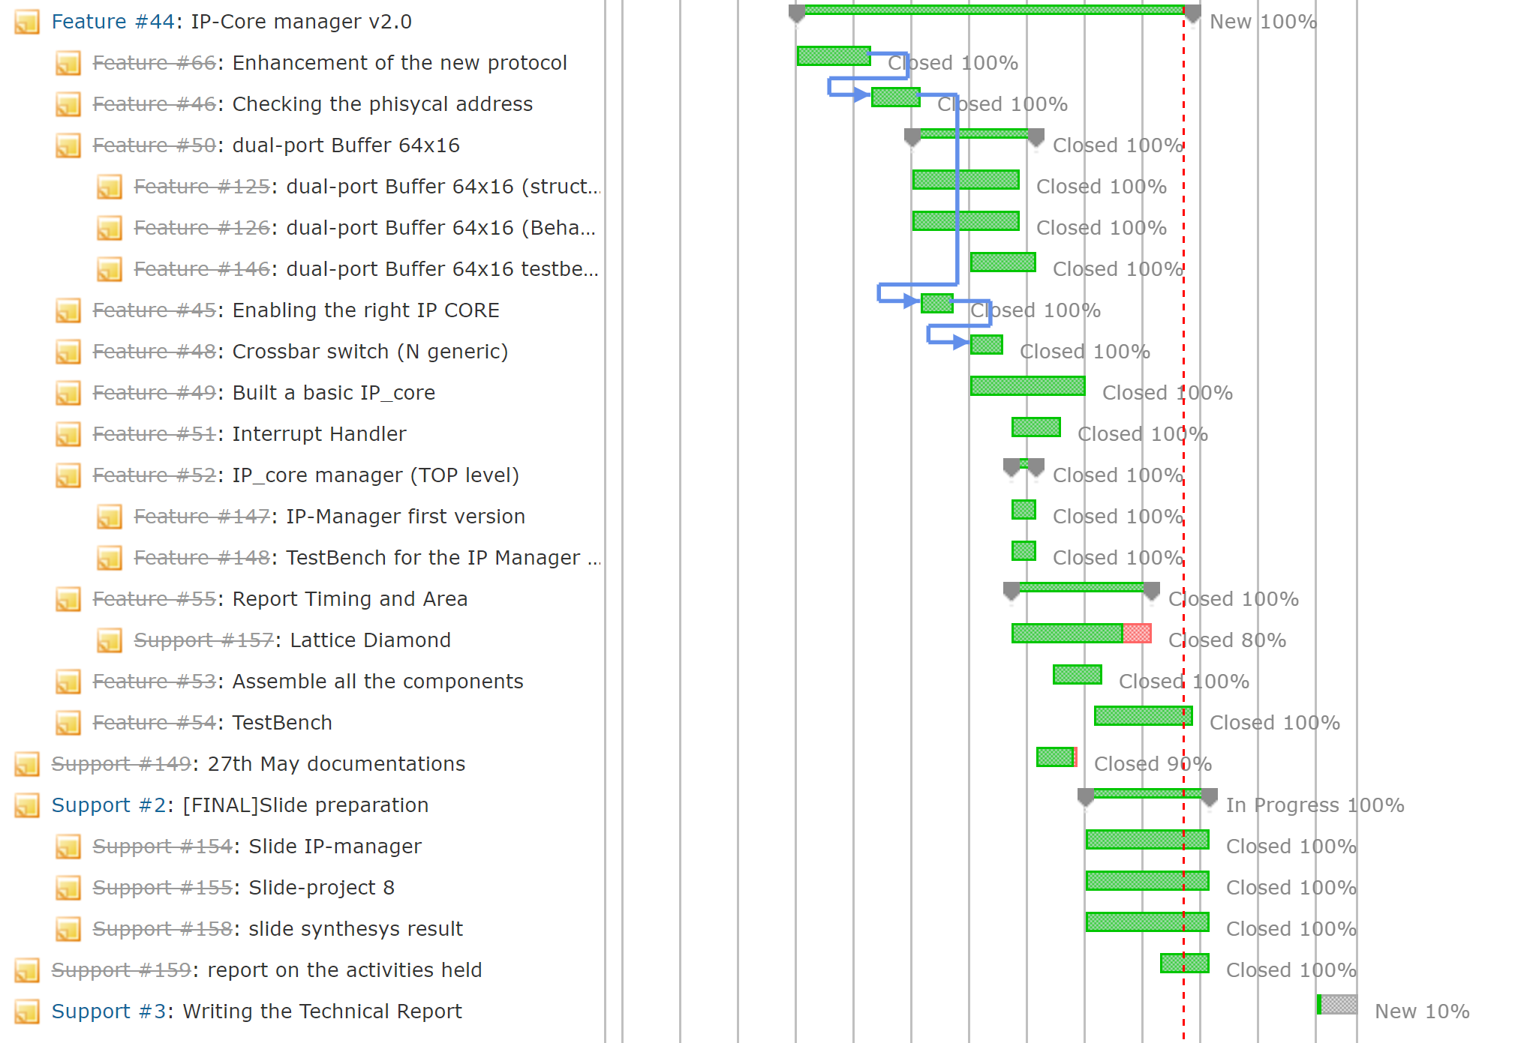
Gantt, IP-core Manager v2.0

Slide 16
Difficulties encountered

Slide 17
