Slide 1
Group 1 - Project 8 IP-core Manager for FPGA-based Designs (RT level)
Emanuele Garolla
Gina Jiang
Evelina Forno
Francesco Buttafuoco
Salvatore Bellino

Slide 2
Manly with Manager

Slide 3
Greatest Questions for Humanity
What’s the purpose in life?
Why there is something instead of nothing?
What is an IP core Manager?

Slide 4
What is an IP core Manager?
Manages the context switching between IP cores
Interrupt Handling
Protects mankind

Slide 5
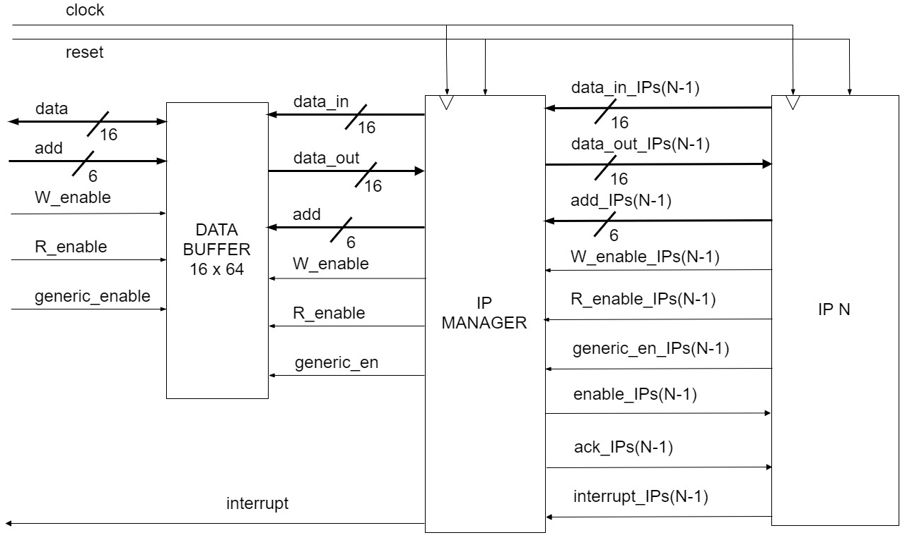
Interface of the IP manager

Slide 6
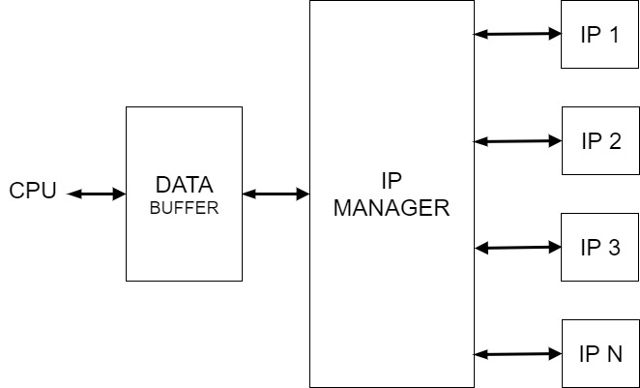
Essence of the IP manager

Slide 7
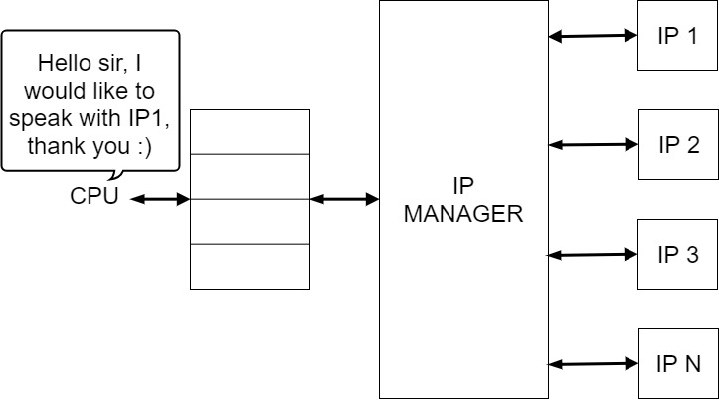
The art of communication

Slide 8
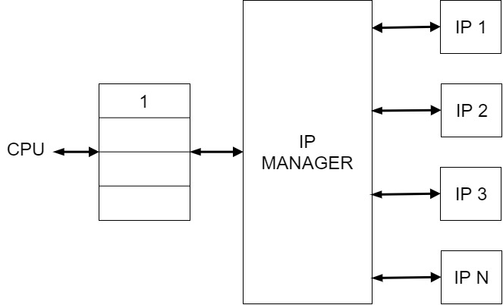
The art of communication

Slide 9
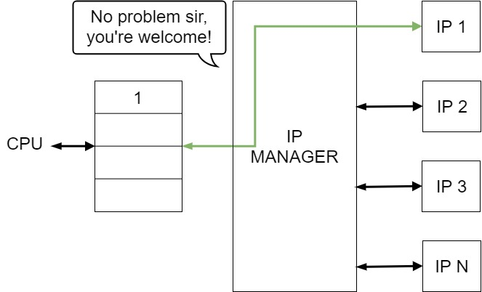
The art of communication

Slide 10
Interrupt Handler
Multiple IP cores can raise an interrupt request simultaneously at any time.
Gives the highest priority to port 0 ( IP 1 ) and the lowest priority to port N
Master (CPU) Slave (FPGA) architecture: an interrupt from the IPs cannot stop an ongoing transaction

Slide 11

Example
Hi, I want to interrupt
Hi, I want to interrupt
IP 1 and IP 3 raise the interrupt at the same time

Slide 12


Example
I am interrupting! Yeeeeeh!!
But..I wanted to interrupt too..
IP 1 is served since is connected to the port with highest priority

Slide 13
Example
Finally I am interrupting too! Yeeeeeh!!
When IP 1 terminates his ISR, IP 3 is served

Slide 14


