Slide 1
Project 8 Reports
Emanuele Garolla
Gina Jiang
Evelina Forno
Francesco Buttafuoco
Salvatore Bellino

Slide 2
Synthesys
Report

Slide 3
Data Buffer (structural)

Slide 4
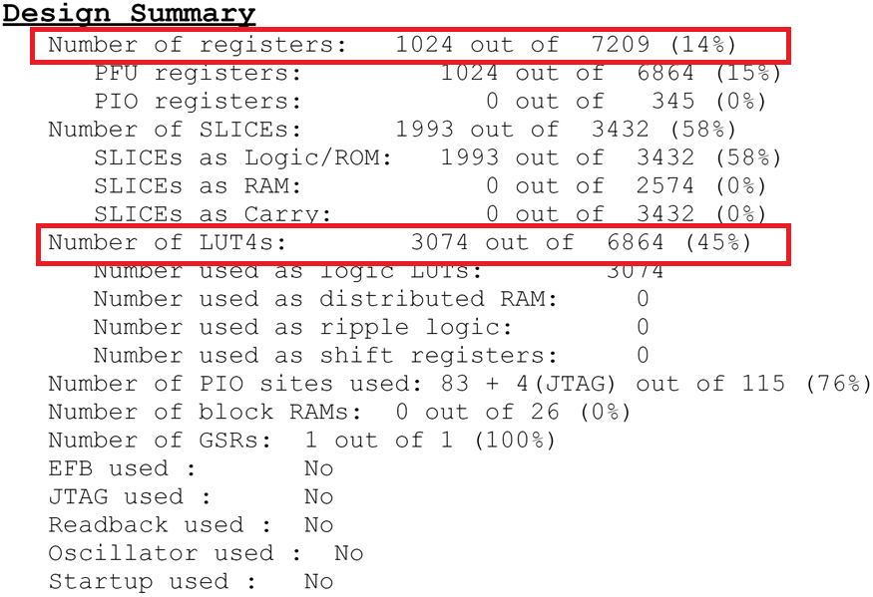

Slide 5
Data Buffer (behavioral)

Slide 6
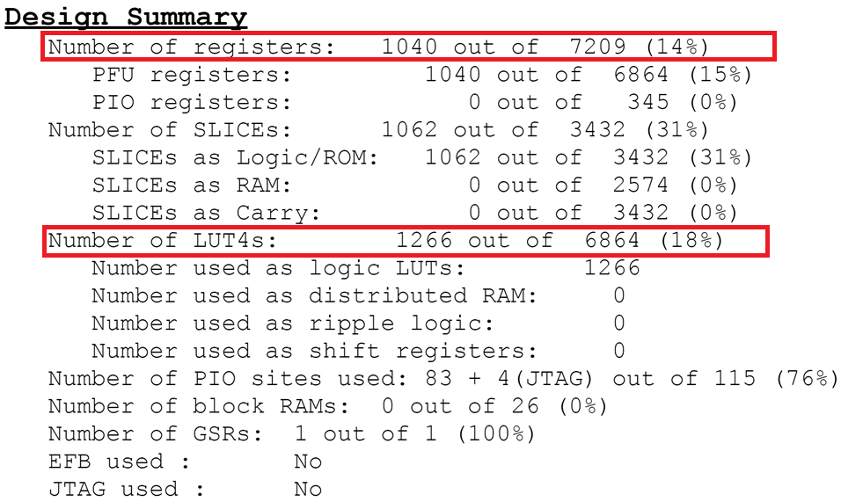

Slide 7
Overall Architecture

Slide 8
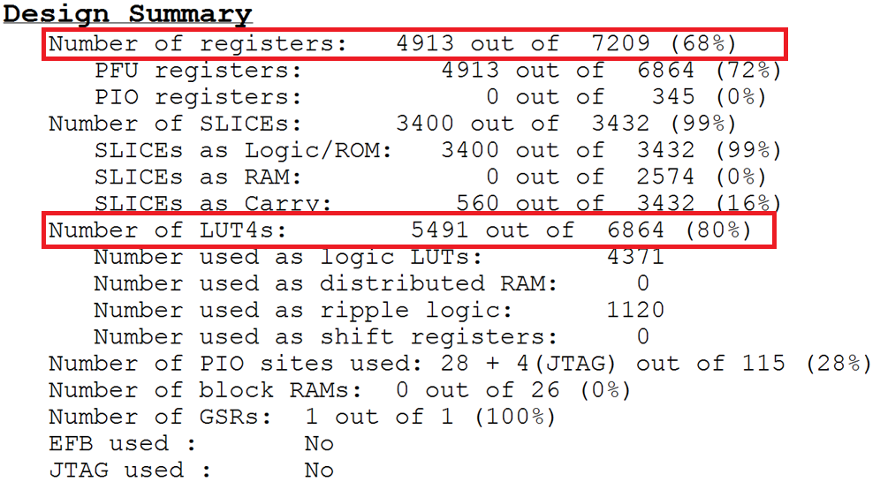

Slide 9
Project
Organization

Slide 10


Communications
In person meeting
Skype, Whatsapp, Telegram, email
GIT and Redmine platform

Slide 11
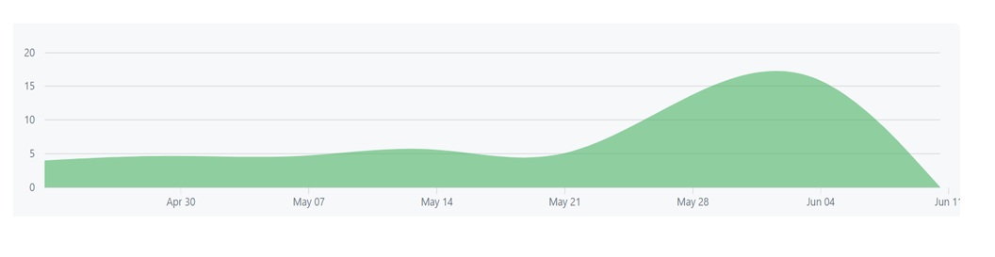
GITHUB
Version control repository and Internet hosting service
https://github.com/Garolla/IPMANAGER/

Slide 12
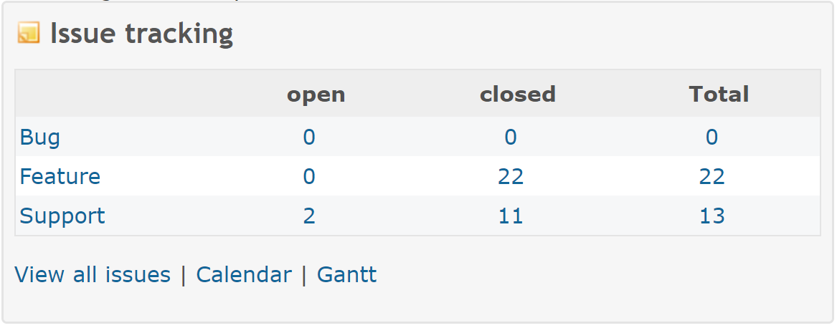
Redmine
Project management web application
https://redmine.consorzio-cini.it/projects/project8-manager-rtl

Slide 13
Gantt

Slide 14
Gantt of the Requirements

Slide 15
Gantt of the Development

Slide 16
Difficulties encountered

Slide 17
