Slide 1
Group 1 - Project 8 IP-core Manager for FPGA-based Designs (RT level)
Emanuele Garolla
Gina Jiang
Evelina Forno
Francesco Buttafuoco
Salvatore Bellino

Slide 2
Manly with Manager

Slide 3
Why we need an IP core manager?
IP stands for Internet Proto, Intellectual Property.
Synthesizable RTL design written in VHDL/Verilog.
Several IP blocks can be used in our designs.
Examples: Microprocessors, DSP, DMA, SDRAM controller, CORDIC, ecc ecc.

Slide 4
Greatest Questions for Humanity
What’s the purpose in life?
Why there is something instead of nothing?
What is an IP core Manager?

Slide 5
IP Manager functions
Handles the context switching between IP cores
Interrupt Handling
Protects mankind

Slide 6
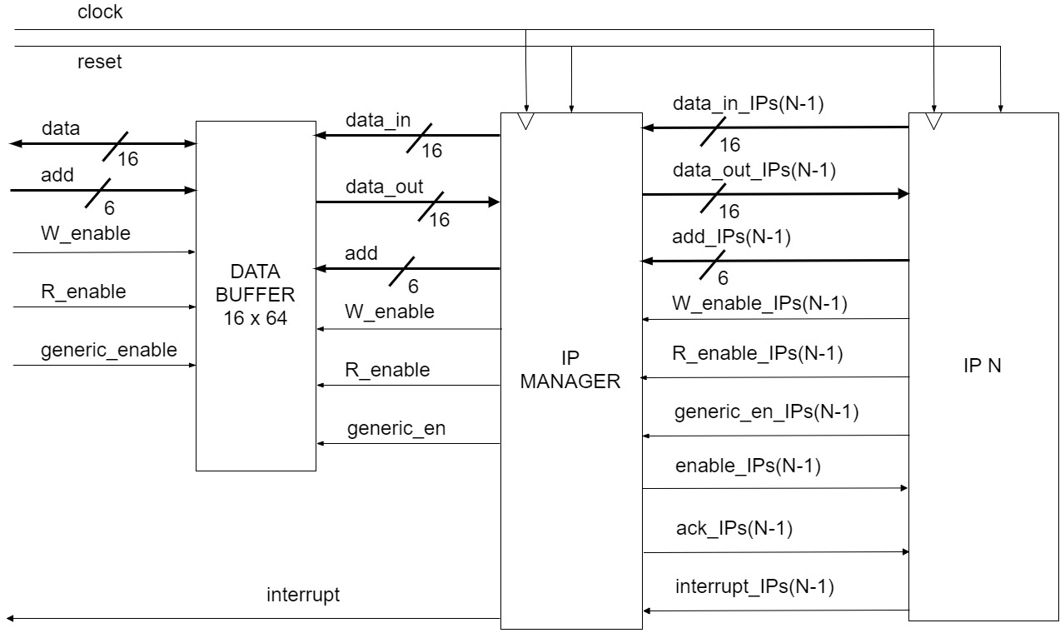
Interface of the IP manager

Slide 7
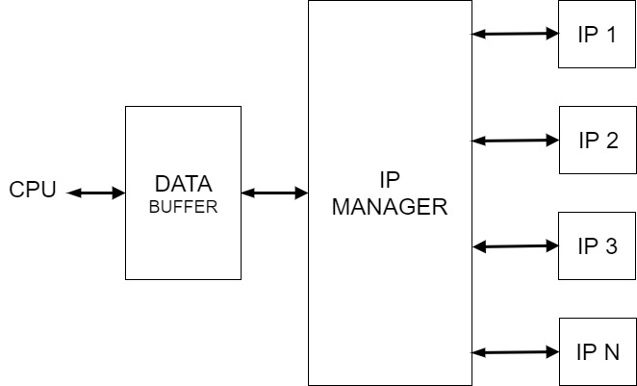
Essence of the IP manager

Slide 8
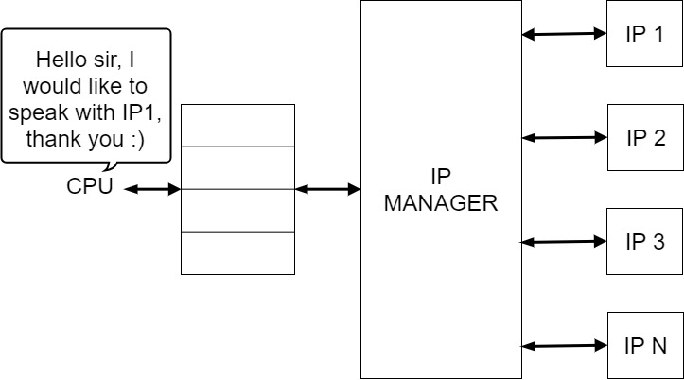
The art of communication

Slide 9
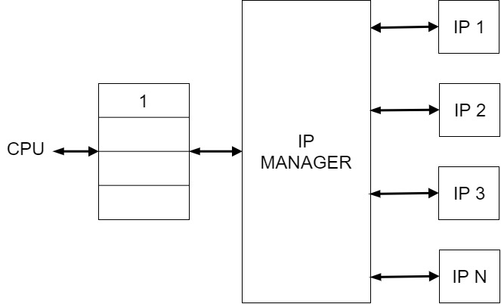
The art of communication

Slide 10
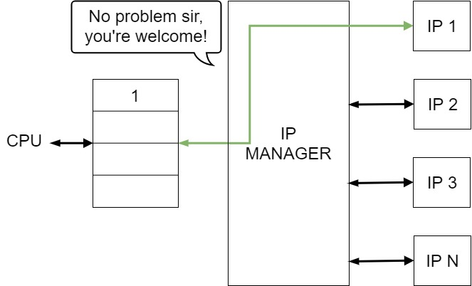
The art of communication

Slide 11
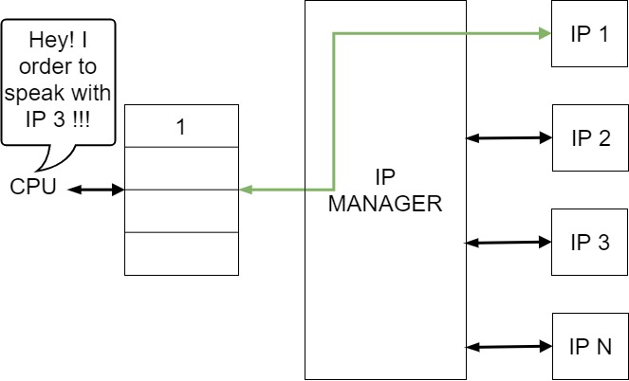
The art of communication

Slide 12
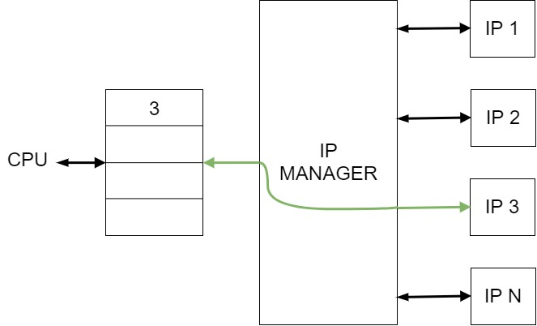
The art of communication

Slide 13
Interrupt Handler
Multiple IP cores can raise an interrupt request simultaneously at any time.
Gives the highest priority to port 0 ( IP 1 ) and the lowest priority to port N
Master (CPU) Slave (FPGA) architecture: an interrupt from the IPs cannot stop an ongoing transaction

Slide 14

Example
Hi, I want to interrupt
Hi, I want to interrupt
IP 1 and IP 3 raise the interrupt at the same time

Slide 15


Example
I am interrupting! Yeeeeeh!!
But..I wanted to interrupt too..
IP 1 is served since is connected to the port with highest priority

Slide 16
Example
Finally I am interrupting too! Yeeeeeh!!
When IP 1 terminates his ISR, IP 3 is served

Slide 17


