Slide 1
Reactive Programming in iOS
Emanuele, Garolla | Consultant | Concept Reply

Slide 2
Meeting agenda
17:30 – Theory
Reactive Programming
Operators
Code Snippets
Contacts & Resources
18:00 – Hands-on
19:45 – Happy hour

Slide 3
REACTIVE PROGRAMMING

Slide 4
“Reactive programming is the most cool paradigm to improve UI and UX”, John Lennon

Slide 5
Reactive programming
Two ways to do Reactive Programming:
BY DESIGN: React, Redux, React Native, Flutter, ecc
Through libraries: the most popular is Reactive Extensions (aka ReactiveX)

Slide 6
Reactive X
Libraries for reactive development
An API for asynchronous programming with observable streams.
Main characteristics are:
FRONTEND: Manipulate UI events and API responses
MULTI-PLATFORM: RxJava, RxJs, RxGo, RxDart, RxKotlin, RxCpp, RxPy, RxScala, ecc
BACKEND: Easy to handle asynchronicity and write concurrent code
Used by company like Microsoft, Netflix, Airbnb and Concept Reply

Slide 7
ReactivEX
Essential concepts in ReactiveX:
OBSERVABLE: represents a stream of asynchronous events
OBSERVER: Observer subscribes to an Observable. Then that observer reacts to whatever item or sequence of items the Observable emits
Operator: are composable functions with which you can filter, select, transform, combine, and compose Observables. Examples of operators are map, filter, combineLatest, etc

Slide 8
Reactive X and ios
Libraries for ios development
Libraries for iOS development:
RxSwift: ReactiveX for Swift, provides the fundamentals of Observables
RxCOCOA: RxSwift's companion, extensions to the Cocoa and Cocoa Touch frameworks
RxDataSources: Reactive data sources for UITableViews and UICollectionViews (sections, animated updates, editing ...).
RxGesture: Reactive view gestures (like tap, pan, swipe, ecc) wrapper
RxSwiftExt: Additional operators and Reactive extensions.
Available through CocoaPods

Slide 9
Reactive Operators

Slide 10
operators
that I use or have used
Creating operators:
asObservable
of
just
create
Conditional operators:
skip
take
Filtering operators:
filter
debounce
distincUntilChanged
Transforming operators:
map
scan
flatMap
Combining operators:
combineLatest
merge
zip
withLatestFrom
Utility operators:
subscribe
observeOn

Slide 11
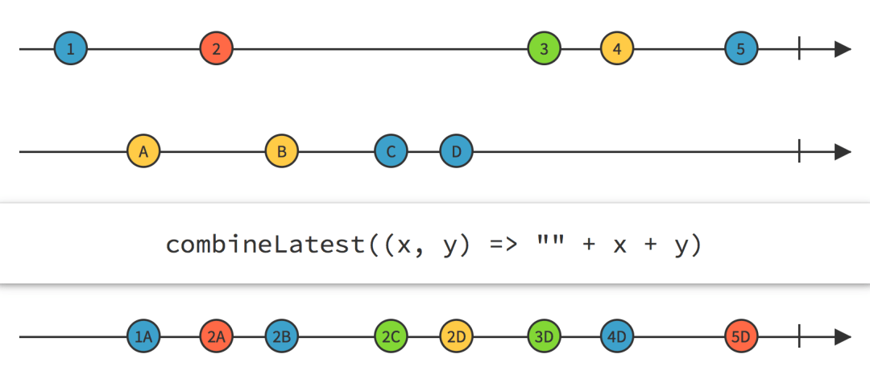
combineLatest
a combining operator
When any of the source Observables emits an item, CombineLatest combines the most recently emitted items from each of the other sources, using a function you provide, and emits the return value from that function.
It’s similar to the zip operator.

Slide 12
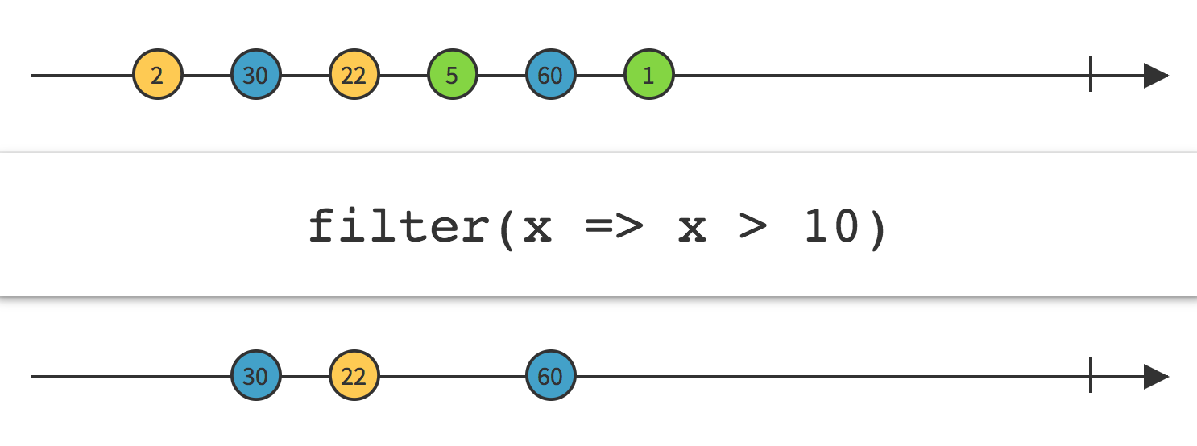
FILTER
a filtering operator
Emit only those items from an Observable that pass a predicate test.
It’s used like you would use the filter function of a Swift array

Slide 13
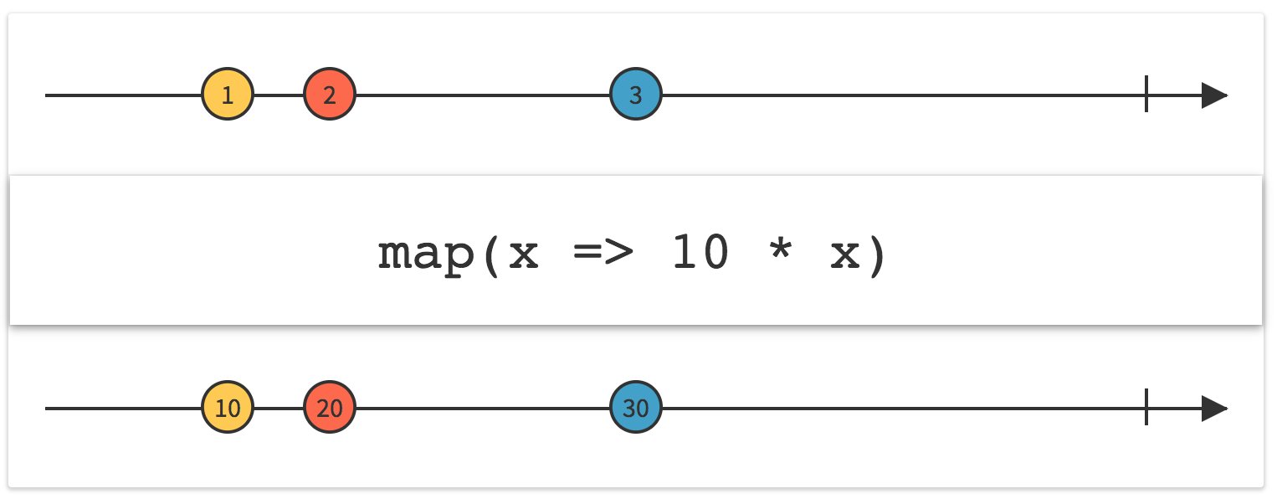
MAP
a TRANSFORMING operator
Transform the items emitted by an Observable by applying the function you provided to each item.
An example of map, used along with filter, is:
.filter{ $0 != nil }.map{ $0! }

Slide 14
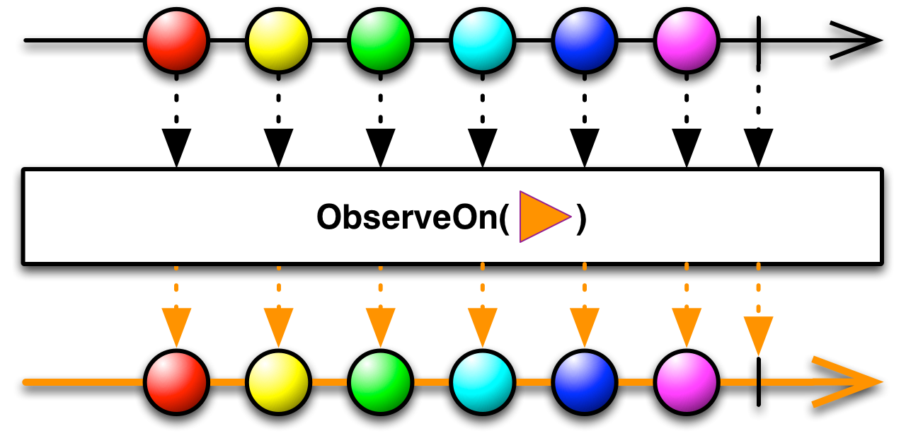
observeon
a utility operator
Causes all operations which happen below it to be executed on the specified scheduler.
You can call it multiple times per stream to move between different threads.
Similar to subscribeOn operator.

Slide 15
Code Snippets

Slide 16
Behavior Relay
Your INITIAL best friend
// Considered a bridge between not-reactive and reactive code
var myRelay : BehaviorRelay<Int> = BehaviorRelay(value: 0)
// You can use it as an Observable
let myObservable : Observable<Int> = myRelay.asObservable()
// You can read its value like any variable
let myValue : Int = myRelay.value
// You can set its value, which will trigger the Observers
myRelay.accept(5)

Slide 17
SUBSCRIBE
Action done when receiving an event
//Outside of the scope
@IBOutlet weak var searchBar: UISearchBar!
...
//Inside a scope, like viewDidLoad
searchBar.rx.text
.subscribe(onNext: { [weak self] text in
self?.doSomethingWonderful(withSearchBarText: text)
}).disposed(by: disposeBag)

Slide 18
BIND
connect events to an UI element
//Outside of the scope
@IBOutlet weak var myTextField: UITextField!
var myRelay : BehaviorRelay<String> = BehaviorRelay(value: "Hi")
...
//Inside a scope, like viewDidLoad
myRelay.asObservable()
.bind(to: myTextField.rx.text)
.disposed(by: disposeBag)
myRelay.accept("Darling")

Slide 19
Avoiding retain cycle
dispose bag & weak self
//Outside of the scope
private var disposeBag = DisposeBag()
//Inside a scope, like viewDidLoad
let countries = Observable.just("Austria", "Belgium", "Italy")
countries.subscribe(onNext: { [weak self] country in
guard let `self` = self else {return}
self.doSomethingAmazing(withCountry: country)
}).disposed(by: disposeBag)

Slide 20
Contacts & resources

Slide 21
Contacts & RESOURCES
Feel free to contact me if you ever get stuck with Rx:
e.garolla@reply.it
Download source code:
https://github.com/Garolla/LabCamp.git
Resources:
ReactiveX: http://reactivex.io/
RxDiagrams: http://rxmarbles.com/
RxSwift: https://github.com/ReactiveX/RxSwift

Slide 22
Thank you
www.reply.com

Slide 23



