Slide 1
https://slidesgo.com/theme/ai-content-detector-pitch-deck#position-1&related-1&rs=detail-related

Slide 2
MyNHANES O que eh o NHANES
Como os dados sao mantidos no site
Sao uma mina de ouro, porem precisam ser normalizados
Exemplos de iniciativas para normalizacao
Por que nao: um Sistema leve que possa acessar os dados e normaliza-los a partir das melhores praticas?
O MyNHANES MVP

Slide 3
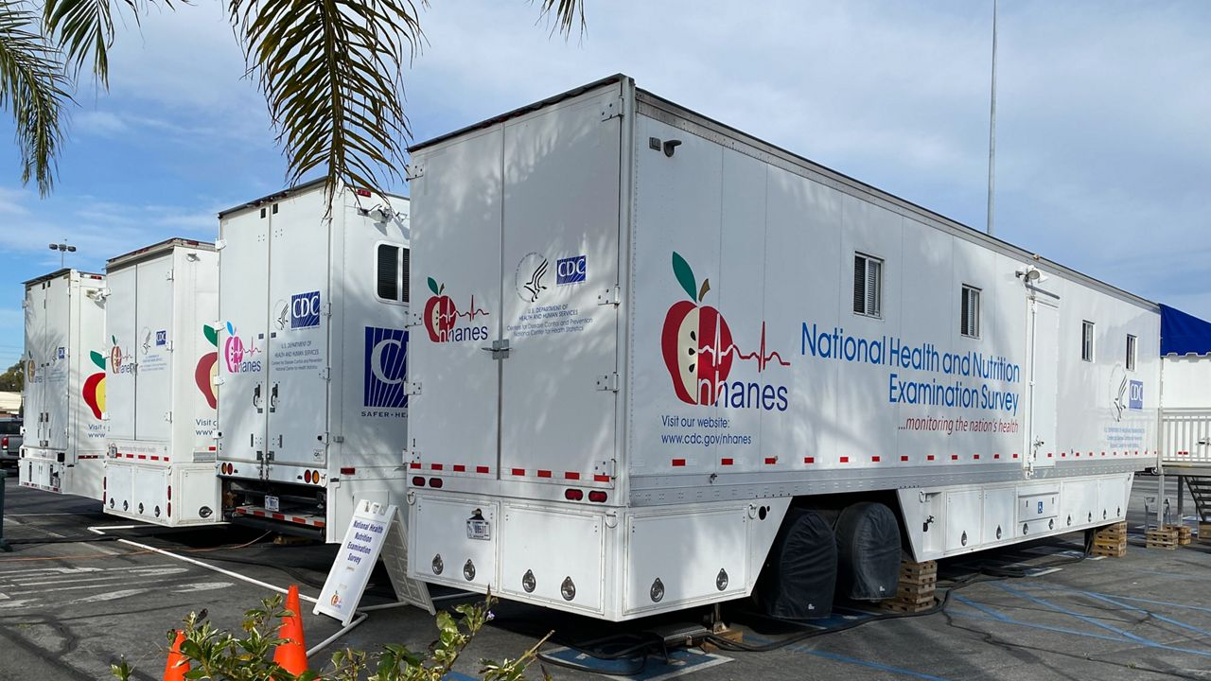
Objective The primary objective of NHANES is to collect data that can be used to determine the prevalence of major diseases and risk factors for diseases, and to monitor trends in health and nutrition over time.
The National Health and Nutrition Examination Survey (NHANES) is a program of studies designed to assess the health and nutritional status of adults and children in the United States.
Methodology NHANES combines interviews and physical examinations. The interviews include questions about demographics, socioeconomics, diet, and health. The physical examinations include medical, dental, and laboratory tests performed by trained health professionals.
Source: https://www.cdc.gov/nchs/nhanes/about_nhanes.htm

Slide 4

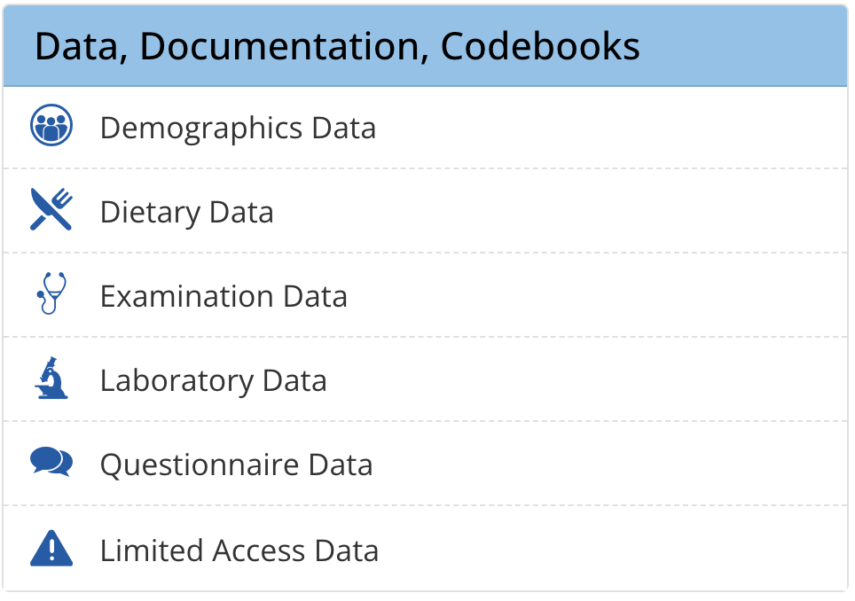
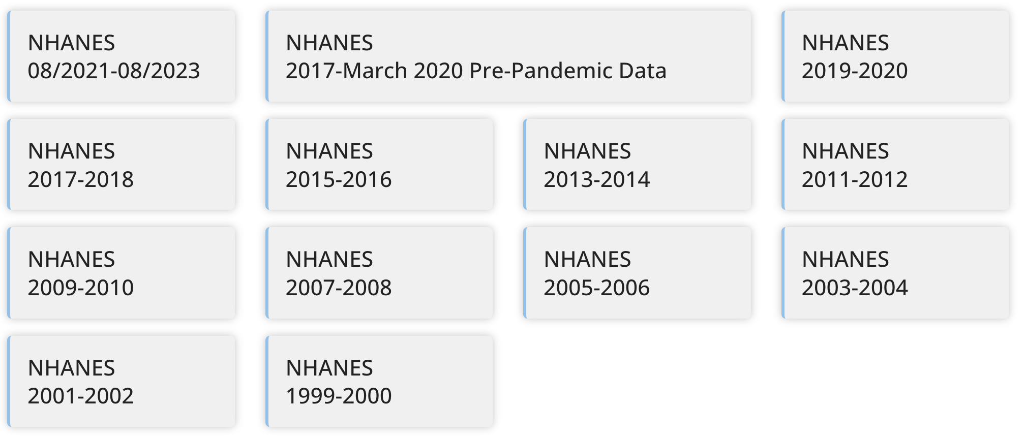

Slide 5
Valuable but Complex: NHANES Data
Valuable Data:
NHANES provides comprehensive data on health and nutrition.
Includes demographics, dietary information, health conditions, laboratory results, and more.
Essential for public health research, policy-making, and setting health standards.
Complex Format:
Data is organized by cycles (years), with each cycle having multiple categories.
Each category contains different datasets.
Datasets are provided in XPT format (SAS transport files), which can be challenging to work with.
Exploration Challenges:
Fragmented data: Each cycle and category must be individually accessed and processed.
Requires specialized tools (like SAS) or conversion to more accessible formats (CSV, SQL, etc.).
Time-consuming and resource-intensive to integrate and analyze data across multiple cycles and categories.
Mostrar em funcionamento

Slide 6

Aggregation and Normalization Initiatives
Harmonized US National Health and Nutrition Examination Survey 1988-2018 for high throughput exposome-health discovery https://www.ncbi.nlm.nih.gov/pmc/articles/PMC9934713/
Challenges and Lessons Learned in Generating and Interpreting NHANES Nutritional Biomarker Data
https://www.ncbi.nlm.nih.gov/pmc/articles/PMC5347107/
Update on NHANES Dietary Data: Focus on Collection, Release, Analytical Considerations, and Uses to Inform Public Policy
https://www.sciencedirect.com/science/article/pii/S2161831323001461

Slide 7
Why not?
Crir e manter um pool de regras de normalizacao dos dados
Interfase dinamica para consultar os dados
Automatizar a extracao dos dados

Slide 8
Propost
Crir e manter um pool de regras de normalizacao dos dados
Automatizar a extracao dos dados
Interfase dinamica para consultar os dados

Slide 9
O MyNHANES
Demonstrar seu funcionamento

Slide 10
O que precisamos fazer
O

