Slide 1
BlowFish
Prepared by
Ayman Yehia
Mohammed Garrana
Ahmed Mohamed Raafat
Under supervision of DR. Bahaa Hassan
14-12-2009

Slide 2
BlowFish
Basic concepts in cryptography
Blowfish in details
Implementation of Blowfish using python
Crypto analysis of Blowfish
BlowFish

Slide 3


Basic concepts in cryptography
1- S-box
2- Feistel cipher
BlowFish

Slide 4
1- S-box (Substitution-box)
In cryptography: S-Box is a basic component of symmetric key encryption algorithms which performs substitution.
In block ciphers: S-Box are typically used to obscure the relationship between the key and the Cipher text.
BlowFish

Slide 5
S-box
S-Box takes some number of input “bits m”, and transforms them into some number of output “bits n”.
S-box types
Fixed tables are normally used, as in the Data Encryption Standard(DES)
Dynamically generated from the key; e.g. the Blowfish
BlowFish

Slide 6
S-box
Example:6×4-bit S-Box from DES (S5)
Given a 6-bit input, the 4-bit output is found by selecting the row using the outer two bits (the first and last bits), and the column using the inner four bits.
BlowFish

Slide 7
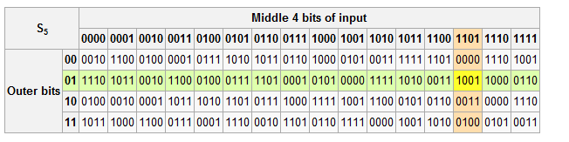
S-Box
An input "011011" has outer bits "01" and inner bits "1101"; the corresponding output would be "1001".
BlowFish

Slide 8
2- Feistel cipher
Feistel networks designed by Horst Feistel in IBM.
One of the advantages of this module is that encryption and decryption operations are very similar, requiring only a reversal of the key schedule.
Therefore the size of the code or circuitry required to implement such a cipher is nearly half.
Feistel construction makes implementing the cryptosystem in hardware easier.
BlowFish

Slide 9
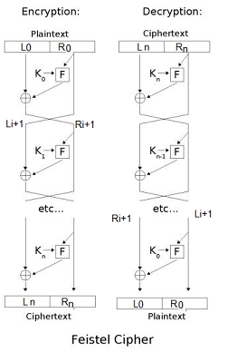
Feistel cipher
BlowFish

Slide 10
Feistel cipher
Encryption process:
Let F be the round function and let be the sub-keys for the rounds respectively.
Split the plaintext block into two equal pieces, (L0, R0)
For each round compute the following:
The cipher text is (Rn + 1,Ln + 1).
BlowFish

Slide 11
Feistel cipher
Decryption Process:
The cipher text is (Rn + 1,Ln + 1).
For
Then (L0,R0) is the plaintext again.
Advantage of this model is that the round function F does not have to be invertible, and can be very complex.
BlowFish

Slide 12
Feistel cipher
The diagram illustrates both encryption and decryption.
The reversal of the subkey order for decryption is the only difference between encryption and decryption.
BlowFish

Slide 13

Blowfish in details
BlowFish

Slide 14
Blowfish
A keyed, symmetric block cipher
Designed in 1993 by Bruce Schneier
Blowfish provides a good encryption rate in software and no effective cryptanalysis of it has been found to date.
However, the Advanced Encryption Standard now receives more attention.
BlowFish

Slide 15
Blowfish
A general-purpose algorithm, intended as a replacement for the aging DES and free of the problems and constraints associated with other algorithms.
The algorithm is hereby placed in the public domain, and can be freely used by anyone.
Notable features of the Bluefish design include key-dependent S-boxes and a highly complex key schedule.
BlowFish

Slide 16
Blowfish
Blowfish use a Feistel network, iterating a simple encryption function 16 times.
The block size is 64 bits,
The key can be 32 bits length up to 448 bits.
BlowFish

Slide 17
Blowfish
Description of algorithm:
The algorithm consists of two parts:
1- Data- encryption and Decryption.
2- key-expansion.
BlowFish

Slide 18
1-Data- encryption and Decryption
Data encryption occurs via a 16-round Feistel network
All operations are XORs and additions on 32-bit words.
The only additional operations are four indexed array data lookups per round.
BlowFish

Slide 19
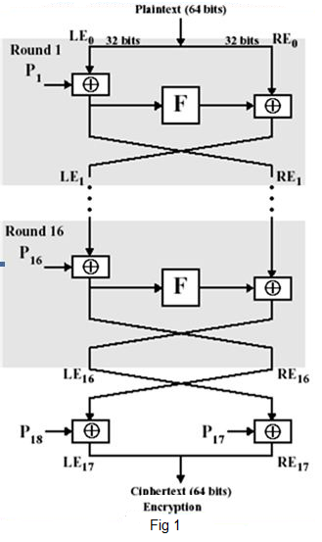
Blowfish Encryption process
BlowFish

Slide 20
Data- encryption
Encryption process:
The input is a 64-bit data of element “x”
Divide x into two 32-bit halves:
xL, xR For i = 1 to 16:
xL = xL XOR Pi
xR = F(xL) XOR xR
Swap xL and xR
Then repeat it 16 time
Swap xL and xR (Undo the last swap.)
xL = xL XOR P18
xR = xR XOR P17
Recombine xL and xR
BlowFish

Slide 21
Data- encryption and Decryption
The P-array consists of 18 32-bit sub-keys P1, P2,..., P18.
There are four 32-bit S-boxes with 256 entries each:
S1,0, S1,1,..., S1,255;
S2,0, S2,1,..,, S2,255;
S3,0, S3,1,..., S3,255;
S4,0, S4,1,..,, S4,255.
BlowFish

Slide 22
Blowfish Function F
Divide xL into four eight-bit quarters: a, b, c, and d.
8 bit all to choose from 256 possibilities of s-box
F(xL) = ((S1,a + S2,b mod 2^32) XOR S3,c) + S4,d mod 2^32.
BlowFish

Slide 23
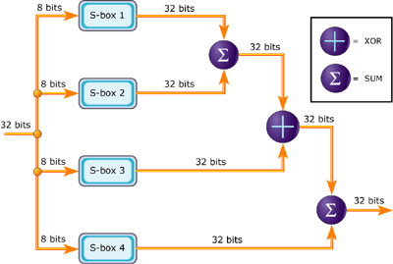
The round function (Feistel function) of Blowfish
BlowFish

Slide 24
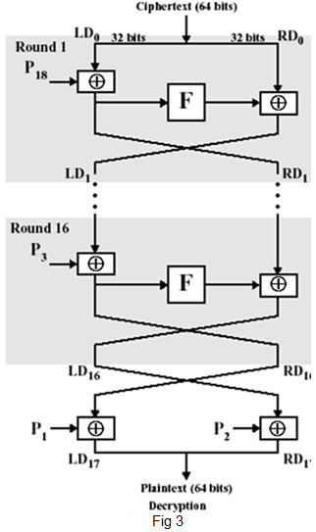
Blowfish Decryption Process
Decryption process
is exactly the same as
encryption, except that
P1, P2,..., P18 are used
in the reverse order.
BlowFish

Slide 25
2- key-expansion
Generating the Sub-keys:
1- Initialize first the P-array and then the four S-boxes, in order, with a fixed string. This string consists of the hexadecimal digits of pi (less the initial 3):
P1 = 0x243f6a88
P2 = 0x85a308d3
P3 = 0x13198a2e
P4 = 0x03707344
BlowFish

Slide 26

key-expansion
2- Split key 8 digit (64 bit ) to 2 part and XOR first part sub key p1 , and second part with sub key p2, and so on until generate the new p18.
3- Until now we XOR p_boxes with sec key however this not enough ,because if xor p_boxes(which is known) with new p_boxes i will get the key.
BlowFish

Slide 27
key-expansion
3- We will generate new chain for p & s -boxs by encrypt them with p-box and old s-box using initial value xl=0 , xr=0.
4- The output will be the new P1, P2 which will be the input to generate the ne P3,P4. until get all new Ps .
5- New P17,P18, then will be the initial value to re-generate s-box, and so on.
BlowFish

Slide 28
key-expansion
In total, 521 iterations are required to generate all required subkeys
521=[(18+256*4)/2](where we have 18 P, and 4 S-boxs with256 element inside each)
BlowFish

Slide 29

Implementation of Blowfish using python
BlowFish

Slide 30
Blowfish using python
We made the Blowfish implementation using python.
The code is writing as object oriented
We add comments as much as we can to make code clear to any one even if he doesn’t know python. Comments are started by “#” and with RED color.
Code is originally written by Michael Gilfix (C) 2002 , and it’s open Source
We added 2 new function, to support unlimited Bits input to cipher and unlimited cipher Bits to decrypt.
If input data is not multiple of 8 character, it is padded by “*” for each character
We call the new 2 fn (en), and (den) you can use them easy as following
Example:-
Blowfish('testtest').en('aaaaaaaabbbbbbbb') --> to encrypt
Blowfish('testtest').den('z\xc4!O\x1d\x9fc\x1c\xa0A\x1e\xf99\xa7\x1b\xc9') --> to decrypt
BlowFish

Slide 31
Encryption Algorithm flowchart
Begin
X/2 = XL and XR
For I = 1 to 16
XL = XL XOR Pi
XR = F (XL) XOR XR
Swap XL and XR
Yes
I < 16
No
Swap XL and XR
XL = XL XOR P18
XR = XR XOR P17
Recombine XL and XR
End
BlowFish

Slide 32
Function F flowchart
Begin
XL/4 = a, b, c, d
Where a, b, c, d are 8 bit quarters
F (XL) = ((S1, a + S2, b mod 2^32) XOR S3, c) + S4, d mod 2^32
End
BlowFish

Slide 33
Python Code & demo
BlowFish

Slide 34
Crypto analysis of Blowfish
There is no effective cryptanalysis on the full-round version of Blowfish known publicly as of 2009.
In 1996, Serge Vaudenay found a known plaintext attack requiring 2^{8r + 1} known plaintexts to break, where r is the number of rounds(in our case 2^{8*16+ 1})
found a class of weak keys that can be detected and broken by the same attack with only 2^{4r + 1} known plaintexts
BlowFish

Slide 35
Crypto analysis of Blowfish
Vincent Rijmen, in his Ph.D. thesis, introduced a second-order differential attack that can break four rounds and no more. There remains no known way to break the full 16 rounds, apart from a brute-force search
recommends using the more recent Twofish algorithm instead of blowfish
BlowFish

Slide 36

BlowFish

