Slide 1
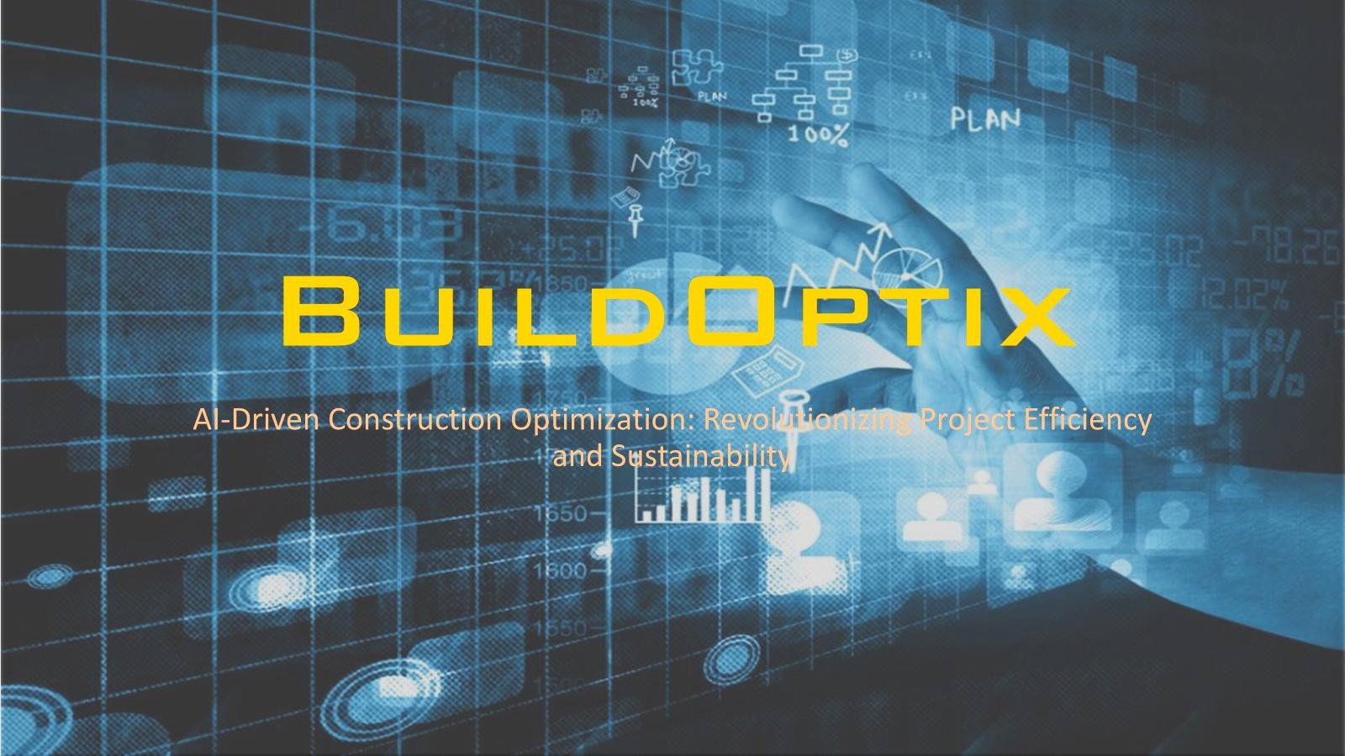

Slide 2
1) Our AI-driven platform is designed to solve long-standing construction issues like rising costs, delays, and material waste.
2) Using advanced algorithms and predictive analytics, it optimizes everything from planning to final construction.
3) The platform offers real-time collaboration, predictive budgeting, and efficient resource management to keep projects on schedule and within budget.
4) By incorporating the latest AI technology, we help make better decisions, reduce waste, promote sustainability, and deliver high-quality construction projects that are cost- effective and environmentally friendly.
Introduction

Slide 3
Problem Statement
Traditional construction methods often lead to cost overruns, delays, and wasted materials, exacerbated by growing populations and limited space.
Clients and architects face difficulties in selecting the right resources and
managing their availability, which adds to the complexity.
These challenges not only reduce efficiency but also contribute to global warming and environmental impact.

Slide 4

Solutions
1. Smart Resource Choices: Our AI helps clients and architects pick the right resources by showing availability and suitability in real time, making decisions easier and reducing delays and extra costs.
2. Better Planning: The platform uses advanced tools to plan construction efficiently, minimizing space and material waste, and spotting issues before they happen.
3. Easy Collaboration: It provides real-time communication tools for all project members, improving coordination and allowing quick adjustments.
4. Forecasting Issues: The AI predicts potential cost overruns and delays,
helping to manage budgets and avoid problems.
5. Eco-Friendly Practices: It reduces material waste and supports sustainable building practices, lowering environmental impact.

