Slide 1
LeekHarvester
2024
Algorithm Trading System
Group 1：Zewei Yu，Qiang Hu，Jiarui Sun，Dexin Sun
2024. 04. 27

Slide 2
Contents
Overview
01
This system includes two main modules.
Backtest Module
02
Do backtest and moniter strategy.
Live Trading Module
03
Do live trading and tca.

Slide 3


Overview
A
Backtest Module
Data_Loader, Account, Order_Excection, Strategy, Backtest
B
Live Trading Module
TradingBot

Slide 4
Backtest
DataLoader
01
Get data from outside source；
Store data in local database(Sqlite);
Aquire data from database to RAM;
Process data requirement during backtesting
Account & Evaluation
02
Manage position and netvalue；
Get buy and sell signal and adjust the position;
Calculate the return metrics such as Sharpe Ratio, MaxDrawdown
Strategy
Logger&UI
05
Generate signal according to the some logic and send the signal to OrderExecution
Flush netvalue and execution information to log file.
Read log file and present in the webpage.
OrderExecution
03
Process order signal from strategy;
Send buy or sell information (quantity,price)to Account
RiskManager
04
Check position and pnl before sending buy or sell signal;
Check order quantity limit;
Check execution limit

Slide 5
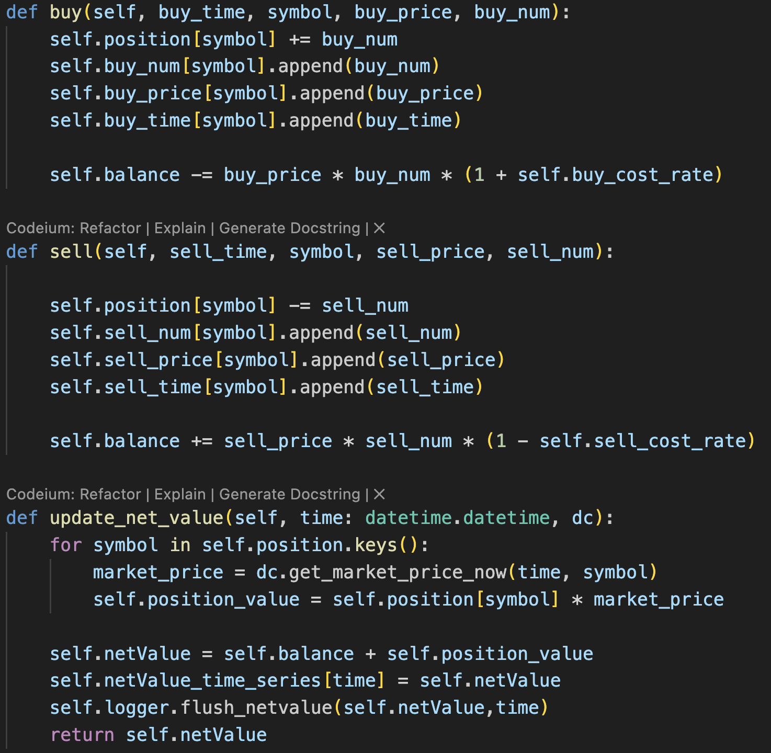
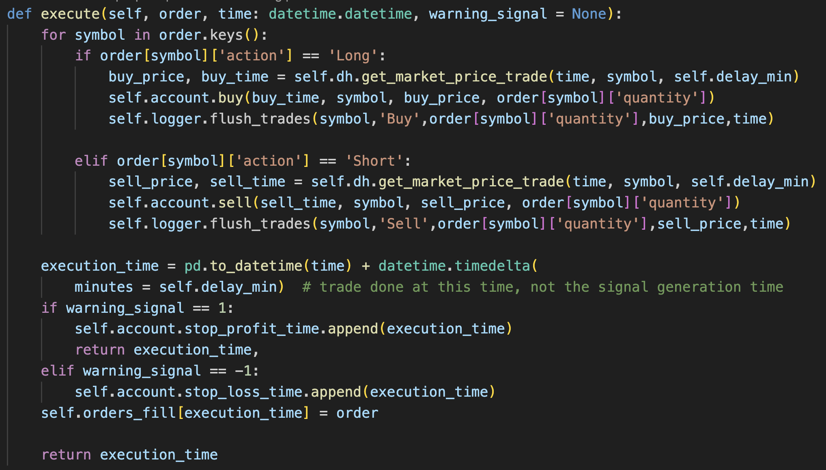
Backtest
Account
OrderExecution

Slide 6
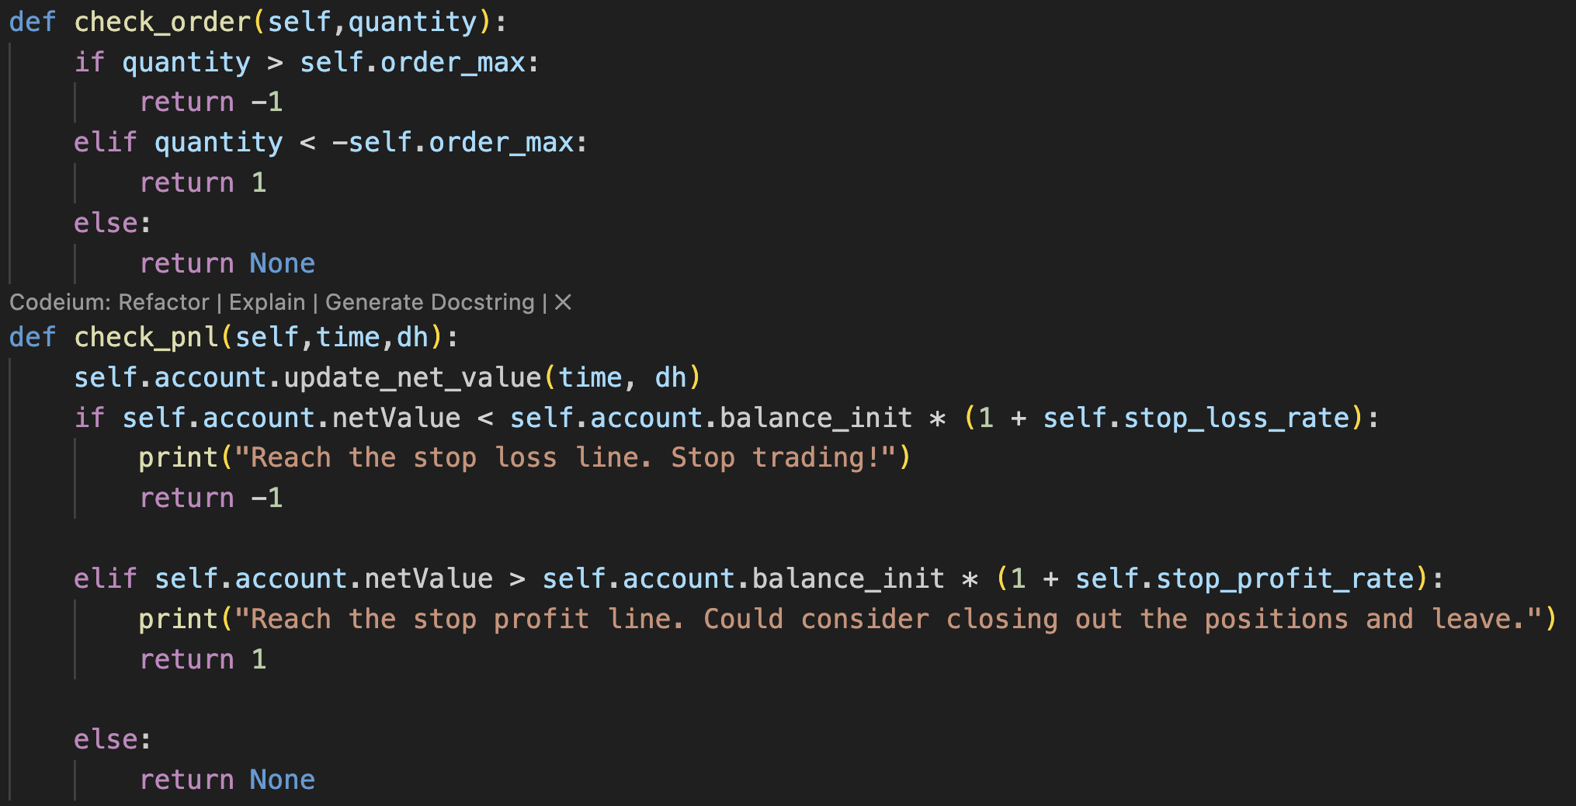
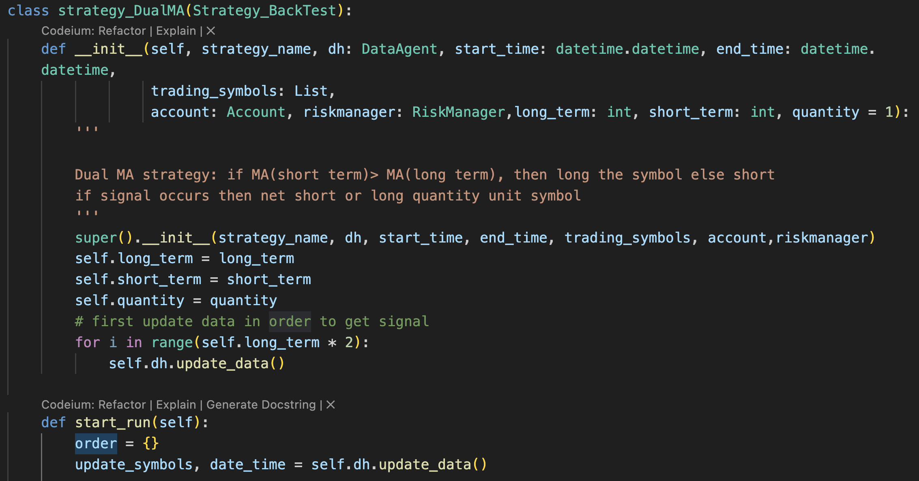
Backtest
RiskManager
Strategy

Slide 7
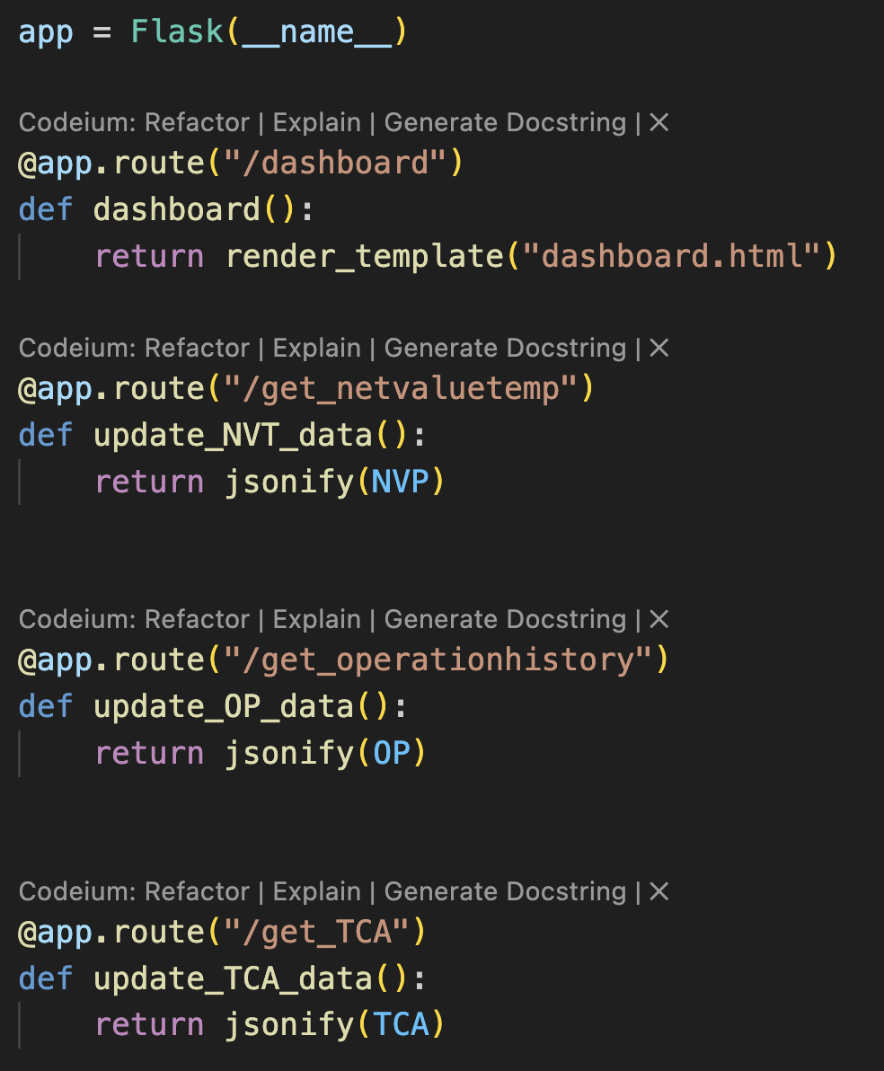
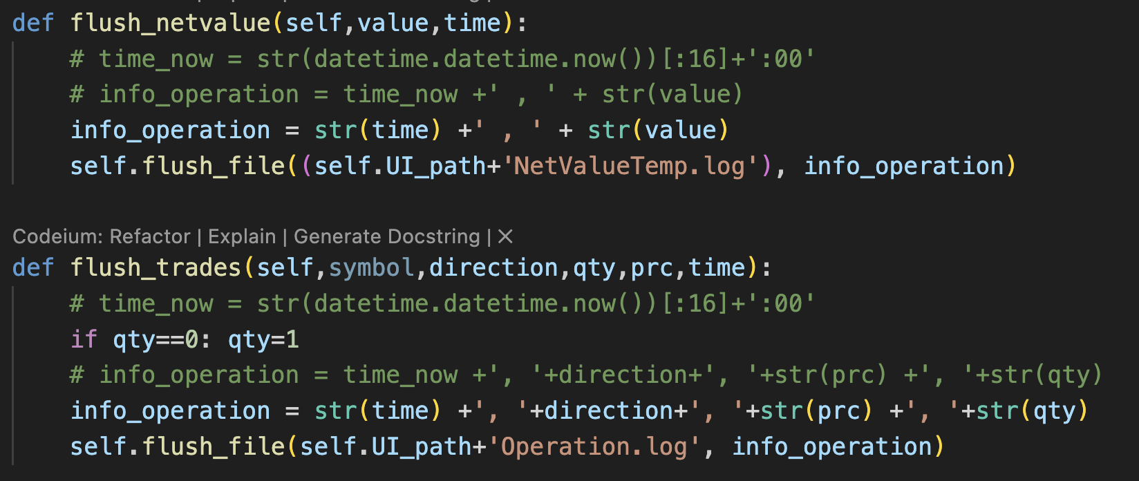
Backtest
Logger
UI

Slide 8
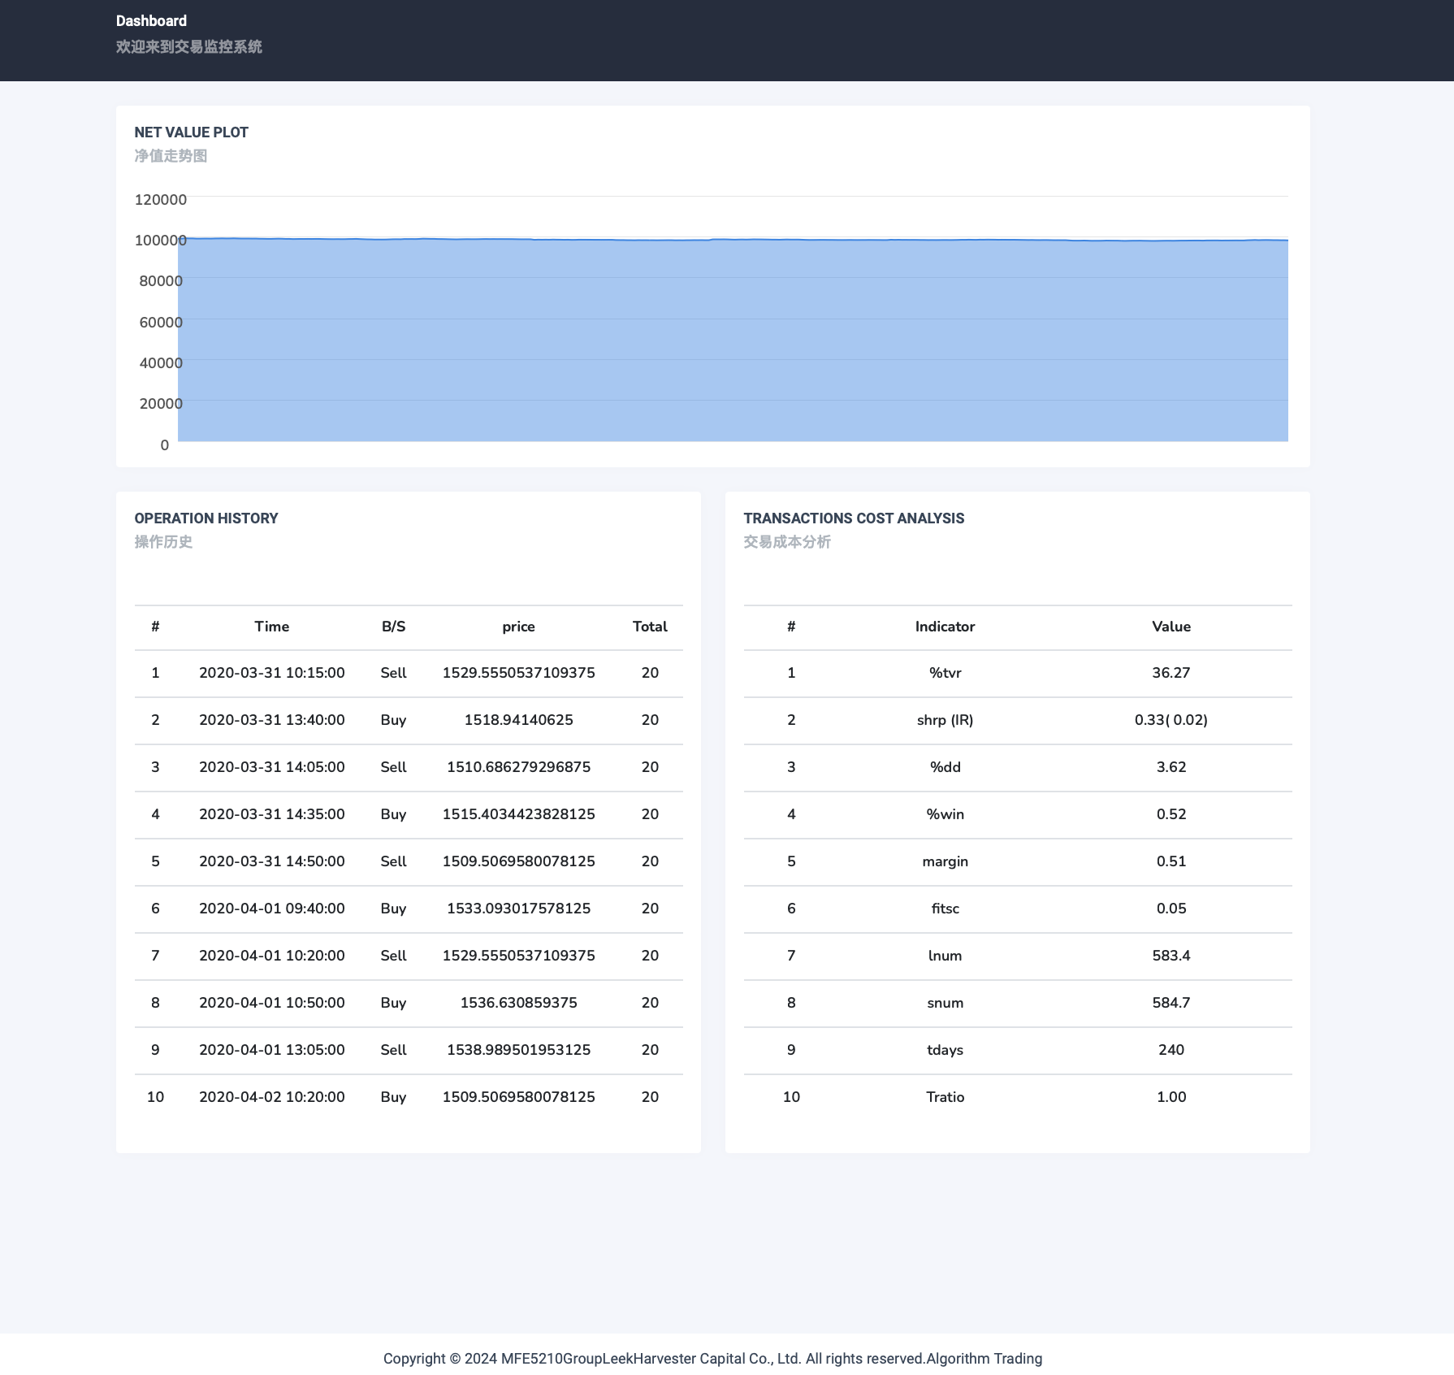
Backtest
Paper Trading Demo
Parameters:
Symble: SZ.000001
Frequency: 5 min
Period: 2020-01-02 - 2020-04-02 10:30:00
Strategy: Dual Moving Average(10,5)

Slide 9
Live Trading
TradingBot
TCA
01
02
Connet to live data source and fetch data;
Manage strategy and account
Calculate the transaction cost metrics, such as average execution price,inplementation shortfall,RPM

Slide 10
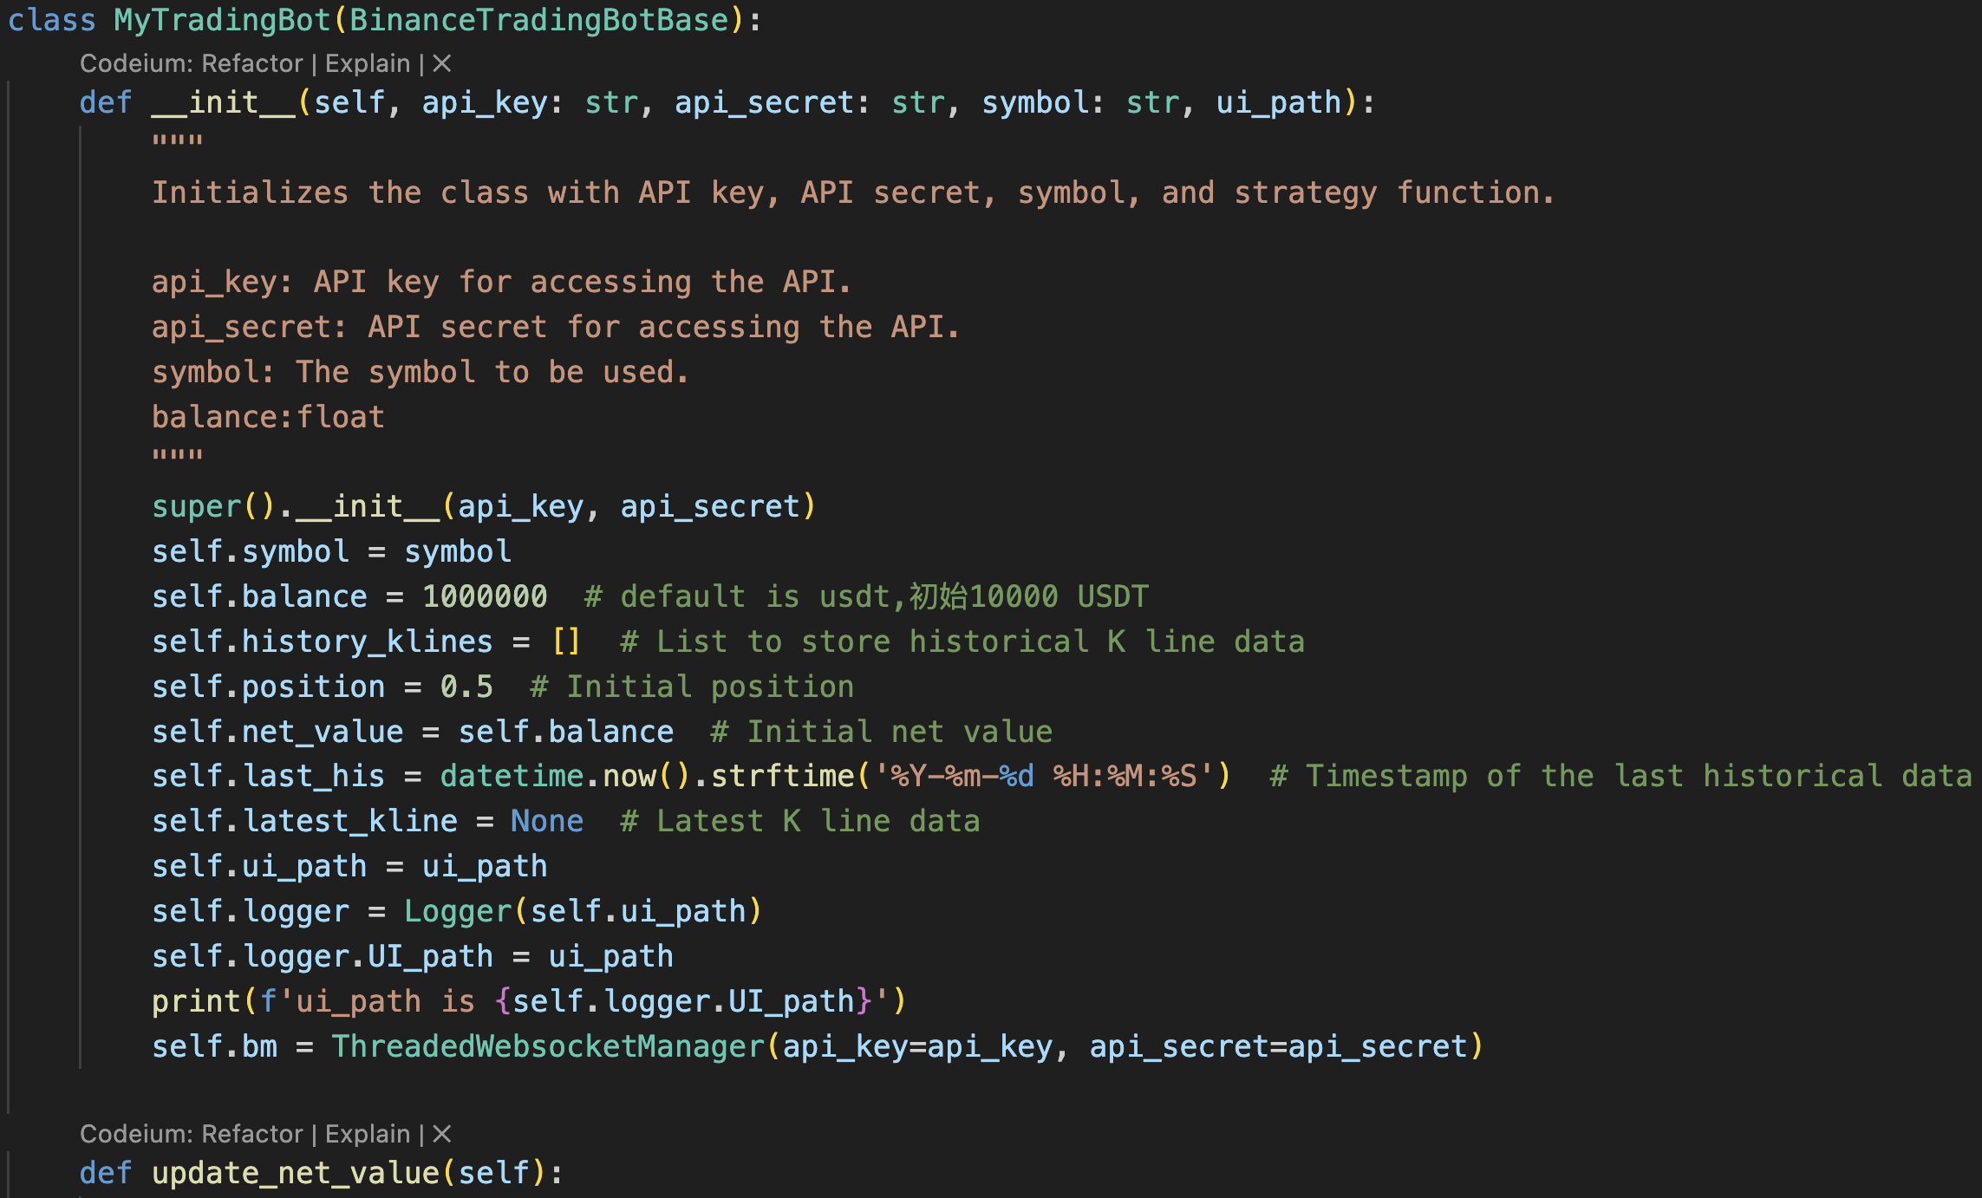
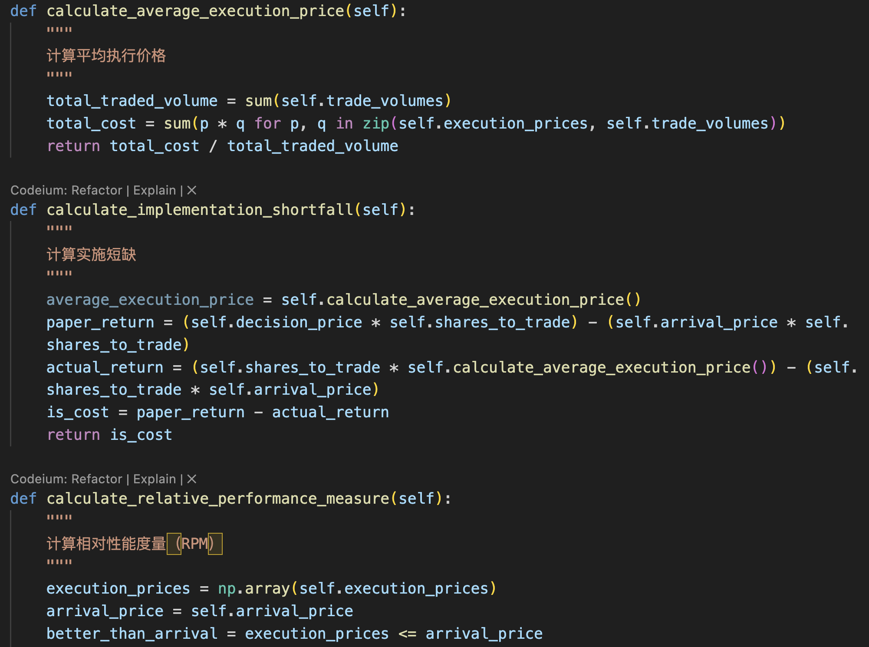
Live Trading
TradingBot
TCA

Slide 11
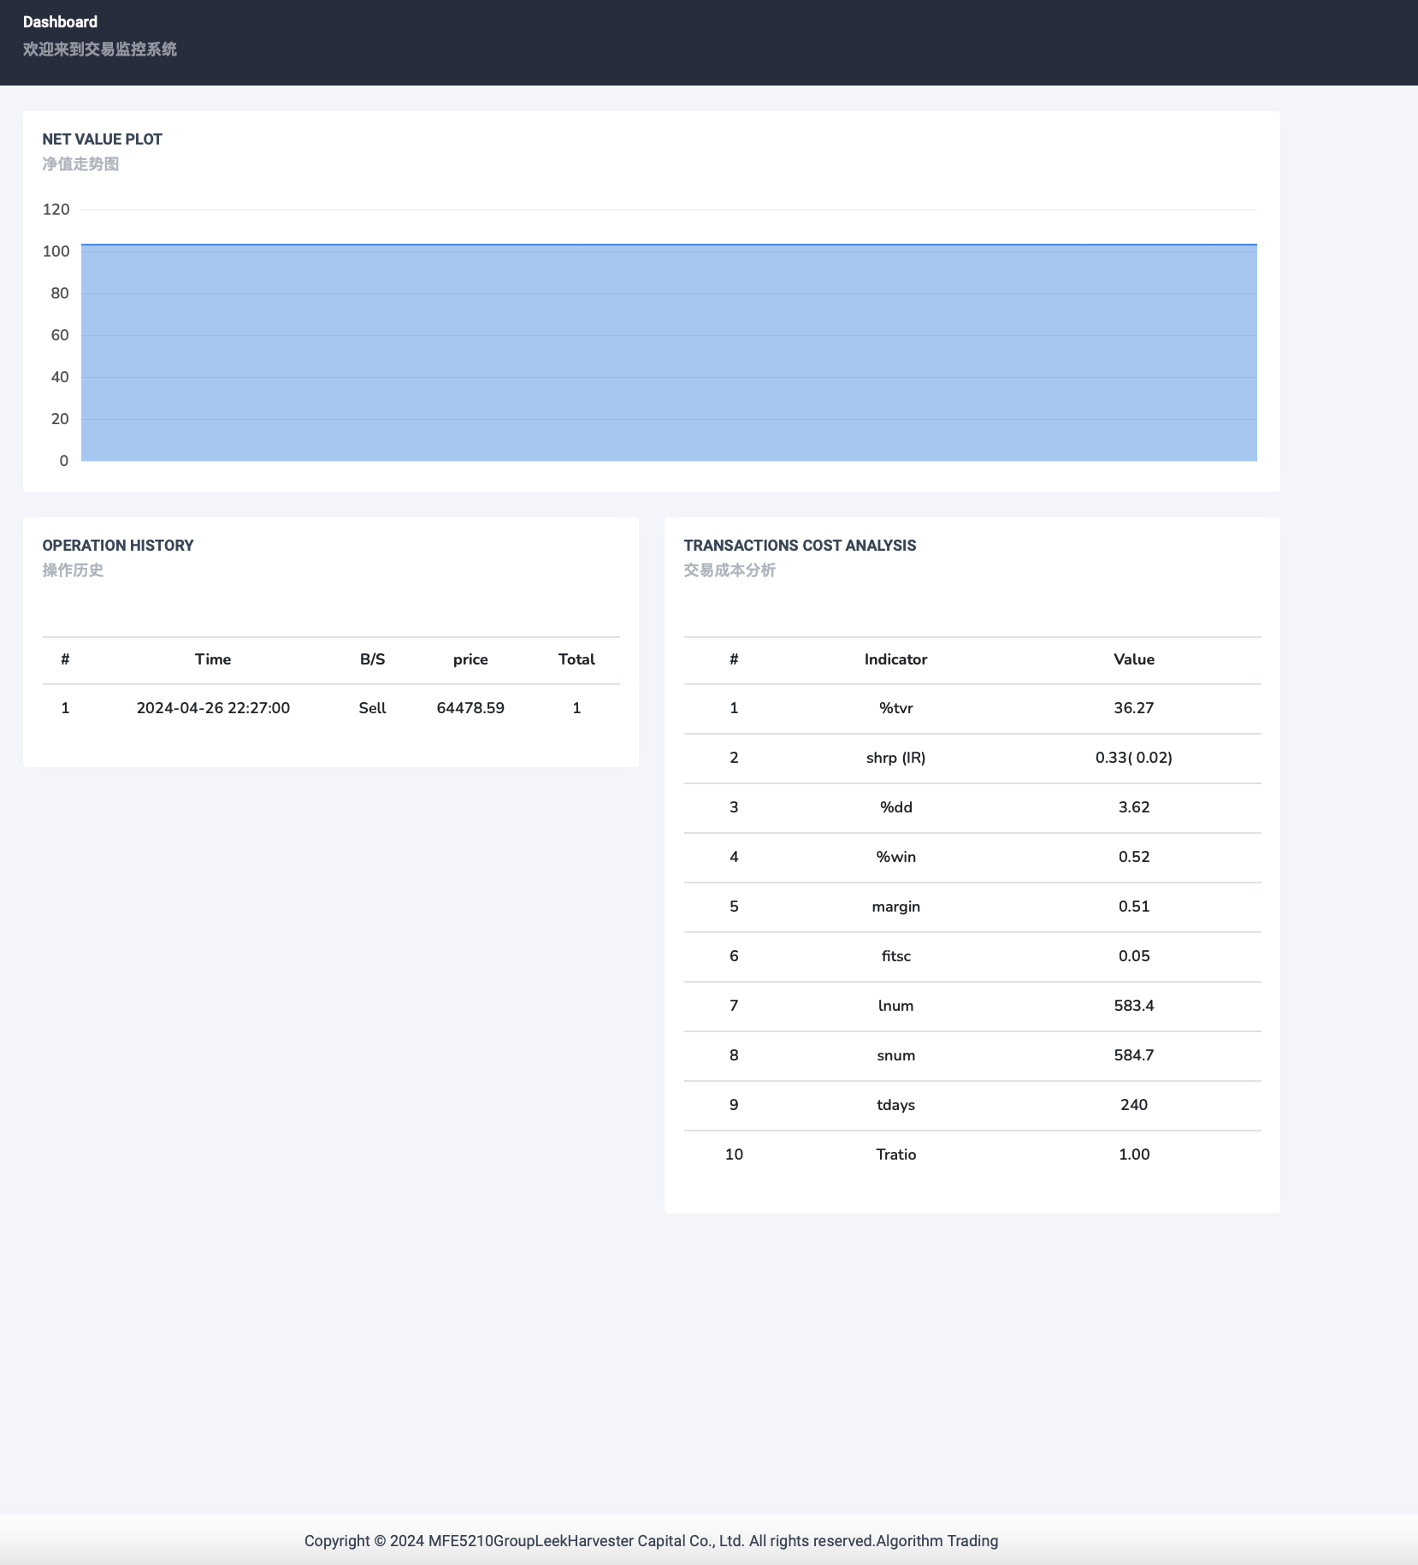
Live Trading
LiveTrading Demo
Parameters:
Symble: BTCUSDT
Frequency: 1 min
Period: Live
Strategy: Dual Moving Average(10,5)

Slide 12
Future Improvements
Better pattern design.
Better strategy.
Multiple accounts management.
...

Slide 13
Thanks!

