Slide 1
SQL Data Analyst Portfolio Project
Garrett Bristol
11/10/2024
Introduction to Data Science

Slide 2
Project Overview
In this project, I began by exploring a site called HackerRank. HackerRank offers coding challenges in algorithms, data structures, AI, and databases to help users improve their computer specific problem-solving skills.

Slide 3
Project Purpose
The platform incorporates a game structure, rewarding users with badges, points, and ranks. This mix of challenges, certifications, and a progressive reward system makes HackerRank a valuable tool for learning and career growth.

Slide 4
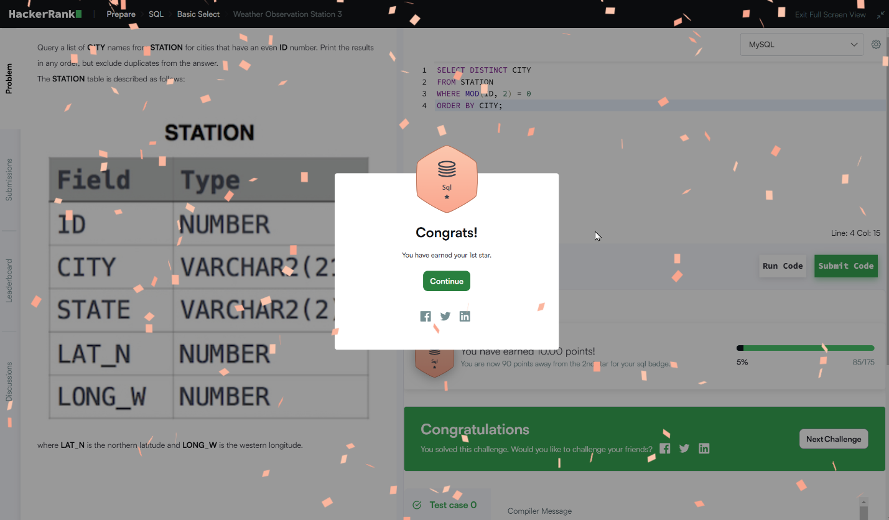
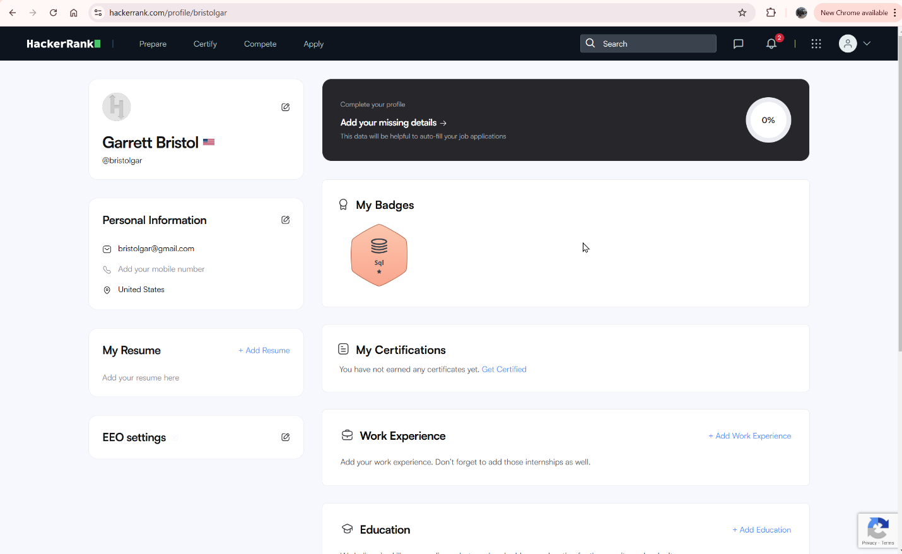
SQL Badge

Slide 5
Conclusion
In this project, I explored HackerRank, a platform offering many coding challenges, but my focus was specifically in SQL to better my database problem-solving skills. It provides certifications in SQL, helping users validate their expertise. The platform rewards users with badges, points, and ranks. This combination of SQL challenges and a reward system makes HackerRank a valuable tool for learning and career growth in the field of databases.

Slide 6

Any Question??

