Slide 1
Graphs – Basic Structure and BFS
Mark Floryan
CLRS Chapter 22.1 and 22.2

Slide 2
Module 1: Graphs Intro

Slide 3
Module 1 Topics (Bolded items in this deck)
Graph Representation
What is a graph?
Adjacency Lists vs. Matrices
Traversing Graphs: Breadth First Search
Traversing Graphs: Depth First Search
Topological Sort
Strongly Connected Components

Slide 4
Graphs

Slide 5
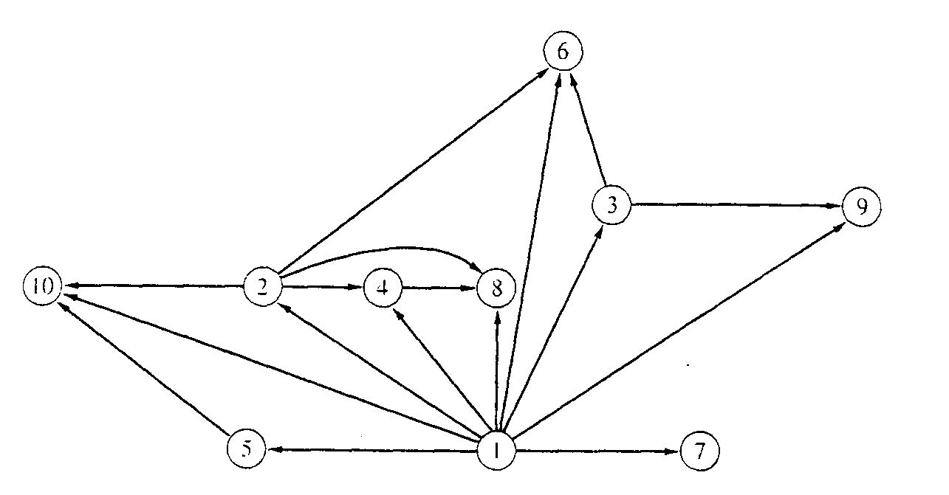
Problems: e.g. Binary relation
x is a proper factor of y

Slide 6
Definition: Directed graph
Directed Graph
A directed graph, or digraph, is a pair
G = (V, E)
where V is a set whose elements are called vertices, and
E is a set of ordered pairs of elements of V.
Vertices are often also called nodes.
Elements of E are called edges, or directed edges, or arcs.
For directed edge (v, w) in E, v is its tail and w its head;
(v, w) is represented in the diagrams as the arrow, v -> w.
In text we simple write vw.

Slide 7
Definition: Undirected graph
Undirected Graph
A undirected graph is a pair
G = (V, E)
where V is a set whose elements are called vertices, and
E is a set of unordered pairs of distinct elements of V.
Vertices are often also called nodes.
Elements of E are called edges, or undirected edges.
Each edge may be considered as a subset of V containing two elements,
{v, w} denotes an undirected edge
In diagrams this edge is the line v---w.
In text we simple write vw, or wv
vw is said to be incident upon the vertices v and w

Slide 8
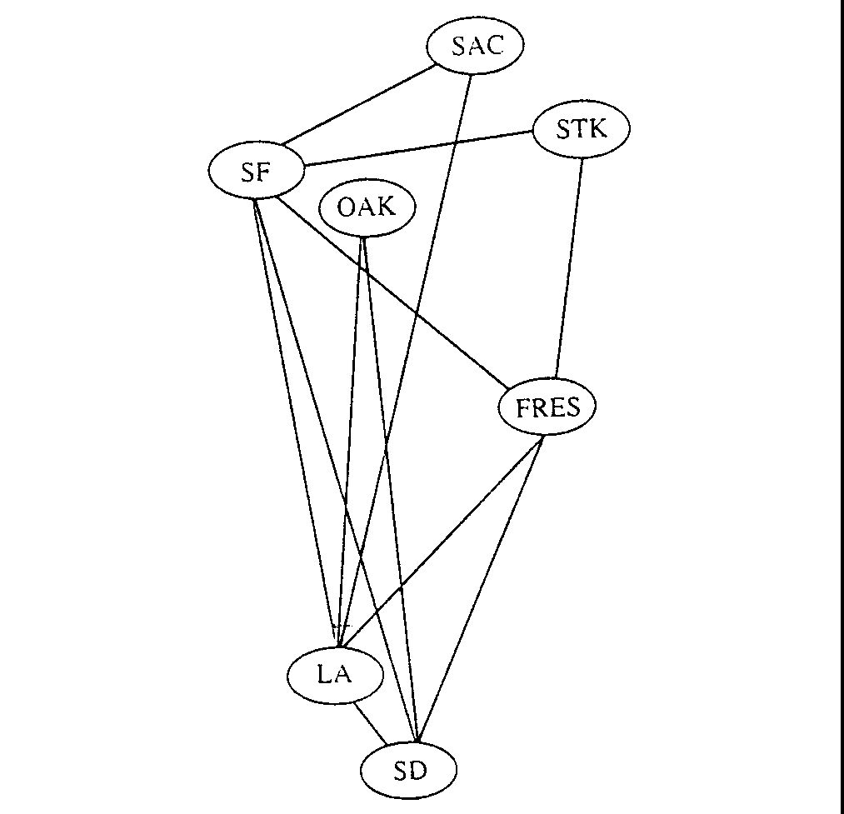
Problems: e.g. Airline Routes

Slide 9
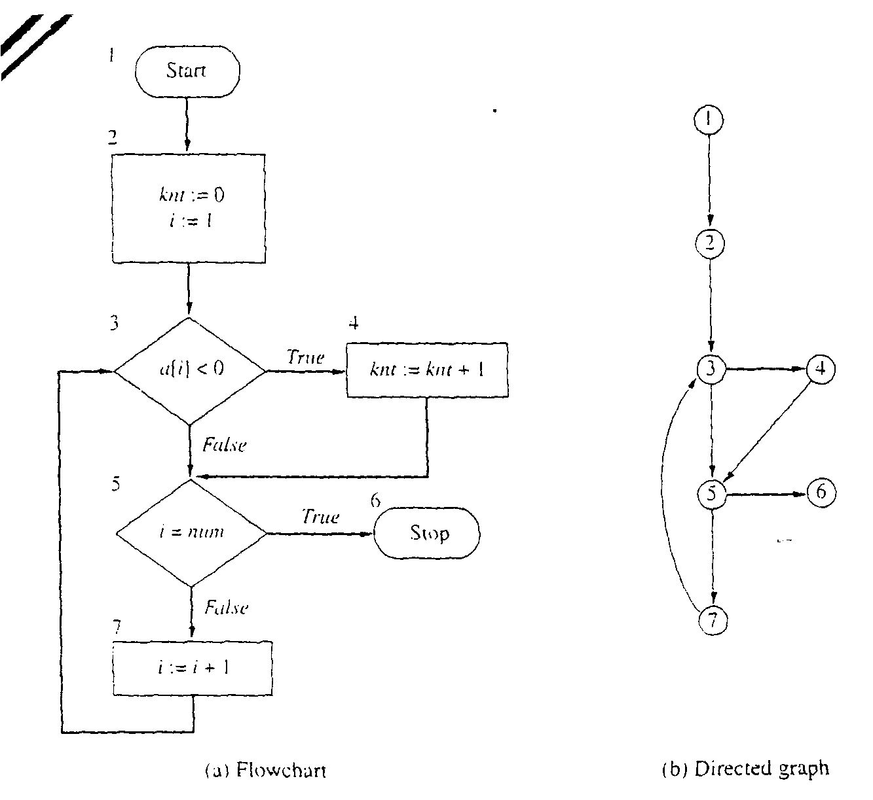
Problems: e.g. Flowcharts

Slide 10
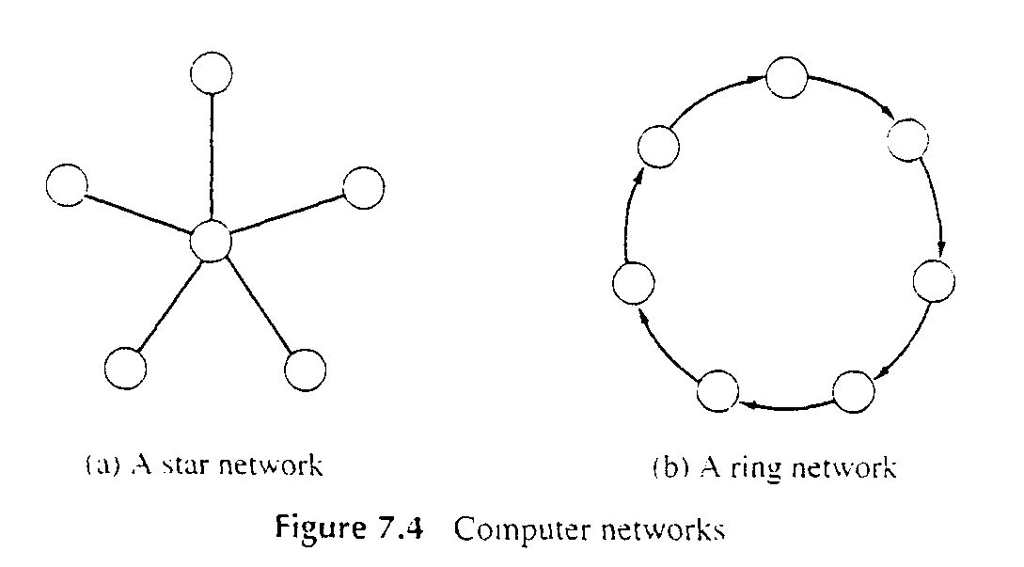
Problems: e.g. Computer Networks

Slide 11
There are a lot of Graphs Terms
Vertex (plural vertices) or Node
Edge (sometimes referred to as an arc)
Note the meaning of incident
Degree of a vertex: how many adjacent vertices
Digraph: in-degree (num. of incoming edges) vs. out-degree
Graphs can be:
Directed or undirected
Weighted or not weighted
weights can be reals, integers, etc.
weight also known as: cost, length, distance, capacity,…
Undirected graphs:
Normally an edge can’t connect a vertex to itself
A directed graph (also known as a digraph)
“Originating” node is the head, the target the tail
An edge may connect a vertex to itself

Slide 12
More Graph Terms
Size of graph? Two measures:
Number of nodes. Usually ‘V’
Number of edges: usually ‘E’
Dense graph: many edges
Maximally dense?
Undirected: each node connects to all others, so e = v(v-1)/2 Called a complete graph
Directed: e = v(v-1) why?
Sparse graph: fewer edges
Could be zero edges…

Slide 13
Terms You Should Know or Learn Now
Path vs. simple path
One vertex is reachable from another vertex
A connected graph
undirected graph, where each vertex is reachable from all others
A strongly connected digraph:
direction affects this!
node u may be reachable from v, but not v from u
Strongly connected means both directions
Connected components for undirected graphs

Slide 14
Terms You Should Know or Learn Now
Cycle
Directed graph: non-empty path with same starting and ending node
An edge may appear more than once (but why?)
Simple cycle: no node repeated except start and end
Undirected graph: same idea
If an edge appears more than once (I.e. non-simple) then we traverse it in the same direction
Acyclic: no-cycles
A connected, acyclic undirected graph: free tree
If we specificy a root, it’s a rooted tree
Acyclic but not connected? a undirected forest
Directed acyclic graph: a DAG

Slide 15
Self-test: Understand these Terms?
Subgraph
Symmetric digraph
complete graph
Adjacency relation
Path, simple path, reachable
Connected, Strongly Connected
Cycle, simple cycle
acyclic
undirected forest
free tree, undirected tree
rooted tree
Connected component

Slide 16
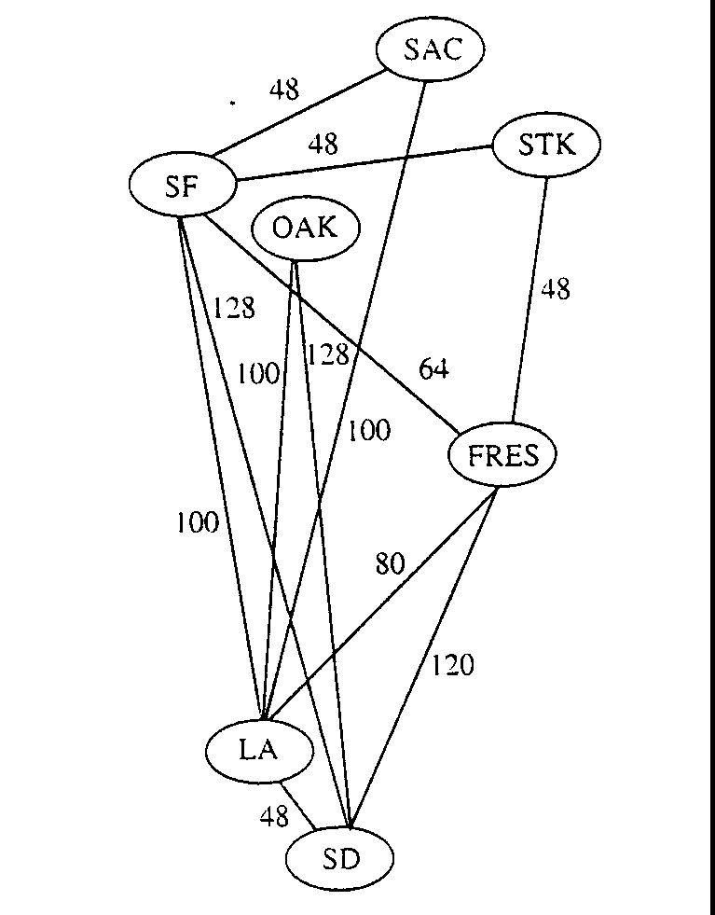
Definitions: Weighted Graph
A weighted graph is a triple (V, E, W)
where (V, E) is a graph (directed or undirected) and
W is a function from E into R, the reals (integer or rationals).
For an edge e, W(e) is called the weight of e.

Slide 17
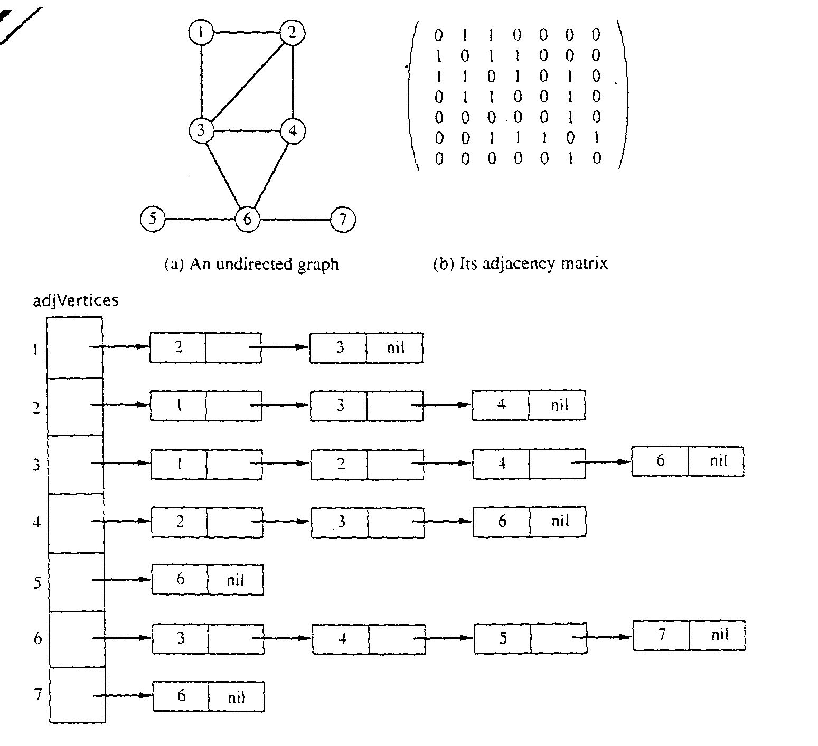
Graph Representations using Data Structures
Adjacency Matrix Representation
Let G = (V,E), n = |V|, m = |E|, V = {v1, v2, …, vn)
G can be represented by an n × n matrix

Slide 18
Array of Adjacency Lists Representation

Slide 19
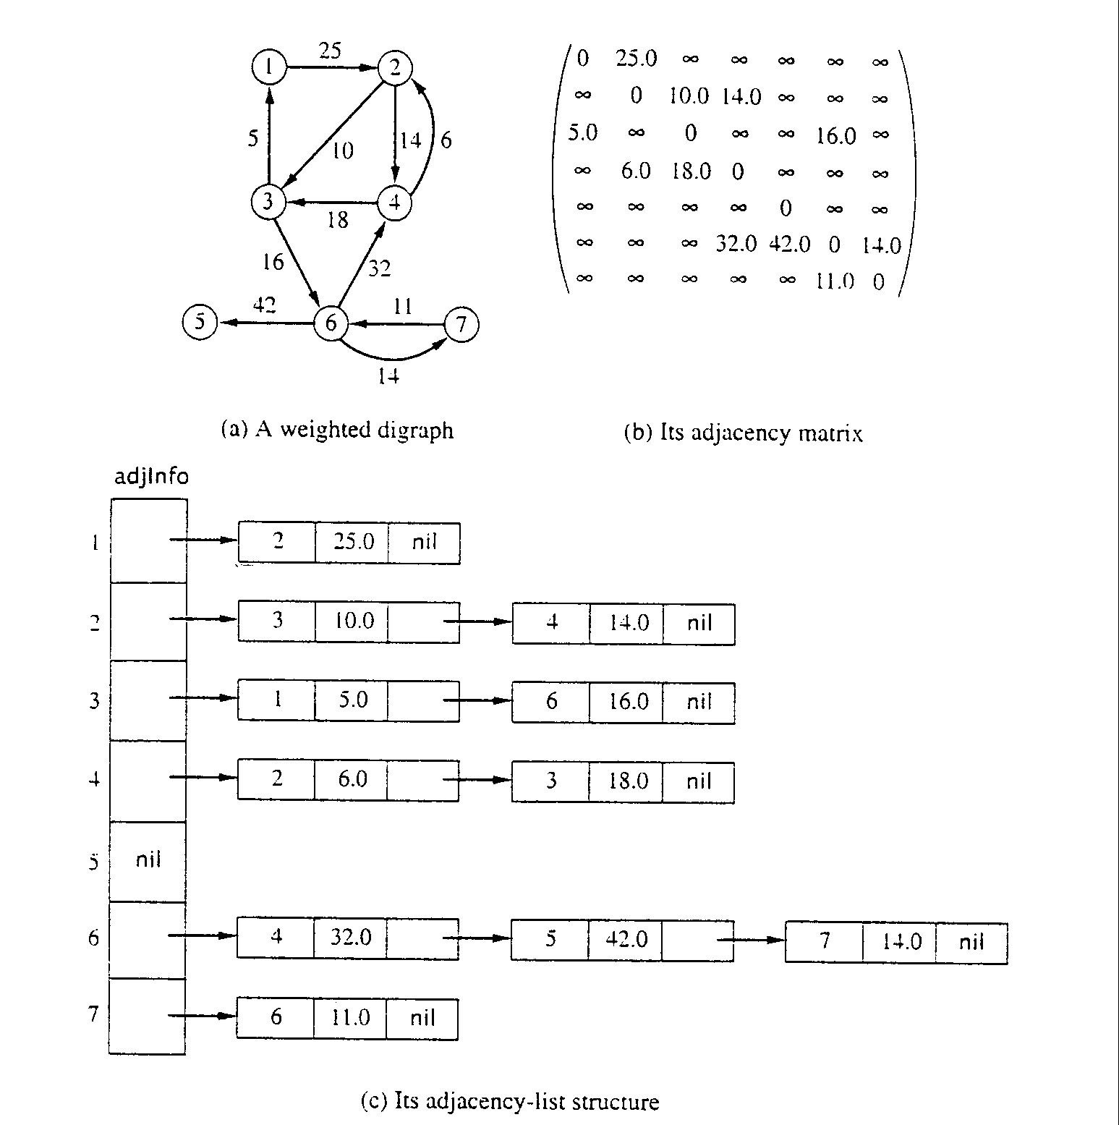
Adjacency Matrix for weight digraph

Slide 20
Array of Adjacency Lists Representation
from -> to, weight

Slide 21
Breadth-First Search

Slide 22
Traversing Graphs
“Traversing” means processing each vertex edge in some organized fashion by following edges between vertices
We speak of visiting a vertex. Might do something while there.
Recall traversal of binary trees:
Several strategies: In-order, pre-order, post-order
Traversal strategy implies an order of visits
We used recursion to describe and implement these
Graphs can be used to model interesting, complex relationships
Often traversal used just to process the set of vertices or edges
Sometimes traversal can identify interesting properties of the graph
Sometimes traversal (perhaps modified, enhanced) can answer interesting questions about the problem-instance that the graph models

Slide 23
BFS: What’s the point
Two purposes:
1) Traverse the graph! Visit every node and do something.
2) Learn something about the “distance” each node is from the starting node
“distance” here means “number of edges away”

Slide 24
BFS: Overall Strategy
Breadth-first search: Strategy
choose a starting vertex, distance d = 0
vertices are visited in order of increasing distance from the starting vertex,
examine all edges leading from vertices (at distance d) to adjacent vertices (at distance d+1)
then, examine all edges leading from vertices at distance d+1 to distance d+2, and so on,
until no new vertex is discovered

Slide 25
BFS: Specific Input/Output
Input:
A graph G
single start vertex s
Output:
Shortest distance from s to each node in G (distance = number of edges)
Breadth-First Tree of G with root s
Note: The paths in this BFS tree represent the shortest paths from s to each node in G

Slide 26
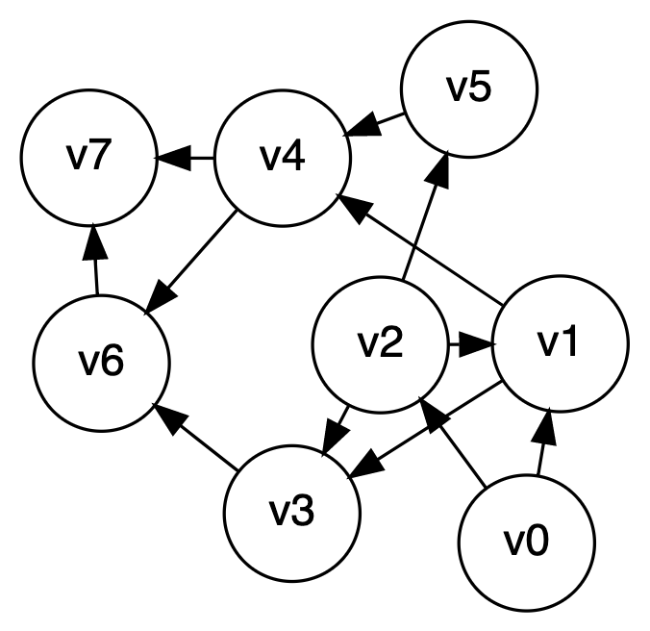
Breadth-first search, quick example
Let’s start at V0

Slide 27
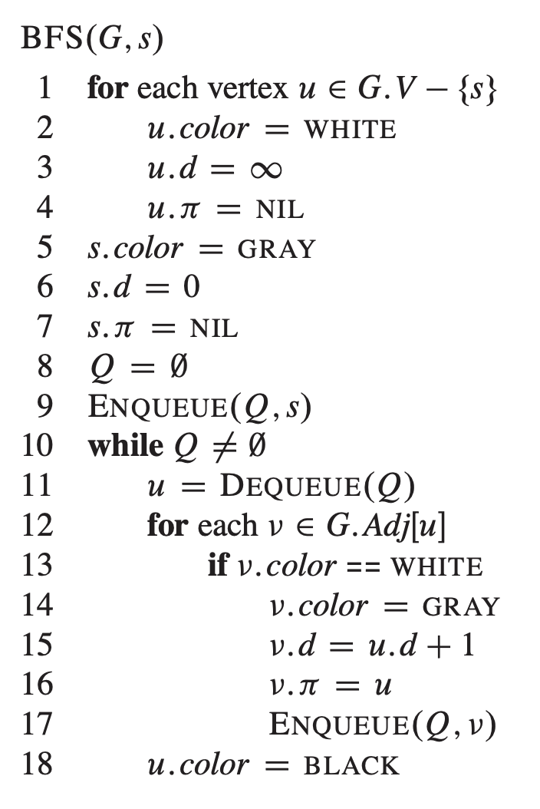
Breadth-first search implementation
Vertices here have some properties:
color = white/gray/black
d = distance from start node
pi = node through which d is achieved

Slide 28
Breadth-first search: Analysis
For a digraph having V vertices and E edges
Each edge is processed once in the while loop for a cost of θ(E)
Each vertex is put into the queue once and removed from the queue and processed once, for a cost θ(V)
Total: θ(V+E)
Extra space is used for color array and queue, there are θ(V)
From a tree (breadth-first spanning tree)
the path in the tree from start vertex to any vertex contains the minimum possible number of edges
Not all vertices are necessarily reachable from a selected starting vertex

Slide 29
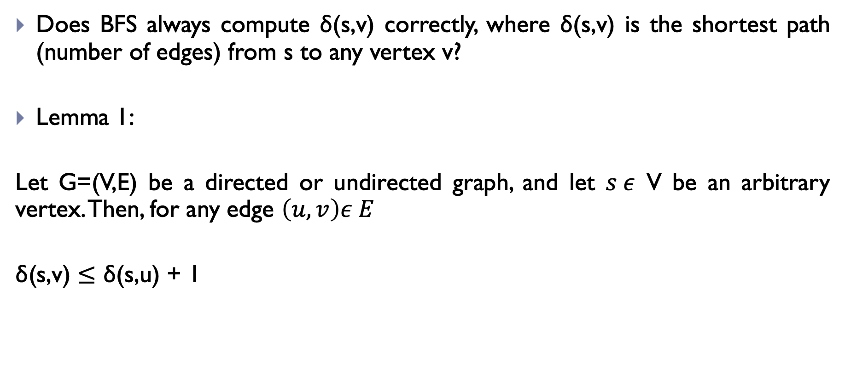
Breadth-first search: Some Properties
Does BFS always compute ẟ(s,v) correctly, where ẟ(s,v) is the shortest path (number of edges) from s to any vertex v?
Lemma 1:
Let G=(V,E) be a directed or undirected graph, and let $s ε$ V be an arbitrary vertex. Then, for any edge $\left(u,v\right)ε E$
$\text{ẟ(}\text{s}\text{,}\text{v}\text{)}$ $≤$ ẟ(s,u) + 1

Slide 30
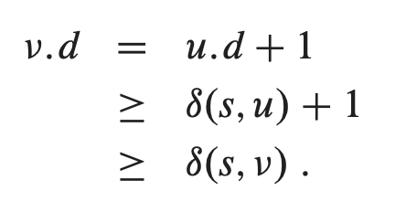
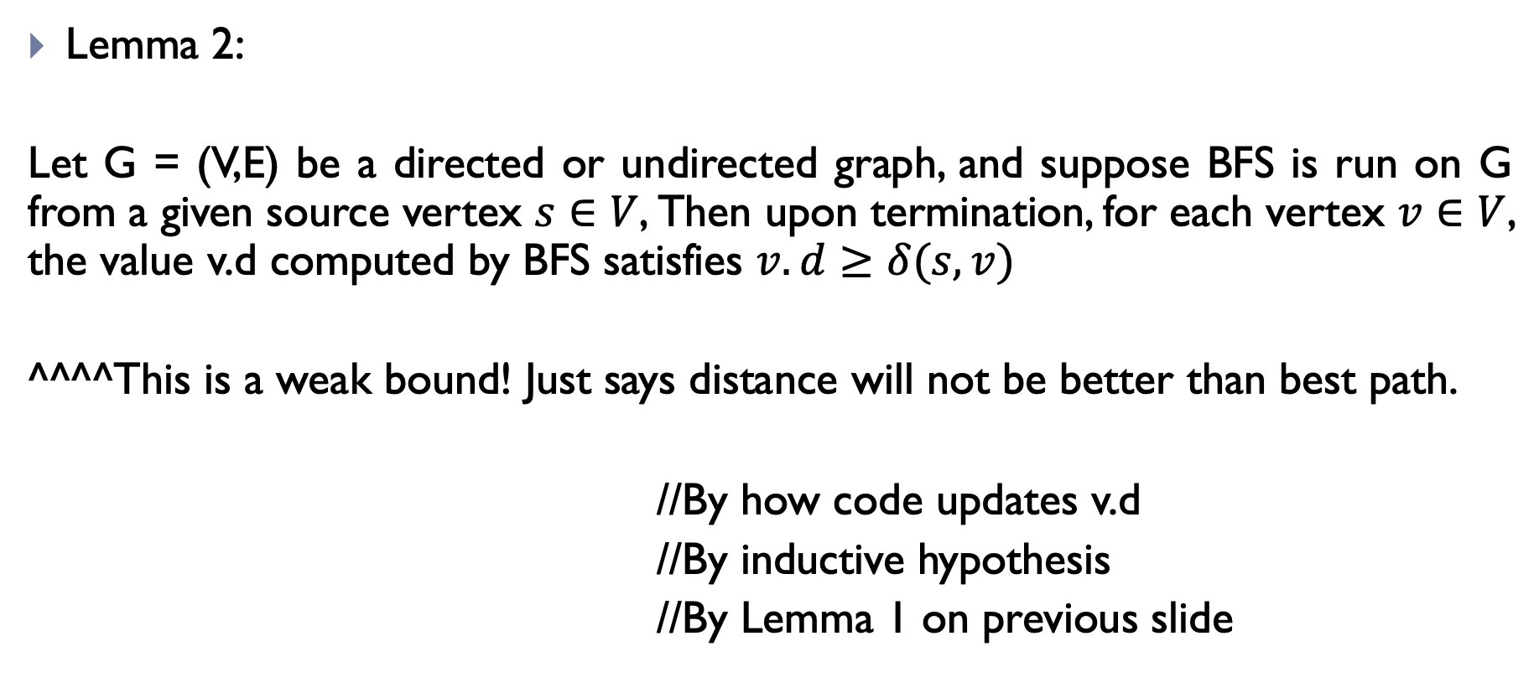
Breadth-first search: Some Properties
Lemma 2:
Let G = (V,E) be a directed or undirected graph, and suppose BFS is run on G from a given source vertex $s∈V$, Then upon termination, for each vertex $v∈V$, the value v.d computed by BFS satisfies $v.d≥δ(s,v)$
^^^^This is a weak bound! Just says distance will not be better than best path.
//By how code updates v.d
//By inductive hypothesis
//By Lemma 1 on previous slide

Slide 31
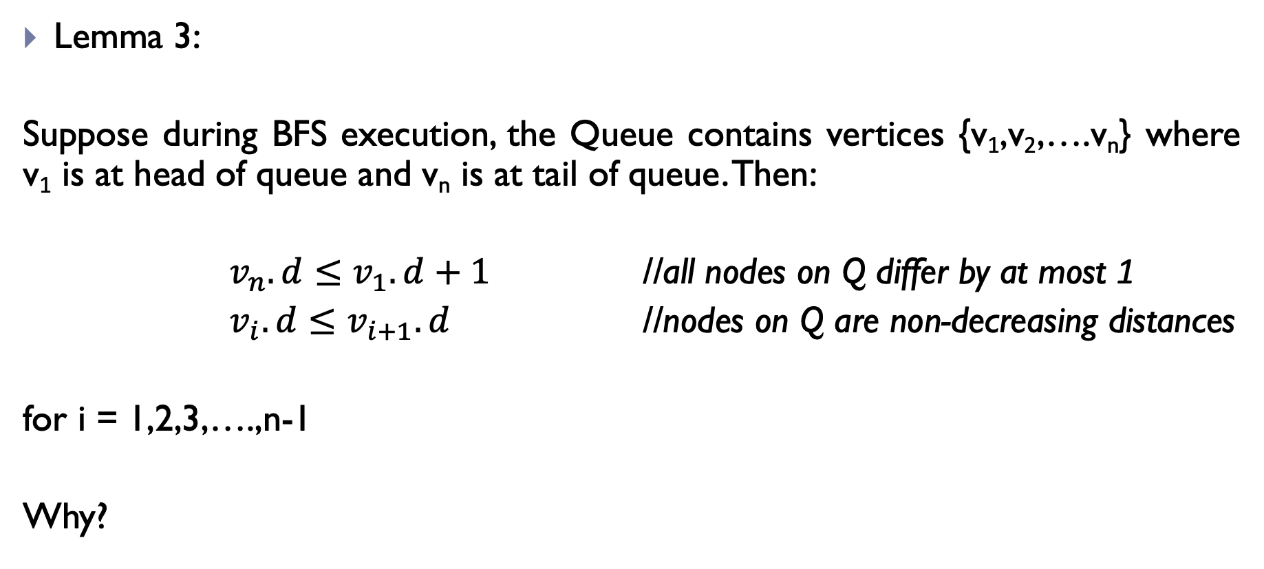
Breadth-first search: Some Properties
Lemma 3:
Suppose during BFS execution, the Queue contains vertices {v₁,v₂,….v_{n}} where v₁ is at head of queue and v_{n} is at tail of queue. Then:
$v_{n}.d≤v_{1}.d+1$ //all nodes on Q differ by at most 1
$v_{i}.d≤v_{i+1}.d$ //nodes on Q are non-decreasing distances
for i = 1,2,3,….,n-1
Why?

Slide 32
Correctness of BFS

Slide 33

Proof of Correctness
Claim:
Let G=(V,E) be a directed or undirected graph, and suppose that BFS is run on G from a given source vertex $s∈V$. Then, during its execution, BFS discovers every vertex $v∈V$ that is reachable from s, and upon termination $v.d=δ(s,v)$ for all $v∈V$.

Slide 34
REMINDER: The Code!
Vertices here have some properties:
color = white/gray/black
d = distance from start node
pi = node through which d is achieved

Slide 35
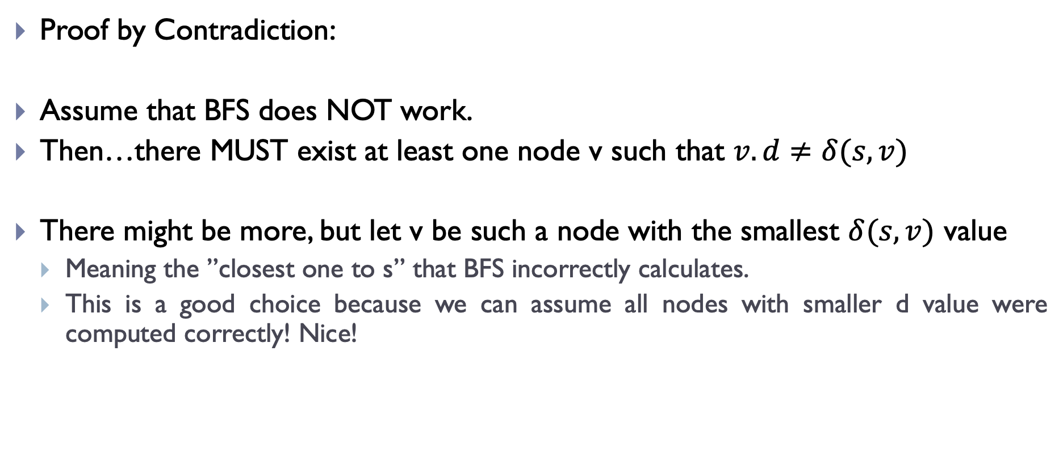
Proof of Correctness
Proof by Contradiction:
Assume that BFS does NOT work.
Then…there MUST exist at least one node v such that $v.d≠δ(s,v)$
There might be more, but let v be such a node with the smallest $δ(s,v)$ value
Meaning the ”closest one to s” that BFS incorrectly calculates.
This is a good choice because we can assume all nodes with smaller d value were computed correctly! Nice!

Slide 36

Proof of Correctness
So, this incorrectly calculated node v has the following property:
$$v.d>δ\left(s,v\right)=δ\left(s,u\right)+1=u.d+1$$
By definition of
optimal path
By how we chose
v
Because of Lemma 2!

Slide 37
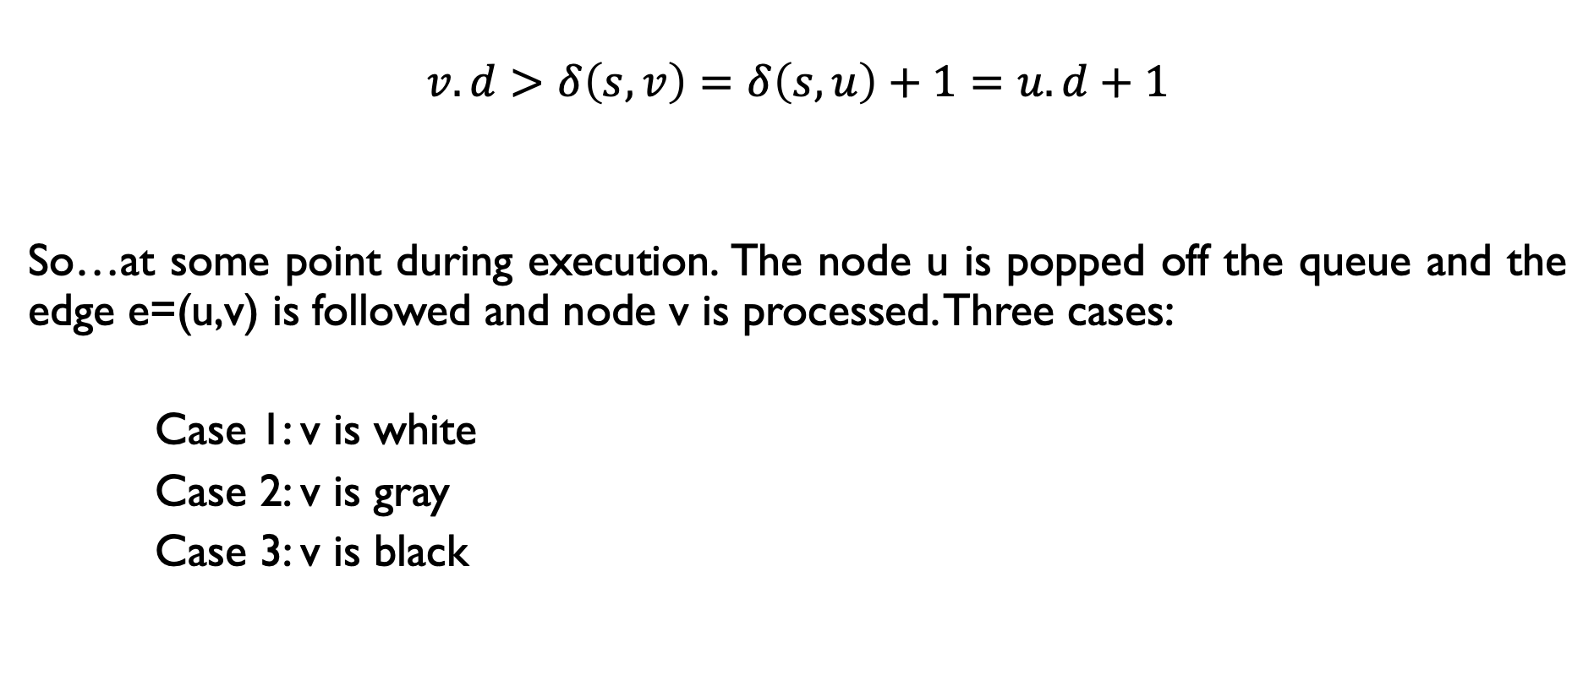
Proof of Correctness
$$v.d>δ\left(s,v\right)=δ\left(s,u\right)+1=u.d+1$$
So…at some point during execution. The node u is popped off the queue and the edge e=(u,v) is followed and node v is processed. Three cases:
Case 1: v is white
Case 2: v is gray
Case 3: v is black

Slide 38

Proof of Correctness
$$v.d>δ\left(s,v\right)=δ\left(s,u\right)+1=u.d+1$$
Case 1: v is white
If v is white, algorithm sets $v.d=u.d+1$ (line 15).
Contradiction! above formula shows $v.d>u.d+1$

Slide 39
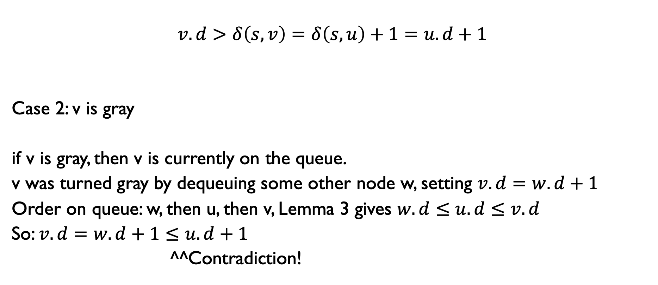
Proof of Correctness
$$v.d>δ\left(s,v\right)=δ\left(s,u\right)+1=u.d+1$$
Case 2: v is gray
if v is gray, then v is currently on the queue.
v was turned gray by dequeuing some other node w, setting $v.d=w.d+1$
Order on queue: w, then u, then v, Lemma 3 gives $w.d≤u.d≤v.d$
So: $v.d=w.d+1≤u.d+1$
^^Contradiction!

Slide 40
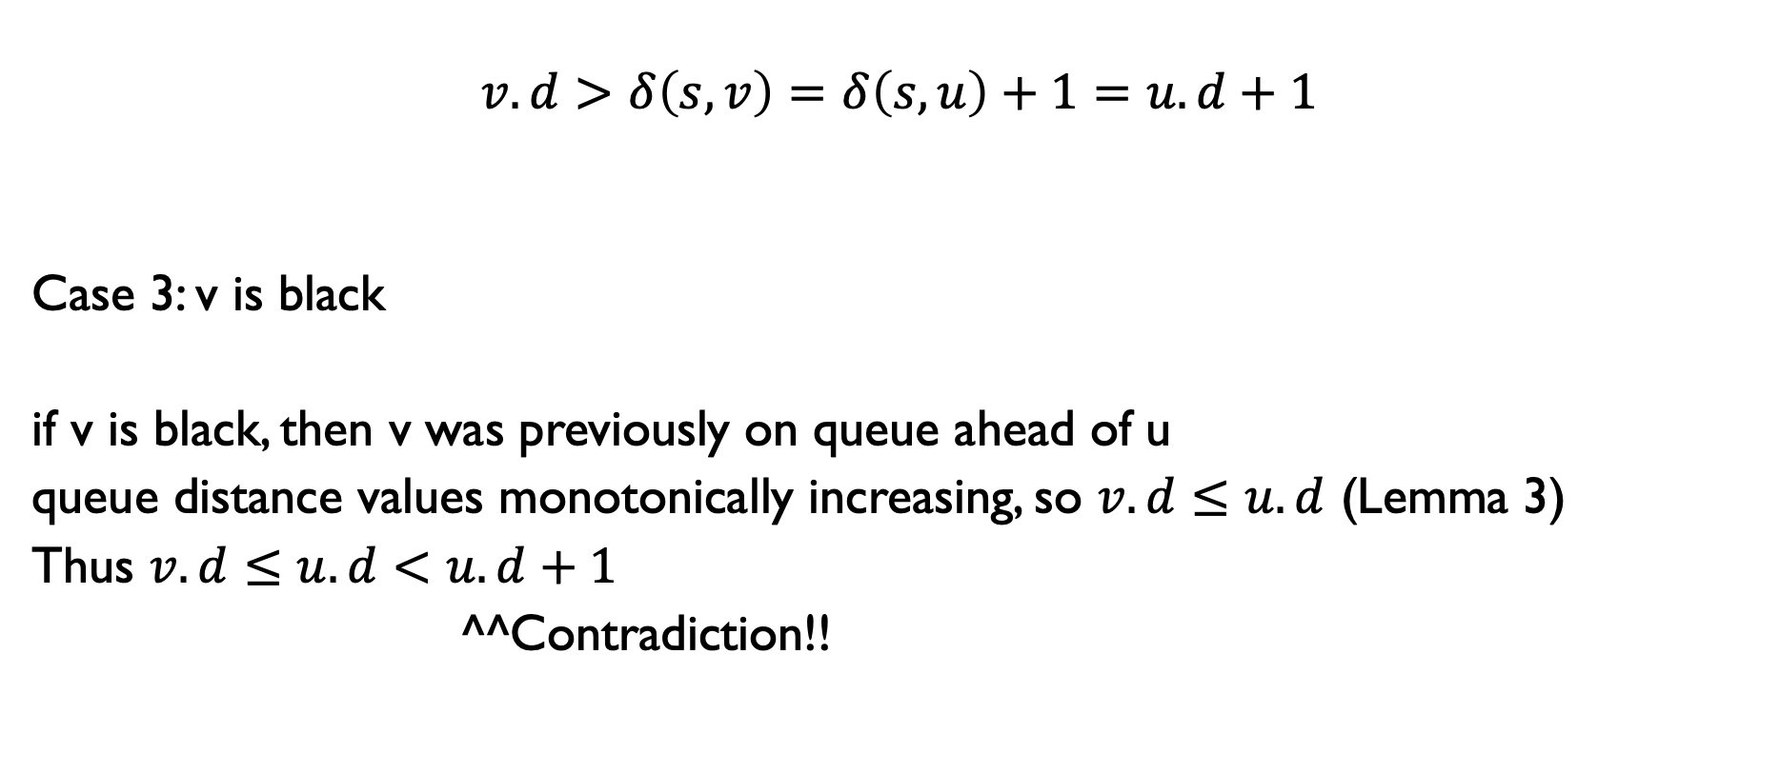
Proof of Correctness
$$v.d>δ\left(s,v\right)=δ\left(s,u\right)+1=u.d+1$$
Case 3: v is black
if v is black, then v was previously on queue ahead of u
queue distance values monotonically increasing, so $v.d≤u.d$ (Lemma 3)
Thus $v.d≤u.d<u.d+1$
^^Contradiction!!

Slide 41

Proof of Correctness
Finishing out the proof!
If BFS is wrong then either:
$$v.d<δ\left(s,v\right)$$
No! By Lemma 2
$$v.d>δ(s,v)$$
No! By proof by contradiction / 3 cases
Thus, $v.d=δ(s,v)$

