Slide 1
Recurrence Relations
CS 3100: DSA2

Slide 2
Recurrence Relations

Slide 3
Solving Recurrence Relations
Several (four) methods for solving:
Directly Solve
Substitution method
In short, guess the runtime and solve by induction
Recurrence trees
We won’t see this in great detail, but a graphical view of the recurrence
Sometimes a picture is worth 2¹⁰ words!
“Master” theorem
Easy to find Order-Class for a number of common cases
Different variations are called different things, depending on the source

Slide 4
Directly Solving (or Iteration Method)

Slide 5
Directly Solve (unrolling the recurrence)
For Mergesort:
T(n) = 2*T(n/2) + n
Do it on board →

Slide 6
Another Example!!
Consider:
T(n) = 3*T(n/4) + n

Slide 7
Unroll the recurrence
T(n) = 3*T(n/4) + n
T(n) = 3*[3*T(n/16)+n/4] + n
= 9T(n/16) + (7/4)n
T(n) = 9T(n/16) + (7/4)n
T(n) = 9[3T(n/64) + n/16] + (7/4)n
T(n) = 27*T(n/64) + 9n/16 + 7n/4
T(n) = 27*T(n/64) + 37n/16 //Pattern??
T(n) = 3^{d} * T(n/4^{d}) + n * ∑(3/4)^{d-1} ←sum from 1 to d

Slide 8
Unroll the recurrence
T(n) = 3^{d} * T(n/4^{d}) + n * ∑(3/4)^{d-1}
We hit base case when:
n/(4^{d}) = 1
n = 4^{d}
d = log₄(n) //seem familiar??

Slide 9
Unroll the recurrence
T(n) = 3^{d} * T(n/4^{d}) + n * ∑(3/4)^{d}
Let’s do one term at a time.
3^{d} * T(n/4^{d})
3^{log4(n)} * T(1)
3^{log4(n)} = n^{log4(3)} //huh? this is a log rule

Slide 10
Unroll the recurrence
T(n) = 3^{d} * T(n/(4^{d})) + n * ∑(3/4)^{d-1}
Let’s do one term at a time.
n * ∑(3/4)^{d-1} //note summation part approaches 4 as d grows
n * ∑(3/4)^{d-1} <= 4*n = Θ(n)

Slide 11
Unroll the recurrence
T(n) = 3^{d} * T(n/4^{d}) + n * ∑(3/4)^{d}
T(n) = 3^{log4(n)} + Θ(n)
T(n) = n^{log4(3)} + Θ(n) //log rules
T(n) = o(n) + Θ(n)
T(n) = Θ(n)

Slide 12
Substitution Method

Slide 13
Iteration or Substitution Method
Strategy
1. Consider Mergesort Recurrence
T(n) = 2*T(n/2) + n
2. Guess the solution
Let’s go with n*log(n) **Remember logs are all base 2 (usually)
3. Inductively Prove that recurrence is in proper order class
For n*log(n), we need to prove that T(n) <= c*n*log(n)
For some ‘c’ constant and for all n >= n0
Remember, we get to choose the ‘c’ and ‘n0’ values
Do it on board →

Slide 14
Substitution Method: Subtleties
Consider:
T(n) = 2*T(n/2) + 1 T(1)=1
Let’s make our guess:
We are thinking O(n)
Try to prove:
T(n) <= c*n
What happens? How do we fix this issue?
On board →

Slide 15
Substitution Method: Subtleties
Consider:
T(n) = 2*T(n/2) + 1

Slide 16
Substitution Method: Subtleties
Summary of the problem / issue:
T(n) = 2*T(n/2) + 1
T(n) <= 2(c*(n/2)) + 1
T(n) <= c*n + 1
What is the issue here?
c*n + 1 is TOO LARGE.
Need to prove exact form of inductive hypothesis

Slide 17
Substitution Method: Subtleties
Here is how we fix the issue. Subtract lower order term.
Inductive Hypothesis:
T(n) <= c*n – d //d is a constant term. Note c*n-d <= c*n
Fix:
T(n) = 2*T(n/2) + 1
T(n) <= 2(c*(n/2) - d) + 1
T(n) <= c*n -2d + 1 <= c*n - d //as long as d >= 1

Slide 18
Substitution Method: Another Pitfall
Consider Mergesort recurrence again:
T(n) = 2*T(n/2) + n
Let’s make our guess:
We are thinking O(n) ← Note that this is INCORRECT!
Try to prove:
T(n) <= c*n
What happens?
On board →

Slide 19
Substitution Method: Another Pitfall
Consider Mergesort recurrence again:
T(n) = 2*T(n/2) + n

Slide 20
Substitution Method: Pitfall Example
Attempt to prove:
T(n) = 2*T(n/2) + n
T(n) <= 2*(c*n/2) + n
T(n) <= c*n + n
Again, need to prove EXACT form of inductive hypothesis.
Subtracting off a lower order term won’t help.
Why?

Slide 21
Recursion Tree Method

Slide 22
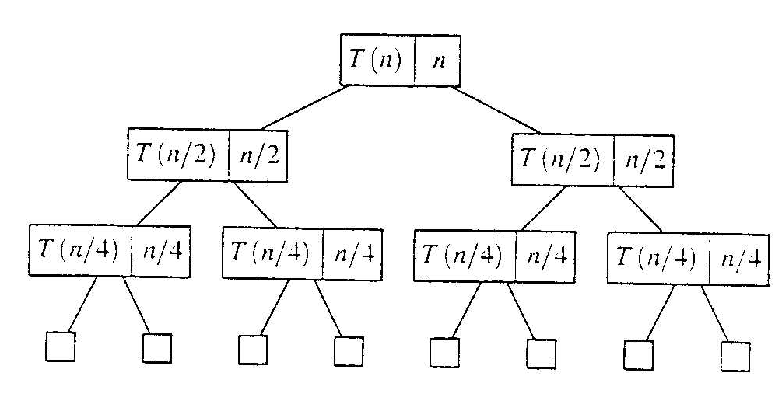
Recursion Tree Method
Evaluate: T(n) = 2*T(n/2) + n
Work copy: T(k) = T(k/2) + T(k/2) + k
For k=n/2, T(n/2) = T(n/4) + T(n/4) + (n/2)
[size| non-recursive cost]

Slide 23
Recursion Tree: Total Cost
To evaluate the total cost of the recursion tree
sum all the non-recursive costs of all nodes
= Sum (rowSum(cost of all nodes at the same depth))
Determine the maximum depth of the recursion tree:
For our example, at tree depth d the size parameter is n/(2^{d})
the size parameter converging to base case, i.e. case 1
such that, n/(2^{d}) = 1,
d = lg(n)
The rowSum for each row is n
Therefore, the total cost, T(n) = n lg(n)

Slide 24
The Master Theorem

Slide 25
The Master Theorem
Given: a divide and conquer algorithm
An algorithm that divides the problem of size n into a subproblems, each of size n/b
Let the cost of each stage (i.e., the work to divide the problem + combine solved subproblems) be described by the function f(n)
Then, the Master Theorem gives us a cookbook for the algorithm’s running time
Some textbooks has a simpler version they call the “Main Recurrence Theorem”
We’ll splits it into individual parts

Slide 26
The Master Theorem (from Cormen)
If T(n) = a T(n/b) + f(n)
then let k = lg a / lg b = log_{b}(a) (critical exponent)
Then three common cases:
If f(n) ∈ O(n^{k-ε}) for some positive ε, then T(n) ∈ Θ(n^{k})
If f(n) ∈ Θ(n^{k}) then T(n) ∈ Θ( f(n) log(n) ) = Θ(n^{k} log(n))
If f(n) ∈ Ω(n^{k+ε}) for some positive ε, and
a f(n/b) ≤ c f(n) for some c < 1 and sufficiently large n, then T(n) ∈ Θ(f(n))
Note: none of these cases may apply

Slide 27
Using the Master Theorem
T(n) = 9T(n/3) + n
A = 9, b = 3, f(n) = n
Master Theorem
k = lg 9 / lg 3 = log3 9 = 2
Since f(n) = O(n^{log3 9 - ε}), where ε=1, case 1 applies: T(n) ∈ Θ(n^{k})
Thus the solution is T(n) = Θ(n²) since k=2

Slide 28
Problems to Try
Can you use a theorem on these?
Assume T(1) = 1
T(n) = T(n/2) + lg n
T(n) = T(n/2) + n
T(n) = 2T(n/2) + n (like Mergesort)
T(n) = 2T(n/2) + n lg n

Slide 29
More Master Theorem Examples

Slide 30
Problems to Try
Let’s try these?
T(n) = 7T(n/3) + n^2
T(n) = 3T(n/3) + n/2
T(n) = 4T(n/2) + n / log(n)
T(n) = 3T(n/3) + n / log(n)

Slide 31
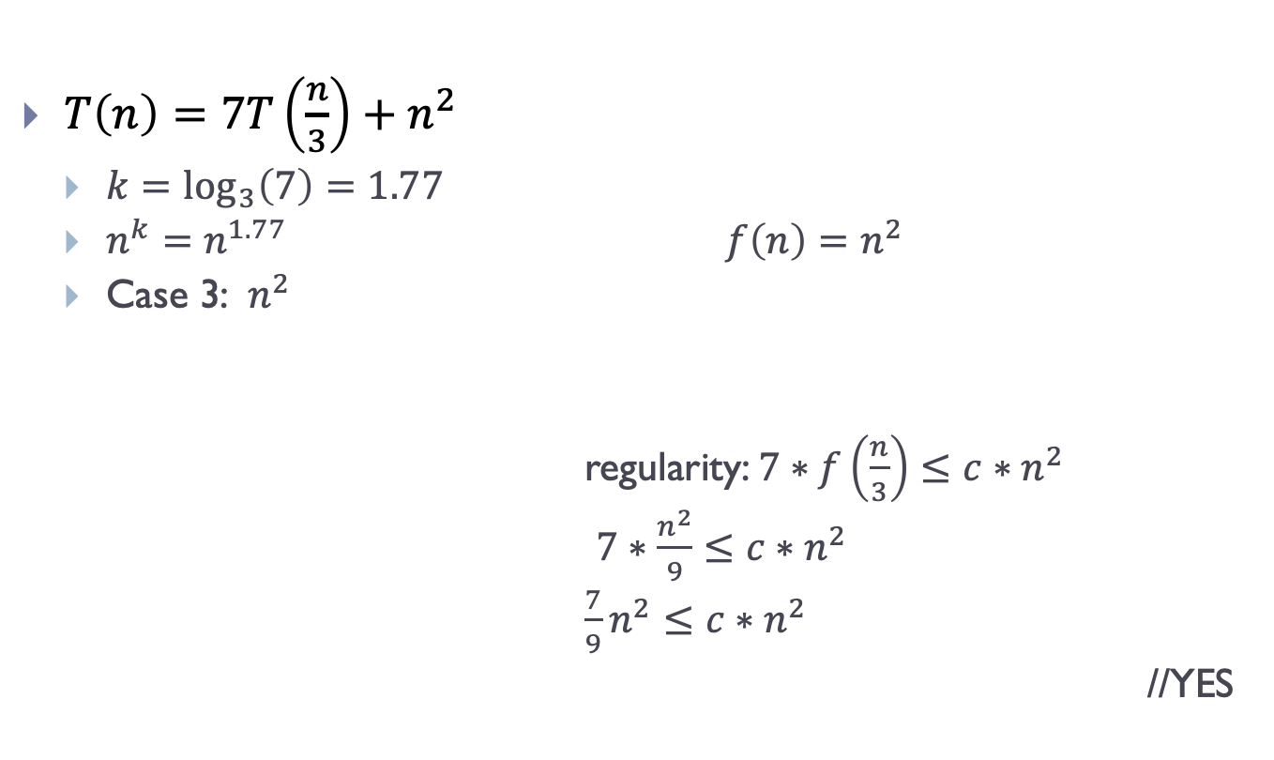
Problems to Try: Solutions
$T\left(n\right)=7T\left(\frac{n}{3}\right)+n^{2}$
$k=\log_{3}\left(7\right)=1.77$
$n^{k}=n^{1.77}$ $f\left(n\right)=n^{2}$
Case 3: $n^{2}$
regularity: $7∗f\left(\frac{n}{3}\right)≤c∗n^{2}$
$7∗\frac{n^{2}}{9}≤c∗n^{2}$
$\frac{7}{9}n^{2}≤c∗n^{2}$
//YES

Slide 32
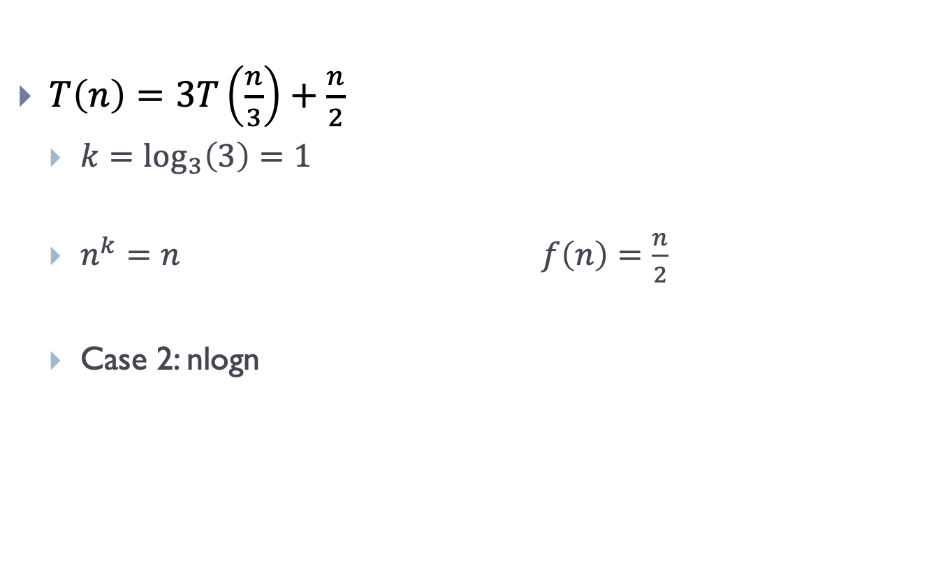
Problems to Try: Solutions
$T\left(n\right)=3T\left(\frac{n}{3}\right)+\frac{n}{2}$
$k=\log_{3}\left(3\right)=1$
$n^{k}=n$ $f\left(n\right)=\frac{n}{2}$
Case 2: nlogn

Slide 33
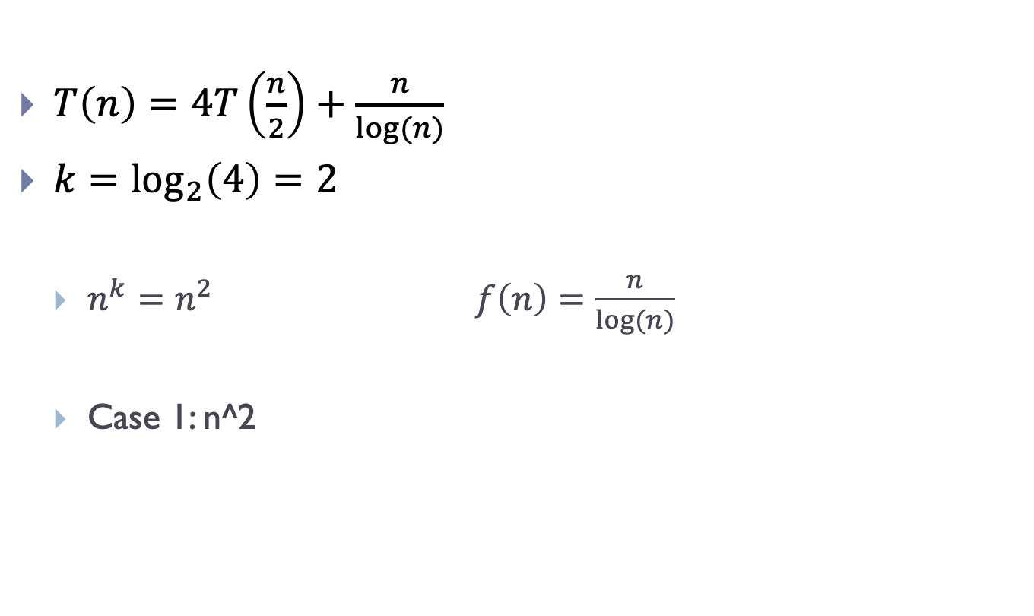
Problems to Try: Solutions
$T\left(n\right)=4T\left(\frac{n}{2}\right)+\frac{n}{log⁡(n)}$
$k=\log_{2}\left(4\right)=2$
$n^{k}=n^{2}$ $f\left(n\right)=\frac{n}{log⁡(n)}$
Case 1: n^2

Slide 34
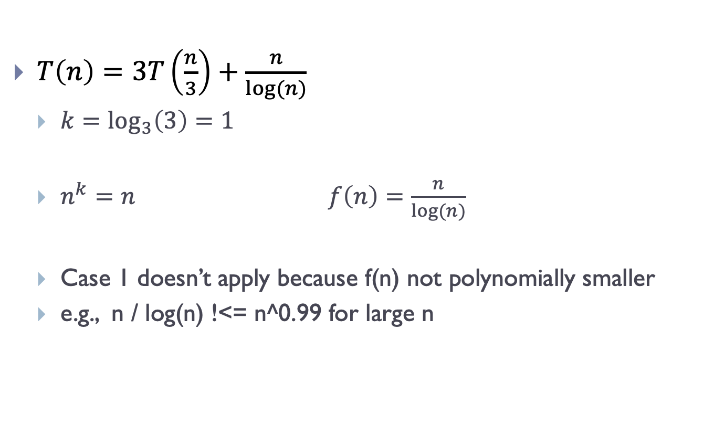
Problems to Try: Solutions
$T\left(n\right)=3T\left(\frac{n}{3}\right)+\frac{n}{log⁡(n)}$
$k=\log_{3}\left(3\right)=1$
$n^{k}=n$ $f\left(n\right)=\frac{n}{log⁡(n)}$
Case 1 doesn’t apply because f(n) not polynomially smaller
e.g., n / log(n) !<= n^0.99 for large n

Slide 35
Solutions
Solutions to problems that aren’t directly in the slides above

Slide 36
Directly Solve (unrolling the recurrence)
For Mergesort:
T(n) = 2*T(n/2) + n
Do it on board →

Slide 37
Directly Solve (unrolling the recurrence)
T(n) = 2*T(n/2) + n
T(n) = 2*[2 * T(n/4) + n/2] + n //unroll one level
= 4*T(n/4) + 2n
= 4*[2*T(n/8) + n/4] + 2n //unroll another level
= 8*T(n/8) + 3n
= 8*[2*T(n/16) + n/8] + 3n //one more time
= 16*T(n/16) + 4n

Slide 38

Directly Solve (unrolling the recurrence)
T(n) = 4*T(n/4) + 2n
= 8*T(n/8) + 3n
= 16*T(n/16) + 4n
= … //what is the general pattern??
= $2^{d}∗T\left(\frac{n}{2^{d}}\right)+dn$ //where d is depth of recursion

Slide 39
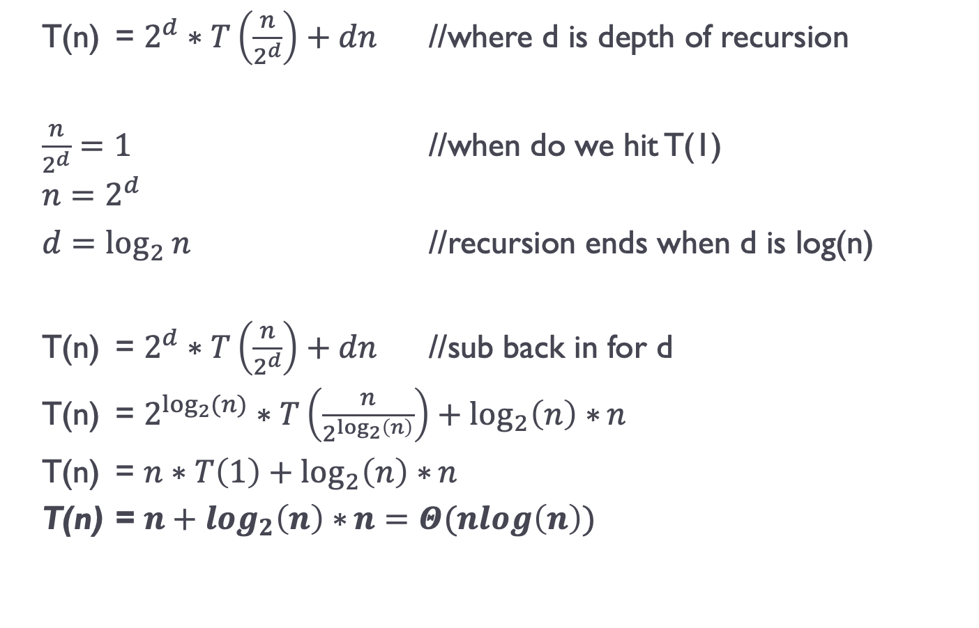
Directly Solve (unrolling the recurrence)
T(n) = $2^{d}∗T\left(\frac{n}{2^{d}}\right)+dn$ //where d is depth of recursion
$\frac{n}{2^{d}}=1$ //when do we hit T(1)
$$n=2^{d}$$
$d=\log_{2}{n}$ //recursion ends when d is log(n)
T(n) = $2^{d}∗T\left(\frac{n}{2^{d}}\right)+dn$ //sub back in for d
T(n) = $2^{\log_{2}{(n)}}∗T\left(\frac{n}{2^{\log_{2}\left(n\right)}}\right)+\log_{2}\left(n\right)∗n$
T(n) = $n∗T\left(1\right)+\log_{2}\left(n\right)∗n$
T(n) = $n+\log_{2}\left(n\right)∗n=Θ(nlog\left(n\right))$

Slide 40
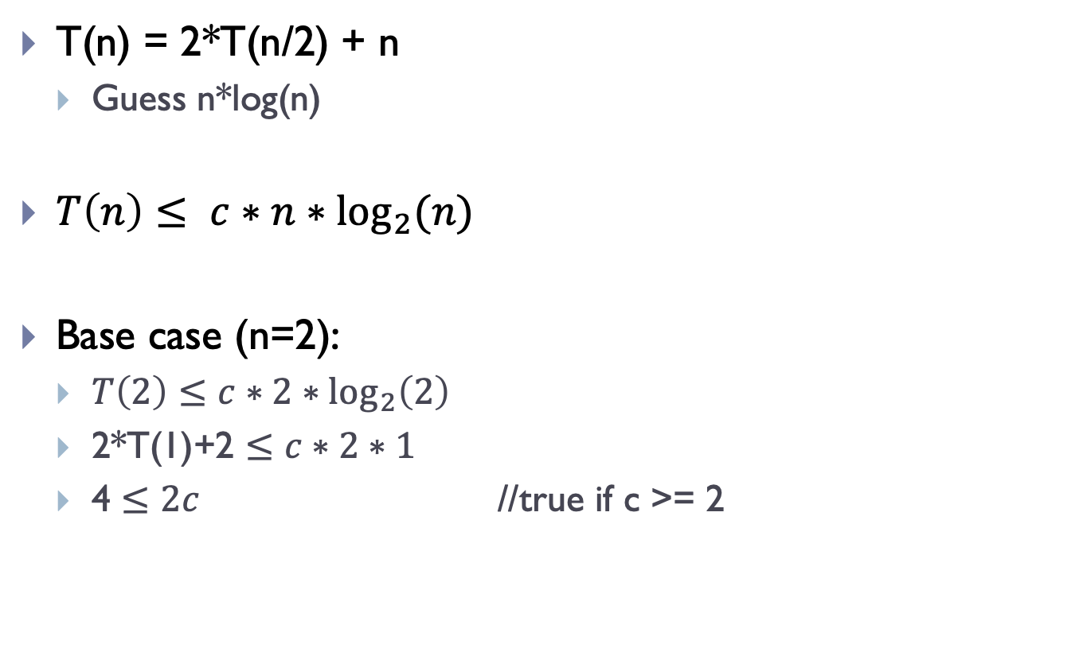
Iteration or Substitution Method
T(n) = 2*T(n/2) + n
Guess n*log(n)
$T\left(n\right)≤ c∗n∗\log_{2}⁡(n)$
Base case (n=2):
$T\left(2\right)≤c∗2∗\log_{2}\left(2\right)$
2*T(1)+2 $≤c∗2∗1$
4 $≤2c$ //true if c >= 2

Slide 41
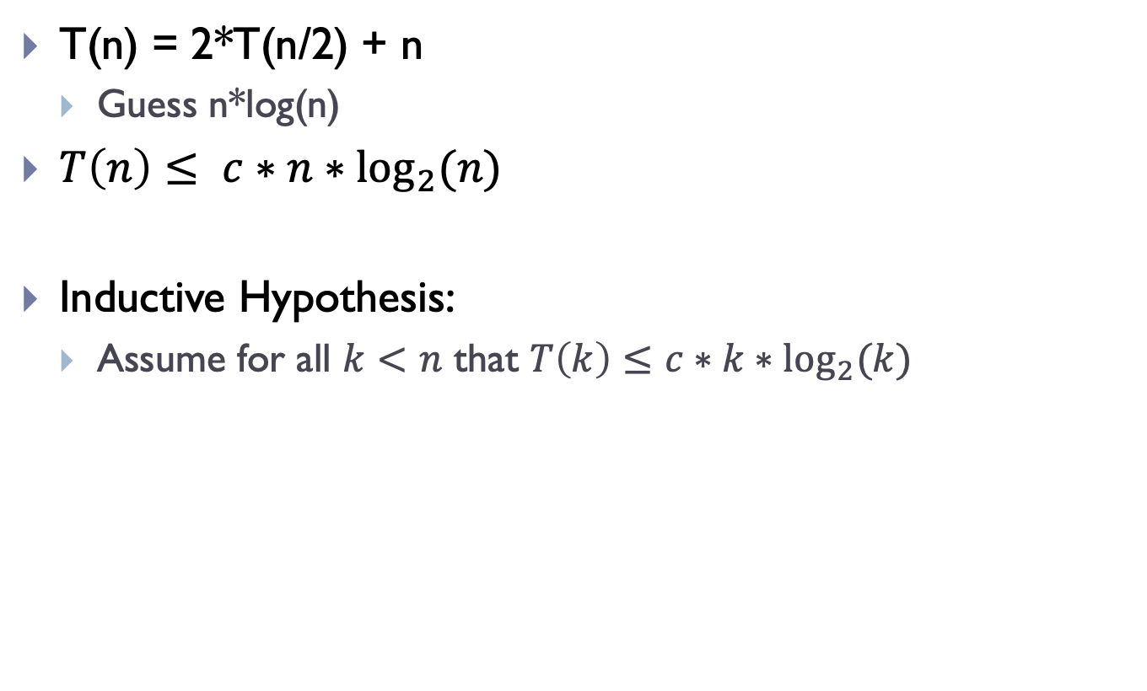
Iteration or Substitution Method
T(n) = 2*T(n/2) + n
Guess n*log(n)
$T\left(n\right)≤ c∗n∗\log_{2}⁡(n)$
Inductive Hypothesis:
Assume for all $k<n$ that $T\left(k\right)≤c∗k∗\log_{2}{(k)}$

Slide 42
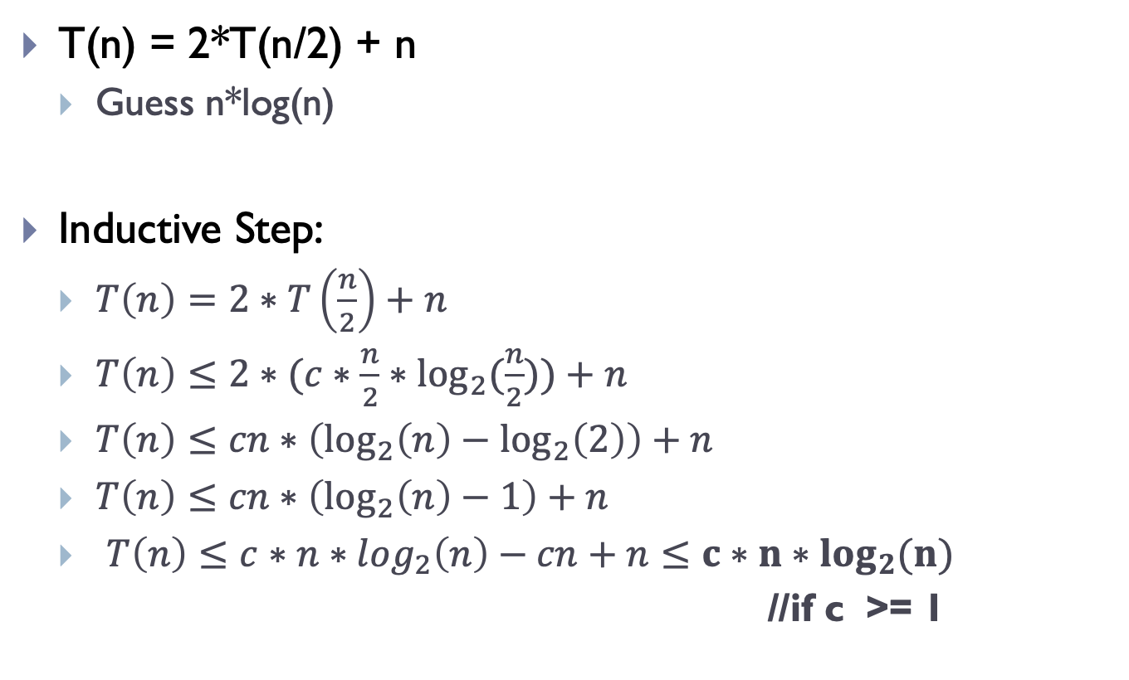
Iteration or Substitution Method
T(n) = 2*T(n/2) + n
Guess n*log(n)
Inductive Step:
$T\left(n\right)=2∗T\left(\frac{n}{2}\right)+n$
$T\left(n\right)≤2∗(c∗\frac{n}{2}∗\log_{2}{(\frac{n}{2}}))+n$
$T\left(n\right)≤cn∗\left(\log_{2}\left(n\right)−\log_{2}\left(2\right)\right)+n$
$T\left(n\right)≤cn∗\left(\log_{2}\left(n\right)−1\right)+n$
$T\left(n\right)≤c∗n∗log_{2}\left(n\right)−cn+n≤c∗n∗\log_{2}{(n)}$
//if c >= 1

Slide 43
Problems to Try
Can you use a theorem on these?
Assume T(1) = 1
T(n) = T(n/2) + lg n
T(n) = T(n/2) + n
T(n) = 2T(n/2) + n (like Mergesort)
T(n) = 2T(n/2) + n lg n

Slide 44
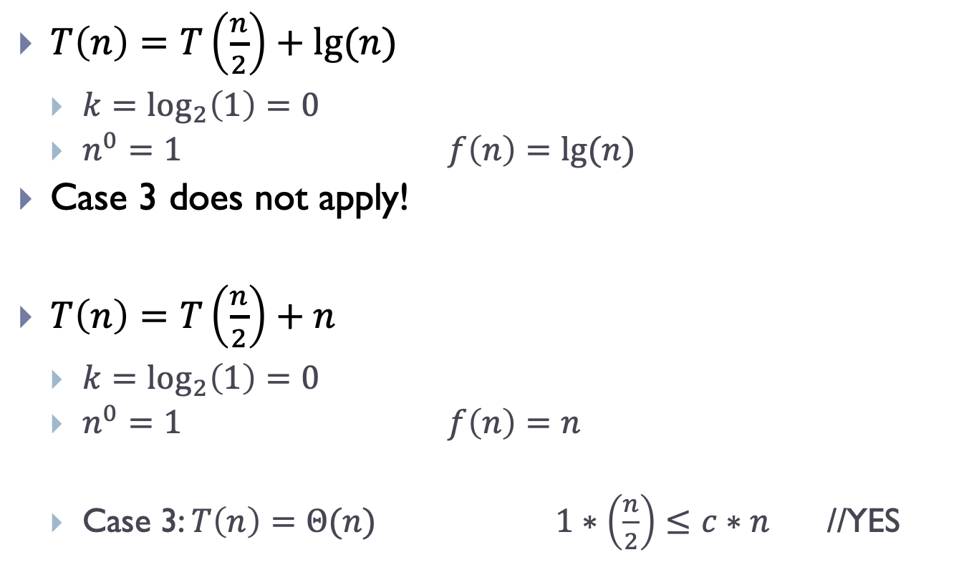
Problems to Try
$T\left(n\right)=T\left(\frac{n}{2}\right)+lg⁡(n)$
$k=\log_{2}\left(1\right)=0$
$n^{0}=1$ $f\left(n\right)=lg⁡(n)$
Case 3 does not apply!
$T\left(n\right)=T\left(\frac{n}{2}\right)+n$
$k=\log_{2}\left(1\right)=0$
$n^{0}=1$ $f\left(n\right)=n$
Case 3: $T\left(n\right)=Θ(n)$ $1∗\left(\frac{n}{2}\right)≤c∗n$ //YES

Slide 45
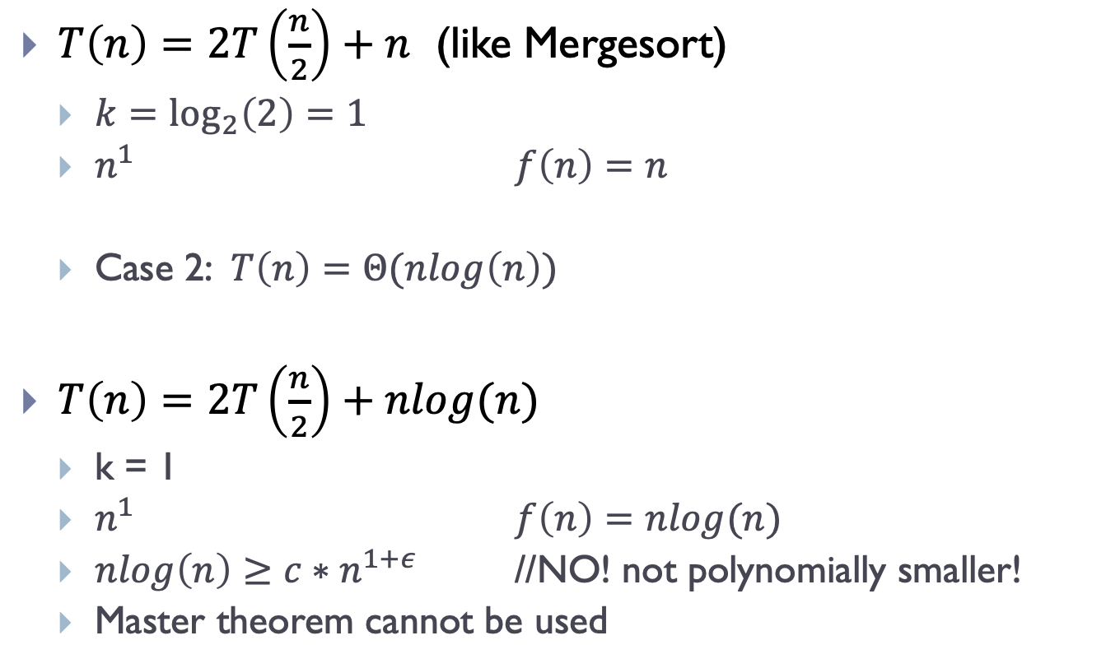
Problems to Try
$T\left(n\right)=2T\left(\frac{n}{2}\right)+n$ (like Mergesort)
$k=\log_{2}\left(2\right)=1$
$n^{1}$ $f\left(n\right)=n$
Case 2: $T\left(n\right)=Θ(nlog\left(n\right))$
$T\left(n\right)=2T\left(\frac{n}{2}\right)+nlog(n)$
k = 1
$n^{1}$ $f\left(n\right)=nlog(n)$
$nlog\left(n\right)≥c∗n^{1+ε}$ //NO! not polynomially smaller!
Master theorem cannot be used

