Slide 1
CS4102 Algorithms Spring 2021 – Floryan and Horton
Module 4, Day 3: Live Session, April 26

Slide 2
Roadmap: Where We’ve Been and Why
Reductions between problems
Why? Can be a practical way of solving a new problem
Coming soon: A proof about one problem’s complexity can be applied to another
Formal definition of a reduction
Examples
Bipartite matching and max network flow
Today: example problems: vertex cover and independent set
Next Lecture: classes of problems: P, NP, NP-Hard, NP-complete

Slide 3
Today: Two graph problems that are similar: minimum vertex cover and maximum independent set
We’ll do a formal proof that these are polynomial-time equivalent
Each reduces to the other
BTW, vertex cover is needed for Basic Written HW, Question 2

Slide 4

Minimum Vertex Cover
Vertex Cover: $C⊆V$ is a vertex cover if every edge in $E$ has one of its endpoints in $C$
Minimum Vertex Cover Problem: Given a graph $G=(V,E)$ find the minimum vertex cover $C$
Vertex cover of size 6
Vertex cover of size 5
Is 5 the smallest? Is there one with 4?

Slide 5
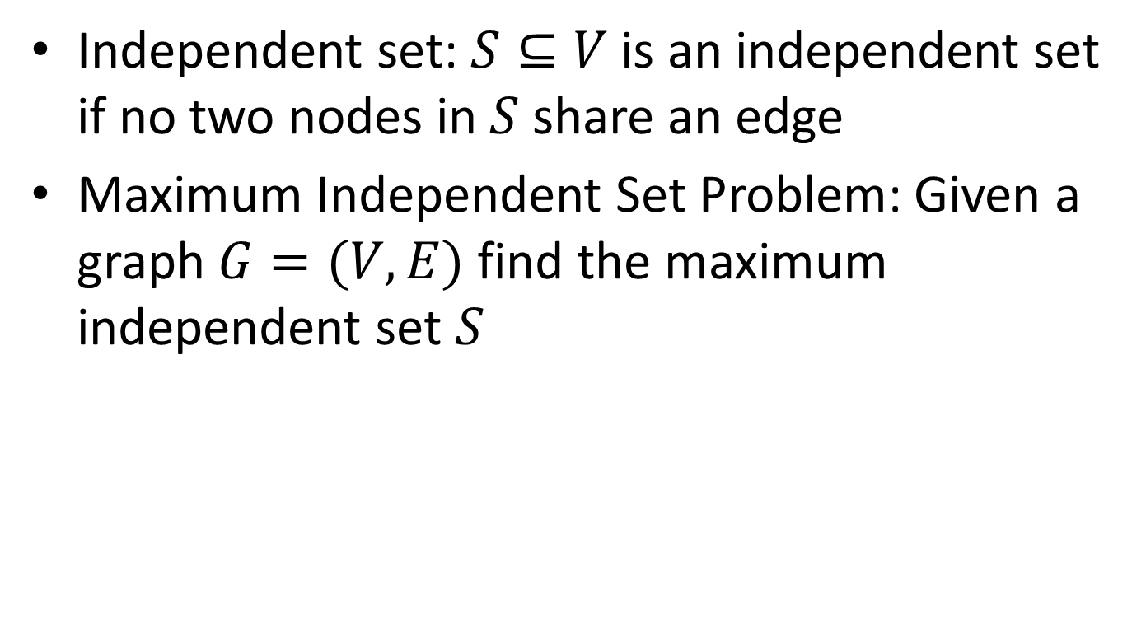
Maximum Independent Set
Independent set: $S⊆V$ is an independent set if no two nodes in $S$ share an edge
Maximum Independent Set Problem: Given a graph $G=(V,E)$ find the maximum independent set $S$

Slide 6
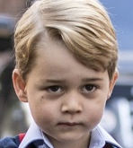



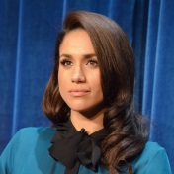






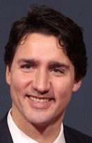
Party Problem
Draw edges between people who don’t get along.
Find the maximum number of people who DO get along.

Slide 7
Example
Independent set of size 6

Slide 8



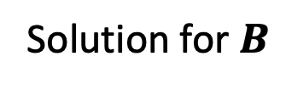





In General: A Reduction
A problem we don’t know how to solve
Reduction
A problem we do know how to solve
$$A$$
Map Instances of problem $A$to Instances of $B$
$$B$$
Using any Algorithm for $B$
Map Solutions of problem $B$to Solutions of $A$
Solution for $A$
Solution for $B$
$$RA$$
$$RB$$

Slide 9
In General: Reduction
Problem we don’t know how to solve
Reduction
Problem we do know how to solve
$$A$$
Map Instances of problem $A$to Instances of $B$
$$B$$
Using any Algorithm for $B$
Map Solutions of problem $B$to Solutions of $A$
For now: we are NOT focusing on an algorithm to solve one of these, just on the reduction!
Solution for $A$
Solution for $B$
$$RA$$
$$RB$$

Slide 10
Polynomial-Time Equivalence
We’ll show a reduction in both directions:
MinVertCov ≤_{p} MaxIndSet
MaxIndSet ≤_{p} MinVertCov
Because they reduce both ways, they are polynomial-time equivalent
(We’ll justify the following claims later.)
If we find a polynomial solution for one, the other is also polynomial
What if we prove an exponential lower-bound for one? Is it possible that the other one could have a polynomial solution?

Slide 11








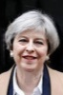
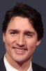
Reduction Idea
$S$ is an independent set of $G$ iff $V−S$ is a vertex cover of $G$
Independent Set
Vertex Cover

Slide 12
Reduction Idea
$S$ is an independent set of $G$ iff $V−S$ is a vertex cover of $G$
Vertex Cover
Independent Set

Slide 13


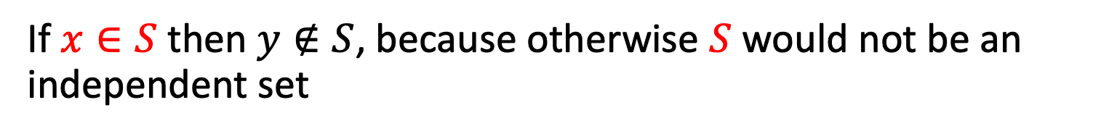
Proof: $⇒$
$S$ is an independent set of $G$ iff $V−S$ is a vertex cover of $G$
Let $S$ be an independent set
Consider any edge $\left(x,y\right)∈E$
If $x∈S$ then $y∉S$, because otherwise $S$ would not be an independent set
Therefore $y∈V−S$, so edge $(x,y)$ is covered by $V−S$

Slide 14
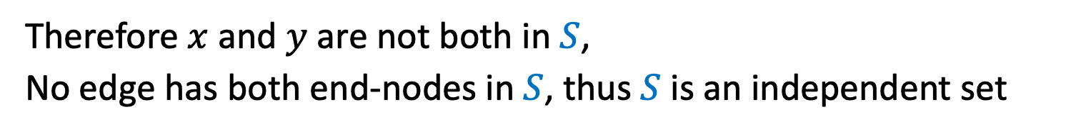


Proof: $⇐$
$S$ is an independent set of $G$ iff $V−S$ is a vertex cover of $G$
Let $V−S$ be a vertex cover
Consider any edge $\left(x,y\right)∈E$
At least one of $x$ and $y$ belong to $V−S$, because $V−S$ is a vertex cover
Therefore $x$ and $y$ are not both in $S$,
No edge has both end-nodes in $S$, thus $S$ is an independent set

Slide 15




























The Reduction: MaxIndSet $≤_{P}$ MinVertCov
MaxIndSet
Reduction
MinVertCov
$$A$$
Do nothing.
$$B$$
$$Θ(1)$$
Algorithm for MinVertCov
Take complement of solution.
Solution for MaxIndSet
$$Θ(V)$$
Solution for $\text{MinVertCov}$
$$RA$$
$$RB$$

Slide 16
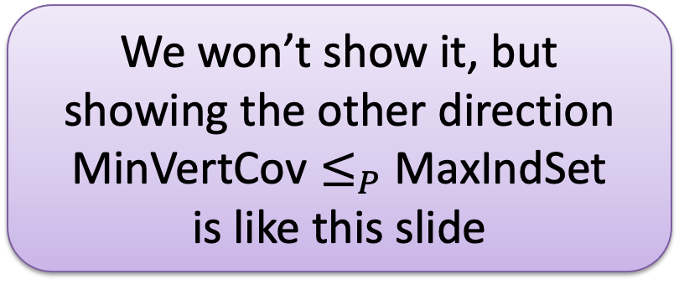

MaxIndSet $≤_{P}$ MinVertCov
MaxIndSet
Reduction
MinVertCov
We won’t show it, but showing the other direction $\text{MinVertCov}≤_{P}$ MaxIndSet is like this slide
$$A$$
Do nothing
$$B$$
$$Θ(1)$$
Yes, it’s kind of trivial, but we just proved it’s a valid reduction. And it’s polynomial.
Algorithm for MinVertCov
Take complement of solution
Solution for MaxIndSet
$$Θ(V)$$
Solution for $\text{MinVertCov}$
$$RA$$
$$RB$$

Slide 17





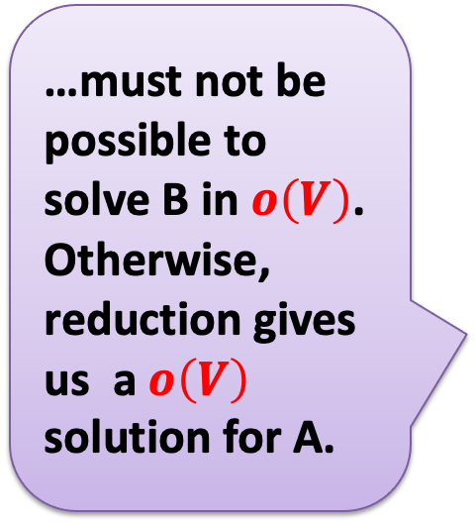

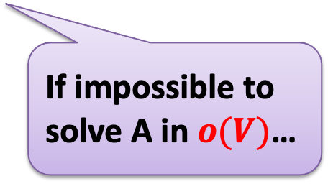
MaxIndSet $≤_{V}$ MinVertCov
…must not be possible to solve B in $o\left(V\right)$. Otherwise, reduction gives us a$o\left(V\right)$ solution for A.
$$A$$
$$B$$
Reduces to, in $Θ(V)$
Problem A
Problem B
can be used to make
Algorithm for B
Algorithm for A
With $Θ\left(V\right)$overhead
If impossible to solve A in $o(V)$…
Given that A $≤_{V}$ B:
If $we prove A$ requires time $Ω(V)$ time, then $B$ must also require $Ω(V)$ time.

Slide 18

MaxIndSet $≤_{P}$ MinVertCov
For two problems A and B, if we show A ≤_{p} B then:
If we prove A is exponential, then B must be exponential.
Otherwise, the polynomial reduction from A to B gives us a polynomial solution to A.
If we find a polynomial algorithm to B, then A is polynomial.
Use the reduction: Convert input for A to input for B, solve B in polynomial time, and you have solution for A (in polynomial time)
Therefore:
MaxIndSet and MinVertCov are either both polynomial, or both exponential

Slide 19
MaxIndSet $≤_{P}$ MinVertCov
MaxIndSet and MinVertCov are either both polynomial, or both exponential
Which is true?
Spoiler alert: We don’t know which is true! (But we think they’re both exponential.)
Both problems are NP-Complete (We’ll explain what that means soon!)

Slide 20
MaxIndSet $≤_{P}$ MinVertCov
MaxIndSet
Reduction
MinVertCov
$$A$$
Do nothing
$$B$$
$$Θ(1)$$
How about we just find a polynomial solution for MinVertCov? ☺
Algorithm for MinVertCov
Take complement of solution
Solution for MaxIndSet
$$Θ(V)$$
Solution for $\text{MinVertCov}$
$$RA$$
$$RB$$

Slide 21
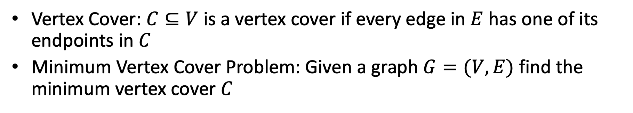
Minimum Vertex Cover
Vertex Cover: $C⊆V$ is a vertex cover if every edge in $E$ has one of its endpoints in $C$
Minimum Vertex Cover Problem: Given a graph $G=(V,E)$ find the minimum vertex cover $C$
Guess what? We can find counterexamples for each of these to show they don’t always work.
Strategy?
How about greedy?
Input Graph
Greedy choice?
(1) Pick remaining vertex of max degree. Remove its incident edges. (2) CLRS 35.1. Pick any edge (u,v). Add both to result. Remove all incident edges for u and v.

Slide 22
Wrapping Up
No one has found a polynomial algorithm for MinVertCov
Summary of what we’ve done
Two new problems: MinVertCov and MaxIndSet
Proved a reduction between them
Examined the consequences of polynomial-time equivalence for two problems with regard to whether they’re polynomial or exponential

