Slide 1
Using DFS for Topological Sorting and Strongly Connected Components
CS 3100: DSA2
Mark Floryan

Slide 2
Module 1: Graphs (cont’d)

Slide 3
Module 1 Topics (Bolded items in this deck)
Graph Representation
What is a graph?
Adjacency Lists vs. Matrices
Traversing Graphs: Breadth First Search
Traversing Graphs: Depth First Search
Topological Sort
Strongly Connected Components

Slide 4
DFS
CLRS Section 22.3 on DFS

Slide 5
Readings
CLRS:
Section 22.3 on DFS
Later/eventually:
Section 22.4 on Topological Sort
Section 22.5 on Strongly Connected Components

Slide 6
DFS: the Strategy in Words
Depth-first search: Strategy
Go as deep as can visiting un-visited nodes
Choose any un-visited vertex when you have a choice
When stuck at a dead-end, backtrack as little as possible
Back up to where you could go to another unvisited vertex
Then continue to go on from that point
Eventually you’ll return to where you started
Reach all vertices? Maybe, maybe not

Slide 7
Observations about the DFS Strategy
Note: we must keep track of what nodes we’ve visited
DFS traverses a subset of E (the set of edges)
Creates a tree, rooted at the starting point: the Depth-first Search Tree (DFS tree)
Each node in the DFS tree has a distance from the start. (We often don’t care about this, but we could.)
At any point, all nodes are either:
Un-discovered
Finished (you backed up from it), or
Discovered (i.e. visited) but not finished
On the path from the current node back to the root
We might back up to it
(Later we’ll call these states: white, black and gray respectively)

Slide 8
DFS Strategy 1: Use a stack
Maintain a Stack (Let’s call it S)
Start at some node ‘s’ (push ‘s’ to S and mark as visited)
While S not empty
Pop a node ‘n’ from S
Process ‘n’ if necessary (depending on problem you are solving)
For each non-visited neighbor of ‘n’
Mark neighbor as visited
Push neighbor onto S
Repeat
Sound familiar? Same as BFS but uses stack instead of queue!
Or we can implement recursively (see next slide)

Slide 9
DFS Strategy #2
Use a recursive function to “visit” each node
Need a non-recursive function to initialize and make first call
Before we look at this code… Important!
Best to think of DFS is a strategy as well as a single, particular bit of pseudo-code
We often add things to DFS code to solve problems
Code shown next is very minimal
”Swiss Army Knife” of graph algorithms?

Slide 10
DFS Strategy 2: Recursion
def dfs(graph, start): //Main loop, inits and calls
visited = {}
dfs_recurse(graph, start, visited)
def dfs_recurse(graph, curnode, visited): //sometimes called dfs_visit()
visited[curnode] = True
alist = graph.get_adjlist(curnode) //get the neighbors of curnode
for v in alist:
if v not in visited:
print(" dfs traversing edge:", curnode, v)
dfs_recurse(graph, v, visited)
# end for-all adjacent vertices
return

Slide 11
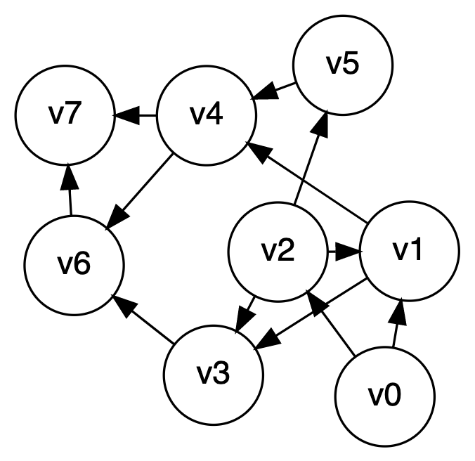
depth-first search, example
Let’s start at V0

Slide 12
DFS to Process all Vertices in a Graph
Purpose: do all required initializations, then call dfs_recurse() as many times as needed to visit all nodes.
May create a DFS forest.
Can be used to count connected components
Could remember which nodes are in each connected component
def dfs_sweep(graph, start):
visited = {}
# loop repeats DFS on every unvisited node
for v in graph:
if v not in visited:
dfs_recurse(graph, v, visited)

Slide 13
Using DFS to Find if a Graphic is Acyclic
Does a graph have a cycle?
DFS is great for this
But, slightly harder if graph is undirected
Use DFS tree: classify edges and nodes as you process them
Nodes:
White: unvisited
Black: done with it, backed up from it (never to return)
Gray: Have reached it; exploring its adjacent nodes; but not done with it

Slide 14
CLRS’s DFS Algorithm (non-recursive part)
DFS(G)
1 for each vertex u in G.V
2 u.color = WHITE
3 u.π = NIL
4 time = 0
5 for each vertex u in G.V
6 if u.color == WHITE // if unseen
7 DFS-VISIT(G, u) // explore paths out of u
// we called this dfs_sweep() earlier

Slide 15
CLRS’s DFS Algorithm (recursive part)
// we called this dfs_recurse() earlier
DFS-VISIT(G, u)
1 time = time + 1 // white vertex u has just been discovered
2 u.d = time // discovery time of u
3 u.color = GRAY // mark as seen
4 for each v in G.Adj[u] // explore edge (u, v)
5 if v.color == WHITE // if unseen
6 v.π = u
7 DFS-VISIT(G, v) // explore paths out of v (i.e., go “deeper”)
8 u.color = BLACK // u is finished
9 time = time + 1
10 u.f = time // finish time of u

Slide 16
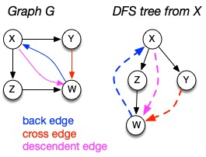
Depth-first search tree
As DFS traverses a digraph, edges classified as:
tree edge, back edge, descendant edge, or cross edge
If graph undirected, do we have all 4 types?

Slide 17
Using Non-Tree Edges to Identify Cycles
From the previous graph, note that:
Back edges (indicates a cycle)
dfs_recurse() sees a vertex that is gray
This back edge goes back up the DFS tree to a vertex that is on the path from the current node to the root
Cross Edges and Descendant Edges (not cycles)
dfs_recurse() sees a vertex that is black
Descendant edge: connects current node to a descendant in the DFS tree
Cross edge: connects current node to a node in another subtree – not a descendant of current node

Slide 18
Non-tree Edges in DFS
Question 1: Finding back edges for an undirected graph is not quite this simple:
The parent node of the current node is gray
Not a cycle, is it? It’s the same edge you just traversed
Question: how would you modify our code to recognize this?
Question 2:
In digraph, how could you modify the code to distinguish cross edges from descendant edges?
Need to record the “time” at which a node was discovered (set to “gray”) and finished (set to “black”)
Also, have a “time counter”, say, ctr
Set d[v] = ctr++ as discovery time
Set f[v] = ctr++ as finish time

Slide 19
Time Complexity of DFS
For a digraph having V vertices and E edges
Each edge is processed once in the while loop of dfs_recurse() for a cost of θ(E)
Think about adjacency list data structure.
Traverse each list exactly once. (Never back up)
There are a total of 2*E nodes in all the lists
The non-recursive dfs_sweep() algorithm will do θ(V) work even if there are no edges in the graph
Thus over all time-complexity is θ(V+E)
Remember: this means the larger of the two values
Note: This is considered “linear” for graphs since there are two size parameters for graphs.
Extra space is used for color array.
Space complexity is θ(V)

Slide 20
depth-first search, example
Let’s start at V0

Slide 21
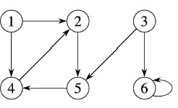
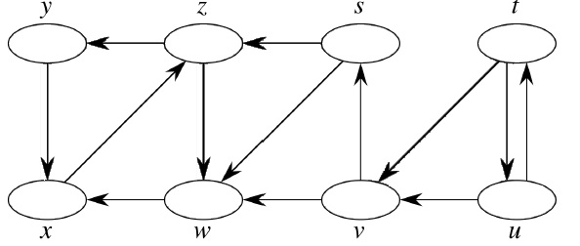
DFS Examples
Source vertex: 1
Source vertex: s

Slide 22
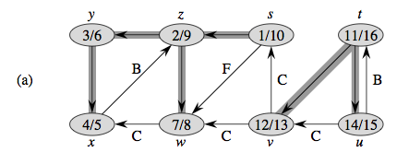
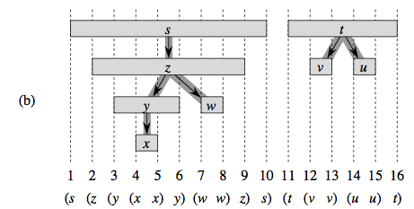
Properties of DFS Search, DFS Trees
“Parentheses Structure”. See pp. 606-609

Slide 23
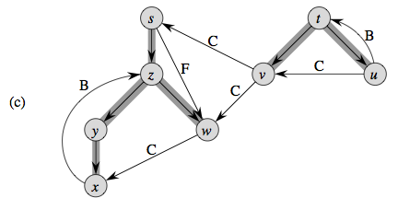
Properties of DFS Search, DFS Trees
Edge Classification. See pp. 606-609

Slide 24
Topological Sorting
Readings: CLRS 22.4

Slide 25
Topological Sort
Given a directed acyclic graph, construct a linear ordering of the vertices such that if there is an edge from u to v, then u appears before v in the ordering.
One valid topological sort is:
V1 V6 V8 V3 V2 V7 V4 V5

Slide 26
Topological Sort
What are allowable orderings I can take all these CS classes?
Note there are many possible orderings
Unlike sorting a list

Slide 27
Getting Dressed
Underwear
Socks
Watch
Pants
Shoes
Shirt
Belt
Tie
Jacket

Slide 28
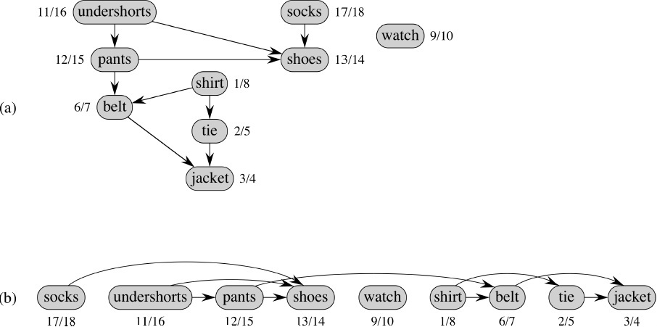
We Can Use DFS and Finish Times
Topologically sorted vertices appear in reverse order of their finish times!
This is the same graph with a different layout.

Slide 29
Topological Sort Algorithm
Strategy: modify the two DFS functions so that they order nodes by finish-time in reverse order. This slide: DFS “Sweep”.
DFS(G)
0 toposort-list = [ ] // empty list
1 for each vertex u in G.V
2 u.color = WHITE
3 u.π = NIL
4 time = 0
5 for each vertex u in G.V
6 if u.color == WHITE // if unseen
DFS-VISIT(G, u) // explore paths out of u
8 // toposort-list contains the result

Slide 30
Topological Sort Algorithm
DFS-VISIT(G, u)
1 time = time + 1 // white vertex u has just been discovered
2 u.d = time // discovery time of u
3 u.color = GRAY // mark as seen
4 for each v in G.Adj[u] // explore edge (u, v)
5 if v.color == WHITE // if unseen
6 v.π = u
7 DFS-VISIT(G, v) // explore paths out of v (i.e., go “deeper”)
8 u.color = BLACK // u is finished
9 time = time + 1
10 u.f = time // finish time of u
11 toposort-list.prepend(u)

Slide 31
Forward vs. Reverse
Topological sort is a type of sort
Implies an ordering
Can sort backwards, of course
Forward topological order
If edge vw in graph, then topo[v] < topo[w]
Reverse topological order
If edge vw in graph, then topo[v] > topo[w]
And, every directed graph has a transpose, which means… (see next slide)

Slide 32
What’s an Edge Mean?
What does our graph model?
Edge uv means do u first, then v. Or, …
Edge uv means task u depends on v (i.e. v must be done first)
The latter is called a dependency graph
“forward in time” vs. “depend on this one”
Big deal? No, we can order vertices in reverse topological order if needed
Underwear
Underwear
Shoes
Shoes
Pants
Pants

Slide 33
Strongly Connected Components in a Digraph
Readings: CLRS 22.5, but you can ignore the proof-y parts

Slide 34
Strongly Connected Components (SCCs)
In a digraph, Strongly Connected Components (SCCs) are subgraphs where all vertices in each SCC are reachable from one another
Thus vertices in an SCC are on a directed cycle
Any vertex not on a directed cycle is an SCC all by itself
Common need: decompose a digraph into its SCCs
Perhaps then operate on each, combine results based on connections between SCCs

Slide 35
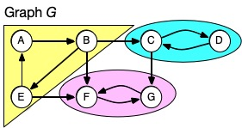
SCC Example
Example: digraph below has 3 SCCs
Note here each SCC has a cycle. (Possible to have a single-node SCC.)
Note connections to other SCCs, but no path leaves a SCC and comes back
Note there’s a unique set of SCCs for a given digraph

Slide 36
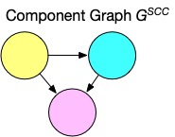
Component Graph
Sometimes for a problem it’s useful to consider digraph G’s component graph, G^{SCC}
It’s like we ”collapse” each SCC into one node
Might need a topological ordering between SCCs

Slide 37
How to Decompose Graph into SCCs
Several algorithms do this using DFS
We’ll use CLRS’s choice (by Kosaraju and Sharir)
Algorithm is:
Call DFS-sweep(G) to find finishing times u.f for each vertex u in G.
Compute G^{T}, the transpose of diagraph G.
(Reminder: transpose means same nodes, edges reversed.)
Call DFS-sweep(G^{T}) but do the recursive calls on nodes in the order of decreasing u.f. (Start with the vertex with largest finish time,…)
The DFS forest produced in Step 3 is the set of SCCs

Slide 38
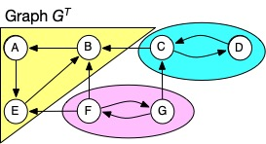
Why Do We Care about the Transpose?
If we call DFS on a node in an SCC, it will visit all nodes in that SCC
But it could leave the SCC and find other nodes ☹
Could we prevent that somehow?
Note that a digraph and its transpose have the same SCCs
Maybe we can use the fact that edge-directions are reversed in G^{T} to stop DFS from leaving an SCC?
But this depends on the order you choose vertices to do DFS-sweep() in G^{T}

Slide 39
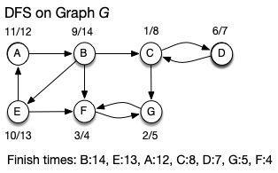
Why Do We Care About Finish Times?
Our algorithm first finds DFS finish times in G
Then calls recursive DFS in transpose from vertex with largest finish time (here, B)
Reversed edges in G^{T} stop it visiting nodes in other SCCs

Slide 40
Why Do We Care About Finish Times?
After recursive DFS in transpose finds SCC containing B, next DFS will start from C
Nodes in previously found SCC(s) have been visited
Reversed edges in G^{T} stop it visiting nodes in SCCs yet to be found

Slide 41
Ties to Topological Sorting
Formal proof of correctness in CLRS, but hopefully from previous slides you’re convinced it works!
Note how the use of finish times makes this seem like topological sort. And it is, if you think of topological ordering for G^{SCC}
Cycles in G, but no cycles in so we could sort that
Topological sort controls the order we do things, and DFS finds all the reachable nodes in an SCC

Slide 42
Final Thoughts
There are many interesting problems involving digraphs and DAGs
They can model real-world situations
Dependencies, network flows, …
DFS is often a valuable strategy to tackle such problems
Not interested in back-edges, since DAGs are acyclic
Ordering, reachability from DFS can be useful

