Slide 1
More Divide and Conquer: Quicksort and Closest Pair of Points
CS 3100: DSA 2
Mark Floryan

Slide 2
Closest Pair of Points
Readings: CLRS 33.4

Slide 3
Closest Pair of Points in 2D Space
Given:
A list of points
Return:
Distance of the pair of points that are closest together (or possibly the pair too)
2
1
5
4
6
7
3
8

Slide 4


Closest Pair of Points: Naïve
Given:
A list of points
Return:
Distance of the closest pair of points
2
1
5
4
6
$$O(n^{2})$$
Naive Algorithm:
Test every pair of points, return the closest.
7
3
We can do better!
8
$$Θ(n\log{n)}$$

Slide 5
Closest Pair of Points: D&C
Divide:
How?
2
At median x coordinate
1
Conquer:
5
4
6
Combine:
7
3
8
5

Slide 6
Closest Pair of Points: D&C
Divide:
2
At median x coordinate
1
Conquer:
5
4
Recursively find closest pairs from Left and Right
6
Combine:
7
3
8
LeftPoints
RightPoints
6

Slide 7
Closest Pair of Points: D&C
Divide:
2
At median x coordinate
1
Conquer:
5
4
Recursively find closest pairs from Left and Right
6
Combine:
7
Return min of Left and Right pairs
?
Problem?
3
8
LeftPoints
RightPoints
7

Slide 8
Closest Pair of Points: D&C
Combine:
2 Cases:
1
2
1. Closest Pair is completely in Left or Right
5
4
6
2. Closest Pair Spans our “Cut”
7
Need to test points across the cut
?
3
8
LeftPoints
RightPoints
8

Slide 9



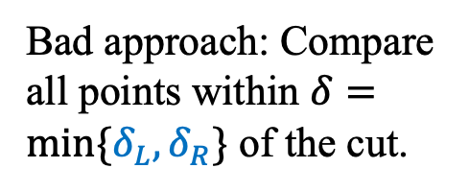
Spanning the Cut
Define “runway” or “strip” along the cut.
Combine:
2. Closest Pair Spanned our “Cut”
1
2
$$δ_{L}$$
Need to test points across the cut.
5
$$δ_{R}$$
4
6
Bad approach: Compare all points within $δ=min⁡\{δ_{L}, δ_{R}\}$ of the cut.
7
How many are there?
3
$$2δ$$
8
LeftPoints
RightPoints
9

Slide 10



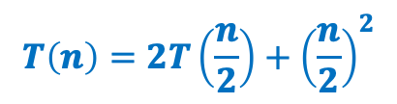
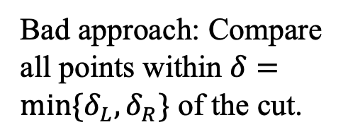
Spanning the Cut
Define “runway” or “strip” along the cut.
Combine:
2. Closest Pair Spanned our “Cut”
1
2
$$δ_{L}$$
Need to test points across the cut
4
5
$$δ_{R}$$
Bad approach: Compare all points within $δ=min⁡\{δ_{L}, δ_{R}\}$ of the cut.
6
7
How many are there?
$$T\left(n\right)=2T\left(\frac{n}{2}\right)+{\left(\frac{n}{2}\right)}^{2}$$
3
$$2δ$$
8
$$=Θ\left(n^{2}\right)$$
LeftPoints
RightPoints
10

Slide 11
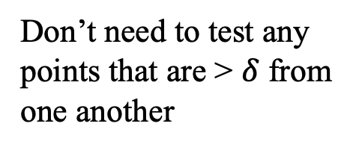
Spanning the Cut
Combine:
2. Closest Pair Spanned our “Cut”
1
2
$$δ_{L}$$
Need to test points across the cut
4
5
$$δ_{R}$$
We don’t need to test all pairs!
6
7
Don’t need to test any points that are > $δ$ from one another
3
$$2δ$$
8
LeftPoints
RightPoints
11

Slide 12



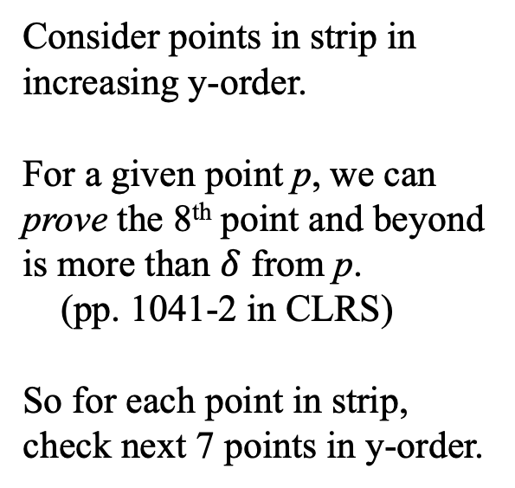

Spanning the Cut
Combine:
1
2
2. Closest Pair Spanned our “Cut”
$$δ_{L}$$
Consider points in strip in increasing y-order.
For a given point p, we can prove the 8th point and beyond is more than $δ$ from p.
(pp. 1041-2 in CLRS)
So for each point in strip, check next 7 points in y-order.
4
5
$$δ_{R}$$
Only check next 7
6
7
3
$$2δ$$
8
LeftPoints
RightPoints
$$Θ\left(n\right) Better!$$
12

Slide 13
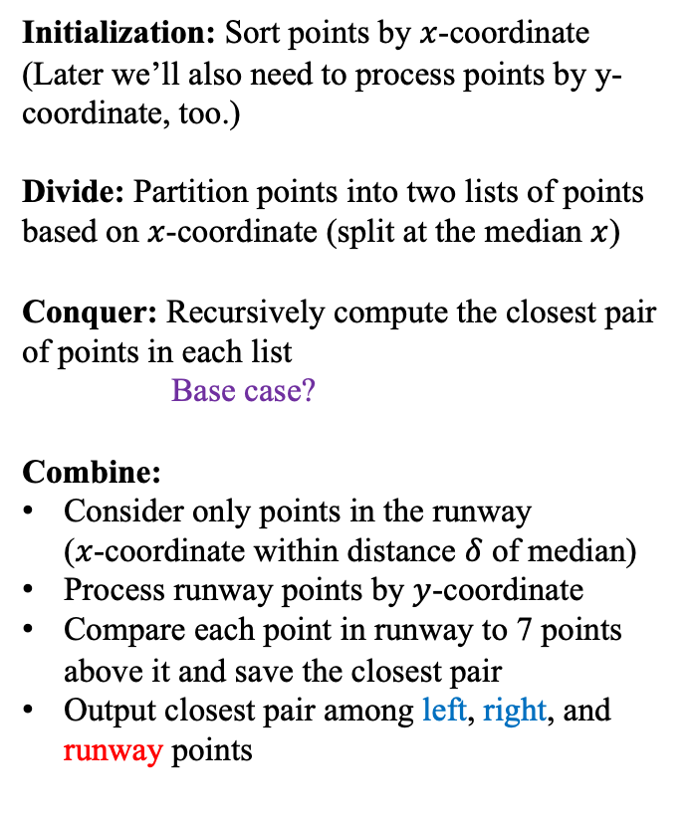
Closest Pair of Points: Divide and Conquer
Initialization: Sort points by $x$-coordinate
(Later we’ll also need to process points by y-coordinate, too.)
Divide: Partition points into two lists of points based on $x$-coordinate (split at the median $x$)
Conquer: Recursively compute the closest pair of points in each list
Base case?
Combine:
Consider only points in the runway ($x$-coordinate within distance $δ$ of median)
Process runway points by $y$-coordinate
Compare each point in runway to 7 points above it and save the closest pair
Output closest pair among left, right, and runway points
1
2
5
4
6
7
?
3
8
LeftPoints
RightPoints

Slide 14



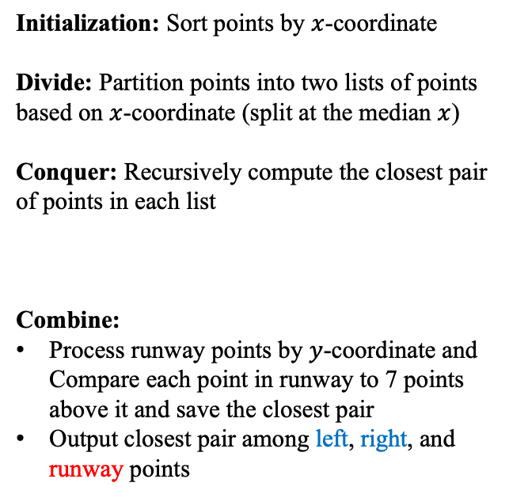

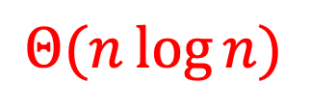

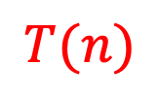


Closest Pair of Points: Divide and Conquer
What is the running time?
$$Θ\left(n\log{n}\right)$$
Initialization: Sort points by $x$-coordinate
Divide: Partition points into two lists of points based on $x$-coordinate (split at the median $x$)
Conquer: Recursively compute the closest pair of points in each list
Combine:
Process runway points by $y$-coordinate and Compare each point in runway to 7 points above it and save the closest pair
Output closest pair among left, right, and runway points
$$Θ(n\log{n})$$
$$Θ\left(1\right)$$
$$2T(n/2)$$
$$T(n)$$
$$T(n)=2T(n/2)+Θ(n)$$
$$Θ\left(n\right)$$
Case 2 of Master’s Theorem
$$T\left(n\right)=Θ\left(n\log{n}\right)$$
$$Θ\left(1\right)$$

Slide 15
Summary for Closest Pair of Points
Comparing all pairs is a brute-force fail
Except for small inputs
Divide and conquer a big improvement
Needed to find an efficient way for part of the combine step
Geometry came through for us here!
Only needed to look at constant number of points for each point in the strip
Implementation subtleties
Don’t want to sort the strip by y-coordinate in each recursive call
In initialization, create an “index” that lets you process all points in order by y-coordinate
(There are other ways to address this.)

