Slide 1
Greedy Algorithms Knapsack Problems
CS 3100 – DSA2
Mark Floryan

Slide 2
CLRS Readings
Chapter 16, Greedy Algorithms
Intro, page 414
Section 16.1, Activity Selection

Slide 3
Activity Selection

Slide 4
Activity-Selection Problem
Problem: You and your classmates go on Semester at Sea
Many exciting activities each morning
Each starting and ending at different times
Maximize your “education” by doing as many as possible
This problem: they’re all equally good!
Another problem: they have weights (we need DP for that one)
Welcome to the activity selection problem
Also called interval scheduling

Slide 5
The Activities!
Id | Start | End | Activity
1 | 9:00 | 10:45 | Fractals, Recursion and Crayolas
2 | 9:15 | 10:15 | Tropical Drink Engineering with Prof. Bloomfield
3 | 9:30 | 12:30 | Managing Keyboard Fatigue with Swedish Massage
4 | 9:45 | 10:30 | Applied ChemE: Suntan Oil or Lotion?
5 | 9:45 | 11:15 | Optimization, Greedy Algorithms, and the Buffet Line
6 | 10:15 | 11:00 | Hydrodynamics and Surfing
7 | 10:15 | 11:30 | Computational Genetics and Infectious Diseases
8 | 10:30 | 11:45 | Turing Award Speech Karaoke
9 | 11:00 | 12:00 | Pool Tanning for Engineers
10 | 11:00 | 12:15 | Mechanics, Dynamics and Shuffleboard Physics
11 | 12:00 | 12:45 | Discrete Math Applications in Gambling

Slide 6
Generalizing Start, End
Id | Start | End | Len | Activity
1 | 0 | 6 | 7 | Fractals, Recursion and Crayolas
2 | 1 | 4 | 4 | Tropical Drink Engineering with Prof. Bloomfield
3 | 2 | 13 | 12 | Managing Keyboard Fatigue with Swedish Massage
4 | 3 | 5 | 3 | Applied ChemE: Suntan Oil or Lotion?
5 | 3 | 8 | 6 | Optimization, Greedy Algorithms, and the Buffet Line
6 | 5 | 7 | 3 | Hydrodynamics and Surfing
7 | 5 | 9 | 5 | Computational Genetics and Infectious Diseases
8 | 6 | 10 | 5 | Turing Award Speech Karaoke
9 | 8 | 11 | 4 | Pool Tanning for Engineers
10 | 8 | 12 | 5 | Mechanics, Dynamics and Shuffleboard Physics
11 | 12 | 14 | 3 | Discrete Math Applications in Gambling

Slide 7
Greedy Approach
Select a first item.
Eliminate items that are incompatible with that item. (I.e. they overlap, not part of a feasible solution)
Apply the greedy choice (AKA selection function) to pick the next item.
Go to Step 2
What is a good greedy choice for selecting next item?

Slide 8
Some Possibilities
Maybe pick the next compatible activity that starts earliest?
“Compatible” here means “doesn’t overlap”
Or, pick the shortest one?
Or, pick the one that has the least conflicts (i.e. overlaps)?
Or…?

Slide 9
Activity-Selection
Formally:
Given a set S of n activities
s_{i} = start time of activity i
f_{i} = finish time of activity i
Find max-size subset A of compatible activities
3
4
6
2
1
5
Assume (wlog) that f₁ ≤ f₂ ≤ … ≤ f_{n}

Slide 10
Activity Selection: A Greedy Algorithm
The algorithm using the best greedy choice is simple:
Sort the activities by finish time
Schedule the first activity
Then schedule the next activity in sorted list which starts after previous activity finishes
Repeat until no more activities
Or in simpler terms:
Always pick the compatible activity that finishes earliest

Slide 11
Optimal Substructure Property
Remember?
Detailed discussion on p. 379 (in chapter on Dynamic Programming)
If A is an optimal solution to a problem, then the components of A are optimal solutions to subproblems
Reminder: Example 1, Shortest Path
Say P is min-length path from CHO to LA and includes DAL
Let P₁ be component of P from CHO to DAL, and P₂ be component of P from DAL to LA
P₁ must be shortest path from CHO to DAL, and P₂ must be shortest path from DAL to LA
Why is this true? Can you prove it? Yes, by contradiction.
Do it! In-class exercise

Slide 12
Activity Selection: Optimal Substructure
Let k be the minimum activity in the solution A (i.e., the one with the earliest finish time). Then A - {k} is an optimal solution to S’ = {i ∈ S: s_{i} ≥ f_{k}}
In words: once activity #1 is selected, the problem reduces to finding an optimal solution for activity-selection over activities in S compatible with activity #1
Proof: if we could find optimal solution B’ to S’ with |B| > |A - {k}|,
Then B U {k} is compatible
And |B U {k}| > |A| -- contradiction! We said A is the overall best.
Note: book’s discussion on p. 416 is essentially this, but doesn’t assume we choose the 1st activity

Slide 13
Back to Semester at Sea…
Id | Start | End | Len | Activity
2 | 1 | 4 | 4 | Tropical Drink Engineering with Prof. Bloomfield
4 | 3 | 5 | 3 | Applied ChemE: Suntan Oil or Lotion?
1 | 0 | 6 | 7 | Fractals, Recursion and Crayolas
6 | 5 | 7 | 3 | Hydrodynamics and Surfing
5 | 3 | 8 | 6 | Optimization, Greedy Algorithms, and the Buffet Line
7 | 5 | 9 | 5 | Computational Genetics and Infectious Diseases
8 | 6 | 10 | 5 | Turing Award Speech Karaoke
9 | 8 | 11 | 4 | Pool Tanning for Engineers
10 | 8 | 12 | 5 | Mechanics, Dynamics and Shuffleboard Physics
3 | 2 | 13 | 12 | Managing Keyboard Fatigue with Swedish Massage
11 | 12 | 14 | 3 | Discrete Math Applications in Gambling
Solution: 2, 6, 9, 11

Slide 14
Visualizing these Activities
ID | Start | End |  | 0 | 1 | 2 | 3 | 4 | 5 | 6 | 7 | 8 | 9 | 10 | 11 | 12 | 13 | 14
1 | 0 | 6
2 | 1 | 4
3 | 2 | 13
4 | 3 | 5
5 | 3 | 8
6 | 5 | 7
7 | 5 | 9
8 | 6 | 10
9 | 8 | 11
10 | 8 | 12
11 | 12 | 14

Slide 15
Visualizing these Activities in Solution
ID | Start | End |  | 0 | 1 | 2 | 3 | 4 | 5 | 6 | 7 | 8 | 9 | 10 | 11 | 12 | 13 | 14
1 | 0 | 6
2 | 1 | 4
3 | 2 | 13
4 | 3 | 5
5 | 3 | 8
6 | 5 | 7
7 | 5 | 9
8 | 6 | 10
9 | 8 | 11
10 | 8 | 12
11 | 12 | 14

Slide 16
Sorted, Then Showing Selection and Incompatibilities
ID | Start | End |  | 0 | 1 | 2 | 3 | 4 | 5 | 6 | 7 | 8 | 9 | 10 | 11 | 12 | 13 | 14
2 | 1 | 4
4 | 3 | 5
1 | 0 | 6
6 | 5 | 7
5 | 3 | 8
7 | 5 | 9
8 | 6 | 10
9 | 8 | 11
10 | 8 | 12
3 | 2 | 13
11 | 12 | 14
Select solid-colored item,
Eliminates activities X’d
out of same color

Slide 17
Book’s Recursive Greedy Algorithm
RECURSIVE-ACTIVITY-SELECTOR(s, f, k, n)
1 m = k + 1 // start with the activity after the last added activity
2 while m ≤ n and s[m] < f[k] // find the first activity in S_{k} to finish
3 m = m + 1
4 if m ≤ n
5 return {a_{m}} U RECURSIVE-ACTIVITY-SELECTOR(s, f, m, n)
6 else return Ø
Add dummy activity a₀ with f₀ = 0, so that sub-problem S₀ is entire set of activities S
Initial call: RECURSIVE-ACTIVITY-SELECTOR(s, f, 0, n)
Run time is θ(n), assuming the activities are already sorted by finish times

Slide 18
Non-recursive algorithm
greedy-interval (s, f)
n = s.length
A = {a₁}
k = 1 # last added
for m = 2 to n
if s[m] ≥ f[k]
A = A U {a_{m}}
k = m
return A
s is an array of the intervals’ start times
f is an array of the intervals’ finish times, sorted
A is the array of the intervals to schedule
How long does this take?

Slide 20
Does Greedy Always Find Optimal Solution?
Yes, we can prove that the greedy algorithm always “stays ahead”!

Slide 21
Does Greedy Always Find Optimal Solution?
Yes, we can prove that the greedy algorithm always “stays ahead”!
How?
Overall idea: Show the i’th interval algorithm chooses always ends earlier than optimal solution

Slide 22
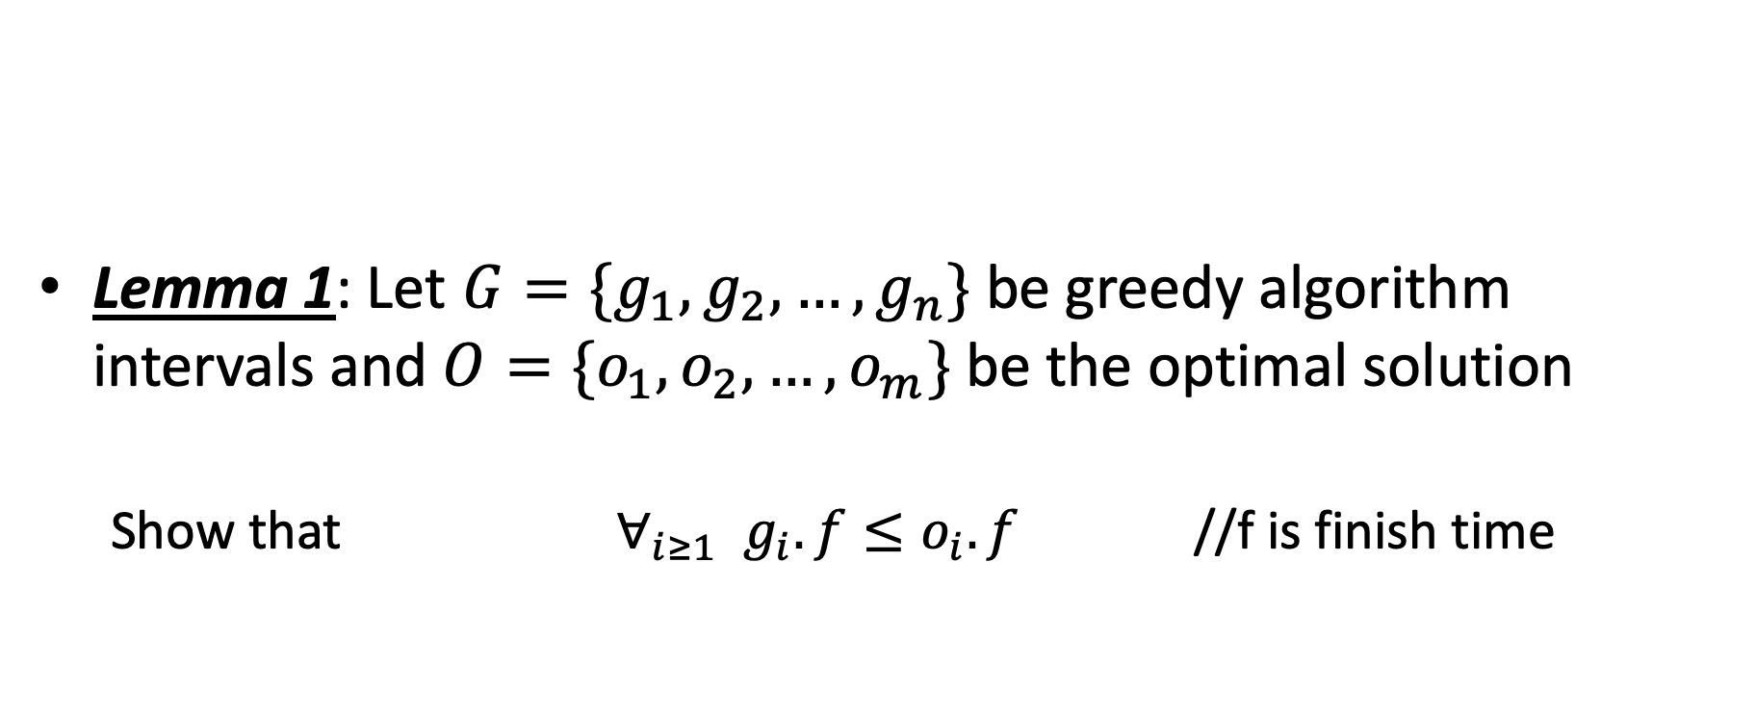
Does Greedy Always Find Optimal Solution?
Lemma 1: Let $G=\{g_{1},g_{2},…,g_{n}\}$ be greedy algorithm intervals and $O=\{o_{1},o_{2},…, o_{m}\}$ be the optimal solution
Show that $∀_{i≥1}{ g}_{i}.f≤o_{i}.f$ //f is finish time

Slide 23
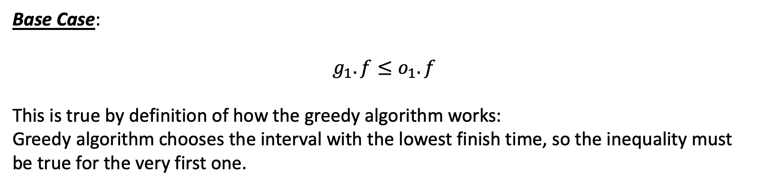
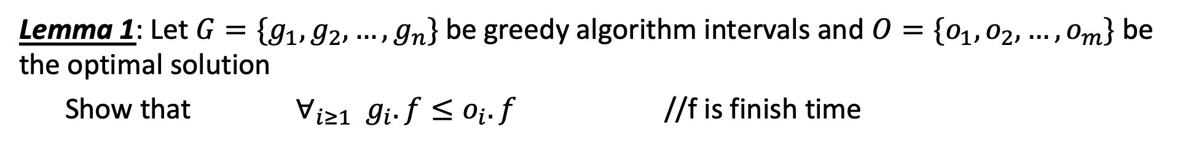
Does Greedy Always Find Optimal Solution?
Lemma 1: Let $G=\{g_{1},g_{2},…,g_{n}\}$ be greedy algorithm intervals and $O=\{o_{1},o_{2},…, o_{m}\}$ be the optimal solution
Show that $∀_{i≥1}{ g}_{i}.f≤o_{i}.f$ //f is finish time
Base Case:
$$g_{1}.f≤o_{1}.f$$
This is true by definition of how the greedy algorithm works:
Greedy algorithm chooses the interval with the lowest finish time, so the inequality must be true for the very first one.

Slide 24
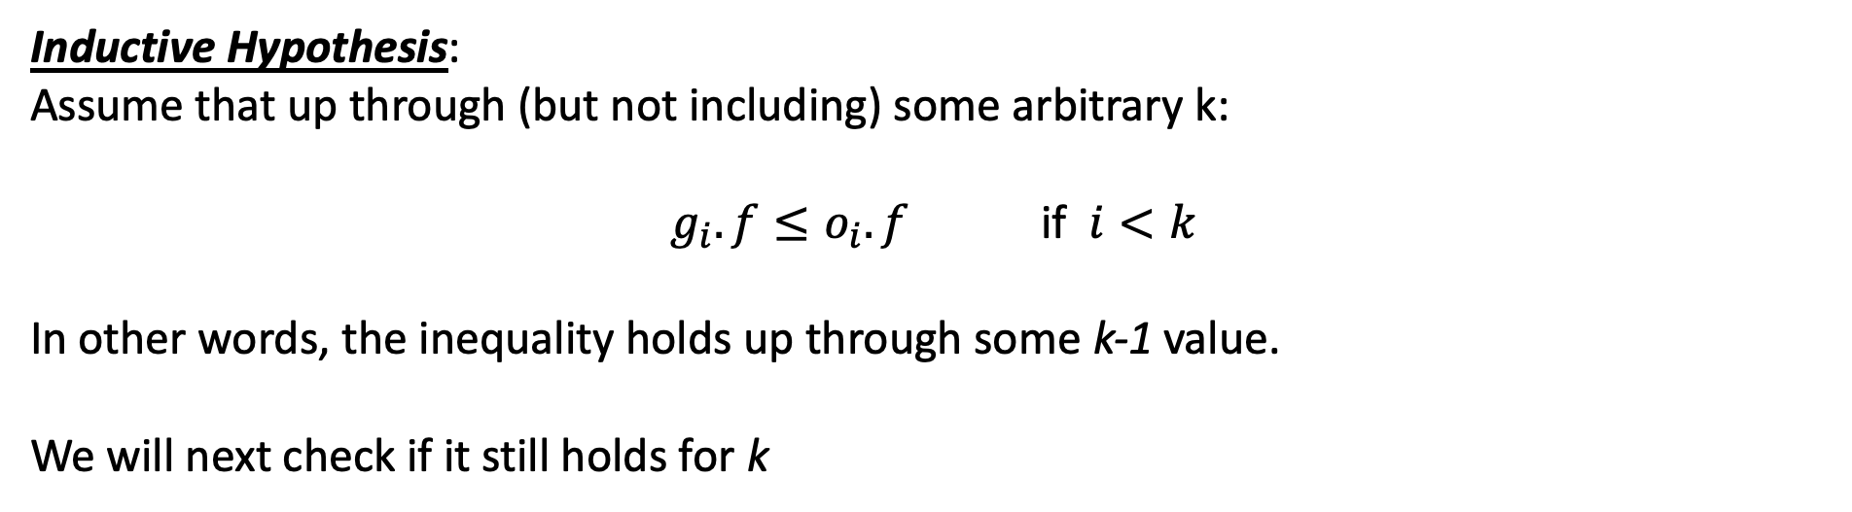
Does Greedy Always Find Optimal Solution?
Lemma 1: Let $G=\{g_{1},g_{2},…,g_{n}\}$ be greedy algorithm intervals and $O=\{o_{1},o_{2},…, o_{m}\}$ be the optimal solution
Show that $∀_{i≥1}{ g}_{i}.f≤o_{i}.f$ //f is finish time
Inductive Hypothesis:
Assume that up through (but not including) some arbitrary k:
$g_{i}.f≤o_{i}.f$ if $i<k$
In other words, the inequality holds up through some k-1 value.
We will next check if it still holds for k

Slide 25
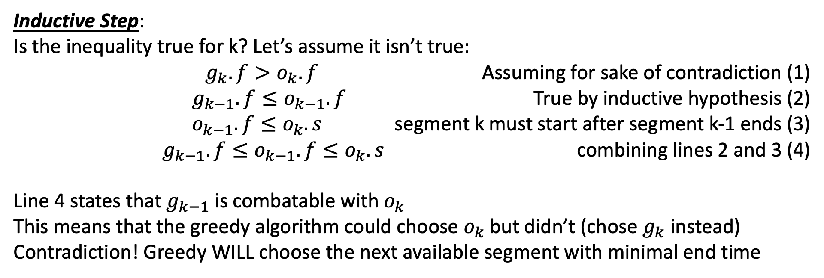
Does Greedy Always Find Optimal Solution?
Lemma 1: Let $G=\{g_{1},g_{2},…,g_{n}\}$ be greedy algorithm intervals and $O=\{o_{1},o_{2},…, o_{m}\}$ be the optimal solution
Show that $∀_{i≥1}{ g}_{i}.f≤o_{i}.f$ //f is finish time
Inductive Step:
Is the inequality true for k? Let’s assume it isn’t true:
$g_{k}.f>o_{k}.f$ Assuming for sake of contradiction (1)
$g_{k−1}.f≤o_{k−1}.f$ True by inductive hypothesis (2)
$o_{k−1}.f≤o_{k}.s$ segment k must start after segment k-1 ends (3)
$g_{k−1}.f≤o_{k−1}.f≤o_{k}.s$ combining lines 2 and 3 (4)
Line 4 states that $g_{k−1}$ is combatable with $o_{k}$
This means that the greedy algorithm could choose $o_{k}$ but didn’t (chose $g_{k}$ instead)
Contradiction! Greedy WILL choose the next available segment with minimal end time

Slide 26
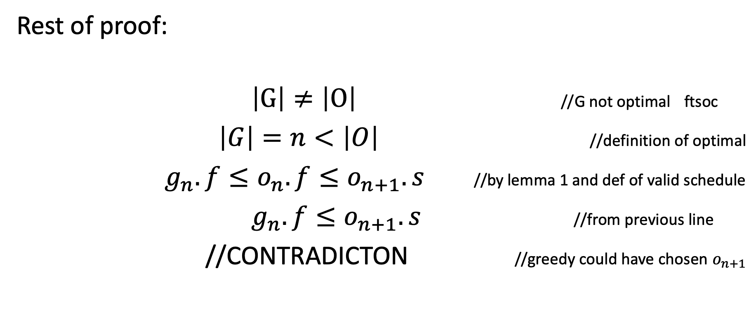
Does Greedy Always Find Optimal Solution?
Rest of proof:
$\left|G\right|≠\left|O\right|$ //G not optimal ftsoc
$\left|G\right|=n<\left|O\right|$ //definition of optimal
$g_{n}.f≤o_{n}.f≤o_{n+1}.s$ //by lemma 1 and def of valid schedule
$g_{n}.f≤o_{n+1}.s$ //from previous line
//CONTRADICTON //greedy could have chosen $o_{n+1}$

Slide 27
Bridge Crossing (If time allows)

Slide 28
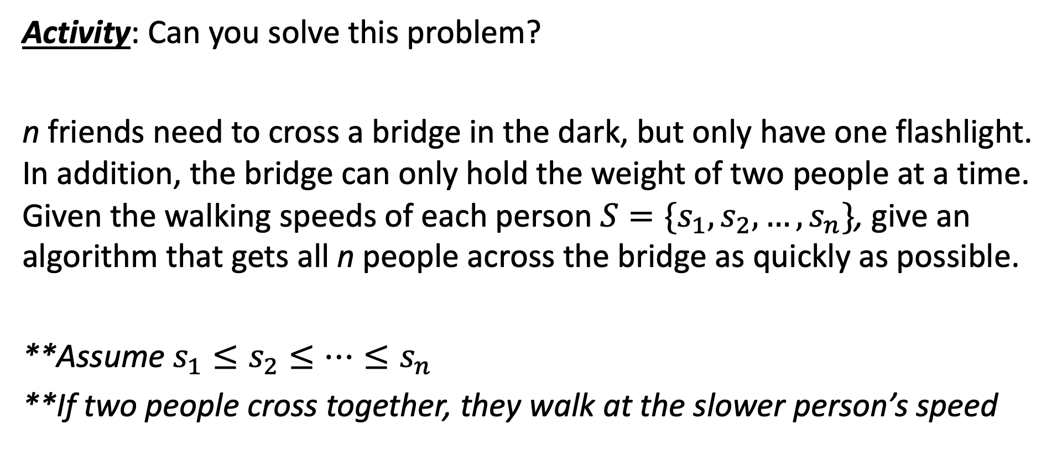
Can you solve it??
Activity: Can you solve this problem?
n friends need to cross a bridge in the dark, but only have one flashlight. In addition, the bridge can only hold the weight of two people at a time. Given the walking speeds of each person $S=\{s_{1},s_{2},…,s_{n}\}$, give an algorithm that gets all n people across the bridge as quickly as possible.
**Assume $s_{1}≤s_{2}≤…≤s_{n}$
**If two people cross together, they walk at the slower person’s speed

Slide 29
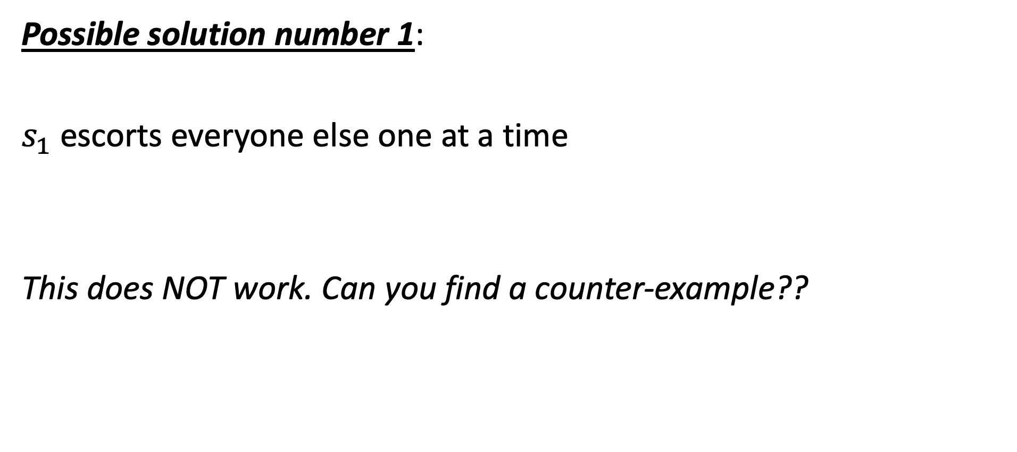
Can you solve it??
Possible solution number 1:
$s_{1}$ escorts everyone else one at a time
This does NOT work. Can you find a counter-example??

Slide 30
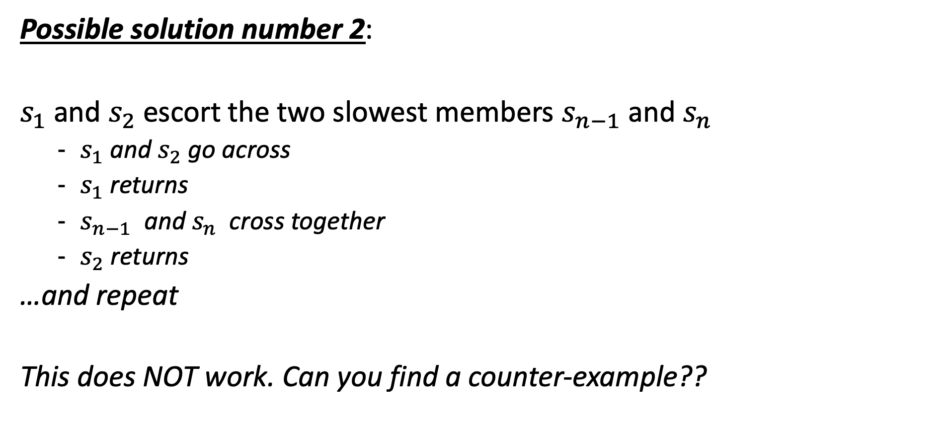
Can you solve it??
Possible solution number 2:
$s_{1}$ and $s_{2}$ escort the two slowest members $s_{n−1}$ and $s_{n}$
$s_{1}$ and $s_{2}$ go across
$s_{1}$ returns
$s_{n−1}$ and $s_{n}$ cross together
$s_{2}$ returns
…and repeat
This does NOT work. Can you find a counter-example??

Slide 31
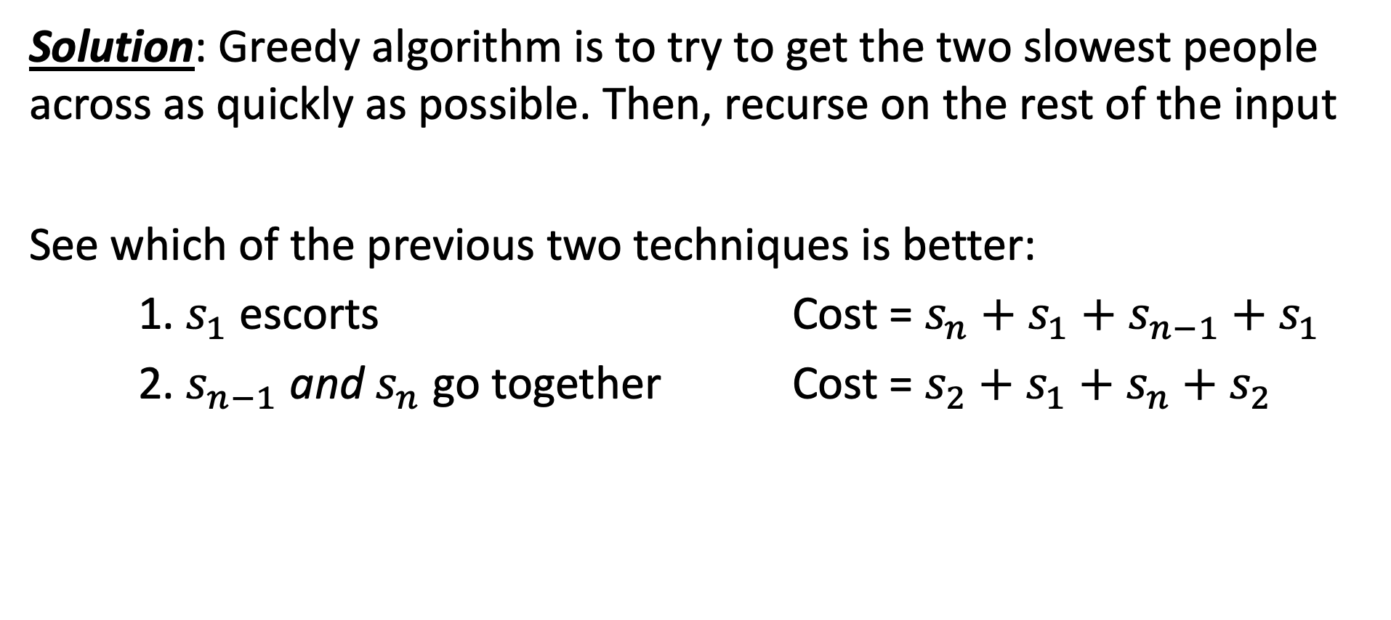
Can you solve it??
Solution: Greedy algorithm is to try to get the two slowest people across as quickly as possible. Then, recurse on the rest of the input
See which of the previous two techniques is better:
1. $s_{1}$ escorts Cost = $s_{n}+s_{1}+s_{n−1}+s_{1}$
2. $s_{n−1}$ and $s_{n}$ go together Cost = $s_{2}+s_{1}+s_{n}+s_{2}$

Slide 32
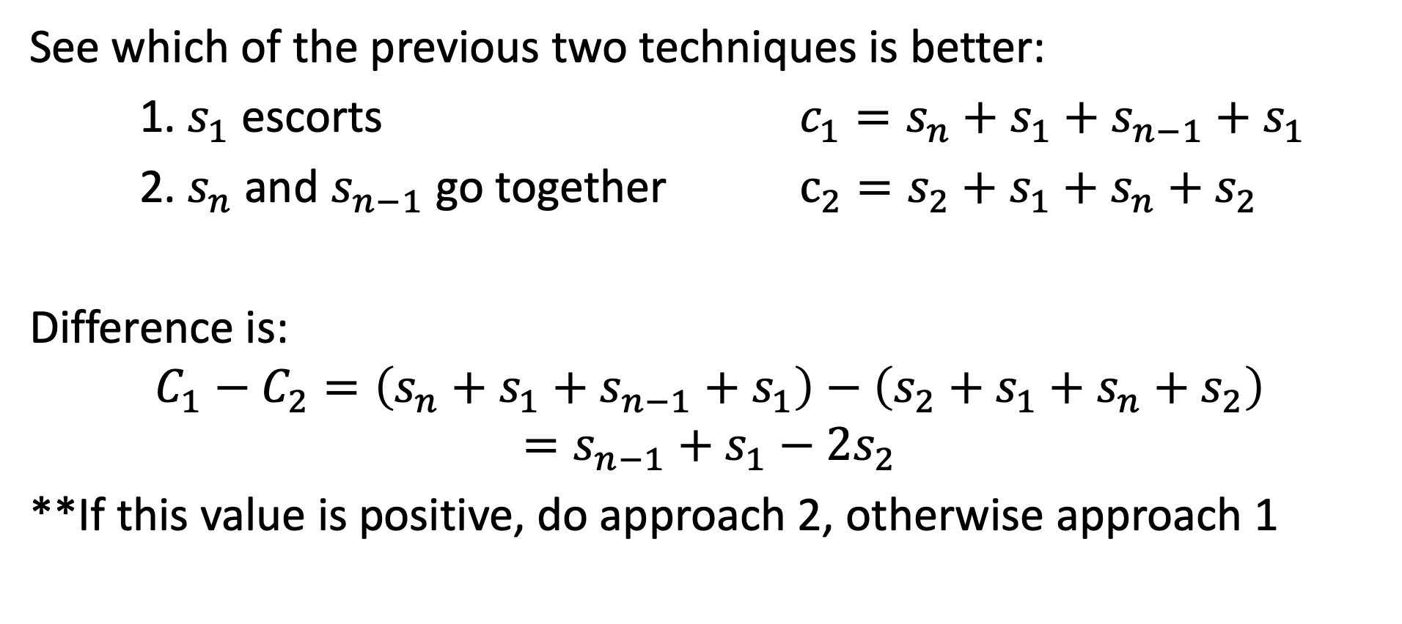
Can you solve it??
See which of the previous two techniques is better:
1. $s_{1}$ escorts ${c_{1}=s}_{n}+s_{1}+s_{n−1}+s_{1}$
2. $s_{n}$ and $s_{n−1}$ go together $c_{2}=s_{2}+s_{1}+s_{n}+s_{2}$
Difference is:
$$C_{1}−C_{2}=\left(s_{n}+s_{1}+s_{n−1}+s_{1}\right)−\left(s_{2}+s_{1}+s_{n}+s_{2}\right)$$
$$=s_{n−1}+s_{1}−2s_{2}$$
**If this value is positive, do approach 2, otherwise approach 1

