Slide 1
Greedy Algorithms Knapsack Problems
CS 3100 – DSA2
Mark Floryan

Slide 2
CLRS Readings
Chapter 16, Greedy Algorithms
Intro, page 414
Section 16.2, Elements of the Greedy Strategy, Knapsack problem

Slide 3
Knapsack Problems

Slide 4


Knapsack Problems
Pages 425-427 in textbook
Description: Thief robbing a store finds n items, each with a profit amount p_{i} and a weight w_{i}
Wants to steal as valuable a load as possible
But can only carry total weight C in their knapsack
Which items should they take to maximize profit?
Form of the solution: an x_{i} value for each item, showing if (or how much) of that item is taken
Inputs are: C, n, the p_{i} and w_{i} values
4

Slide 5
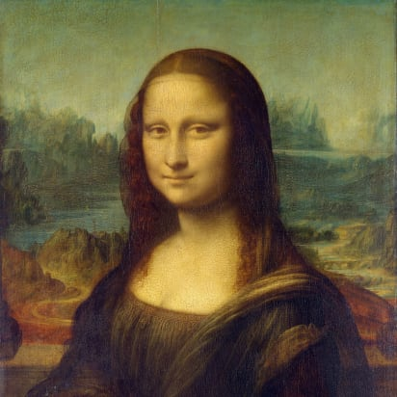

Two Types of Knapsack Problem
0/1 knapsack problem
Each item is discrete: must choose all of it or none of it. So each x_{i} is 0 or 1
Greedy approach does not produce optimal solutions
But dynamic programming does
Fractional knapsack problem (AKA continuous knapsack)
Can pick up fractions of each item. So each x_{i} is a value between 0 or 1
A greedy algorithm finds the optimal solution
5

Slide 6
Formal Statement of Fractional Knapsack Problem
Given n objects and a knapsack of capacity C, where object i has weight w_{i} and earns profit p_{i}, find values x_{i} that maximize the total profit subject to the constraints

Slide 7
Greedy Approach
Let’s use a greedy strategy to solve the fractional knapsack
Build solution by stages, adding one item to partial solution found so far
At each stage, make locally optimal choice based on the greedy choice (sometimes called the greedy rule or the selection function)
Locally optimal, i.e. best choice given what info available now
Irrevocable: a choice can’t be un-done
Sequence of locally optimal choices leads to globally optimal solution (hopefully)
Must prove this for a given problem!
Approximation algorithms, heuristic algorithms

Slide 8
A Bit More Terminology
Problems solvable by both Dynamic Programming and the Greedy approach have the optimal substructure property:
An optimal solution to a problem contains within it optimal solutions to subproblems
This allows us to build a solution one step at a time, because we can solve increasingly smaller problems with confidence

Slide 9
Greedy Approach for Fractional Knapsack?
Build up a partial solutions:
Determine which of the remaining items to add
How much can you add (its x_{i})
Repeat until knapsack is full (or no more items)
Which item to choose next? What’s a good greedy choice (AKA greedy selection)?
Let’s try several obvious options on this example:
n = 3, C = 20
Item | Value | Weight
1 | 25 | 18
2 | 24 | 15
3 | 15 | 10

Slide 10
Possible Greedy Choices for Knapsack
Greedy choice #1: by highest profit value
n = 3, C = 20
Item 1 first. Can take all of it, so x₁ is 1. Capacity used is 18 of 20. Profit so far is 25.
Item 2 next. Room for only 2 units, so x₂ is 2/15 = 0.133. Capacity used is 20 of 20. Profit so far is 25 + (24 x 0.133) = 28.2.
Item 3 would be next, but knapsack full! x₃ is 0. Total profit is 28.2. x_{i} = (1, .133, 0)
Item | Value | Weight
1 | 25 | 18
2 | 24 | 15
3 | 15 | 10
Select item 1 first, then item 2, then item 3. Take as much of each as fits!

Slide 11
Possible Greedy Choices for Knapsack
Greedy choice #2: by lowest weight
n = 3, C = 20
Item 3 first. Can take all of it, so x₃ is 1. Capacity used is 10 of 20. Profit so far is 15.
Item 2 next. Room for only 10 units, so x₂ is 10/15 = 0.667. Capacity used is 20 of 20. Profit so far is 15 + (24 x 0.667) = 31.
Item 1 would be next, but knapsack full! x₁ is 0. Total profit is 31.0. x_{i} = (0, .667, 1)
Note it’s better than previous greedy choice.
Best possible?
Item | Value | Weight
1 | 25 | 18
2 | 24 | 15
3 | 15 | 10
Select item 3 first, then item 2, then item 1. Take as much of each as fits!

Slide 12
Possible Greedy Choices for Knapsack
Greedy choice #3: highest value-to-weight ratio
n = 3, C = 20
Item 2 first. Can take all of it, so x₂ is 1. Capacity used is 15 of 20. Profit so far is 24.
Item 3 next. Room for only 5 units, so x₁ is 5/10 = 0.5. Capacity used is 20 of 20. Profit so far is 24 + (15 x 0.5) = 31.5.
Item 1 would be next, but knapsack full! x₁ is 0. Total profit is 31.5. x_{i} = (0, 1, 0.5)
This greedy choice produces optimal solution!
Must prove this (but we won’t today).
Item | Value | Weight | Ratio
1 | 25 | 18 | 1.4
2 | 24 | 15 | 1.6
3 | 15 | 10 | 1.5
Select item 2 first, then item 3, then item 1. Take as much of each as fits!

Slide 13
Fractional Knapsack Algorithm
FRACTIONAL_KNAPSACK(a, C)
1 n = a.last
2 for i = 1 to n
3 ratio[i] = a[i].p / a[i].w
4 sort(a, ratio)
5 weight = 0
6 i = 1
7 while (i ≤ n and weight < C)
8 if (weight + a[i].w ≤ C)
9 println “select all of object “ + a[i].id
10 weight = weight + a[i].w
11 else
12 r = (C – weight) / a[i].w
13 println “select “ + r + “ of object “ + a[i].id
14 weight = C
15 i = i+1
Worst-case runtime: for loop and while loop take θ(n) time,
sorting takes θ(nlgn) time, so algorithm takes θ(nlgn) time

Slide 14
Another Knapsack Example to Try
Assume for this problem that:
Ratios of profit to weight:
What order do we examine items?
What are the x_{i} values that result?
What’s the total profit?
p₁/w₁ = 5/120 = .0417
p₂/w₂ = 5/150 = .0333
p₃/w₃ = 4/200 = .0200
p₄/w₄ = 8/150 = .0533
p₅/w₅ = 3/140 = .0214

Slide 15
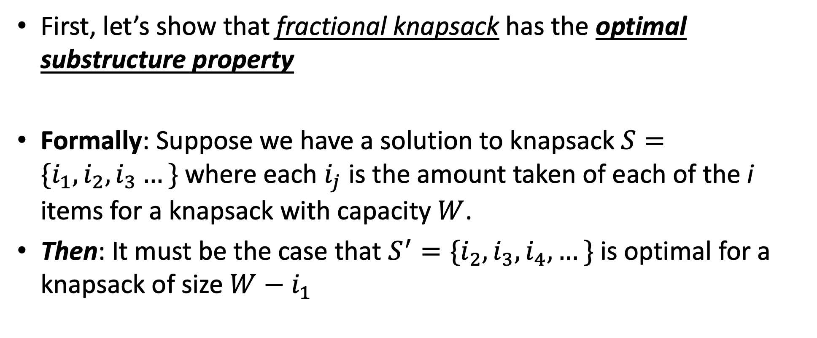
Optimal Substructure Proof
First, let’s show that fractional knapsack has the optimal substructure property
Formally: Suppose we have a solution to knapsack $S=\{i_{1},i_{2},i_{3}…\}$ where each $i_{j}$ is the amount taken of each of the i items for a knapsack with capacity $W$.
Then: It must be the case that $S^{′}=\{i_{2},i_{3},i_{4},…\}$ is optimal for a knapsack of size $W−i_{1}$

Slide 16
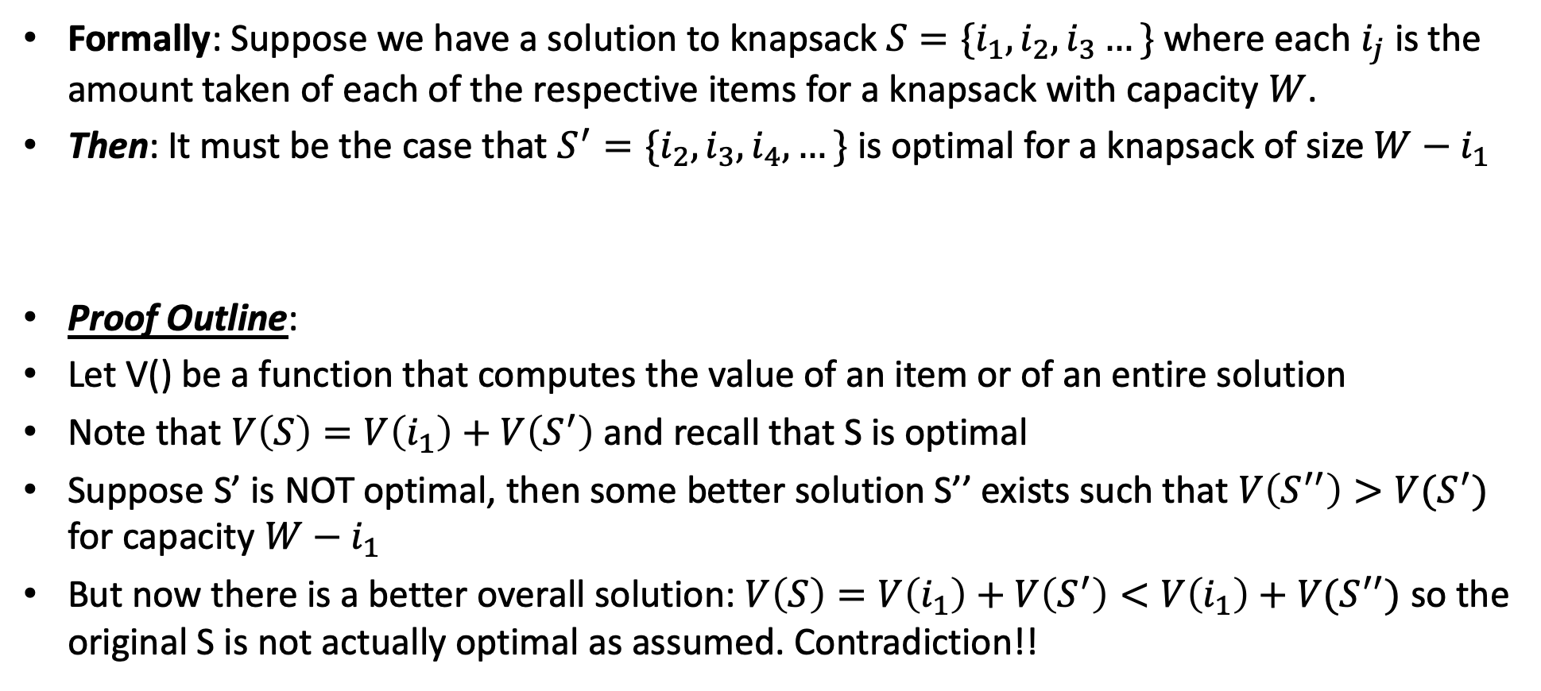
Optimal Substructure Proof
Formally: Suppose we have a solution to knapsack $S=\{i_{1},i_{2},i_{3}…\}$ where each $i_{j}$ is the amount taken of each of the respective items for a knapsack with capacity $W$.
Then: It must be the case that $S^{′}=\{i_{2},i_{3},i_{4},…\}$ is optimal for a knapsack of size $W−i_{1}$
Proof Outline:
Let V() be a function that computes the value of an item or of an entire solution
Note that $V\left(S\right)=V\left(i_{1}\right)+V\left(S^{′}\right)$ and recall that S is optimal
Suppose S’ is NOT optimal, then some better solution S’’ exists such that $V\left(S^{′′}\right)>V(S^{′})$ for capacity $W−i_{1}$
But now there is a better overall solution: $V\left(S\right)=V\left(i_{1}\right)+V\left(S^{′}\right)<V\left(i_{1}\right)+V(S^{′′})$ so the original S is not actually optimal as assumed. Contradiction!!

Slide 17
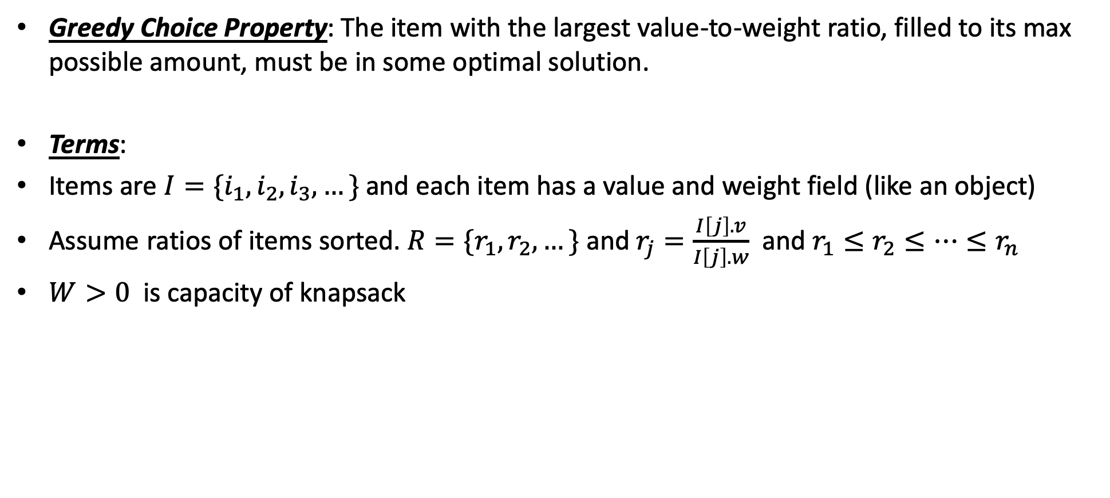
Greedy Choice Property
Greedy Choice Property: The item with the largest value-to-weight ratio, filled to its max possible amount, must be in some optimal solution.
Terms:
Items are $I=\{i_{1}, i_{2},i_{3},…\}$ and each item has a value and weight field (like an object)
Assume ratios of items sorted. $R=\{r_{1},r_{2},…\}$ and $r_{j}=\frac{I\left[j\right].v}{I\left[j\right].w}$ and $r_{1}≤r_{2}≤…≤r_{n}$
$W>0$ is capacity of knapsack

Slide 18
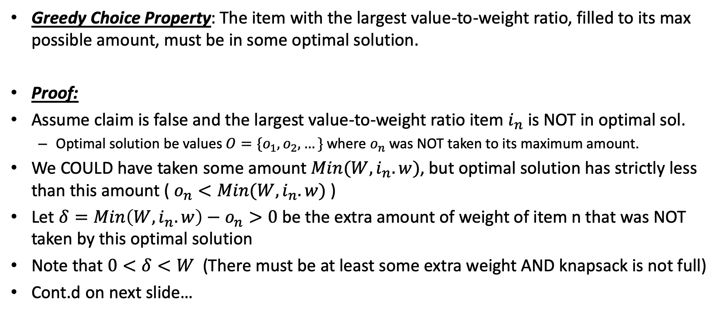
Greedy Choice Property
Greedy Choice Property: The item with the largest value-to-weight ratio, filled to its max possible amount, must be in some optimal solution.
Proof:
Assume claim is false and the largest value-to-weight ratio item $i_{n}$ is NOT in optimal sol.
Optimal solution be values $O=\{o_{1},o_{2},…\}$ where $o_{n}$ was NOT taken to its maximum amount.
We COULD have taken some amount $Min(W,i_{n}.w)$, but optimal solution has strictly less than this amount ( $o_{n}<Min(W,i_{n}.w)$ )
Let $δ=Min\left(W,i_{n}.w\right)−o_{n}>0$ be the extra amount of weight of item n that was NOT taken by this optimal solution
Note that $0<δ<W$ (There must be at least some extra weight AND knapsack is not full)
Cont.d on next slide…

Slide 19
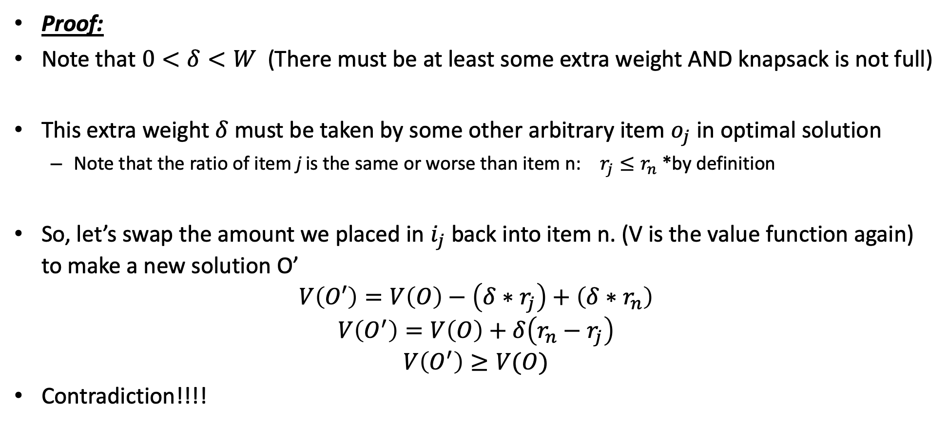
Greedy Choice Property
Proof:
Note that $0<δ<W$ (There must be at least some extra weight AND knapsack is not full)
This extra weight $δ$ must be taken by some other arbitrary item $o_{j}$ in optimal solution
Note that the ratio of item j is the same or worse than item n: $r_{j}≤r_{n}$ *by definition
So, let’s swap the amount we placed in $i_{j}$ back into item n. (V is the value function again) to make a new solution O’
$$V\left(O′\right)=V\left(O\right)−\left(δ∗r_{j}\right)+\left(δ∗r_{n}\right)$$
$$V\left(O^{′}\right)=V\left(O\right)+δ\left(r_{n}−r_{j}\right)$$
$$V\left(O^{′}\right)≥V(O)$$
Contradiction!!!!

Slide 20
0/1 knapsack
n = 3, C = 4
Let’s try this same greedy solution with the 0/1 version
New example inputs →
Item 1 first. So x₁ is 1. Capacity used is 1 of 4. Profit so far is 3.
Item 2 next. There’s room for it! So x₂ is 1. Capacity used is 3 of 4. Profit so far is 3 + 5 = 8.
Item 3 would be next, but its weight is 3 and knapsack only has 1 unit left! So x₃ is 0. Total profit is 8. x_{i} = (1, 1, 0)
But picking items 1 and 3 will fit in knapsack, with total value of 9
Thus, the greedy solution does not produce an optimal solution to the 0/1 knapsack algorithm
Greedy choice left unused room, but we can’t take a fraction of an item
The 0/1 knapsack problem doesn’t have the greedy choice property
Item | Value | Weight | Ratio
1 | 3 | 1 | 3
2 | 5 | 2 | 2.5
3 | 6 | 3 | 2

