Slide 1
Dynamic Programming Sequences
(1) String Edit Distance
(Not in textbook. Certainly not the Shakespeare part!)
(2) Longest Common Subsequence
(CLRS 15.4)

Slide 2
Sequences
Problems about the relationship between two sequences
Strings (sequence of characters)
Text (sequence of words)
Genetic sequences (sequence of nucleotides)
Etc.
How similar are two sequences?
How one could be transformed to the other?
What do they share in common?
String Edit Distance
Longest Common Subsequence

Slide 3
Sequence Alignment
How could we define the similarity of two strings?
Maybe character-by-character, showing places there’s an “issue”?
This is the idea of an alignment
Mismatched characters, insertions or deletions (gaps)
Example: ocurrance vs. occurrence. Three possible alignments are:
o | c | u | r | r | a | n | c | e | -
o | c | c | u | r | r | e | n | c | e
o | c | - | u | r | r | a | n | c | e
o | c | c | u | r | r | e | n | c | e
6 mismatches, 1 gap
1 mismatch, 1 gap
o | c | - | u | r | r | - | a | n | c | e
o | c | c | u | r | r | e | - | n | c | e
0 mismatches, 3 gaps

Slide 4
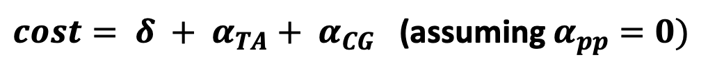
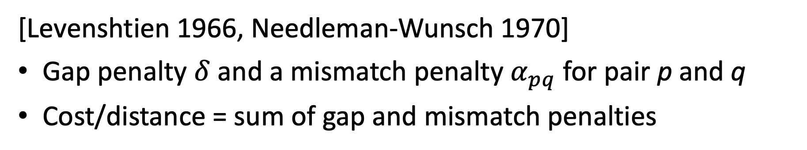
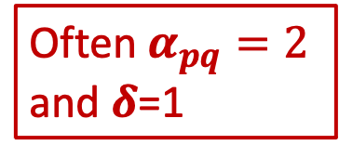
Edit Distance
[Levenshtien 1966, Needleman-Wunsch 1970]
Gap penalty $δ$ and a mismatch penalty $α_{pq}$ for pair p and q
Cost/distance = sum of gap and mismatch penalties
A | T | C | G | A | C | T | C | A | G | T
A | T | - | G | A | C | A | G | A | G | T
Often $α_{pq}=\text{2}$ and $δ$=1
$cost= δ + α_{TA}+ α_{CG}$ (assuming $α_{pp}=0)$
Many applications: Spelling correction, bioinformatics, text processing and analysis, speech recognition, computer file difference (diff), birdsong analysis, …

Slide 5
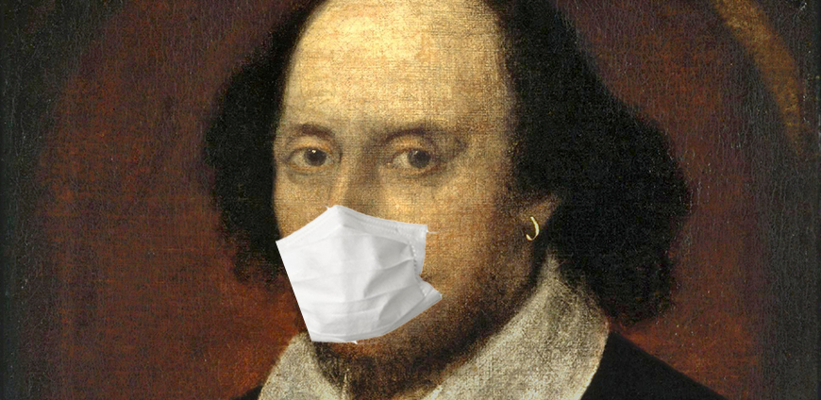
An Interesting Application You Probably Never Considered!
Text Processing in Early Modern English drama texts (!)
Scholars’ problems involve knowing if/how two versions of a text differ
A document created from one (or more) older versions
When they differ, which is “correct”?
Spelling wasn’t standardized in the 1590s/early 1600s
CS researchers in field of digital humanities applied sequence alignment algorithms to spelling variation, collation, …
E.g. someone named Horton (paper in Research in Humanities Computing, Vol. 2, 1994)

Slide 6
An Example of the Problem
Mee thought all his senses were lokt in his eye As iewels in christall for some prince to buy Who tendring their owne worth from where they were glast Did poynt you to buy them along as you past
Love’s Labours Lost (Quarto, 1598)
Me thought all his sences were lockt in his eye As iewels in christall for some prince to buy Who tendring their own worth from whence they were glast Did point out to buy them along as you past
Love’s Labours Lost (First Folio, 1623)
Are these different? If so, where?

Slide 7
An Example of the Problem
Mee thought all his senses were lokt in his eye As iewels in christall for some prince to buy Who tendring their owne worth from where they were glast Did poynt you to buy them along as you past
Love’s Labours Lost (Quarto, 1598)
Me thought all his sences were lockt in his eye As iewels in christall for some prince to buy Who tendring their own worth from whence they were glast Did point out to buy them along as you past
Love’s Labours Lost (First Folio, 1623)
Words marked like this are different strings. But…

Slide 8
An Example of the Problem
Mee thought all his senses were lokt in his eye As iewels in christall for some prince to buy Who tendring their owne worth from where they were glast Did poynt you to buy them along as you past
Love’s Labours Lost (Quarto, 1598)
Me thought all his sences were lockt in his eye As iewels in christall for some prince to buy Who tendring their own worth from whence they were glast Did point out to buy them along as you past
Love’s Labours Lost (First Folio, 1623)
Most scholars would say all but two are only spelling variations and not “substantive variants”

Slide 9
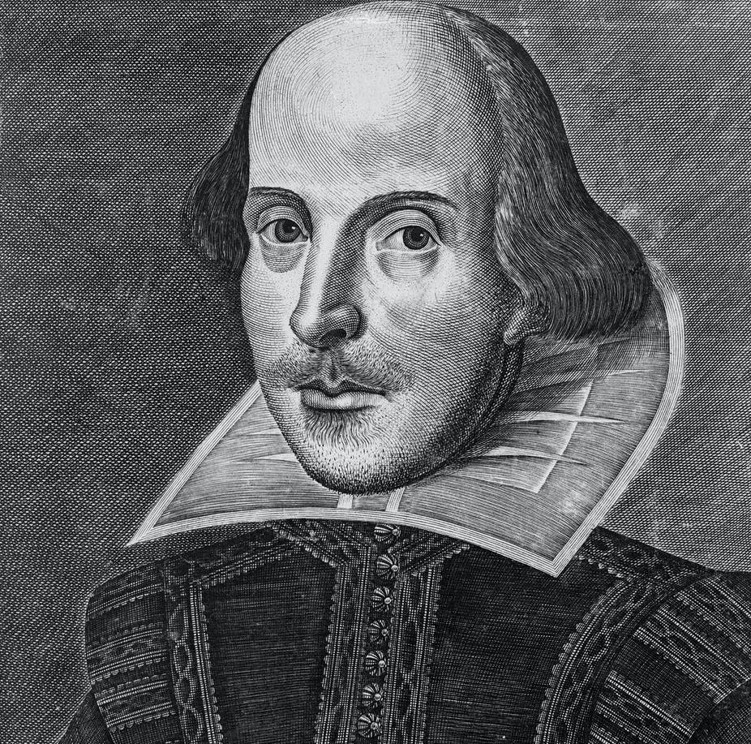
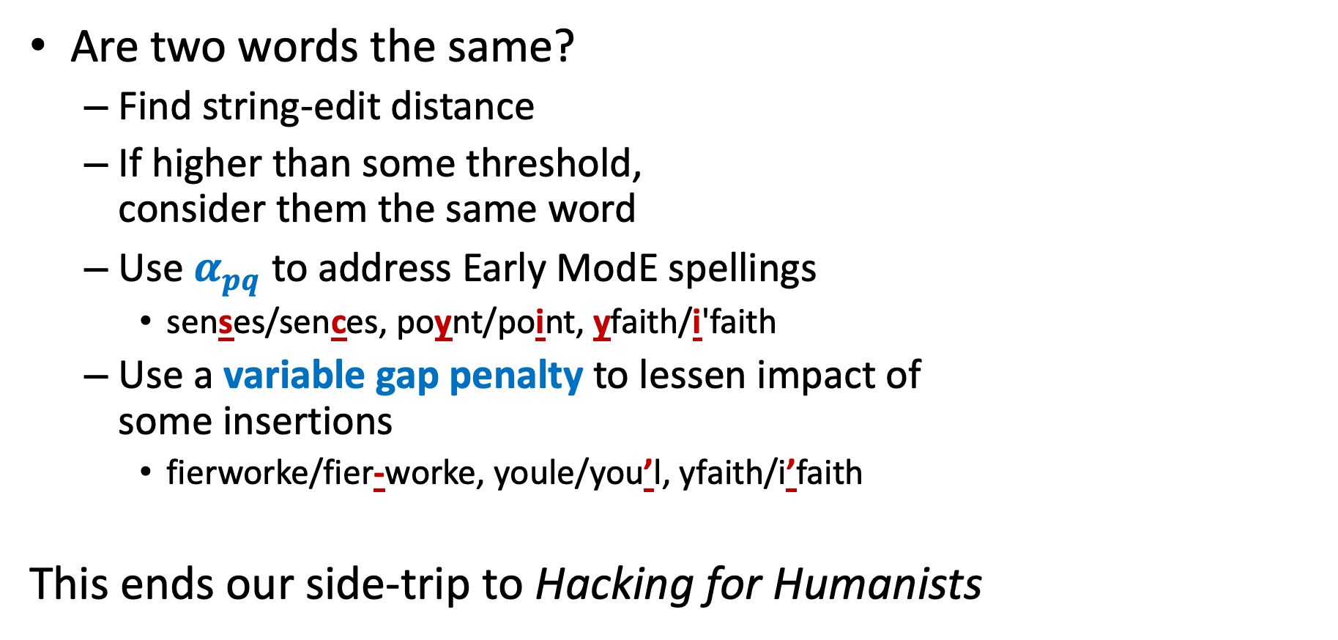
Are two words the same?
Find string-edit distance
If higher than some threshold, consider them the same word
Use $α_{pq}$ to address Early ModE spellings
senses/sences, poynt/point, yfaith/i'faith
Use a variable gap penalty to lessen impact of some insertions
fierworke/fier-worke, youle/you’l, yfaith/i’faith
This ends our side-trip to Hacking for Humanists
OK, 21st century know-it-all, how can any of this help?

Slide 10
Where were we before? Oh yeah…
[Levenshtien 1966, Needleman-Wunsch 1970]
Gap penalty $δ$ and a mismatch penalty $α_{pq}$ for pair p and q
Cost/distance = sum of gap and mismatch penalties
A | T | C | G | A | C | T | C | A | G | T
A | T | - | G | A | C | A | G | A | G | T
Often $α_{pq}=\text{2}$ and $δ$=1
$cost= δ + α_{TA}+ α_{CG}$ (assuming $α_{pp}=0)$
Many applications: Spelling correction, bioinformatics, text processing and analysis, speech recognition, computer file difference (diff), birdsong analysis, text processing in old-spelling texts

Slide 11

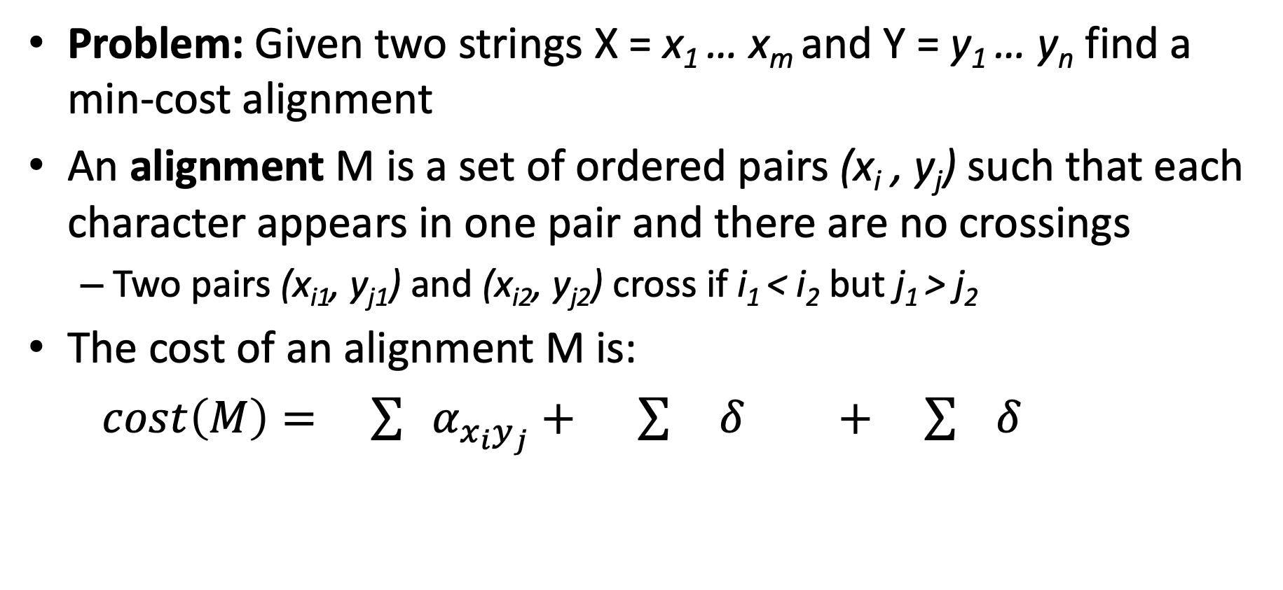


Sequence Alignment: Problem Statement
Problem: Given two strings X = x₁ … x_{m} and Y = y₁ … y_{n} find a min-cost alignment
An alignment M is a set of ordered pairs (x_{i} , y_{j}) such that each character appears in one pair and there are no crossings
Two pairs (x_{i1}, y_{j1}) and (x_{i2}, y_{j2}) cross if i₁ < i₂ but j₁ > j₂
The cost of an alignment M is:
$cost\left(M\right)= \sum{{ α}_{{x_{i}y}_{j}}}+ \sum{ δ} + \sum{ δ}$
$$x_{i}, y_{j}∈M$$
${i :x}_{i}$unmatched
${j:y}_{j}$unmatched
mismatches
gaps

Slide 12
Example: Alignment and Matching
Example: an alignment of X = CGACTA and Y = GACAGA
x₁ | x₂ | x₃ | x₄ | x₅ |  | x₆
C | G | A | C | T | - | A
- | G | A | C | A | G | A
 | y₁ | y₂ | y₃ | y₄ | y₅ | y₆
$$M=\{ \left(x_{2},y_{1}\right),\left(x_{3},y_{2}\right), \left(x_{4},y_{3}\right), \left(x_{5},y_{4}\right), \left(x_{6},y_{6}\right) \}$$
Note:
M contains “matches” where there is a mismatch cost
Items that are part of gaps are not in M. We say they don’t “match”

Slide 13
Dynamic Programming
Requires Optimal Substructure
Solution to larger problem contains the solutions to smaller ones
Avoid extra work due to overlapping subproblems
Idea:
Identify the recursive structure of the problem
What is the “last thing” done?
Save the solution to each subproblem in memory
Select a good order for solving subproblems
“Top Down”: Solve each recursively
“Bottom Up”: Iteratively solve smallest to largest

Slide 14
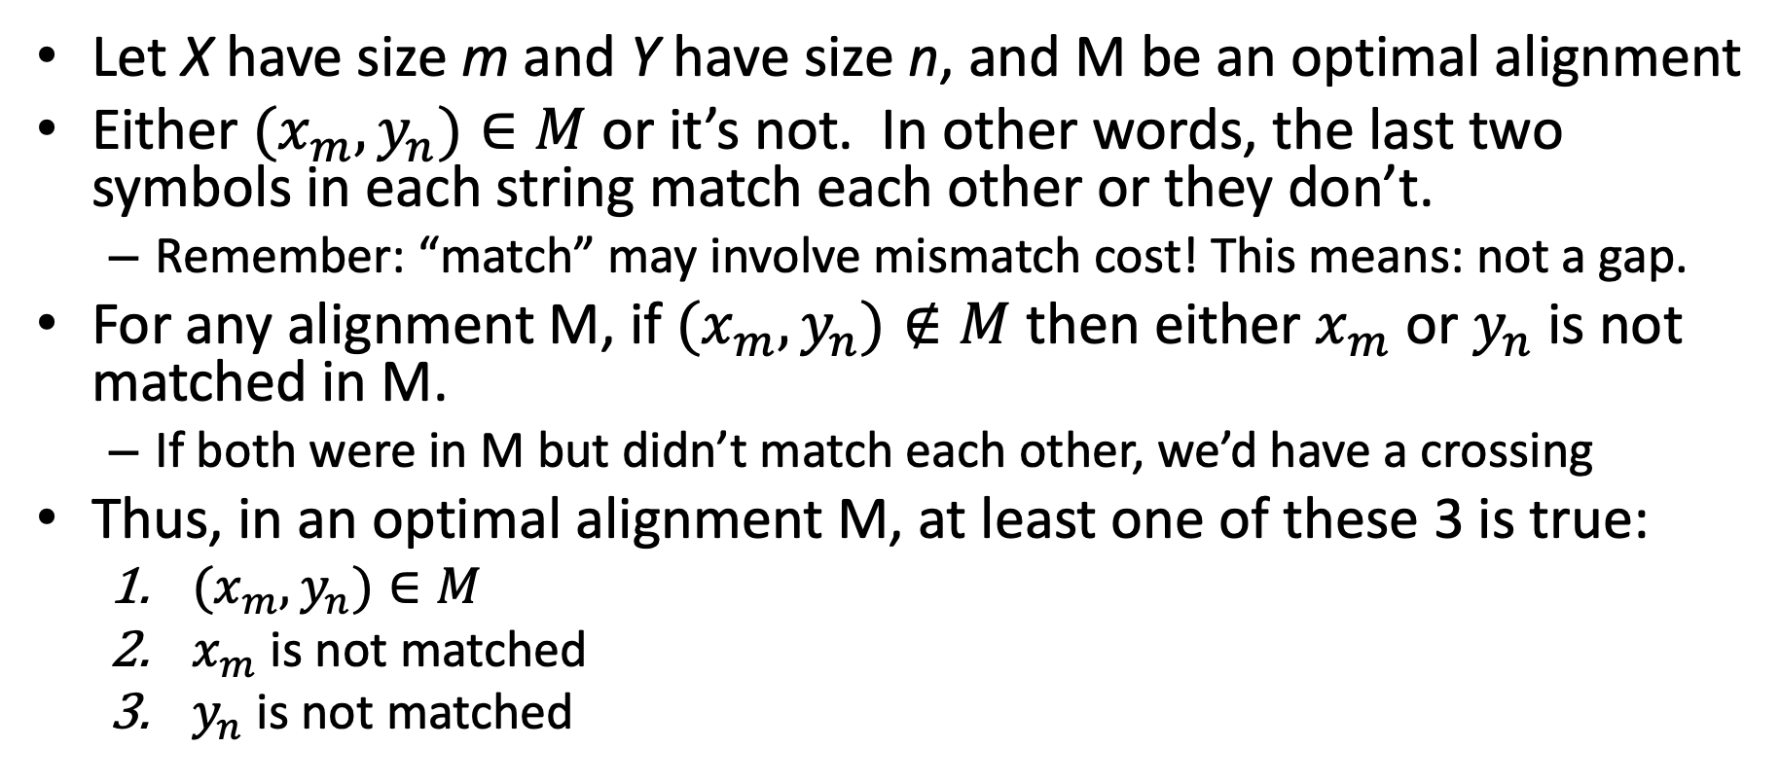
Recursive Structure
Let X have size m and Y have size n, and M be an optimal alignment
Either $(x_{m},y_{n})∈M$ or it’s not. In other words, the last two symbols in each string match each other or they don’t.
Remember: “match” may involve mismatch cost! This means: not a gap.
For any alignment M, if $(x_{m},y_{n})∉M$ then either $x_{m}$ or $y_{n}$ is not matched in M.
If both were in M but didn’t match each other, we’d have a crossing
Thus, in an optimal alignment M, at least one of these 3 is true:
$(x_{m},y_{n})∈M$
$x_{m}$ is not matched
$y_{n}$ is not matched

Slide 15
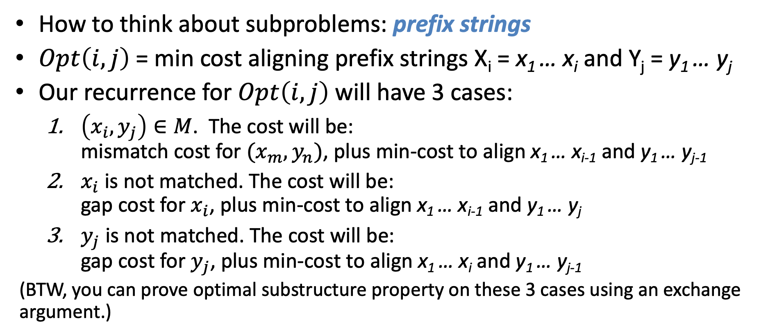
Subproblems and Costs
How to think about subproblems: prefix strings
$Opt\left(i,j\right)$= min cost aligning prefix strings X_{i} = x₁ … x_{i} and Y_{j} = y₁ … y_{j}
Our recurrence for $Opt\left(i,j\right)$will have 3 cases:
$\left(x_{i},y_{j}\right)∈M$. The cost will be: mismatch cost for $(x_{m},y_{n})$, plus min-cost to align x₁ … x_{i-1} and y₁ … y_{j-1}
$x_{i}$ is not matched. The cost will be: gap cost for $x_{i}$, plus min-cost to align x₁ … x_{i-1} and y₁ … y_{j}
$y_{j}$ is not matched. The cost will be: gap cost for $y_{j}$, plus min-cost to align x₁ … x_{i} and y₁ … y_{j-1}
(BTW, you can prove optimal substructure property on these 3 cases using an exchange argument.)

Slide 16
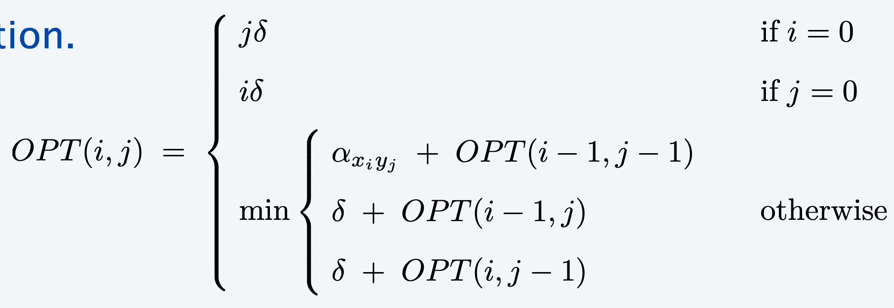

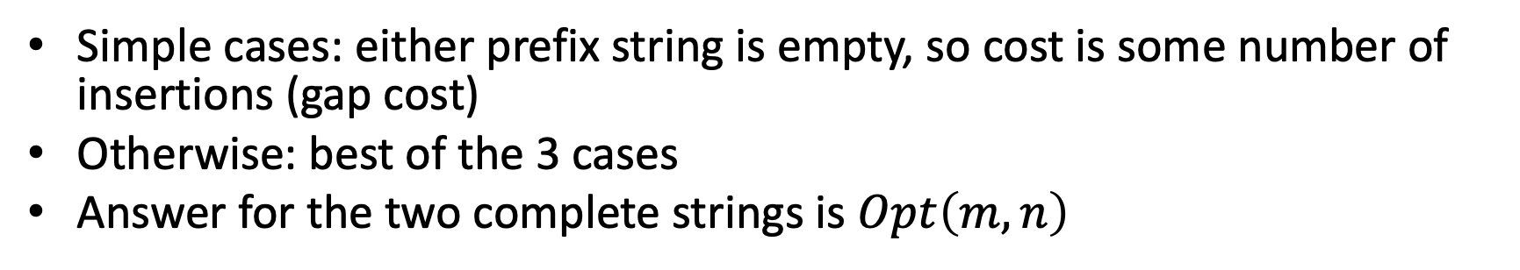
The Recurrence
Simple cases: either prefix string is empty, so cost is some number of insertions (gap cost)
Otherwise: best of the 3 cases
Answer for the two complete strings is $Opt\left(m,n\right)$

Slide 17
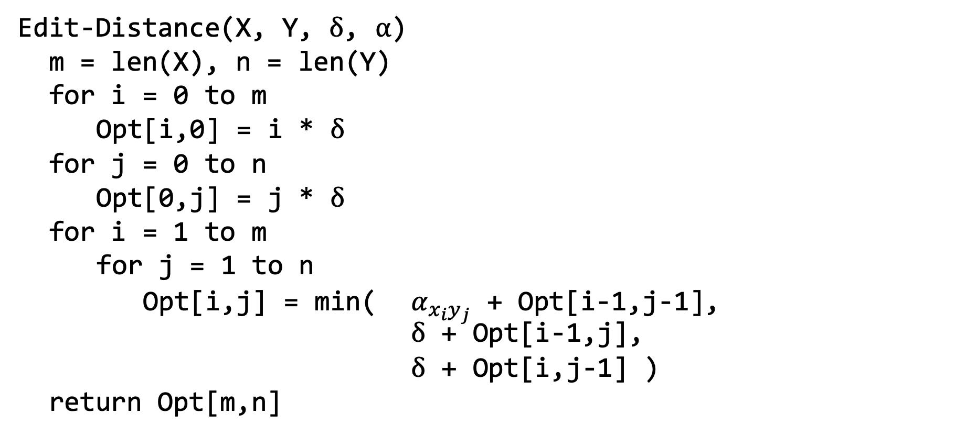
Bottom-up Implementation
Time complexity?
Edit-Distance(X, Y, $δ$, $α$)
m = len(X), n = len(Y)
for i = 0 to m
Opt[i,0] = i * $δ$
for j = 0 to n
Opt[0,j] = j * $δ$
for i = 1 to m
for j = 1 to n
Opt[i,j] = min( $α_{{x_{i}y}_{j}}$ + Opt[i-1,j-1], $δ$ + Opt[i-1,j],
$δ$ + Opt[i,j-1] )
return Opt[m,n]
Constant time to file each cell in the table. So Θ(n ・ m).
Space complexity the same.

Slide 18
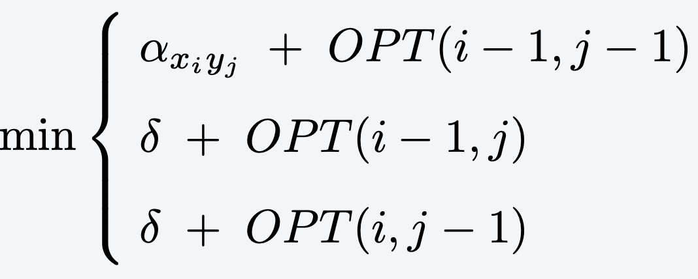

Small Example
Y = “army” → X = “air”
Y
$α_{pq}=\text{2}$ and $δ$=1
 |  | a | r | m | y
 | 0 | 1 | 2 | 3 | 4
a | 1 | 0 | 1 | 2 | 3
i | 2
r | 3
X

Slide 19
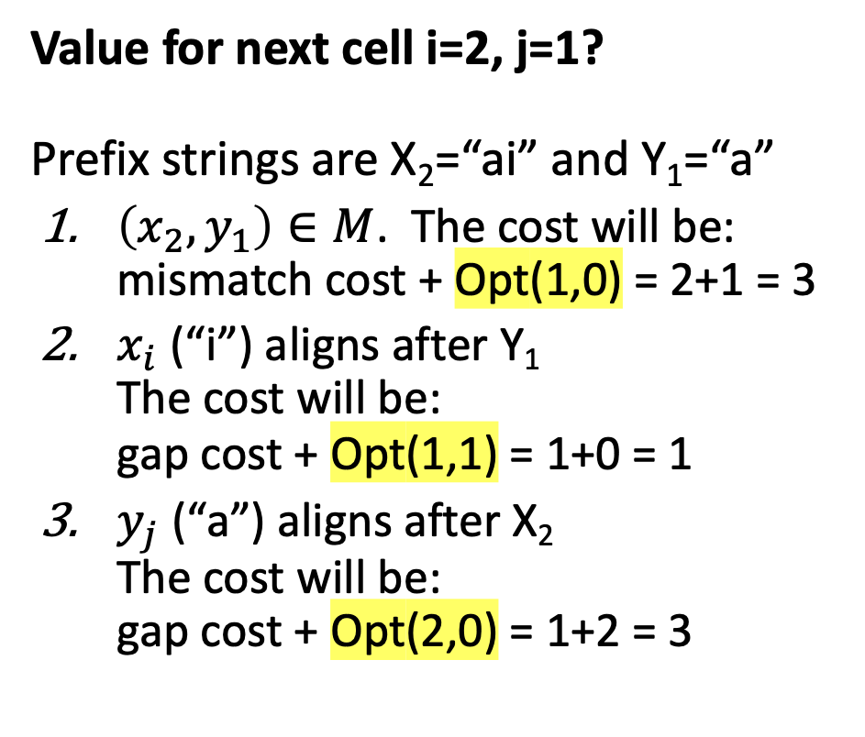
Small Example
Y = “army” → X = “air”
Value for next cell i=2, j=1? Prefix strings are X₂=“ai” and Y₁=“a”
$\left(x_{2},y_{1}\right)∈M$. The cost will be: mismatch cost + Opt(1,0) = 2+1 = 3
$x_{i}$ (“i”) aligns after Y₁ The cost will be: gap cost + Opt(1,1) = 1+0 = 1
$y_{j}$ (“a”) aligns after X₂ The cost will be: gap cost + Opt(2,0) = 1+2 = 3
Y
$α_{pq}=\text{2}$ and $δ$=1
 |  | a | r | m | y
 | 0 | 1 | 2 | 3 | 4
a | 1 | 0 | 1 | 2 | 3
i | 2 | ???
r | 3
X₂ | a | i
Y₁ |  | a
X
X₂ | a | i
Y₁ | a | -
X₂ | a | i | -
Y₁ |  |  | a

Slide 20
Complete Solution
army → air
$α_{pq}=\text{2}$ and $δ$=1
Y
 |  | a | r | m | y
 | 0 | 1 | 2 | 3 | 4
a | 1 | 0 | 1 | 2 | 3
i | 2 | 1 | 2 | 3 | 4
r | 3 | 2 | 1 | 2 | 3
X

Slide 21

Backtrack to Get the Edit
Y
$α_{pq}=\text{2}$ and $δ$=1
army → air
y != r and we came from left: Delete y How do we know we didn’t come diagonally?
m != r and we came from left: Delete m
r == r Keep r and move diagonally (x₃, y₂) added to alignment M
a != i and we came from above: Insert i
a == a Keep a and move diagonally (x₁, y₁) added to alignment M
 |  | a | r | m | y
 | 0 | 1 | 2 | 3 | 4
a | 1 | 0 | 1 | 2 | 3
i | 2 | 1 | 2 | 3 | 4
r | 3 | 2 | 1 | 2 | 3
X
x₁ | x₂ | x₃ | x₄ | x₅
a | i | r | - | -
a | - | r | m | y
y₁ |  | y₂ | y₃ | y₄

Slide 22
Summary on Sequence Alignment
Model for meaning of “similar”
Alignment, with flexible costs for mismatches and gaps
Recursive structure based on whether last items in each sequence are part of the “match” (perhaps with mismatch cost)
Remember, if not matched, part of a gap (insertion)
3 cases
Table stores partial solutions for prefixes of both strings
Time- and space-complexity is Θ(n ・ m)
Want to learn more?
Proof of correctness is shortest-path induction proof for a graph model of table
Another algorithm (Hirschberg) reduces space complexity to Θ(n + m)

Slide 23
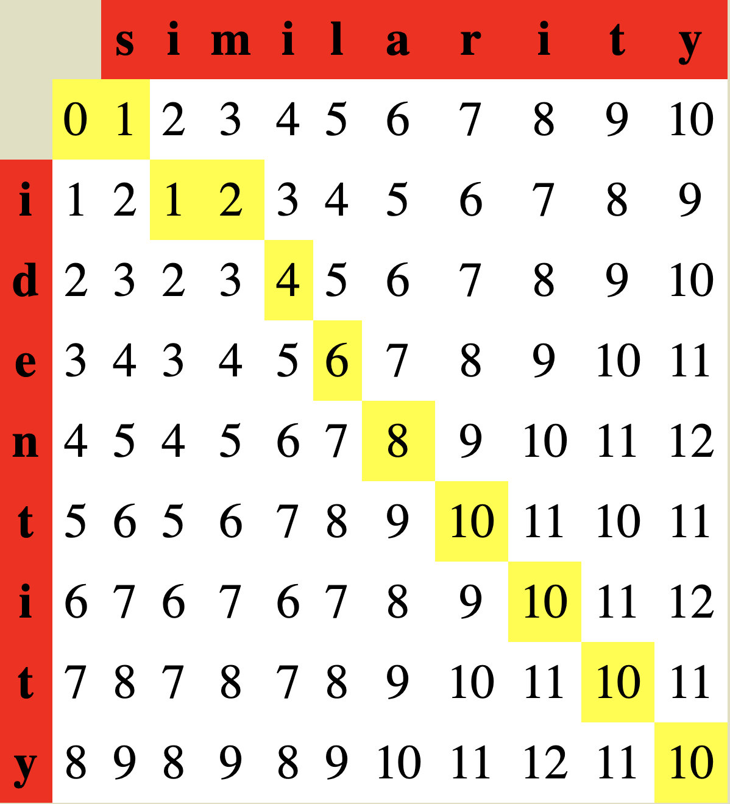

Larger Example
identity and similarity
Alignment found is: i d e n t i t y s i m i l a r i t y
Note (t,r) “matched” but we moved diagonally and incurred a cost
Same for (n,a), (e,l), (d,i)
From online calculator at: http://www.let.rug.nl/~kleiweg/lev/ Try it!
$α_{pq}=\text{2}$ and $δ$=1

Slide 25
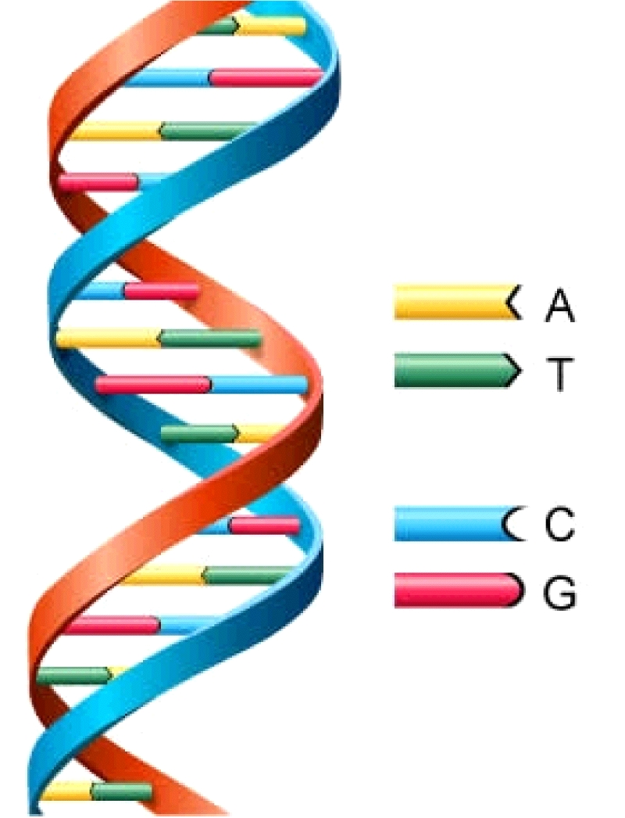
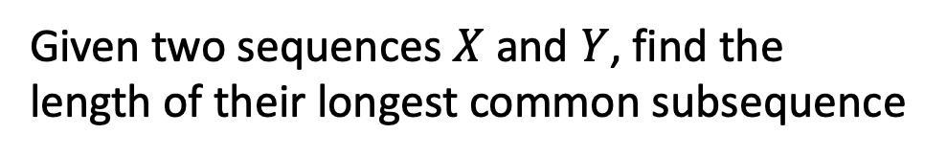
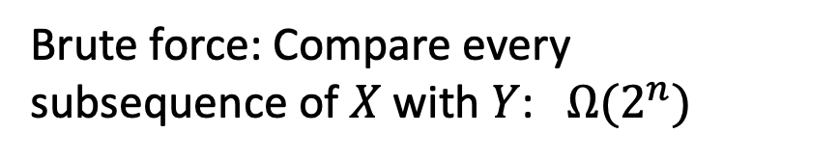
Longest Common Subsequence
Given two sequences $X$ and $Y$, find the length of their longest common subsequence
Example:
X = ATCTGAT Y = TGCATA
LCS = TCTA
X = AT C TGAT Y = TGCAT A
Note this is an alignment where matched items are equal
Brute force: Compare every subsequence of $X$ with $Y$: $Ω(2^{n})$
Applications other than bioinformatics?
Of course, Including version control!
http://cbx33.github.io/gitt/afterhours3-1.html

Slide 26
Dynamic Programming
Requires Optimal Substructure
Solution to larger problem contains the solutions to smaller ones
Avoid extra work due to overlapping subproblems
Idea:
Identify the recursive structure of the problem
What is the “last thing” done?
Save the solution to each subproblem in memory
Select a good order for solving subproblems
“Top Down”: Solve each recursively
“Bottom Up”: Iteratively solve smallest to largest
Subproblems will be defined in same way as for edit distance: prefix strings

Slide 27
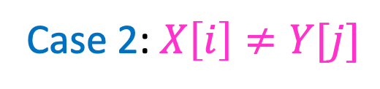

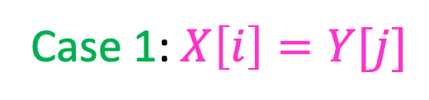
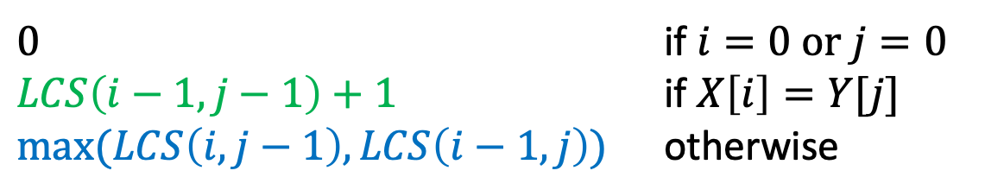
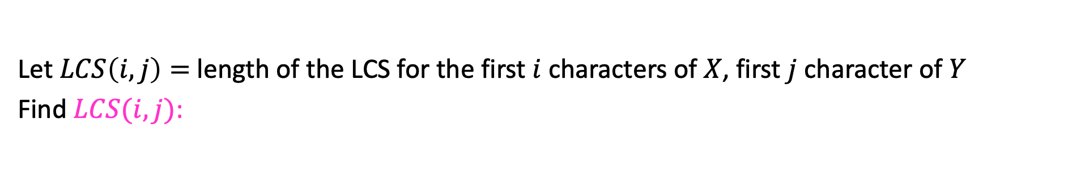



1. Identify Recursive Structure
Let $LCS\left(i,j\right)=$ length of the LCS for the first $i$ characters of $X$, first $j$ character of $Y$
Find $LCS(i,j)$:
X = ATCTGCGT
Y = TGCATAT
Case 1: $X\left[i\right]=Y[j]$
$$LCS\left(i,j\right)=LCS\left(i−1, j−1\right)+1$$
Case 2: $X\left[i\right]≠Y[j]$
X = ATCTGCGA
Y = TGCATAC
X = ATCTGCGA
Y = TGCATAC
$LCS\left(i,j\right)=LCS\left(i,j−1\right)$
$LCS\left(i,j\right)=LCS\left(i−1,j\right)$
$0$ if $i=0$ or $j=0$
$LCS\left(i−1,j−1\right)+1$ if $X\left[i\right]=Y[j]$
$\max{(LCS\left(i,j−1\right),LCS\left(i−1,j\right))}$ otherwise
$$LCS\left(i,j\right)=$$

Slide 28
Dynamic Programming
Requires Optimal Substructure
Solution to larger problem contains the solutions to smaller ones
Avoid extra work due to overlapping subproblems
Idea:
Identify the recursive structure of the problem
What is the “last thing” done?
Save the solution to each subproblem in memory
Select a good order for solving subproblems
“Top Down”: Solve each recursively
“Bottom Up”: Iteratively solve smallest to largest

Slide 29



1. Identify Recursive Structure
Let $LCS\left(i,j\right)=$ length of the LCS for the first $i$ characters of $X$, first $j$ character of $Y$
Find $LCS(i,j)$:
X = ATCTGCGT
Y = TGCATAT
Case 1: $X\left[i\right]=Y[j]$
$$LCS\left(i,j\right)=LCS\left(i−1, j−1\right)+1$$
Case 2: $X\left[i\right]≠Y[j]$
X = ATCTGCGA
Y = TGCATAC
X = ATCTGCGA
Y = TGCATAC
$LCS\left(i,j\right)=LCS\left(i,j−1\right)$
$LCS\left(i,j\right)=LCS\left(i−1,j\right)$
Read from M[i,j]
if present
$0$ if $i=0$ or $j=0$
$LCS\left(i−1,j−1\right)+1$ if $X\left[i\right]=Y[j]$
$\max{(LCS\left(i,j−1\right),LCS\left(i−1,j\right))}$ otherwise
$$LCS\left(i,j\right)=$$
Save to M[i,j]

Slide 30
Dynamic Programming
Requires Optimal Substructure
Solution to larger problem contains the solutions to smaller ones
Avoid extra work due to overlapping subproblems
Idea:
Identify the recursive structure of the problem
What is the “last thing” done?
Save the solution to each subproblem in memory
Select a good order for solving subproblems
“Top Down”: Solve each recursively
“Bottom Up”: Iteratively solve smallest to largest

Slide 31













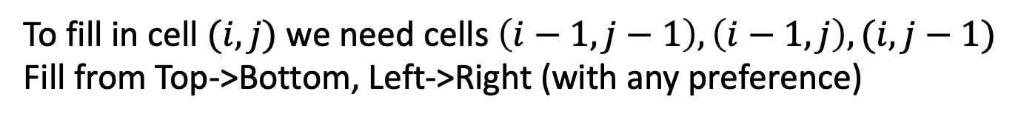














3. Solve in a Good Order
$0$ if $i=0$ or $j=0$
$LCS\left(i−1,j−1\right)+1$ if $X\left[i\right]=Y[j]$
$\max{(LCS\left(i,j−1\right),LCS\left(i−1,j\right))}$ otherwise
$$LCS\left(i,j\right)=$$
$$X=$$
$$A$$
$$T$$
$$C$$
$$T$$
$$G$$
$$A$$
$$T$$
$$Y=$$
$$0$$
$$1$$
$$2$$
$$3$$
$$4$$
$$5$$
$$6$$
$$7$$
$$0$$
0 | 0 | 0 | 0 | 0 | 0 | 0 | 0
0 | 0 | 1 | 1 | 1 | 1 | 1 | 1
0 | 0 | 1 | 1 | 1 | 2 | 2 | 2
0 | 0 | 1 | 2 | 2 | 2 | 2 | 2
0 | 1 | 1 | 2 | 2 | 2 | 3 | 3
0 | 1 | 2 | 2 | 3 | 3 | 3 | 4
0 | 1 | 2 | 2 | 3 | 3 | 4 | 4
$$T$$
$$1$$
$$G$$
$$2$$
$$C$$
$$3$$
$$A$$
$$4$$
$$T$$
$$5$$
$$A$$
$$6$$
To fill in cell $(i,j)$ we need cells $\left(i−1,j−1\right),\left(i−1,j\right),(i,j−1)$
Fill from Top->Bottom, Left->Right (with any preference)

Slide 32
LCS Length Algorithm
LCS-Length(X, Y) // Y for M’s rows, X for its columns
1. n = length(X) // get the # of symbols in X
2. m = length(Y) // get the # of symbols in Y
3. for i = 1 to m M[i,0] = 0 // special case: Y₀
4. for j = 1 to n M[0,j] = 0 // special case: X₀
5. for i = 1 to m // for all Y_{i}
6. for j = 1 to n // for all X_{j}
7. if ( X[i] == Y[j] )
8. M[i,j] = M[i-1,j-1] + 1
9. else M[i,j] = max( M[i-1,j], M[i,j-1] )
10. return M[m,n] // return LCS length for Y and X

Slide 33
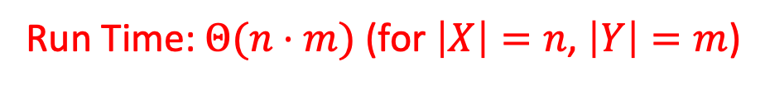
Run Time?
$0$ if $i=0$ or $j=0$
$LCS\left(i−1,j−1\right)+1$ if $X\left[i\right]=Y[j]$
$\max{(LCS\left(i,j−1\right),LCS\left(i−1,j\right))}$ otherwise
$$LCS\left(i,j\right)=$$
$$X=$$
$$A$$
$$T$$
$$C$$
$$T$$
$$G$$
$$A$$
$$T$$
$$Y=$$
$$0$$
$$1$$
$$2$$
$$3$$
$$4$$
$$5$$
$$6$$
$$7$$
$$0$$
0 | 0 | 0 | 0 | 0 | 0 | 0 | 0
0 | 0 | 1 | 1 | 1 | 1 | 1 | 1
0 | 0 | 1 | 1 | 1 | 2 | 2 | 2
0 | 0 | 1 | 2 | 2 | 2 | 2 | 2
0 | 1 | 1 | 2 | 2 | 2 | 3 | 3
0 | 1 | 2 | 2 | 3 | 3 | 3 | 4
0 | 1 | 2 | 2 | 3 | 3 | 4 | 4
$$T$$
$$1$$
$$G$$
$$2$$
$$C$$
$$3$$
$$A$$
$$4$$
$$T$$
$$5$$
$$A$$
$$6$$
Run Time: $Θ(n⋅m)$ (for $\left|X\right|=n$, $\left|Y\right|=m$)

Slide 34
Reconstructing the LCS
$0$ if $i=0$ or $j=0$
$LCS\left(i−1,j−1\right)+1$ if $X\left[i\right]=Y[j]$
$\max{(LCS\left(i,j−1\right),LCS\left(i−1,j\right))}$ otherwise
$$LCS\left(i,j\right)=$$
$$X=$$
$$A$$
$$T$$
$$C$$
$$T$$
$$G$$
$$A$$
$$T$$
$$Y=$$
$$0$$
$$1$$
$$2$$
$$3$$
$$4$$
$$5$$
$$6$$
$$7$$
$$0$$
0 | 0 | 0 | 0 | 0 | 0 | 0 | 0
0 | 0 | 1 | 1 | 1 | 1 | 1 | 1
0 | 0 | 1 | 1 | 1 | 2 | 2 | 2
0 | 0 | 1 | 2 | 2 | 2 | 2 | 2
0 | 1 | 1 | 2 | 2 | 2 | 3 | 3
0 | 1 | 2 | 2 | 3 | 3 | 3 | 4
0 | 1 | 2 | 2 | 3 | 3 | 4 | 4
$$T$$
$$1$$
$$G$$
$$2$$
$$C$$
$$3$$
$$A$$
$$4$$
$$T$$
$$5$$
$$A$$
$$6$$
Start from bottom right,
if symbols matched, print that symbol then go diagonally
else go to largest adjacent

Slide 35
Reconstructing the LCS
$0$ if $i=0$ or $j=0$
$LCS\left(i−1,j−1\right)+1$ if $X\left[i\right]=Y[j]$
$\max{(LCS\left(i,j−1\right),LCS\left(i−1,j\right))}$ otherwise
$$LCS\left(i,j\right)=$$
$$X=$$
$$A$$
$$T$$
$$C$$
$$T$$
$$G$$
$$A$$
$$T$$
$$Y=$$
$$0$$
$$1$$
$$2$$
$$3$$
$$4$$
$$5$$
$$6$$
$$7$$
$$0$$
0 | 0 | 0 | 0 | 0 | 0 | 0 | 0
0 | 0 | 1 | 1 | 1 | 1 | 1 | 1
0 | 0 | 1 | 1 | 1 | 2 | 2 | 2
0 | 0 | 1 | 2 | 2 | 2 | 2 | 2
0 | 1 | 1 | 2 | 2 | 2 | 3 | 3
0 | 1 | 2 | 2 | 3 | 3 | 3 | 4
0 | 1 | 2 | 2 | 3 | 3 | 4 | 4
$$T$$
$$1$$
$$G$$
$$2$$
$$C$$
$$3$$
$$A$$
$$4$$
$$T$$
$$5$$
$$A$$
$$6$$
Start from bottom right,
if symbols matched, print that symbol then go diagonally
else go to largest adjacent

Slide 36
Reconstructing the LCS
$0$ if $i=0$ or $j=0$
$LCS\left(i−1,j−1\right)+1$ if $X\left[i\right]=Y[j]$
$\max{(LCS\left(i,j−1\right),LCS\left(i−1,j\right))}$ otherwise
$$LCS\left(i,j\right)=$$
$$X=$$
$$A$$
$$T$$
$$C$$
$$T$$
$$G$$
$$A$$
$$T$$
$$Y=$$
$$0$$
$$1$$
$$2$$
$$3$$
$$4$$
$$5$$
$$6$$
$$7$$
$$0$$
0 | 0 | 0 | 0 | 0 | 0 | 0 | 0
0 | 0 | 1 | 1 | 1 | 1 | 1 | 1
0 | 0 | 1 | 1 | 1 | 2 | 2 | 2
0 | 0 | 1 | 2 | 2 | 2 | 2 | 2
0 | 1 | 1 | 2 | 2 | 2 | 3 | 3
0 | 1 | 2 | 2 | 3 | 3 | 3 | 4
0 | 1 | 2 | 2 | 3 | 3 | 4 | 4
$$T$$
$$1$$
$$G$$
$$2$$
$$C$$
$$3$$
$$A$$
$$4$$
$$T$$
$$5$$
$$A$$
$$6$$
Start from bottom right,
if symbols matched, print that symbol then go diagonally
else go to largest adjacent

Slide 37
Top-Down Solution with Memoization
We need two functions; one will be recursive.
LCS-Length(X, Y) // Y is M’s cols.
1. n = length(X)
2. m = length(Y)
3. Create table M[m,n]
4. Assign -1 to all cells M[i,j]
// get value for entire sequences
5. return LCS-recur(X, Y, M, m, n)
LCS-recur(X, Y, M, i, j)
1. if (i == 0 || j == 0) return 0
// have we already calculated this subproblem?
2. if (M[i,j] != -1) return M[i,j]
3. if ( X[i] == Y[j] )
M[i,j] = LCS-recur(X, Y, M, i-1, j-1) + 1
5. else
6. M[i,j] = max( LCS-recur(X, Y, M, i-1, j), LCS-recur(X, Y, M, i, j-1) )
7. return M[i,j]

Slide 39
Another LCS Example
Let’s see how LCS algorithm works on the following example:
X = ABCB
Y = BDCAB
What is the Longest Common Subsequence
of X and Y?
LCS(X, Y) = BCB
X = A B C B
Y = B D C A B

Slide 40
LCS Example (0)
ABCB
BDCAB
j 0 1 2 3 4 5
i
Yj
B
D
C
A
B
0
Xi
A
1
2
B
3
C
4
B
X = ABCB; m = |X| = 4
Y = BDCAB; n = |Y| = 5
Allocate array M[5,4]
Note: In this example, X is M’s rows, Y is the columns. Opposite from earlier example.

Slide 41
LCS Example (1)
ABCB
BDCAB
j 0 1 2 3 4 5
i
Yj
B
D
C
A
B
0
Xi
0
0
0
0
0
0
A
1
0
2
B
0
3
C
0
4
B
0
for i = 1 to m M[i,0] = 0
for j = 1 to n M[0,j] = 0

Slide 42
LCS Example (2)
ABCB
BDCAB
j 0 1 2 3 4 5
i
Yj
B
D
C
A
B
0
Xi
0
0
0
0
0
0
A
1
0
0
2
B
0
3
C
0
4
B
0
if (X[i] == Y[j])
M[i,j] = M[i-1,j-1] + 1
else M[i,j] = max( M[i-1,j], M[i,j-1] )

Slide 43
LCS Example (3)
ABCB
BDCAB
j 0 1 2 3 4 5
i
Yj
B
D
C
A
B
0
Xi
0
0
0
0
0
0
A
1
0
0
0
0
2
B
0
3
C
0
4
B
0
if (X[i] == Y[j])
M[i,j] = M[i-1,j-1] + 1
else M[i,j] = max( M[i-1,j], M[i,j-1] )

Slide 44
LCS Example (4)
ABCB
BDCAB
j 0 1 2 3 4 5
i
Yj
B
D
C
A
B
0
Xi
0
0
0
0
0
0
A
1
0
0
0
0
1
2
B
0
3
C
0
4
B
0
if (X[i] == Y[j] )
M[i,j] = M[i-1,j-1] + 1
else M[i,j] = max( M[i-1,j], M[i,j-1] )

Slide 45
LCS Example (5)
ABCB
BDCAB
j 0 1 2 3 4 5
i
Yj
B
D
C
A
B
0
Xi
0
0
0
0
0
0
A
1
0
0
0
0
1
1
2
B
0
3
C
0
4
B
0
if (X[i] == Y[j] )
M[i,j] = M[i-1,j-1] + 1
else M[i,j] = max( M[i-1,j], M[i,j-1] )

Slide 46
LCS Example (6)
ABCB
BDCAB
j 0 1 2 3 4 5
i
Yj
B
D
C
A
B
0
Xi
0
0
0
0
0
0
A
1
0
0
0
0
1
1
2
B
0
1
3
C
0
4
B
0
if (X[i] == Y[j] )
M[i,j] = M[i-1,j-1] + 1
else M[i,j] = max( M[i-1,j], M[i,j-1] )

Slide 47
LCS Example (7)
ABCB
BDCAB
j 0 1 2 3 4 5
i
Yj
B
D
C
A
B
0
Xi
0
0
0
0
0
0
A
1
0
0
0
0
1
1
2
B
0
1
1
1
1
3
C
0
4
B
0
if (X[i] == Y[j] )
M[i,j] = M[i-1,j-1] + 1
else M[i,j] = max( M[i-1,j], M[i,j-1] )

Slide 48
LCS Example (8)
ABCB
BDCAB
j 0 1 2 3 4 5
i
Yj
B
D
C
A
B
0
Xi
0
0
0
0
0
0
A
1
0
0
0
0
1
1
2
B
0
1
1
1
1
2
3
C
0
4
B
0
if (X[i] == Y[j] )
M[i,j] = M[i-1,j-1] + 1
else M[i,j] = max( M[i-1,j], M[i,j-1] )

Slide 49
LCS Example (10)
ABCB
BDCAB
j 0 1 2 3 4 5
i
Yj
B
D
C
A
B
0
Xi
0
0
0
0
0
0
A
1
0
0
0
0
1
1
2
B
0
1
1
1
1
2
3
C
0
1
1
4
B
0
if (X[i] == Y[j] )
M[i,j] = M[i-1,j-1] + 1
else M[i,j] = max( M[i-1,j], M[i,j-1] )

Slide 50
LCS Example (11)
ABCB
BDCAB
j 0 1 2 3 4 5
i
Yj
B
D
C
A
B
0
Xi
0
0
0
0
0
0
A
1
0
0
0
0
1
1
2
B
0
1
1
1
1
2
3
C
0
1
1
2
4
B
0
if (X[i] == Y[j] )
M[i,j] = M[i-1,j-1] + 1
else M[i,j] = max( M[i-1,j], M[i,j-1] )

Slide 51
LCS Example (12)
ABCB
BDCAB
j 0 1 2 3 4 5
i
Yj
B
D
C
A
B
0
Xi
0
0
0
0
0
0
A
1
0
0
0
0
1
1
2
B
0
1
1
1
1
2
3
C
0
1
1
2
2
2
4
B
0
if (X[i] == Y[j] )
M[i,j] = M[i-1,j-1] + 1
else M[i,j] = max( M[i-1,j], M[i,j-1] )

Slide 52
LCS Example (13)
ABCB
BDCAB
j 0 1 2 3 4 5
i
Yj
B
D
C
A
B
0
Xi
0
0
0
0
0
0
A
1
0
0
0
0
1
1
2
B
0
1
1
1
1
2
3
C
0
1
1
2
2
2
4
B
0
1
if ( X[i] == Y[j] )
M[i,j] = M[i-1,j-1] + 1
else M[i,j] = max( M[i-1,j], M[i,j-1] )

Slide 53
LCS Example (14)
ABCB
BDCAB
j 0 1 2 3 4 5
i
Yj
B
D
C
A
B
0
Xi
0
0
0
0
0
0
A
1
0
0
0
0
1
1
2
B
0
1
1
1
1
2
3
C
0
1
1
2
2
2
4
B
0
1
1
2
2
if (X[i] == Y[j] )
M[i,j] = M[i-1,j-1] + 1
else M[i,j] = max( M[i-1,j], M[i,j-1] )

Slide 54
LCS Example (15)
ABCB
BDCAB
j 0 1 2 3 4 5
i
Yj
B
D
C
A
B
0
Xi
0
0
0
0
0
0
A
1
0
0
0
0
1
1
2
B
0
1
1
1
1
2
3
C
0
1
1
2
2
2
4
B
3
0
1
1
2
2
if ( X[i] == Y[j] )
M[i,j] = M[i-1,j-1] + 1
else M[i,j] = max( M[i-1,j], M[i,j-1] )

Slide 55
Practice!
X = [G, D, V, E, G, T, A] and Y = [G, V, C, E, K, S, T]
Find the LCS, show the table M
Can you reconstruct the LCS from M?

