Slide 1

Microsoft Digital Production Group

Slide 2
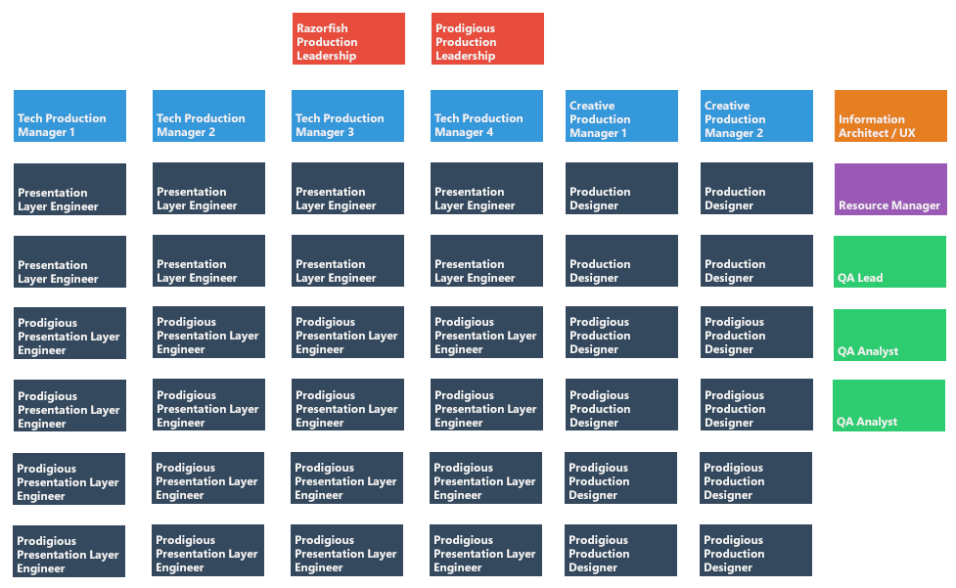
Current Structure: 2 Teams
2 Production Managers
1 Resourcing Manager
1 QA Lead
8-16 Developers

Slide 3
Current Structure: 2 Teams
Team 1: Primarily Flash Development

Slide 4
Current Structure: 2 Teams
Team 2: Primarily HTML5/Mobile Development

Slide 5
Expanding the Group: Leadership

Slide 6
Expanding the Group: Designers/Engineers
Team 3: Social

Slide 7
Expanding the Group: Designers/Engineers
Team 4: HTML Email

Slide 8
Expanding the Group: Designers/Engineers
Team 5: Motion Design

Slide 9
Expanding the Group: Designers/Engineers
Team 6: Responsive Design

Slide 10
Expanding the Group: Miscellaneous Roles

Slide 11
Final Structure

Slide 12
Razorfish Employees

Slide 13
Prodigious Employees

Slide 14
Final Structure
3-6 Technical Production Managers
1-2 Creative Production Managers
4-8 Developer/Designers per Production Team
3-6 Miscellaneous Roles
25-75 People per Production Group

Slide 15
Microsoft Digital Production Group

