Slide 1
Software Reliability and Safety
CS 8317 – Spring 2026
Module 2:
Tree Based Reliability Models & Integrated SRE/Hazard Analysis

Slide 2
Agenda
Deliverables
  Assignment 1 due today
  Assignment 2 due next week
Environment and needs
Background: Existing approaches
TBRMs: Tree-based reliability Models
Integrated SRE using TBRMs & others

Slide 3
Overview
Reliability: Problem/failure-free operations
  Time domain: for a specific period.
    Reliability growth models.
  Input domain: for a specific input set.
    Repeated sampling models.
A new integrated approach: TBRMs
  Tree-based reliability models (TBRMs)
  Both input/time domain information.
  Data driven/sensitive partitions.
  Risk focusing and remedial actions.
  Details: SRE2 j7tbrm.pdf (Tian 1995),
    SRE2_3_b1sreAIC.pdf (Tian 1998) with more background

Slide 4
Product Environment
Large (medium-reliable) products:
  Commercial: Compilers, software tools and computing environments.
  Telecommunication products too.
  Size: Up to millions of LOC.
  Widely distributed/large user population.
  No precise operational profile.
  Process: roughly waterfall.
Overall testing:
  Long testing period (2 ∼ 18 months).
  Different testing sub-phases.
  System testing focuses on reliability.
  Test-until-it-breaks commonly used.
  Staffing level variations.
  Code base stability

Slide 5
Testing Environment
Scenario-based testing.
  Shifting focus: learning/dependency.
  Functionality-based scenario classes:
    Randomized workload
    Progression: complexity & intensity increases
    Defect fixing and related runs
    Division among testers.
Specific reliability analysis issues:
  Scenario-based ∼ random testing
    Due to parallelism and interleaving
  Defect fixing effect:
    No long-term dependency
    Short-term dependency will need grouping. Discussed later
  Uneven faults; TBRMs

Slide 6
Needs and Constraints
Need assessment and analysis:
  Track test effort, progress and defect.
  Reliability assessment and prediction.
  Effective defect detection and removal.
  Process and quality improvement.
Environmental constraints:
  Minimize cost & schedule risks.
  Data availability and affordability.
  Process refinement.
  Maximize data utilization.

Slide 7
Overall Solution
Combine SRGMs and IDRMs into TBRMs.
Analysis and control:
  SRGMs
  TBRMs: tree-based reliability models.
  Progress monitoring & exit criteria.
Problem identification and correction:
  Use of input domain information
    IDRMs (input domain reliability models)
    Identify high risk areas
  Automatic partitioning via TBRMs.
  Remedial actions for improvement.

Slide 8
Solution: Coverage & Scope
Product coverage:
  Commercial products from IBM.
  Improvement over original process.
  Evolutionary approach:
    Individual techniques.
    Integration and refinement.
Scope of Engagement:
  Data definition and collection.
  Data visualization and analysis.
  Test progress tracking.
  Reliability tracking with SRGMs.
  Reliability improvement with TBRMs.

Slide 9
Data: UBST & Data
Data and tracking:
  Integration with schedule information.
  Normalization effect.
  Summary reports and visualization.
  Consistency checking automation.
Customer usage information gathering
  Operational profile construction.
Coverage and input-domain analysis:
  Functionality/function/static/dynamic.
  Different levels of coverage for different testing phases.
  Focused coverage through TBRM.

Slide 10
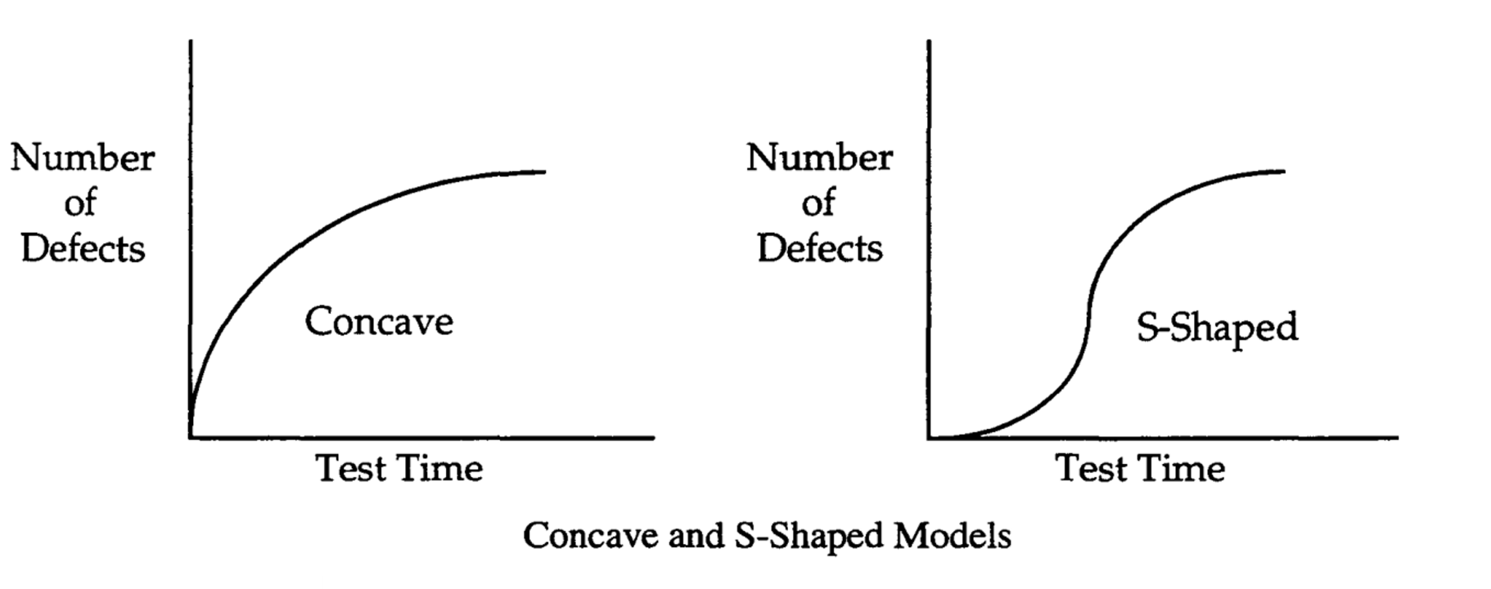
Software Reliability Growth Model
Shape can either take a concave or S-shape
Use cumulative defects over time
Measuring test time:
  Calendar time, example months
  Number of test runs
  Execution time, example CPU time, transactions etc.

Slide 11
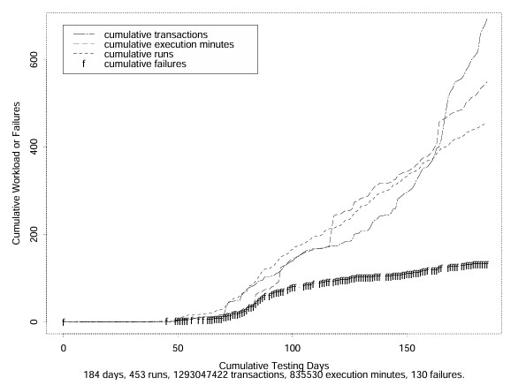
Experience: SRGMs
Time measurements: Fig.2 (Tian 1998)
  Product E

Slide 12
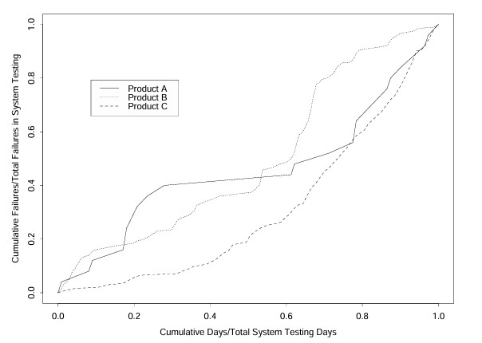
Experience: SRGMs
Model applicability and effectiveness:
  Calendar time models useless.
  Products A, B, and C: Fig.3 (Tian 1998)

Slide 13
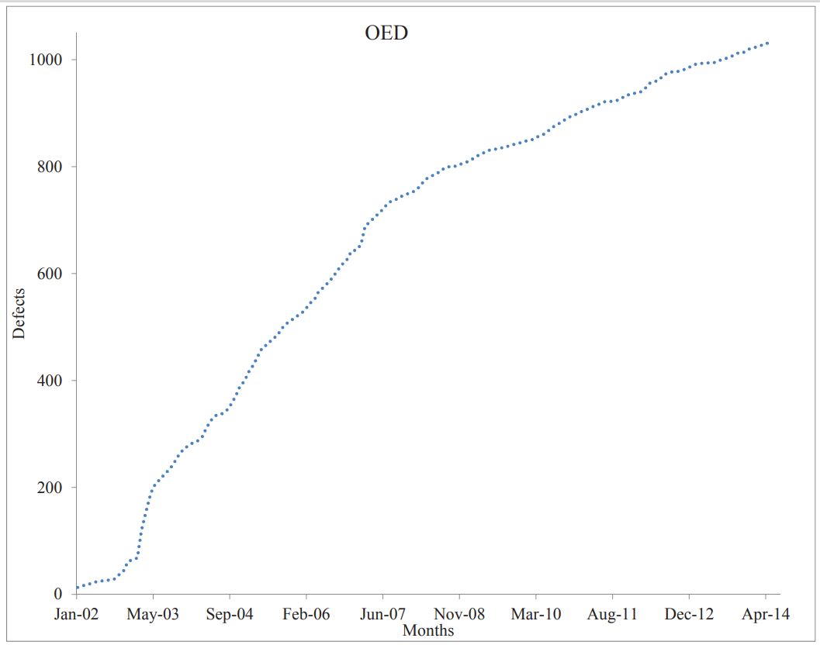
Experience: SRGMs
Model applicability and effectiveness:
  Calendar time Fig. 3 (Abuta-Tian 2018)
    SRE4_j36oedSRE.pdf

Slide 14
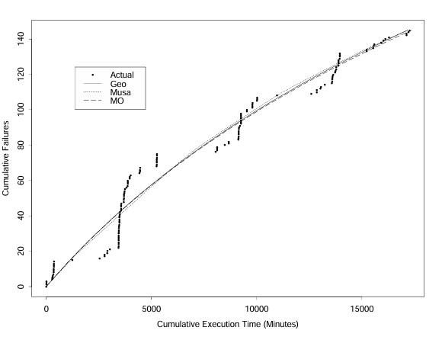
Experience: SRGMs
Model applicability and effectiveness:
  Execution time models costly & sensitive.
  Product B Fig.6b (Tian 1998)
    Geo – Moranda’s geometric de-eutrophication model
    Musa – Musa’s basic execution time model
    Musa-Okumoto – logarithmic Poisson execution time model

Slide 15
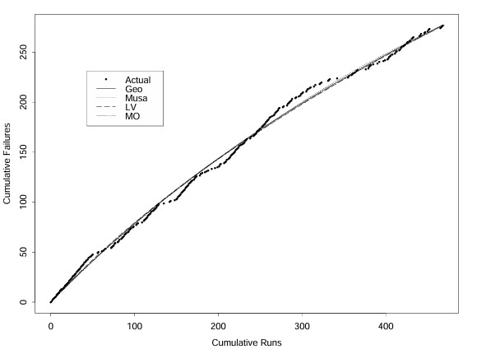
Experience: SRGMs
Model applicability and effectiveness:
  Runs suitable for some products.
  Product B: Fig.6a (Tian 1998)
    LV – Littlewood-Varrel Bayesian model

Slide 16
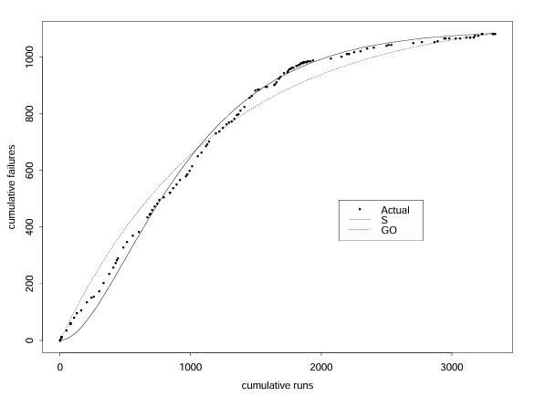
Experience: SRGMs
Model applicability and effectiveness:
  Runs suitable for some products.
  Product D: Fig.8a (Tian 1998)
    S: Yamada-Ohba-Osaki S-shaped non-homogeneous Poisson process (NHPP) model

Slide 17
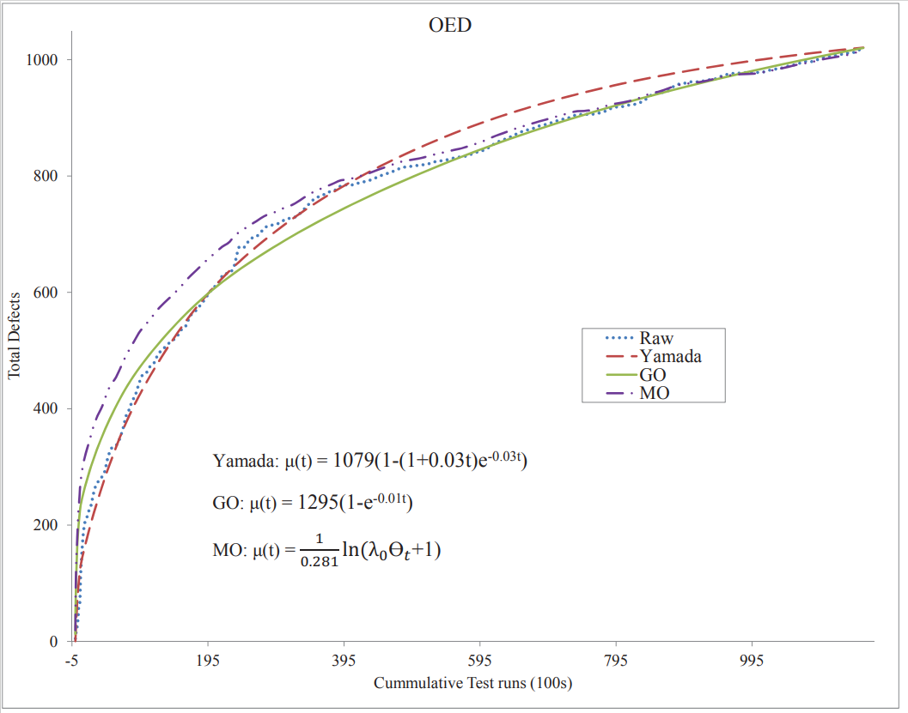
Experience: SRGMs
Non-Homogenous Poison Process (NHPP) models
  Concave – Goel-Okumoto
  S-Shape – Yamada
  Musa-Okumoto
    Another variation on NHPP → logarithmic execution
  Fig. 12 (Abuta-Tian 2018)

Slide 18
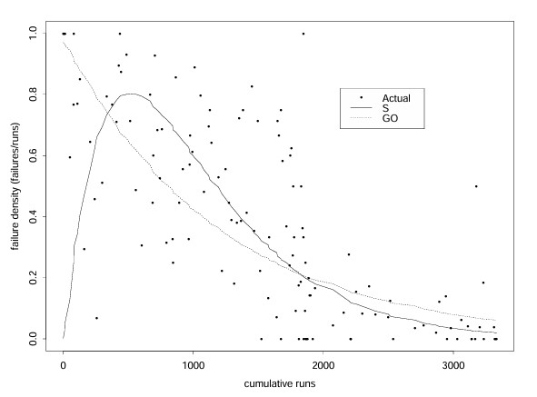
Experience: SRGMs
Model applicability and effectiveness:
  Runs suitable some products.
  Product D: Fig.8b (Tian 1998)
    Failure intensity data (rate data)
    GO: Goel-Okumoto NHPP model

Slide 19
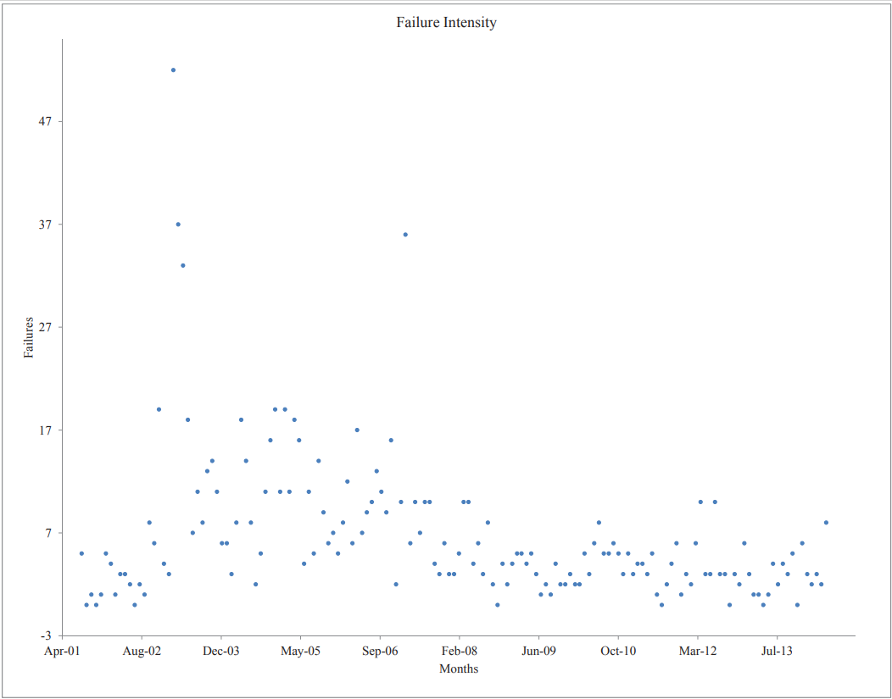
Experience: SRGMs
Model applicability and effectiveness:
  Failure intensity – Fig. 7 (Abuta-Tian 2018)

Slide 20
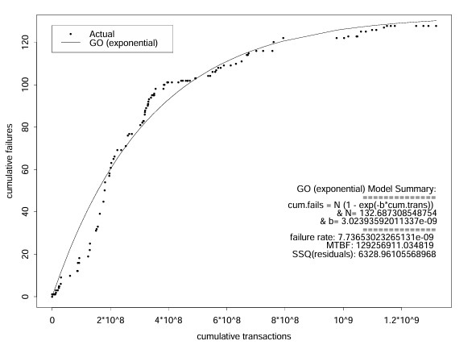
Experience: SRGMs
Model applicability and effectiveness:
  Transactions for other products.
  Product E: Fig.9 (Tian 1998)

Slide 21
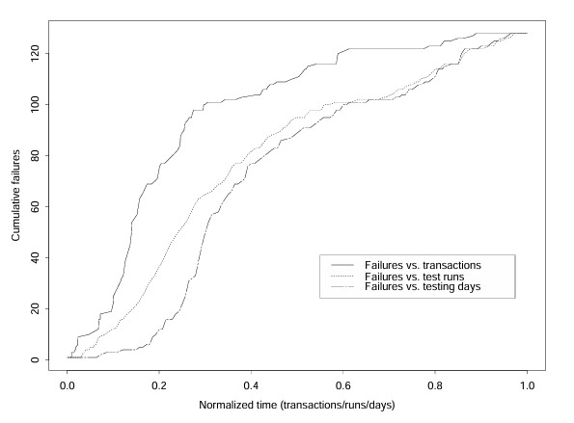
Experience: SRGMs
Model applicability and effectiveness:
  Time measurement comparison
  Product E: Fig.5 (Tian 1998)

Slide 22
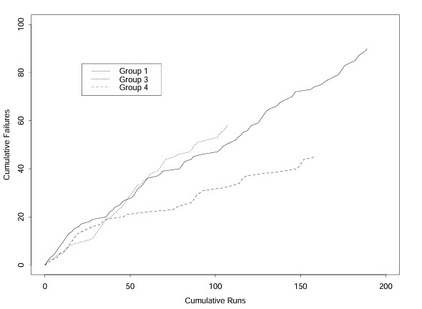
Experience: SRGMs
Model applicability and effectiveness:
  Context sensitive modeling for sub-groups or sub-phases ⇒ TBRMs.
  product B: Fig.7 (Tian 1998)
    Groups 1,3, and 4: Failure interval data
    Groups 1 and 3 : Execution time-based failure

Slide 23

Operational Reliability Assessment
System's reliability snapshot during operation
  Failure rate stability/operational stability
Use Input Domain Reliability Model (IDRM)
  Nelson model (Nelson, 1978)
  Estimate's reliability (R) for different time segments as:
    ƒ – number of failures
    λ – failure rate
    n – number of runs
Stable period
  Individual rate falls 15% with the stable period s to N (Abuta-Tian 2018)

Slide 24
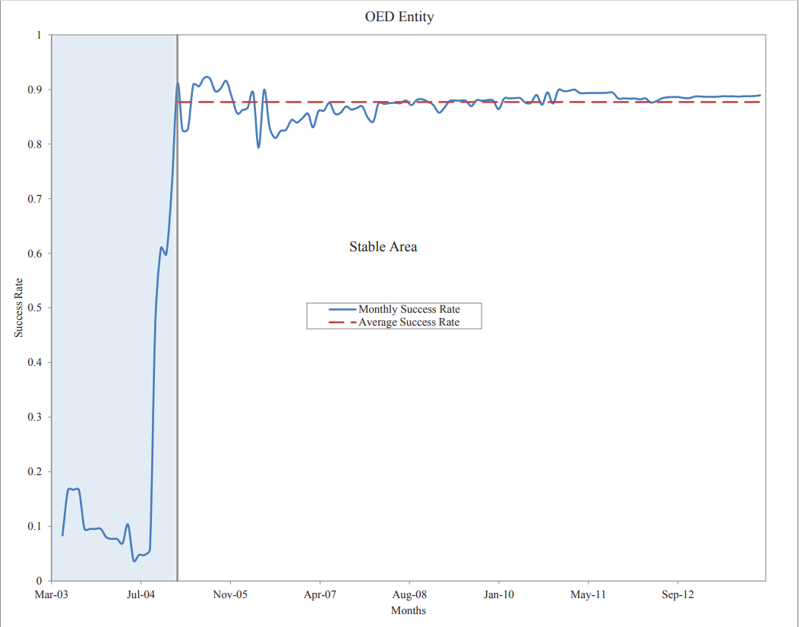
Operational Reliability Assessment
Model applicability and effectiveness:
  Fig. 8 (Abuta-Tian 2018)

Slide 25
Other: Trend Test
Analyze reliability of a system, using defects
  Uniquely counted defects
  Set at an interval (Month)
Use Laplace trend test, were Laplace factor:
  Negative - decreasing failure intensity
    Implies reliability growth
    Most defects have been found
  Positive - increased failure intensity
    Implies reliability decay
Trend not established for region between
  Reliability decay
  Reliability growth

Slide 26
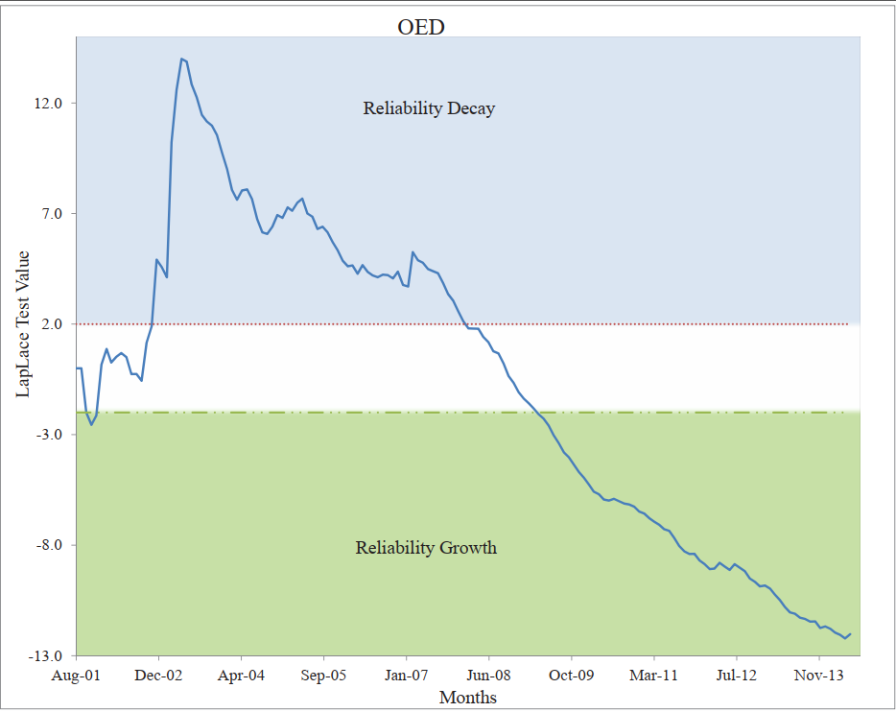
Other: Trend Test
Model applicability and effectiveness:
  Gives a better view of defect distribution
  Demonstrated Reliability growth
  Fig. 5 (Abuta-Tian 2018)

Slide 27
Experience: SRGM Conclusions
Modeling result interpretation:
  Accuracy of models:
    Assessment, model goodness-of-fit.
    Prediction: training & testing sets
  Product purity at exit.
  Bounded estimations: multiple models.
  Convergence of modeling results.
Evolving to usage-based data/model:
  Assurance of homogeneity:
    Homogeneous – constant fault detection rater per fault
    If ‘yes’, run-based data/model;
    If ‘no’, transaction measurement.
  Suitable for input domain analysis.
  Also, as cross validation for TBRMs.

Slide 28
Assessing Existing Approaches
Time domain reliability analysis:
  Customer perspective.
  Overall assessment and prediction.
  Ability to track reliability change.
  Problem: how to improve reliability?
Input domain reliability analysis:
  Explicit operational profile.
  Better input state definition.
  Hard to handle change/evolution.
  Problem: realistic reliability assessment and handling numerous data sets/partitions?

Slide 29
An Integrated Approach
Combine strengths of the two.
Using TBRM for individual modeling:
  Input state: categorical information.
  Each run as a data point.
  Time cutoff for partitions too.
  Data sensitive partitioning
    Nelson models for subsets.
Integrated reliability analyses:
  TBRM: partitioned subset reliability.
  Use both input and timing information.
  Monitoring changes in trees.
  Enhanced exit criteria.
  SRGM: overall reliability near exit.
  Integrate into the testing process.

Slide 30
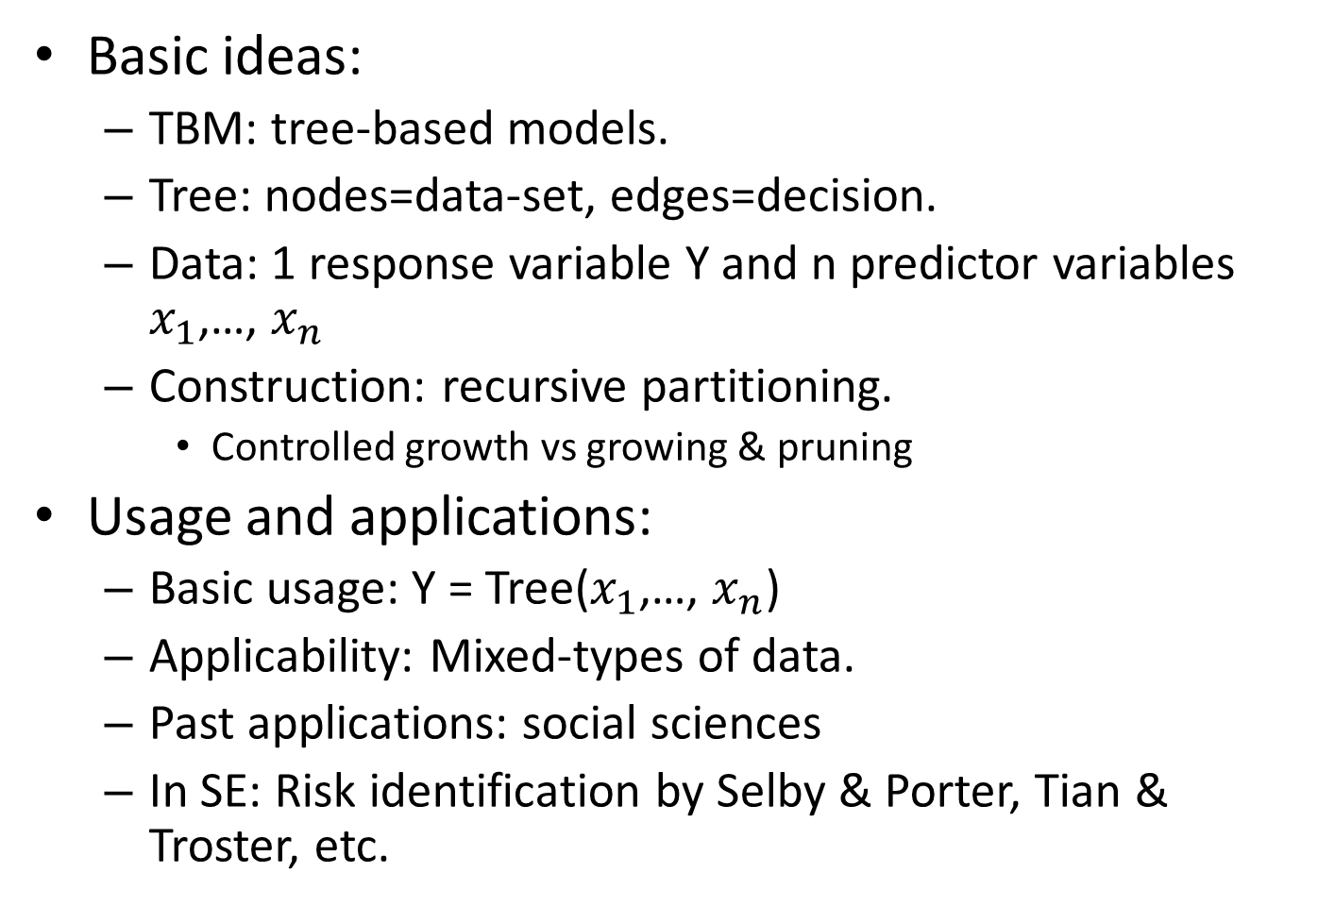
TBM: Technique for Integration
Basic ideas:
  TBM: tree-based models.
  Tree: nodes=data-set, edges=decision.
  Data: 1 response variable Y and n predictor variables $x_{1}$,…, $x_{n}$
  Construction: recursive partitioning.
    Controlled growth vs growing & pruning
Usage and applications:
  Basic usage: Y = Tree($x_{1}$,…, $x_{n}$)
  Applicability: Mixed-types of data.
  Past applications: social sciences
  In SE: Risk identification by Selby & Porter, Tian & Troster, etc.

Slide 31
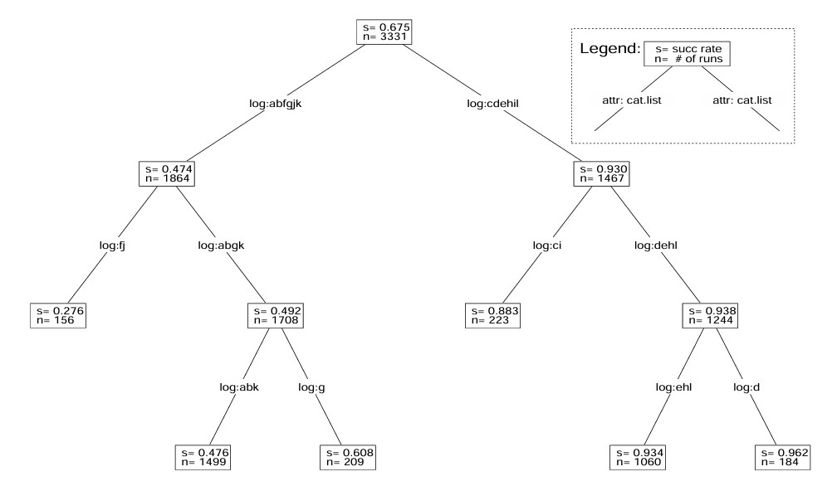
TBRM Simple Example
1 categorical predictor and 1 response:
  Binary grouping for partitioning
  Example: Fig 10 (Tian 1998)

Slide 32
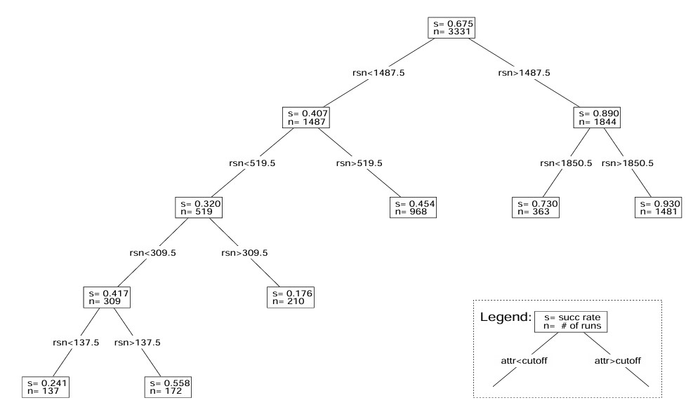
TBRM Simple Example
1 numerical predictor and 1 response:
  Binary operator (≥) for partitioning
    Run numbering (rsn)
  Example: Fig 15 (Tian 1998)

Slide 33
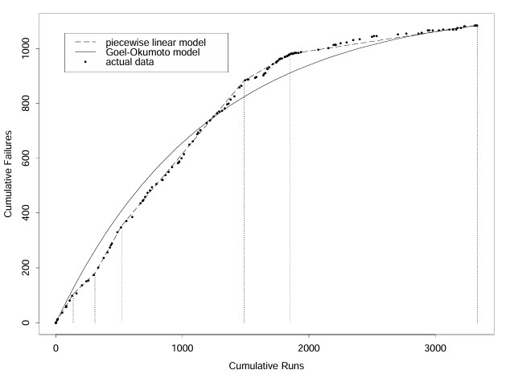
TBRM Simple Example
1 categorical predictor and 1 response:
  Interpretation as piecewise linear model
  Example continued: Fig 14 (Tian 1998)

Slide 34
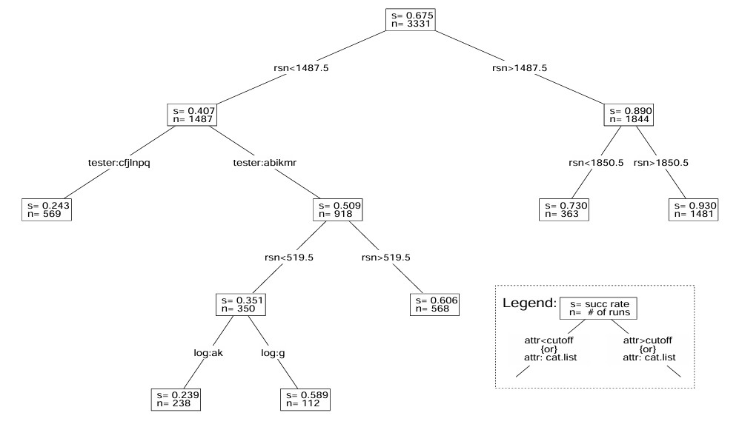
TBRM Example
The n mixed predictors and 1 response:
  Full TBRM
  Example: Fig 11 (Tian 1998)

Slide 35
TBRM in Integrated Analysis
Tree-based reliability models (TBRMs) using all information:
  Input domain partitioning information.
  Testing results.
  Timing information.
  Each run as a data point.
Model construction:
  Response: Result indicator.
    1 for success, 0 for failure.
    Nelson model for subsets.
    Mapping to failure rate or mean-time-between-failures (MTBF)
  Predictor: Timing and input states.
    Data sensitive partitioning.
    Key factors affecting reliability.
    Homogeneity of product reliability.

Slide 36
Using Integrated Analysis
Interpretation of trees:
  Predicted response: success rate.
    Nelson reliability estimate.
  Time predictor: reliability change.
  State predictor: risk identification.
Monitoring reliability change:
  Change in predicted response.
  Through tree structural change.
Risk identification and remedies:
  Identify high risk input state.
  Additional analysis.
  Enhanced test cases.
  Remedies for components.

Slide 37
TBRMs in Integrated Analysis
Treatment of product bundles:
  TBRM for individual products.
  Dynamic change with respect to process needs.
  SRGM (& TBRM) for bundle near exit.
Risk identification:
  High risk input sub-domains.
  Additional analysis for the identified.
  Guide for remedial actions.
Results interpretation:
  Progression of trees & tree types.
  Usage as exit criteria.

Slide 38
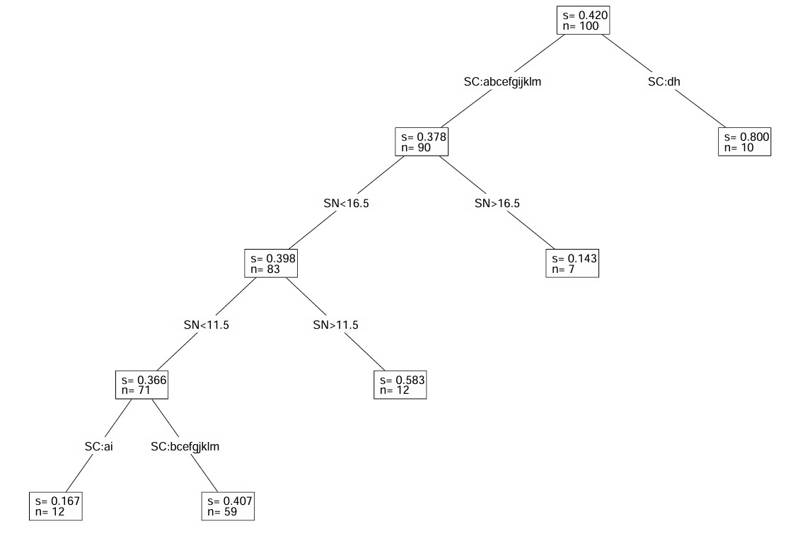
TBRMs at Different Times
Fig 12a (Tian 1998): an early TBRM.
  High-risk areas identified by input
  Early actions to improve reliability
    Test scenario SC and SN (Scenario Number)

Slide 39
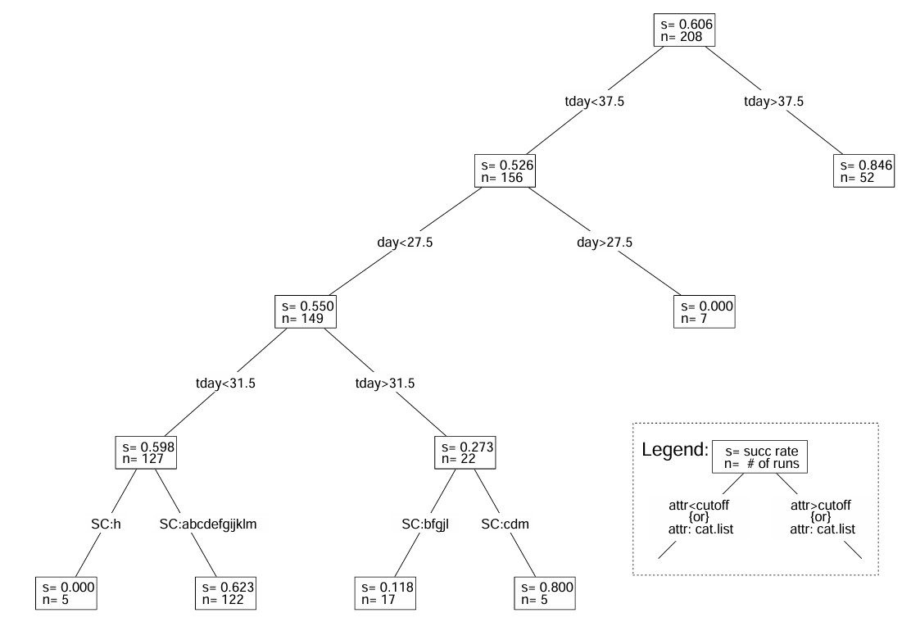
TBRMs at Different Times
Fig 12b (Tian 1998): whole testing phase
  High-risk areas ≈ early runs
  Uniformly reliable implies ready for release

Slide 40
Cross Validation
Consistency with macro models:
  Effects on cost, schedule, quality.
Validate with reliability growth models:
  Trend of reliability growth.
  Stability of failure arrivals.
  Estimated reliability.
  Product purity level at exit.
Process changes & improvements:
  Failure detection and fault removal.
  Long term effect on development.
Ultimate test: In-field problems.

Slide 41
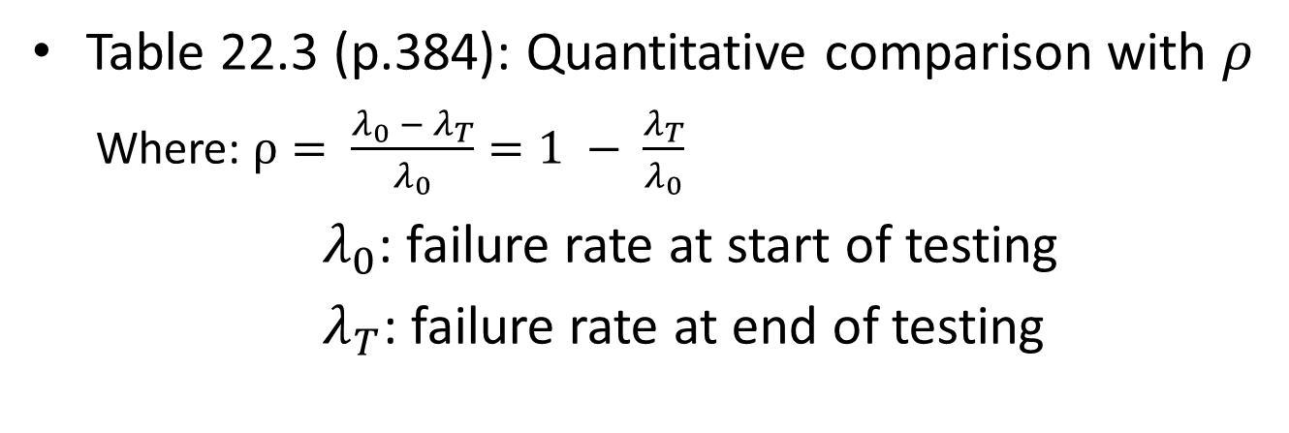
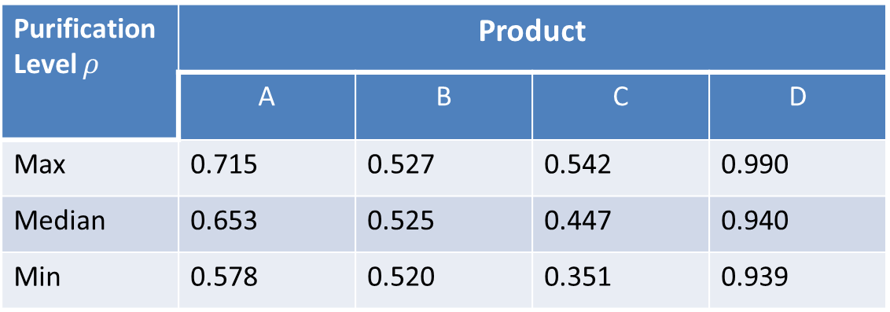
TBRM Result Comparison
Purification Level $ρ$ | Product
 | A | B | C | D
Max | 0.715 | 0.527 | 0.542 | 0.990
Median | 0.653 | 0.525 | 0.447 | 0.940
Min | 0.578 | 0.520 | 0.351 | 0.939
Table 22.3 (p.384): Quantitative comparison with $ρ$
  Where: $ρ= \frac{λ_{0} − λ_{T}}{λ_{0}}=1 − \frac{λ_{T}}{λ_{0}}$
$λ_{0}$: failure rate at start of testing
$λ_{T}$: failure rate at end of testing

Slide 42
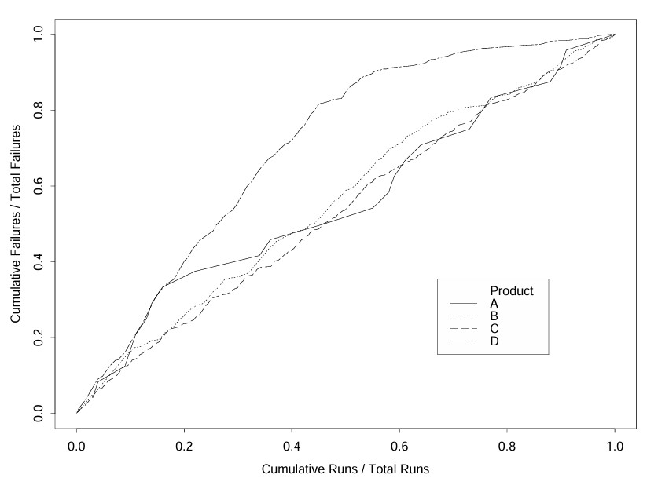
TBRM Result Comparison
Fig 22.6 (p.384): TBRMs used in D
  Better reliability growth in D
  Compare to A, B, and C (no TBRMs)

Slide 43
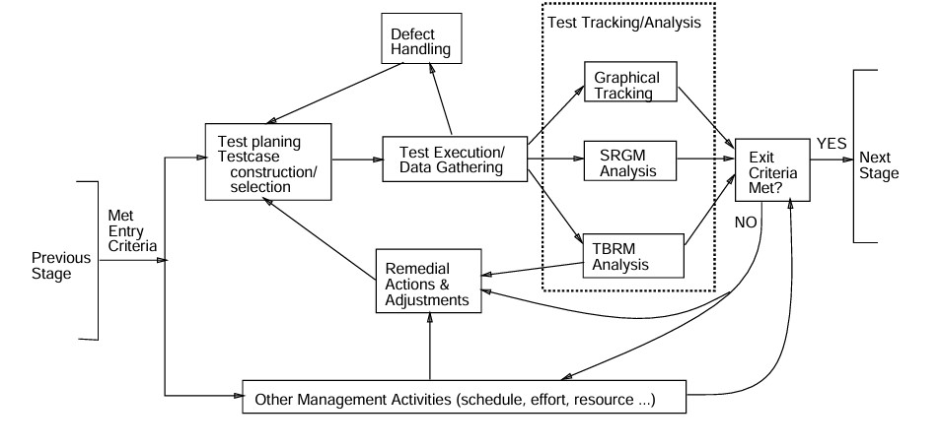
Integrated Approach: Implementation
Modified testing process: Fig 18 (Tian 1998)
  Additional link for data analysis.
  Process change and remedial actions.

Slide 44
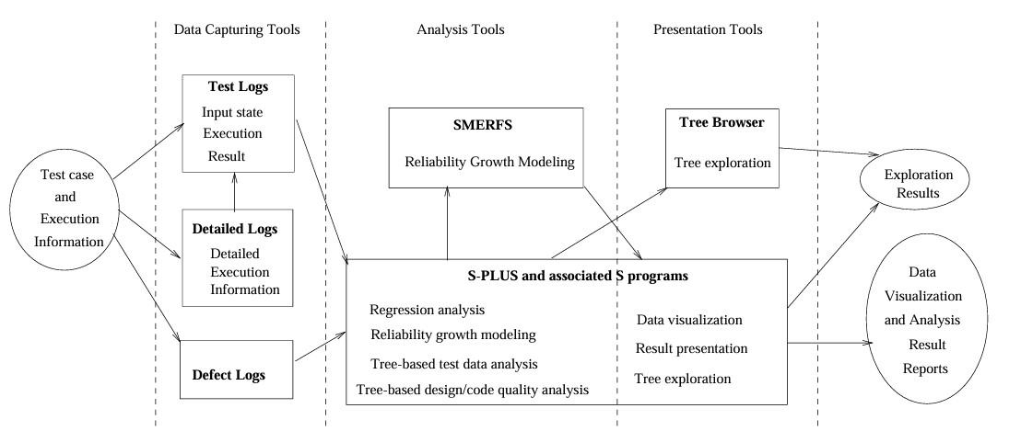
Integrated Approach: Implementation
Tool support: Fig 20 (Tian 1998)
  Different types of tools
  I/O and interconnection

Slide 45
Integrated Approach: Implementation
Activities and Responsibilities:
  Evolutionary, stepwise refinement.
  Collaboration: project & quality orgs.
  Experience factory prototype (Basili).
Implementation:
  Passive tracking and active guidance.
  Periodic and event-triggered.
  Software tool support

Slide 46
Implementation Support
Types of tool support:
  Data capturing
    Mostly existing logging tools
    Modified to capture new data
  Analysis and modeling
    SMERFS modeling tool
    S-PLUS and related programs
  Presentation/visualization and feedback
    S-PLUS and Tree-Browser
Implementation of tool support:
  Existing (IBM + others) tools: cost go down
  New tools and utility programs
  Tool integration
    Loosely coupled suite of tools
    Connectors/utility programs
    Common depository: S-PLUS

Slide 47
Application Summary
Tracking and input-domain analysis:
  Effectiveness of visualization.
  Problems with input-domain assessment.
Time-domain analysis refinement:
  Data normalization by runs/transactions best.
  Context sensitive modeling promising.
Integrated approach using TBRM:
  Guidance as well as assessment.
  Risk focusing implies reliability improvement.
  Progression of trees.
  Usage as exit criteria.
  Cross validation.

Slide 48
Future Directions
Implementation and deployment:
  Data: automated data capturing.
  OP: evolutionary approach.
  Integration: analysis and improvement.
  Use in different industrial environments.
Exploration and improvement:
  Customize time/transaction measurement.
  Early indicators/predictive modeling.
  Customer environment/OP refinement.
  Integrate to life-cycle quality models.
  Management and cost modeling.
  Refinement of modeling techniques.
Continued research at SMU and collaboration with our industrial partners.

Slide 49
Hazard Analysis (HA) Agenda
Hazard Analyses and Techniques
Fault Tree Analysis (FTA)
Event Tree Analysis (ETA)
Other HA Techniques

Slide 50
Safety Techniques
Hazard and risk identification:
  Accident scenarios: actual/hypothetical
    Starting points for safety
  Focus: operations and operational enviroment
Hazard analysis and assessment:
  Fault trees: (static) logical conditions
  Event trees: dynamic sequences
  Other analyses/assessment techniques
Hazard and risk resolution
  Hazard elimination
  Hazard reduction
  Hazard control
  Damage control

Slide 51
Safety Techniques in Process
Starting points for safety (initiation)
  Accident actual/hypothetical
    Hazard and risk identification
Hazard analysis (pre-process?)
  Input: above plus expertise
  Output: driver for Hazard Resolution (below)
Hazard and risk resolution
  Negate
    Tolerate(passive)/control(active)
  Damage control (post accident)
  In-process:
    Cascading activities
    Hazard Resolution and/plus Hazard Analysis

Slide 52
Hazard Analysis: Types/Levels/Scope
Sub-system hazard analyses (SSHA)
  Hazard within individual sub-system
  Component/sub-system in isolation
System hazard analyses (SHA)
  Focus: interface and interaction
  Sub system/environment/human effect on system
  Throughout development process
  Focus on early phases to provide info. for other activities (hazard resolution and safety verification)
SHA/SSHA in software process
  Throughout development process
  Focus on early phases to provide information for other activities
    Hazard resolution and safety verification

Slide 53
Hazard Analyses: Techniques
Primary techniques for SHA/SSHA:
  Fault-tree analyses (FTA)
  Event-tree analyses (ETA)
  SQE Ch.16.4 and Safeware Ch.14.
Other techniques:
  Design reviews & checklists
  Hazard indices
  Risk trees
  Cause-consequence analysis (CCA)
  Hazard & operability analysis (HAZOP)
  Failure modes and effect analysis (FMEA)
  FMECA (FMEA + Criticality), etc.
    Above: “Safeware” Ch.14.
    Specific to software: “Safeware” Ch.15.
  System Theoretic Accident Mode (STAMP) (Model 4)

Slide 54
Hazard Analysis: FTA
Fault tree idea:
  Top event (accident)
  Intermediate events/conditions
  Basic or primary events/conditions
  Logical connections
  Form a tree structure
Elements of a fault tree:
  Nodes: conditions and sub-conditions
    Terminal vs. no terminal
  Logical relations among sub-conditions
    AND, OR, NOT
  Other types/extensions possible

Slide 55
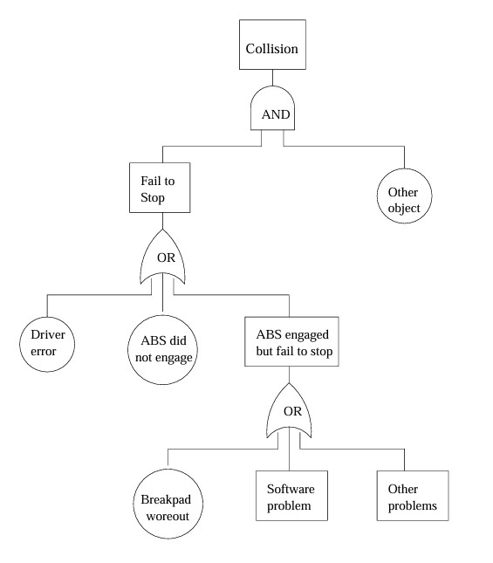
Hazard Analysis: FTA Example
Example FTA for an automobile accident (Fig. 16.3, p.276)

Slide 56
Hazard Analysis: ETA
Even Tree Analysis (ETA): Why?
  FTA: focus on static analysis
    Logical conditions (static)
  Dynamic aspect of accidents
  Timing and temporal relations
  Real-time control systems
Search space/strategy concerns:
  Contrast ETA with FTA:
    FTA: backward search
    ETA: forward search
  May yield different path/info.
  ETA provide additional info.

Slide 57
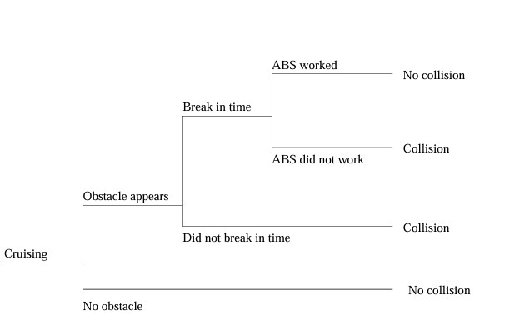
Hazard Analysis: ETA Example
Example ETA for an automobile accident (Fig 16.4, p.277)
Compare/contrast with FTA a few slides back.

Slide 58
Hazard Analysis: SFTA
SFTA: Software FTA
  Same concept applied to software
  Actual implementation (white-box)
  Language elements (high-level):
    Assignment and function calls
    Branching statement, loops, etc.
  It can also be used for specification/architecture
    Black-box control flow diagram
    Equivalent language representation
SFTA construction:
  Templates/examples for diff. statements
  Safeware 18.2.2 (pp.497-507)
    Additional work needed, especially for system design/architecture new work of STPA by Leveson

Slide 59
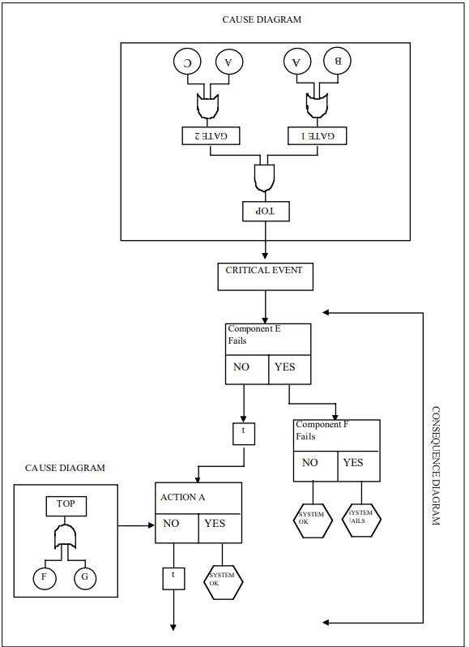
Cause-Consequence Analysis
Construct the Cause Tree
  Work backwards from the critical event
  Identifying primary, secondary, and root causes
  Assign probabilities to basic events
Develop the Consequence Tree
  Move forward from the critical event
  Identify safety functions and barriers
  Determine possible outcomes
Ref: Jeremiah Genest - CCA

Slide 60
Hazard Analysis: ETA & CCA
ETA alone: trace of accident. May desire explanation also (from FTA)
Cause-consequence diagram (CCA):
  Combine ETA with FTA
  Explaining decisions in ETA
Using ETA and CCA:
  Partial vs. total ETA
  Focus on main consequences
  Details: “Safeware” 14.5-14.6 (pp.327-pp.335)

Slide 61
Hazard Analyses: FMEA & FMECA
Failure modes and effect analysis (FMEA)
  Reverse of FTA
  Some similarity to OP
  Focus on logical conditions
  Typically include environmental variables, operational scenarios, etc.
FMEA relation to other Hazard Analysis techniques
  Similar to ETA, but not focusing on time nor sequence
  FMECA (FMEA + Criticality), etc.
  Root in traditional (hardware) reliability engineering
  Less so because of the dynamic/variable nature of software executions

