Slide 1
Things that are nice to know when you’re doing this project

Slide 2
What are we doing?
create socket
connect socket to server
send and receive data

Slide 3
What are we doing, a closer look
create a socket
get the file descriptor that is returned by socket()
connect socket to server
resolve the hostname
use the resolved hostname info and format it so that it can be used to connect a socket to the specified server
perform the connect the socket to the server with the formatted address!
send and receive messages
perform a write() with the formatted HTTP GET request that consists of the hostname and URI that were passed in as arguments when you called your program from the command line
perform a read() where you parse the headers and body of the response from the server (make sure you read the whole message)

Slide 4
Create socket
int socket(int domain, int type, int protocol);
what is returned by the system call socket()?
http://linux.die.net/man/2/socket
what domain, type, and protocol do we use?
domain: AF_INET
this specifies that we’re using IPv4
type: SOCK_STREAM
this specifies that we’re using TCP
protocol: 0
if you can tell me why we’re using 0 as the protocol, I will give you a prize
need to include sys/socket.h for sockets
need to include sys/types.h for data types used in system calls
also include unistd.h … because it will help you?

Slide 5
Connect the socket
What do you need to connect to a socket to a server?
ip address, port, format of the address (IPv4, IPv6, etc.)

Slide 6
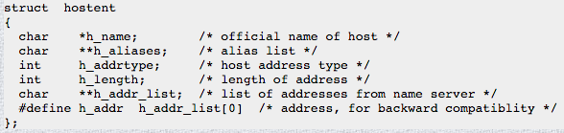
HIGH LEVEL EXPLANATION:
i want to take the hostname (server) passed in at the command line and figure out its IP address and then format it in a way that can be used to connect a socket to that server
DETAILED EXPLANATION:
hostent is the struct returned by the function gethostbyname(). in order to resolve a hostname (i.e. cs.byu.edu) to its IP address, the gethostname() function is used. the information from the resolved hostname that is currently stored in the hostent struct will then be put into a sockaddr_in struct. a sockaddr_in struct is a data structure that the system call connect() knows how to use to connect the socket to the server.
defined in netdb.h

Slide 7
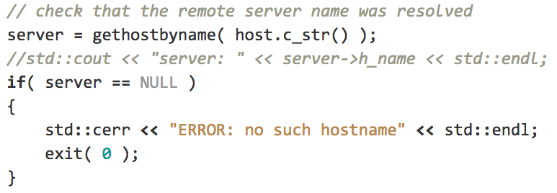
struct hostent* server
include netinet/in.h for internet domain address

Slide 8
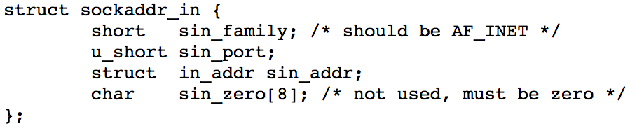
struct sockaddr_in
defined in netinet/in.h

Slide 9
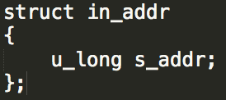
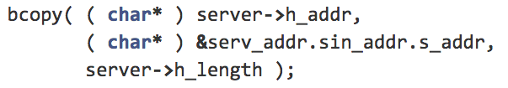
struct in_addr sin_addr
need to set s_addr in in_addr
you can use memcpy, bcopy, somethingcopy, as long as it works!

Slide 10
ushort sin_port
htons( port number )

Slide 11
Call connect()
connect() signature
using connect() in real life

Slide 12
write() a request

Slide 13
read() the response
make sure that you’re reading all of the response
you may need to clear the buffer after each time you use the buffer

Slide 14
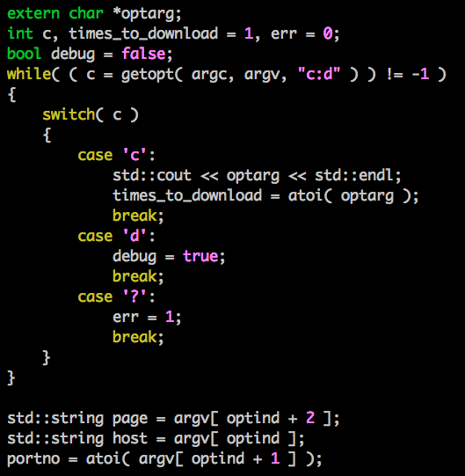
getopt example
the important things to note are:
“c:d”
this means the program is expecting 2 options c and d.
the program expects some value to be passed after the c, this is signified by the colon (:) after the c
the index values of hostname , uri, and port may be different depending on which flags are passed. getopt provides the ‘optind’ variable to access all the arguments after the parsed flags

