Slide 1
Predicting epidemics with machine learning
Plex

Slide 2


These resources are available at
https://www.manning.com/books/machine-learning-with-r-the-tidyverse-and-mlr (for concepts
https://mlr3book.mlr-org.com/ (for current code)

Slide 3

Before starting session, please run the R code in Google Colab
The R code template is available at
https://colab.research.google.com/drive/1AeSFSa-6CD0oLyhwG8bUnATs_fPSKB-O?usp=drive_link

Slide 4
General overview of the machine learning process
Data for training
Learner
Data
Resampling
Data for testing
Model
Performance
Measure
Prediction
Notes:
https://mlr3book.mlr-org.com/chapters/chapter2/data_and_basic_modeling.html

Slide 5
4 general components of supervised learning
Task: The common task in supervised learning is to predict a target variable based on a set of features.
An algorithm learns patterns from labeled data.
Classification algorithms are used to predict categorical output variables.
Regression algorithms are used to predict continuous output variables.
Dataset
Target or output variable (“dependent or response variable”)
Features (“independent or predictor variables”)
Learner (algorithms)
Predictions
Notes:
A machine learning algorithm is said to be supervised if it uses a ground truth or, in other words, labeled data.

Slide 6
General overview of the machine learning process
Data for training
Learner
Data
Resampling
Data for testing
Model
Performance
Measure
Prediction
Notes:
https://mlr3book.mlr-org.com/chapters/chapter2/data_and_basic_modeling.html

Slide 7
Understanding your data
Task
The common task in supervised learning is to predict a target variable based on a set of features.
An algorithm learns patterns from labeled data.
Classification algorithms are used to predict categorical output variables.
Regression algorithms are used to predict continuous output variables.
Dataset
Target or output variable (“dependent or response variable”)
Features (“independent or explanatory variables”)
Learner (algorithms)
Predictions

Slide 8
Fusarium head blight dataset
GitHub repository
https://github.com/DenisAShah/RFVariableSelectionwithFHB
A dataset
999 observations (rows)
338 variables (columns)
Target variable
Occurrence of FHB epidemics in the United States
1 represents epidemic and 0 represents no epidemic
Features
330 possible predictor variables
All predictors are numeric

Slide 9
General overview of the machine learning process
Data for training
Learner
Data
Resampling
Data for testing
Model
Performance
Measure
Prediction
Notes:
https://mlr3book.mlr-org.com/chapters/chapter2/data_and_basic_modeling.html

Slide 10

“All models are wrong, but some are useful” George E. P. Box
Machine learning algorithms include
Algorithms for classification | Algorithms for regression
K-nearest neighbors (kNN) | K-nearest neighbors (kNN)
Logistic regression | Generalized additive models
Support vector machines | Support vector machines, ridge regression
Naive Bayes model | LASSO and elastic net
Decision trees, random forest… | Random forest, XGBoost…
Notes:
“All models are wrong, but some are useful” – George Box
No free lunch theorem - While certain algorithms tend to perform better than others with certain types of data, no single algorithm will always outperform all others on all problems.

Slide 11
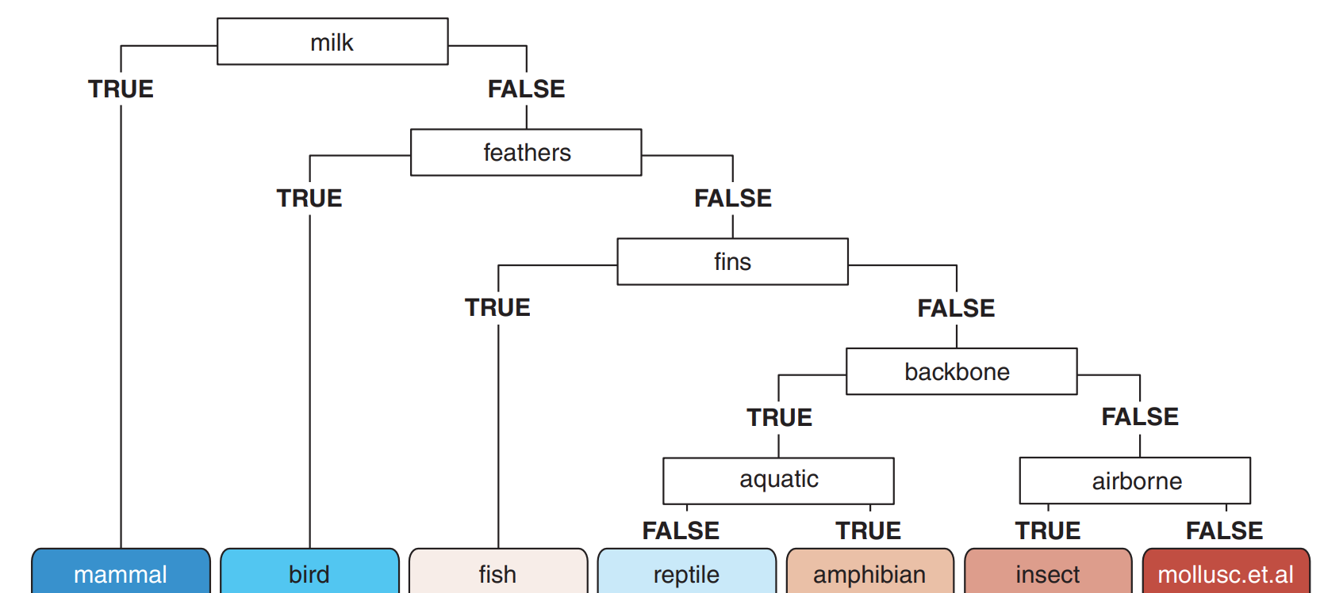
Simple structure of a decision tree
Components
Root node
Nodes
Leaves

Slide 12
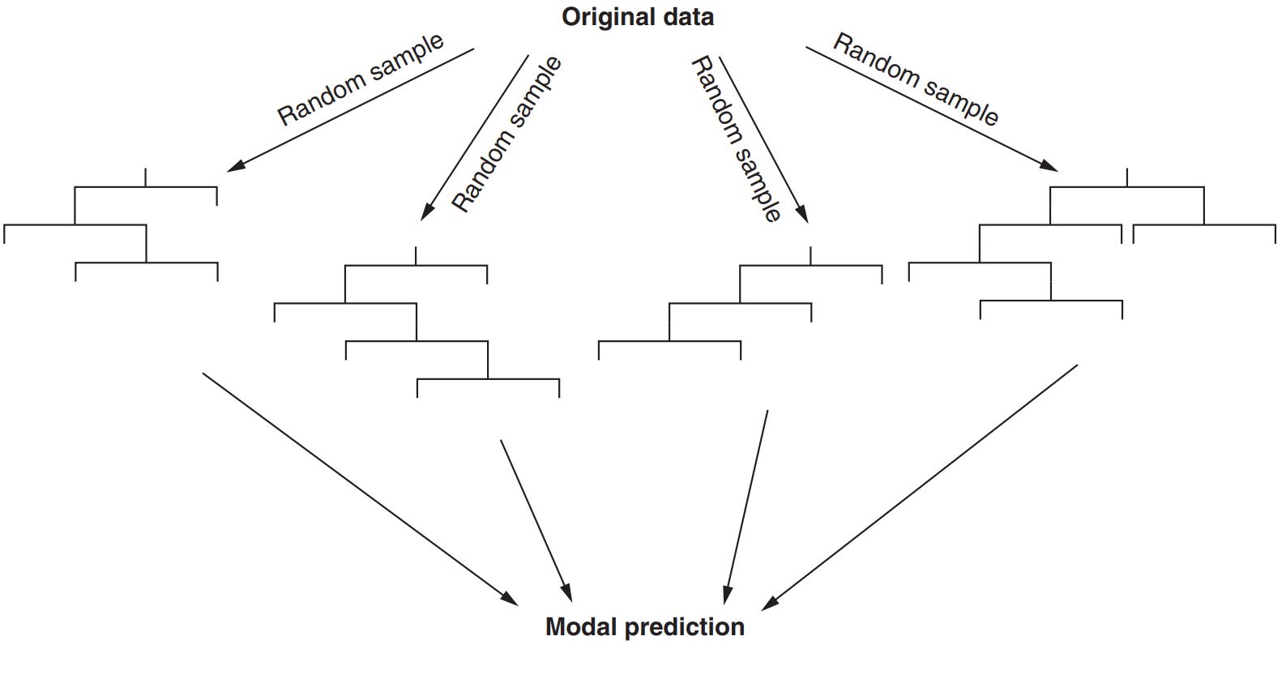
What is a random forest

Slide 13
Supervised machine learning
Our task is to correctly classify each observation in the FHB dataset on whether an epidemic occur or not.
Classification problem
Why is this problem considered a classification?

Slide 14
General overview of the machine learning process
Data for training
Learner
Data
Resampling
Data for testing
Model
Performance
Measure
Prediction
Notes:
https://mlr3book.mlr-org.com/chapters/chapter2/data_and_basic_modeling.html

Slide 15
Cross-validation approaches
There are three common cross-validation approaches
Holdout cross-validation
K-fold cross-validation
Leave-one-out cross validation

Slide 16
Feature selection
The goal of feature selection is to determine which features are most relevant for a specific task.
Multicollinearity
Two or more predictor variables are highly correlated with each other.
Criteria for selection
Biological meaning
Correlation analysis
Random forests
Notes:
With so many variables in my dataset (300), how do I know which variables are likely predictive?
Boruta algorithm:
Boruta iteratively compares importances of attributes with importances of shadow attributes, created by shuffling original ones. Attributes that have significantly worst importance than shadow ones are being consecutively dropped. On the other hand, attributes that are significantly better than shadows are admitted to be Confirmed. Shadows are re-created in each iteration. Algorithm stops when only Confirmed attributes are left, or when it reaches maxRuns importance source runs. If the second scenario occurs, some attributes may be left without a decision. They are claimed Tentative.

Slide 17
Feature selection using the Random Forest family of algorithms
The goal of feature selection is to determine which features are important for a specific task.
Three wrapper algorithms
Boruta algorithm
Each variable is confirmed, rejected, tentative)
varSelRF
Variables are selected from random forests using OOB error
VSURF
Variable Selection Using Random Forests
Notes:
Boruta algorithm:
Boruta iteratively compares importances of attributes with importances of shadow attributes, created by shuffling original ones. Attributes that have significantly worst importance than shadow ones are being consecutively dropped. On the other hand, attributes that are significantly better than shadows are admitted to be Confirmed. Shadows are re-created in each iteration. Algorithm stops when only Confirmed attributes are left, or when it reaches maxRuns importance source runs. If the second scenario occurs, some attributes may be left without a decision. They are claimed Tentative.

Slide 18
General overview of the machine learning process
Data for training
Learner
Data
Resampling
Data for testing
Model
Performance
Measure
Prediction
Notes:
https://mlr3book.mlr-org.com/chapters/chapter2/data_and_basic_modeling.html

Slide 19
A random forest for Fusarium head blight!
Select best predictor variables
Train the random forest model
Validate the random forest model
Measure model accuracy by comparing model predictions with unseen observations
How well our random forest predicts whether a location will experience a FHB epidemic or not.

Slide 20
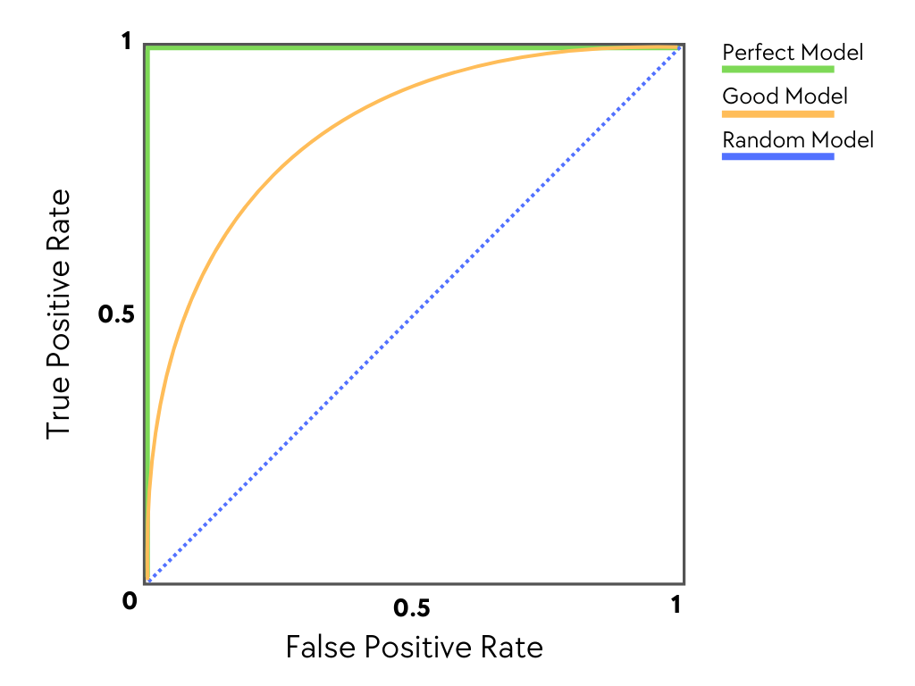
AUC ROC: Area under Receiver Operating Characteristic curve
https://en.wikipedia.org/wiki/Receiver_operating_characteristic
Figure credit: Priyansh Soni
Notes:
Sensitivity or true positive rate
Specificity or false positive rate
https://www.blog.trainindata.com/auc-roc-analysis/

Slide 21
Hyperparameter tuning
What is a parameter?
A parameter is a variable or values that is estimated from the data and that is internal to the model and controls how it makes predictions on new data.
What is hyperparameter?
A hyperparameter is a variable or option that controls how a model makes predictions but is not estimated from the data.
What is the objective of hyperparameter tuning?
Hyperparameter tuning is the problem of choosing a set of optimal hyperparameters for a learning algorithm.

Slide 22
Hyperparameters in a random forest
num.trees – the number of individual trees in the forest
mtry – the number of features to randomly sample at each node
min.node.size – the minimum number of cases allowed in a leaf
splitrule – Metric used to evaluate the quality of a split
Q: How do we know what are the best values for each hyperparameter?
A: In random forest, the Gini index is regularly used as our objective function to determine the best split at each node.

Slide 23

Interpretation of SHAP values
In machine learning, SHAP (SHapley Additive exPlanations) values quantify how much each feature contributes to the model’s prediction for each observation.
Reference: https://dl.acm.org/doi/10.5555/3295222.3295230

Slide 24
Model ensemble…

