Slide 1
Control Reinforcement Learning with SAEs
Garrett McNeill
Paper : https://arxiv.org/pdf/2602.10437

Slide 2
Terminology
CRL : Control Reinforcement Learning
AFM : Adaptive Feature Masking
SFT : Standard Fine Tuning
S : State space
A : Action space
T : Transition Function
R : Reward Function
c : Steering Co-efficent

Slide 3
Limitations of SAEs
Dependencies on datasets
Non adaptive steering co efficient's
Big Feature Libraries

Slide 4
How does CRL solve the issues
CRL is an adaptive method that utilizes reinforcement learning
More dynamic than previous methods
Provides explainable logs about selection process
Can provide similar boost to SFT without re-training network parameters

Slide 5
How does it work?
CRL trains an actor and critic agent with PPO on feature selection
S : The residual stream of the transformer at the intervention layer
A : All the possible features to choose from
T : The forward pass of the network
R : The reward associated with the trained task ( benchmark )

Slide 6
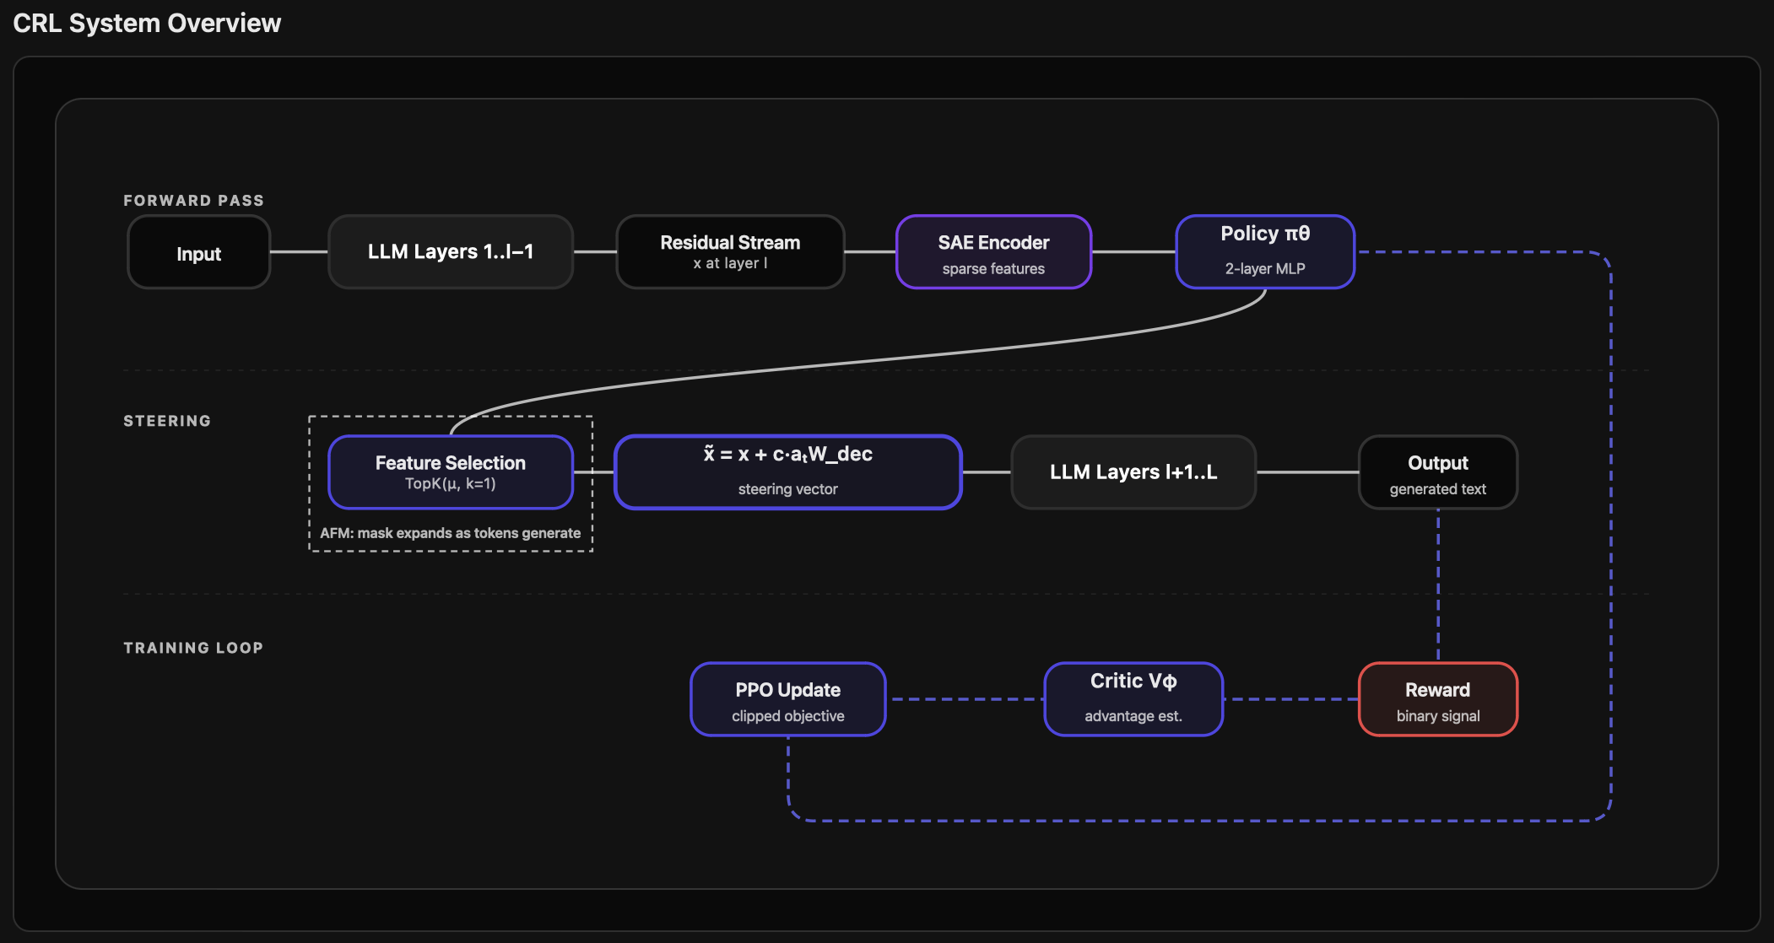

Slide 7
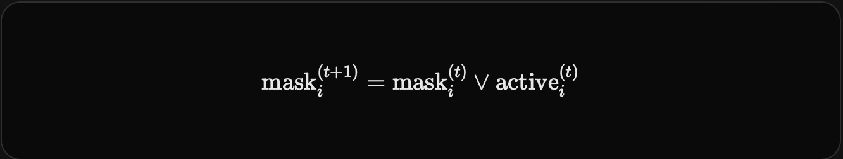
AFM
Action space is very large, causing problems in exploration
AFM solves this by slowly expanding the valid actions to relevant features

Slide 8
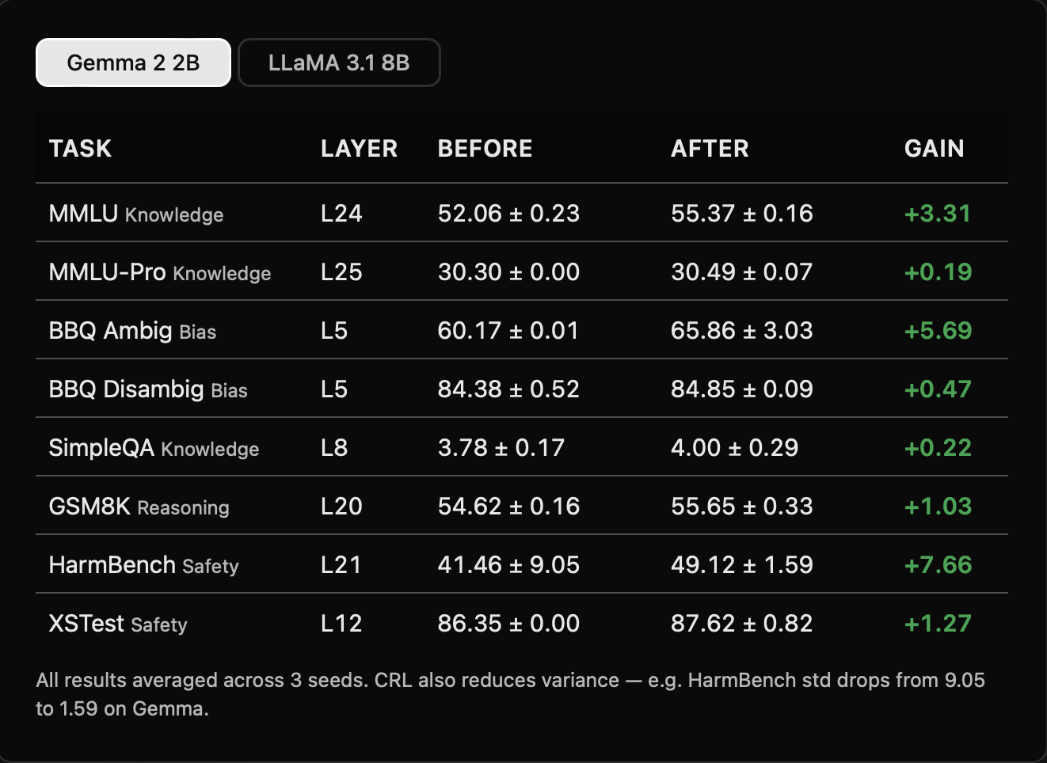

Slide 9
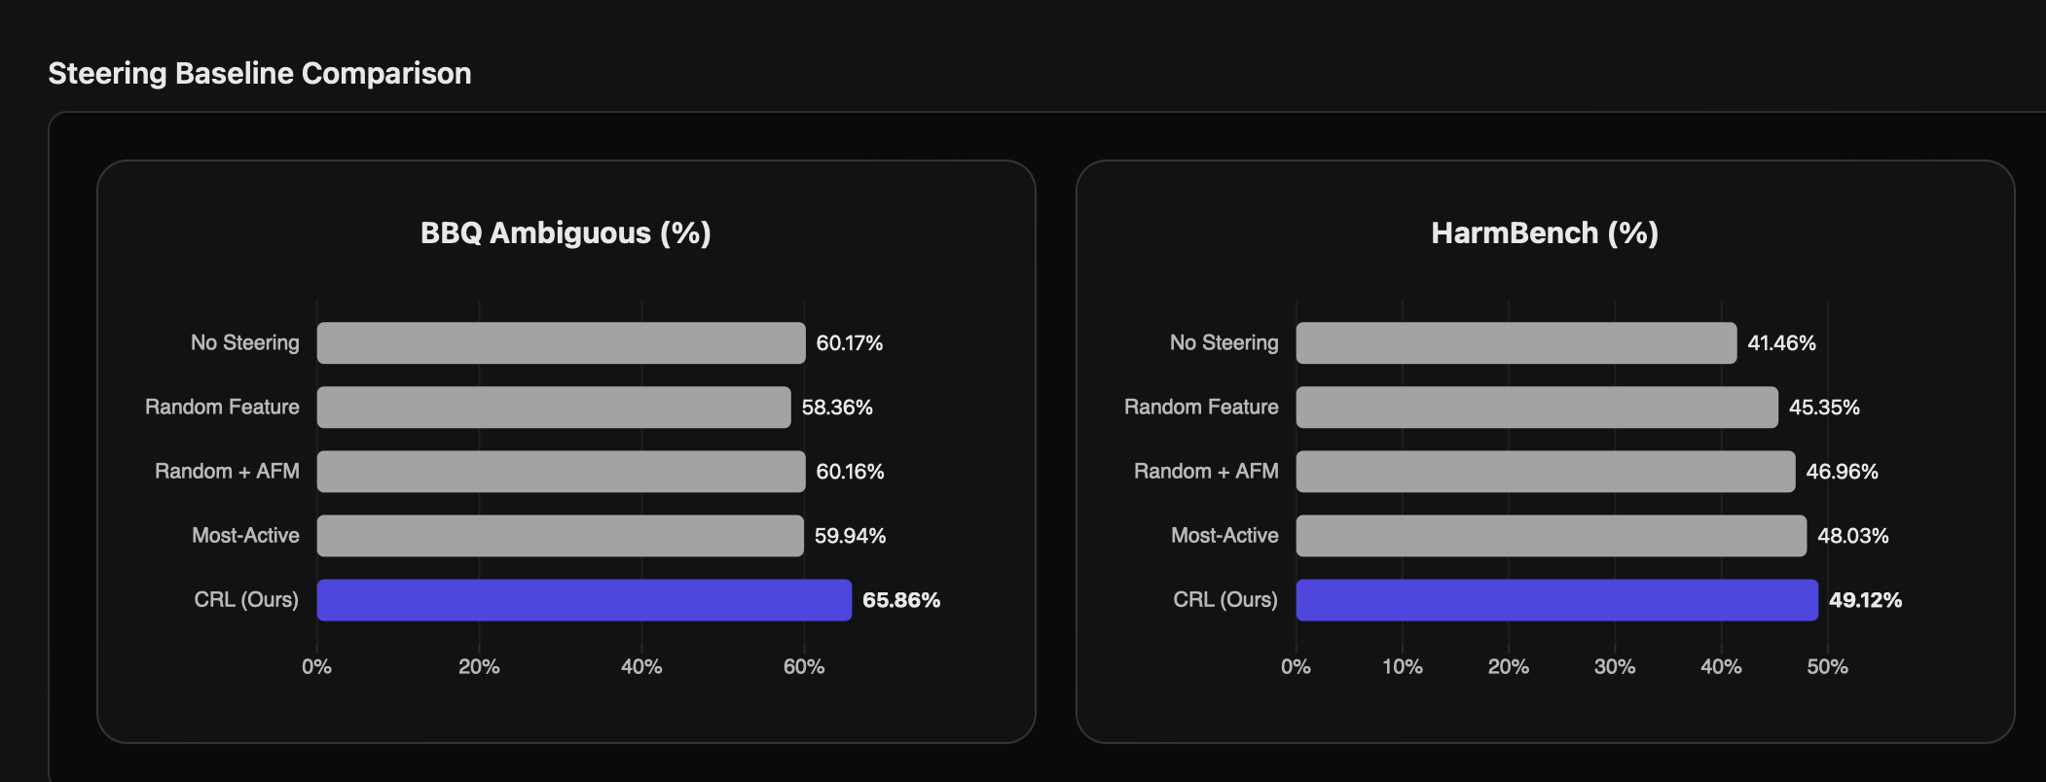

Slide 10
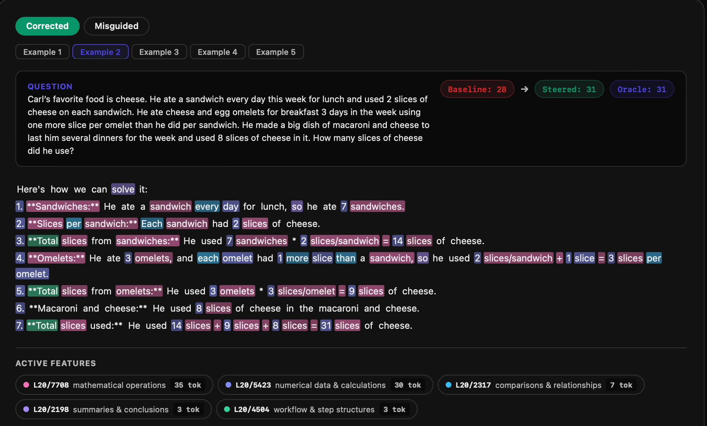

Slide 11
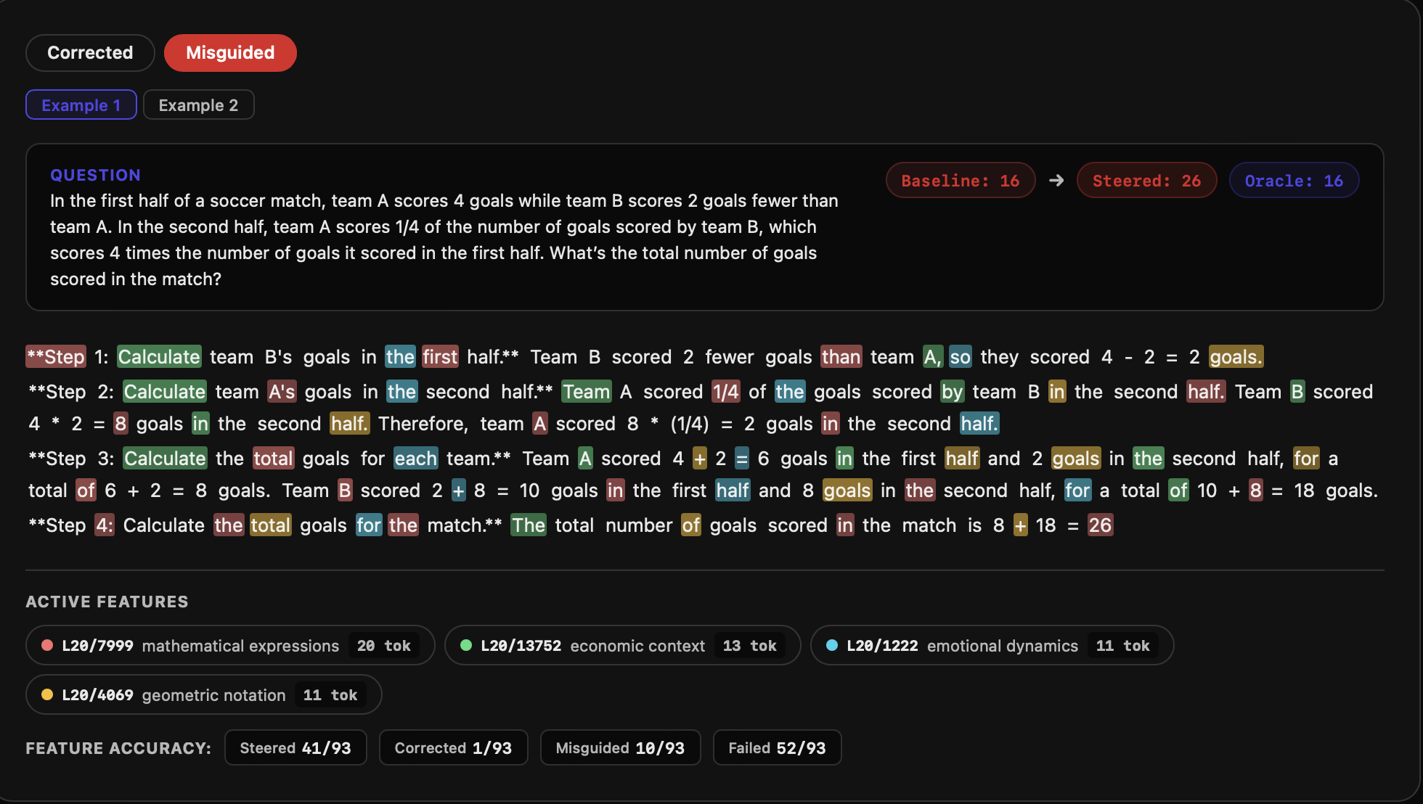

Slide 12
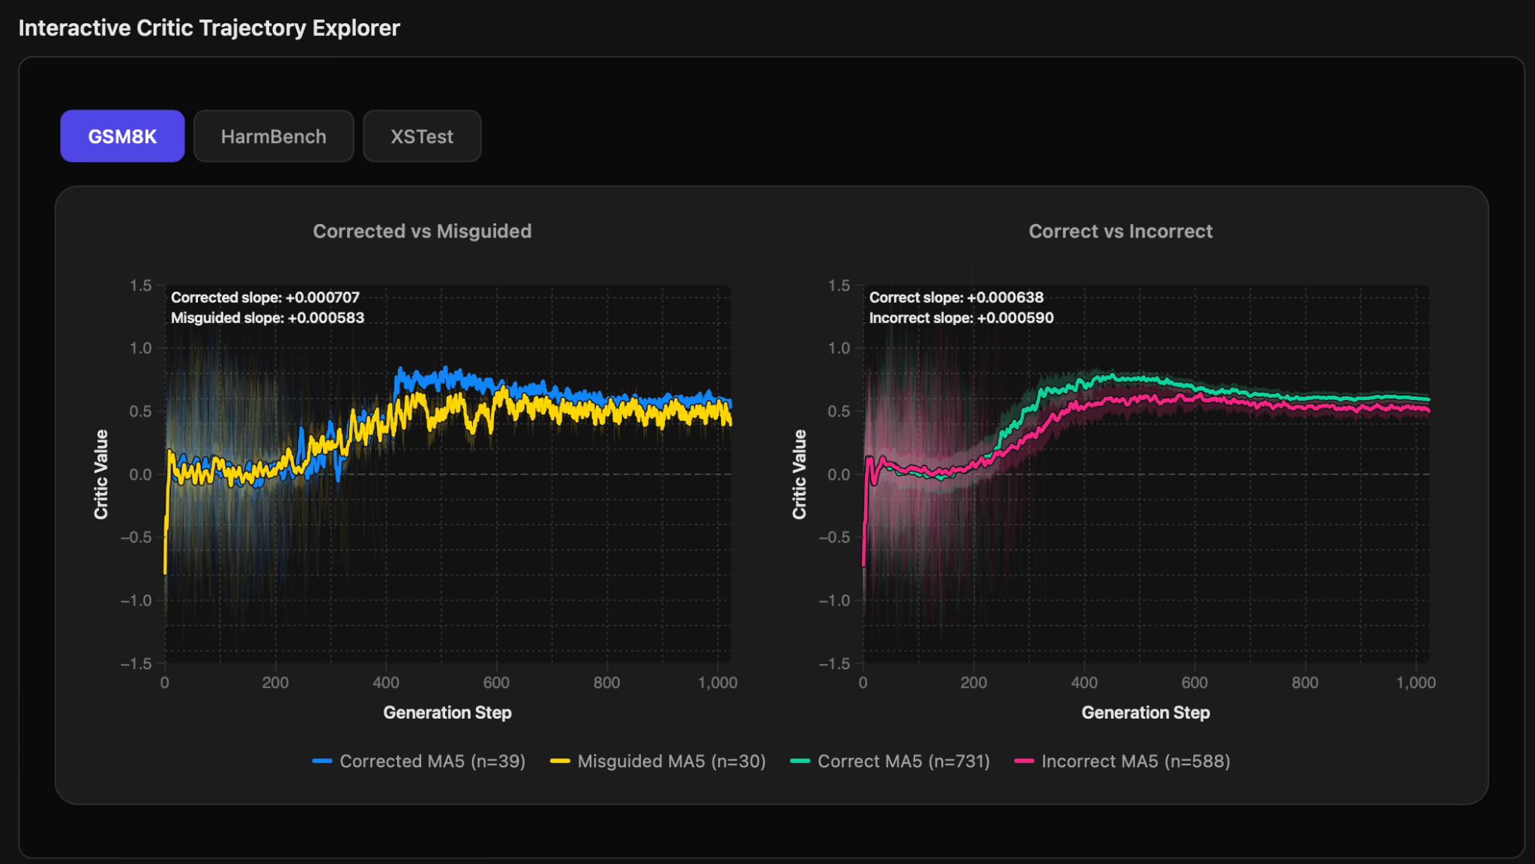

Slide 13
