Slide 1
X-rays and their Applications for Analysis
Andrew George, Sunny Sun
The Ohio State University, Physics Department
3/22/2016

Slide 2
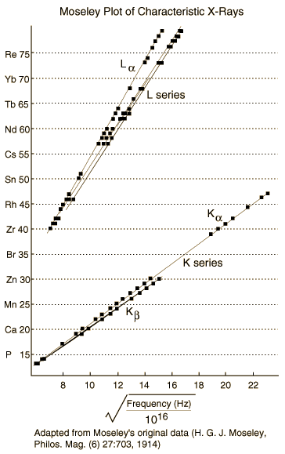
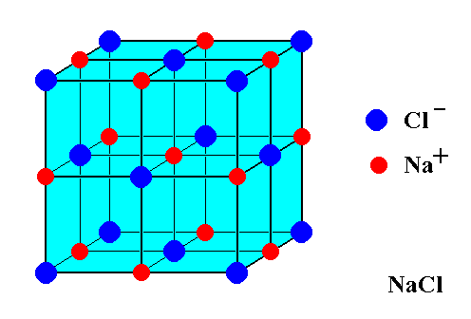
The significance of Bragg Diffraction and Mosley’s pot
Bragg Diffraction:
Mosley’s plot
With a wavelength that is small (.1nm) and a d of typically 3000nm for optical gratings we’ll have an angle of .0002
"Moseley." Hyperphysics. Accessed March 22, 2016. http://hyperphysics.phy-astr.gsu.edu/hbase/quantum/imgqua/moseley.gif.
Notes:
<number>

Slide 3
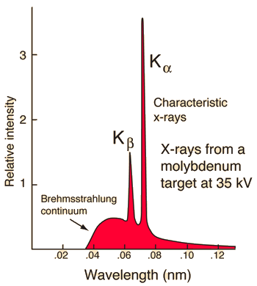
Theory of Bragg Diffraction
Two types of X-rays
The first is breaking radiation which is caused by electrons that are accelerated by an x-ray tube hitting copper. The copper deaccelerates the electrons and energy is lost. Energy is conserved and released in the form of electromagnetic waves which are the X-rays
The second are characteristic X-rays. When a material is hit electrons in the lower shells are excited to the higher shells. This causes the electrons originally in the higher shells to drop down and causes a photon to be released which becomes the characteristic X-rays.
Hyperphysics. Accessed March 22, 2016. http://hyperphysics.phy-astr.gsu.edu/hbase/quantum/imgqua/xraych.gif.

Slide 4
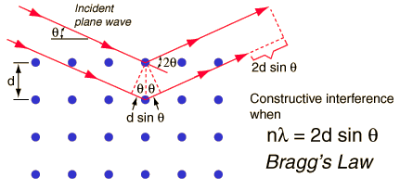
Bragg’s Law and its importance
Bragg’s law is the main form of analysis. By finding an associated wavelength, integer number, and angle, the crystal spacing can be solved and be later used as a grating for other experiments
."Bragg's Law." Hyperphysics. Accessed March 22, 2016. http://hyperphysics.phy-astr.gsu.edu/hbase/quantum/bragg.html.
Notes:
<number>

Slide 5
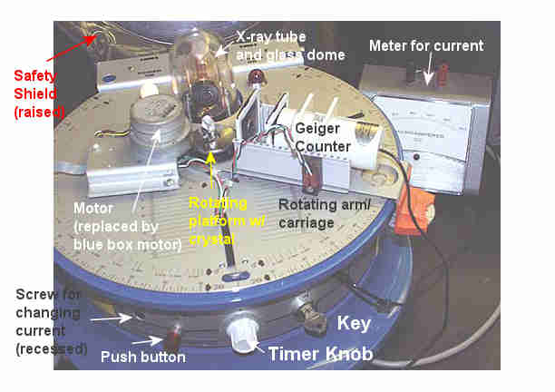
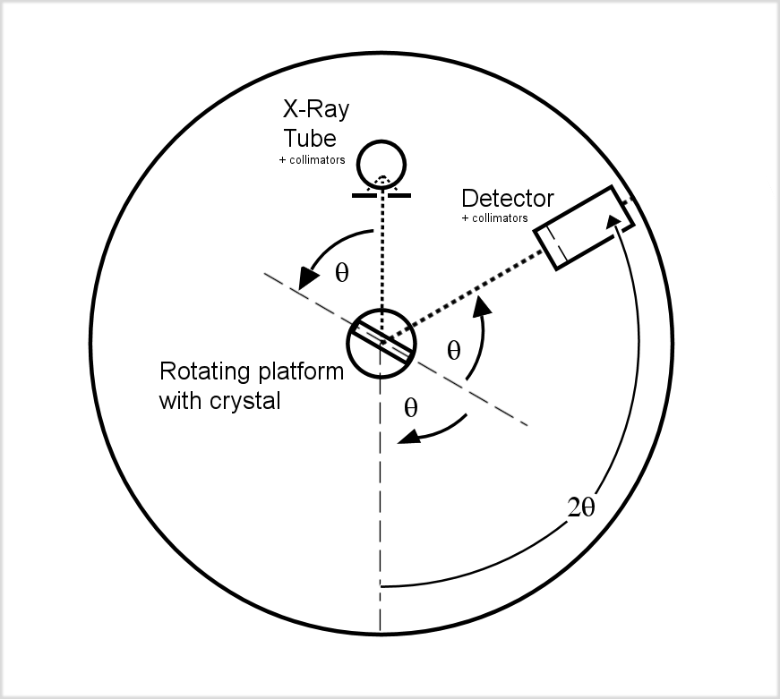
Mechanical Background of the X-ray machine
Farrell, Margie. READ ME. MS, The Ohio State University, Columbus.
-Detector is twice the angle of the incident rays
-Important to keep the current of the X-ray tube less than 80 microamps

Slide 6
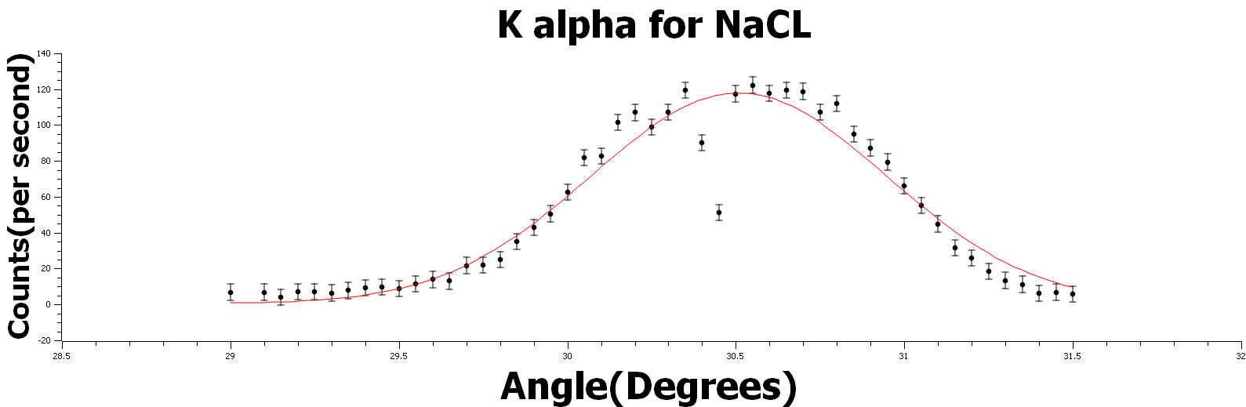
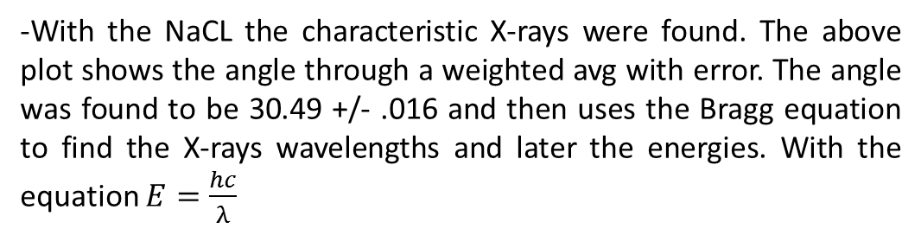
Analysis with Bragg Diffraction
-With the NaCL the characteristic X-rays were found. The above plot shows the angle through a weighted avg with error. The angle was found to be 30.49 +/- .016 and then uses the Bragg equation to find the X-rays wavelengths and later the energies. With the equation
-Errors were in the counts with were
-N being the number of counts and this being a Poisson distribution

Slide 7
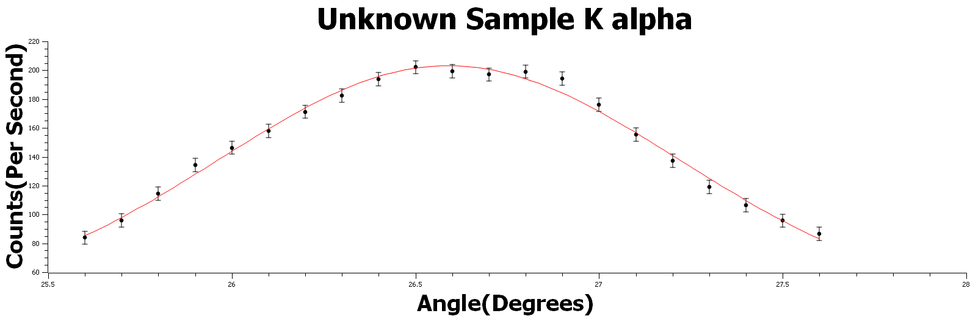
Finding the Unknown
Use a weighted average between angles to find d. D was found to be 3.18 Å +/- .023. This is closest to KBr

Slide 8
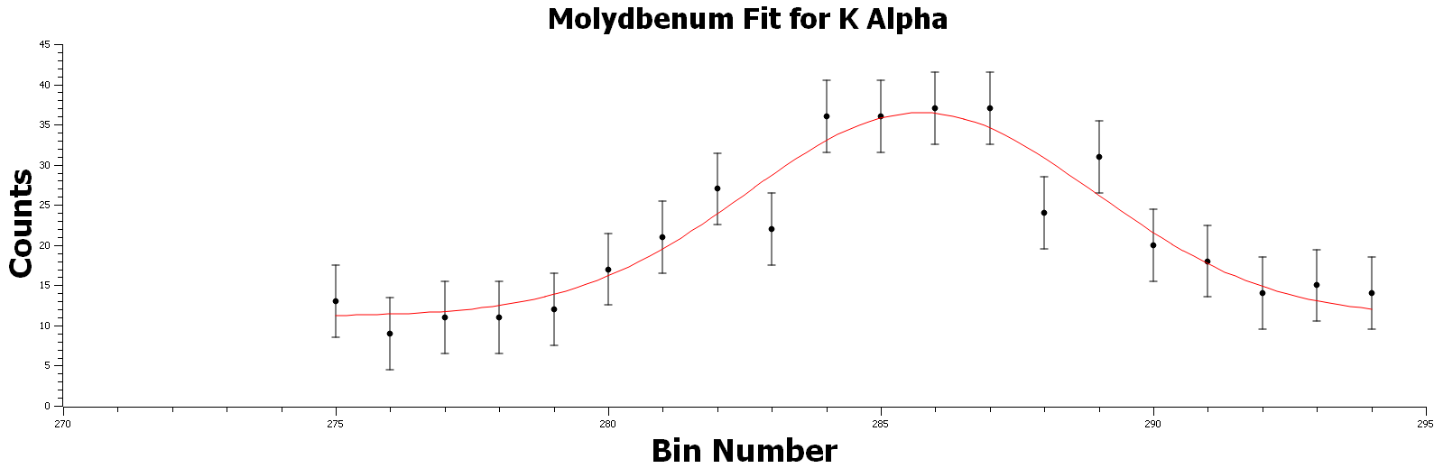
Constructing Mosley’s Plot
Associated Chi-Squared/DoF:.9048
Center point: 285.74 +/- 0.34

Slide 9
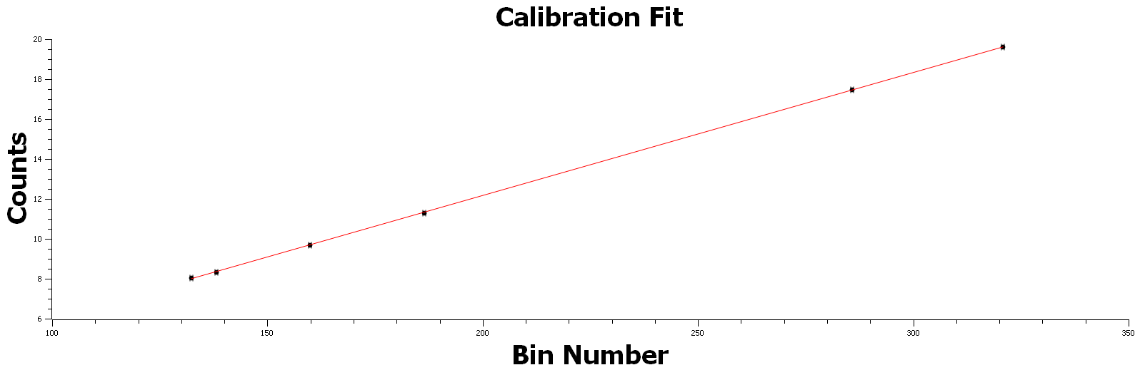
Calibration Graph For McA
Correlation Coefficient: R^2=.99,
Slope: .0617+/-.0002
Y intercept: -.179+/-.044

Slide 10
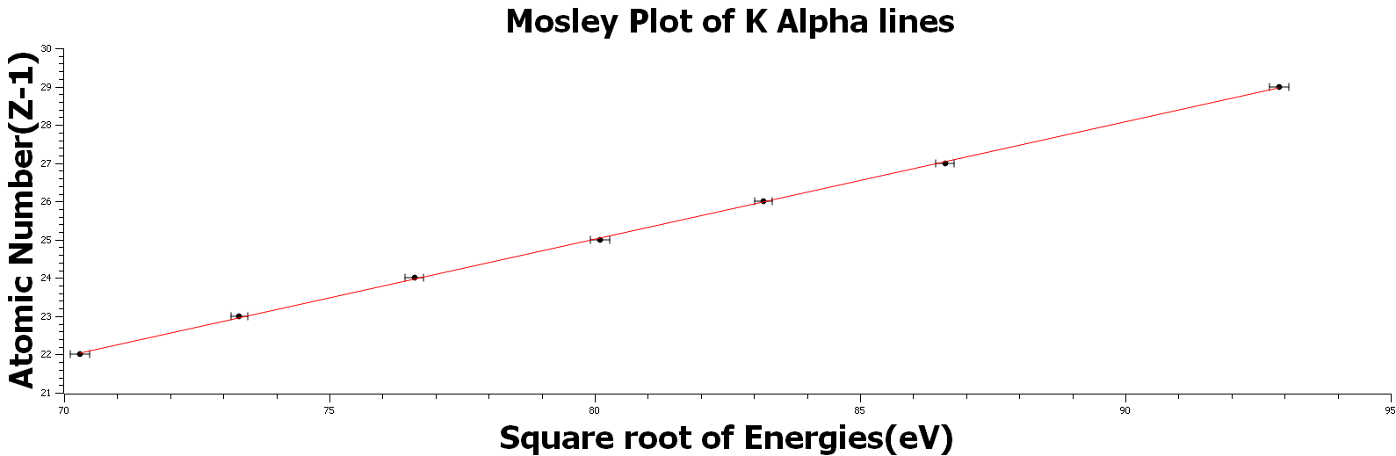
The Mosley Plot
Correlation Coefficient: R^2=.99
Slope: .3071+/- .0002
Y Intercept: -.44+/-.17
Elements used: Vanadium, Chromium, Manganese, Iron, Cobalt, Nickel, Zinc

Slide 11
Results from Unknown
Three Samples: Unknown metal, unknown yellow paint, unknown aluminum
Unknown Metal
-Found to be an alloy. Nickel was associated with one peak and copper with the other.
Unknown Yellow Paint
-Had three big peaks. The peaks associated were Cadmium, Titanium and Zinc. One smaller peak which was sulfur.
Unknown Foil
-Had one main peak and one small peak. Main peak was Tin small peak showed small traces of copper.

Slide 12
Review
Bragg Diffraction
-Bragg diffraction allows crystals to be used as a diffraction grating
-Allows identification of crystals through bond length, and if bond length is known also the characteristic x-rays of the material the electrons are hitting.
-Unknown sample was found to be KBr
Mosley’s plot
-Shows the significance of the atomic number “Z” and that it’s a physical measurable quantity
-Helped build the foundations for the modern periodic table
-Can be used to identify what elements are in materials through known values in the Mosley plot

Slide 13
References
1."Bragg's Law." Hyperphysics. Accessed March 22, 2016. http://hyperphysics.phy-astr.gsu.edu/hbase/quantum/bragg.html.
2. Hyperphysics. Accessed March 23, 2016. http://hyperphysics.phy-astr.gsu.edu/hbase/quantum/moseley.html.

