Slide 1

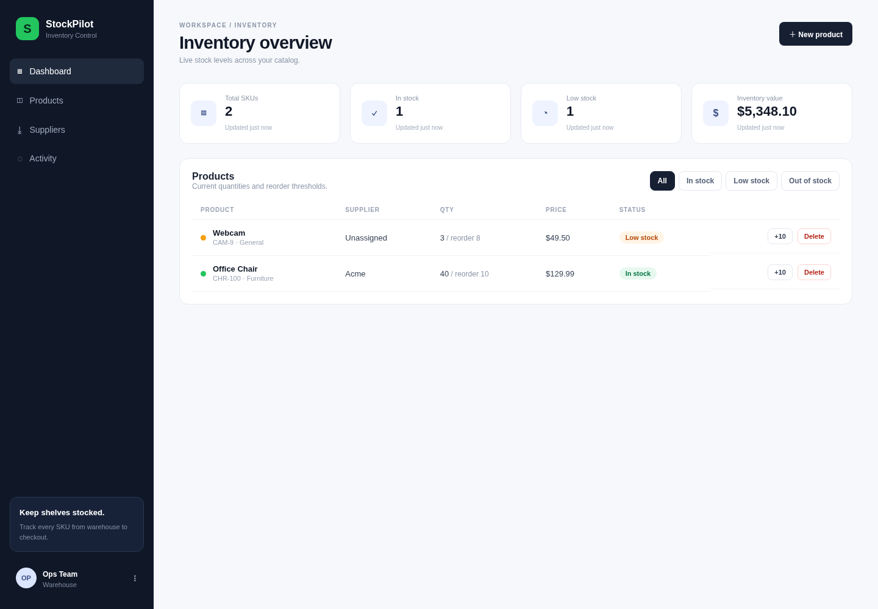
StockPilot
Inventory management, shipped the DevOps way. Tech stack & architecture overview.
Live app, served through the Kubernetes ingress on AWS
Notes:
StockPilot is a small inventory management app. The app itself is simple on purpose — the focus of the project is how it is built, shipped and run.

Slide 2

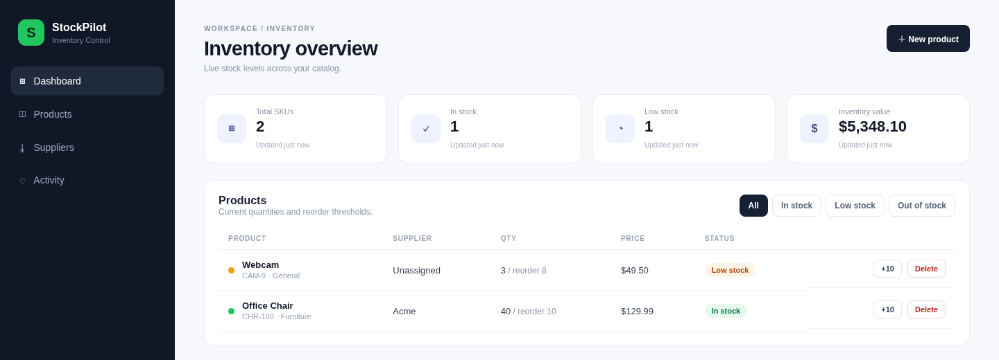


What is StockPilot?
Track products
SKUs, suppliers, prices and quantities
Catch low stock early
Reorder thresholds flag items to restock
See the big picture
Live totals and inventory value at a glance
Inventory overview dashboard
Notes:
A SaaS-style dashboard for a warehouse team: add products, adjust stock, and see what needs reordering.

Slide 3
Architecture at a glance
AWS · VPC + EKS Kubernetes cluster (built with Terraform)
Frontend
React + Nginx
2+ replicas of each app
Auto-scales on load
Health checks restart failures
Users
web browser
Ingress
NGINX
Backend API
FastAPI
Database
PostgreSQL
Prometheus
collects metrics
Grafana
dashboards
Code push
GitHub Actions: test, build, scan
GHCR image registry
Helm deploy to EKS
Notes:
Users hit a single ingress, which routes to the React frontend or the FastAPI backend. The backend stores data in PostgreSQL. Prometheus scrapes the backend's metrics and Grafana shows them. Everything runs in an EKS cluster inside a VPC, both created by Terraform. Along the bottom: how code gets there — push, GitHub Actions builds and scans, images go to GHCR, Helm deploys.

Slide 4






The tech stack
Frontend
Backend
Database
React + Vite, served by Nginx
Python FastAPI + SQLAlchemy
PostgreSQL 16
CI/CD
Platform
Monitoring
GitHub Actions, Trivy, GHCR
Docker, Kubernetes (EKS), Helm, Terraform
Prometheus + Grafana
Notes:
Six layers, each with one main tool. Next few slides cover why we picked each.

Slide 5
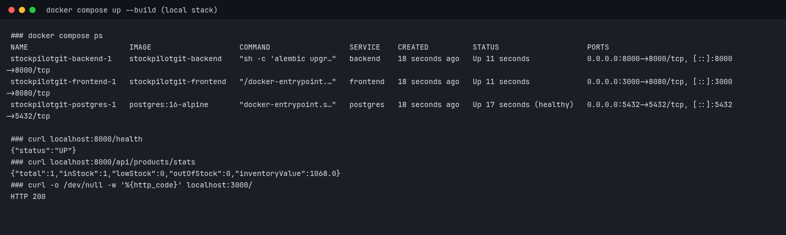
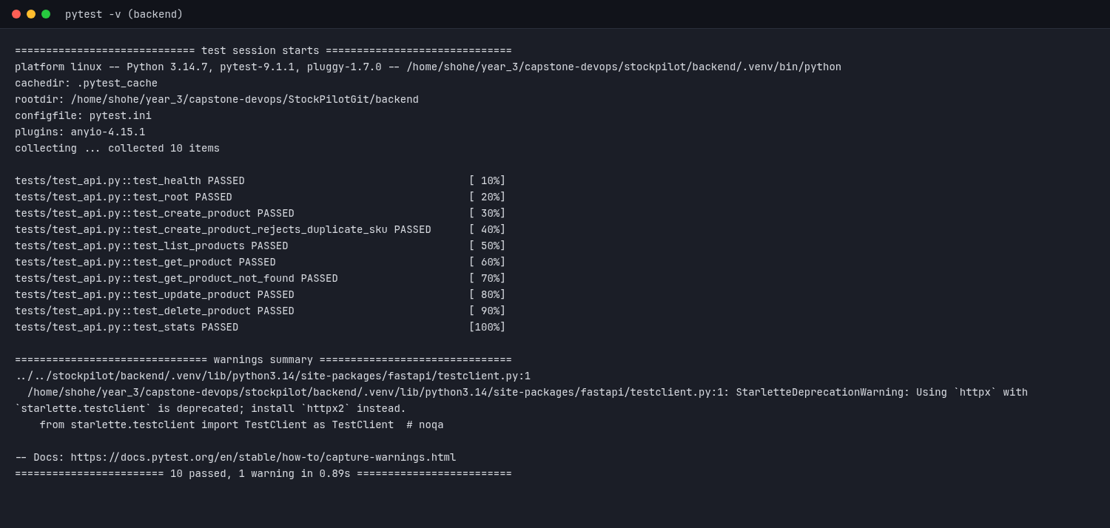
App layer: simple, fast, proven
React + Vite
Reusable UI components; instant reloads in dev
FastAPI
Quick to build, auto API docs, built-in validation
Whole stack runs locally with one command (Docker Compose)
PostgreSQL
Reliable database for structured inventory data
Automated API tests: 10/10 passing
Notes:
We chose popular, well-documented tools so the team could move fast. FastAPI gives us Swagger docs for free. Docker Compose lets anyone run the full app locally with one command.

Slide 6

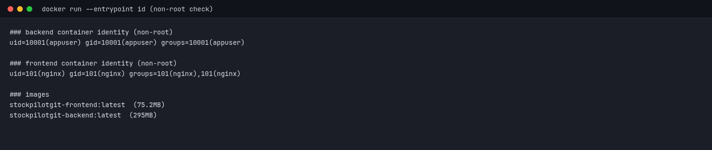

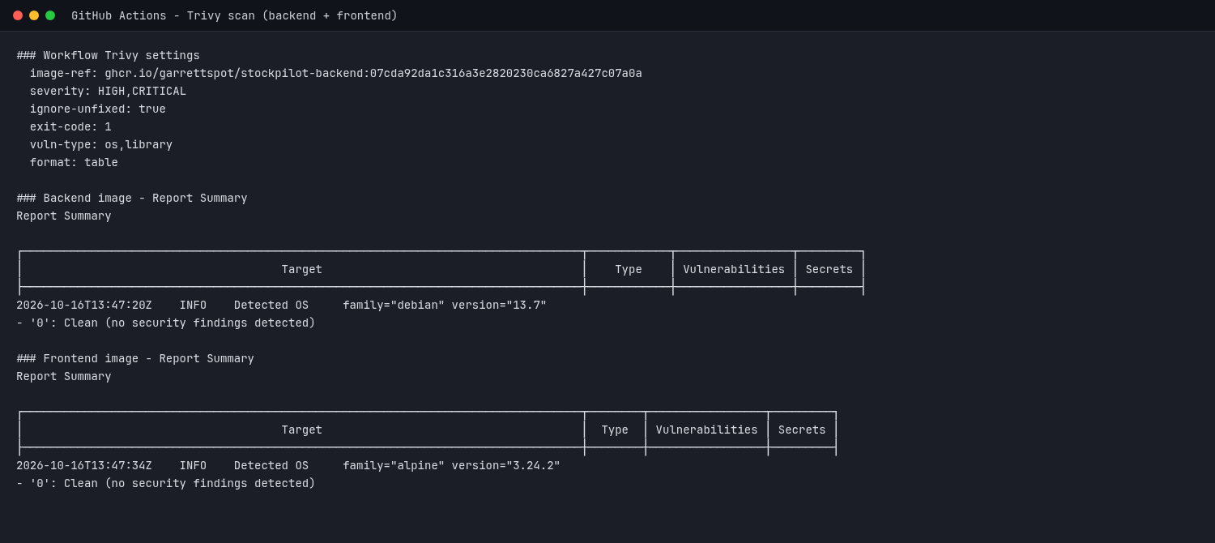

Containers, built secure by default
Docker
Same image runs on a laptop, in CI and in the cloud
Non-root & slim
Containers run without admin rights; small images
Both containers run as non-root users
Trivy scanning
Every build is checked; serious CVEs block release
Trivy: 0 HIGH/CRITICAL vulnerabilities
Notes:
Containers make the app portable. We harden them: non-root users, small base images, and an automatic vulnerability scan that fails the pipeline if anything serious is found.

Slide 7



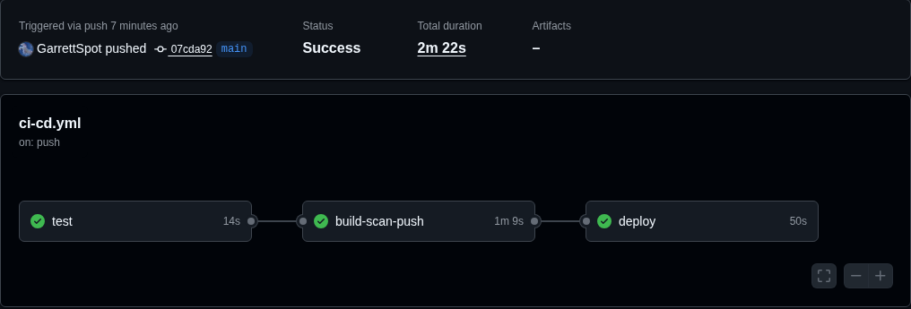
CI/CD: from push to production
Push
Test
Build & scan
Publish image
Deploy
Why GitHub Actions?
Lives next to the code, no extra servers
Every push is tested and scanned
Live on the cluster in under 3 minutes
A real pipeline run: test → build-scan-push → deploy (2m 22s)
Notes:
Every push to main runs the pipeline: tests, Docker builds, a Trivy scan, publishing images to GitHub's container registry, then a Helm deploy to EKS. No manual steps.

Slide 8
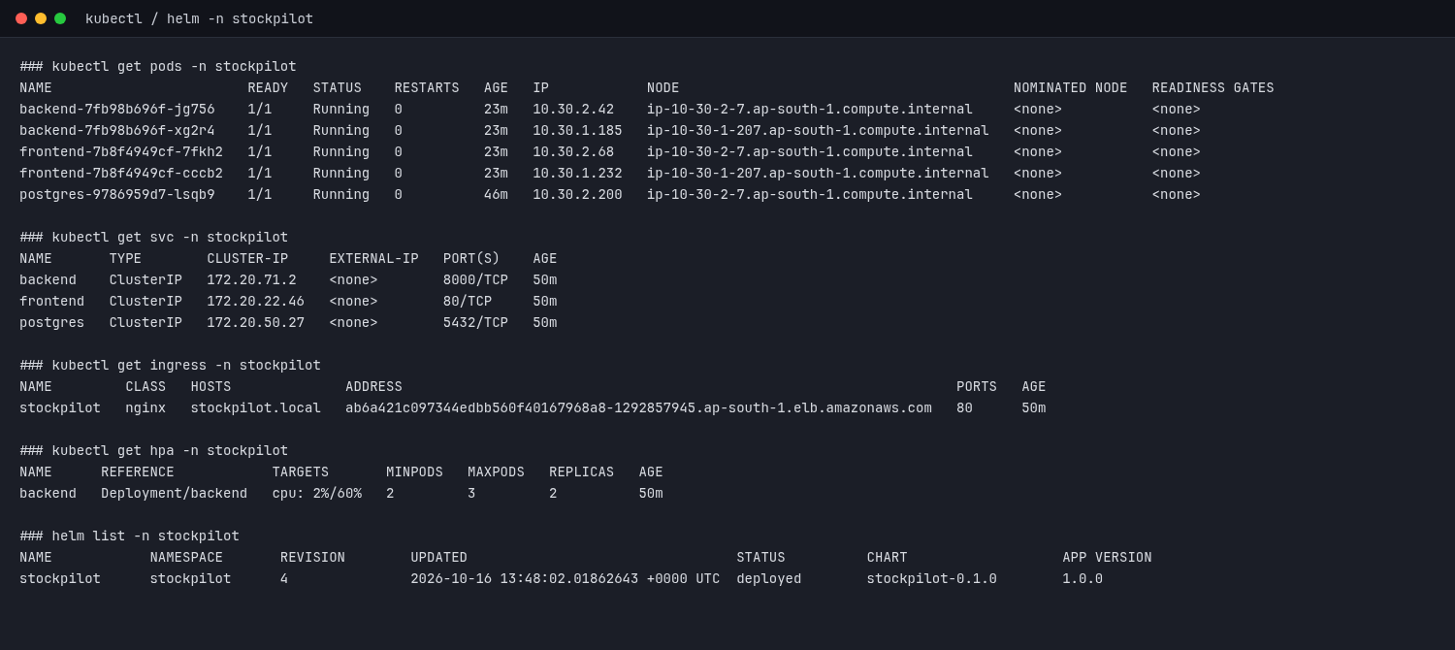

Kubernetes (AWS EKS) + Helm
Self-healing
Crashed pods restart automatically
Auto-scaling
Adds backend pods when traffic rises
Helm charts
One versioned package; repeatable deploys
Pods, services, ingress and autoscaler all running
Notes:
Kubernetes keeps the app running and scales it. EKS means AWS runs the control plane for us. Helm packages all our Kubernetes config so every deploy is identical.

Slide 9

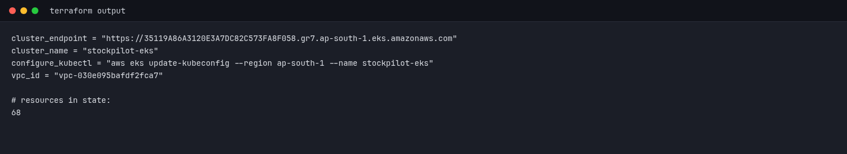
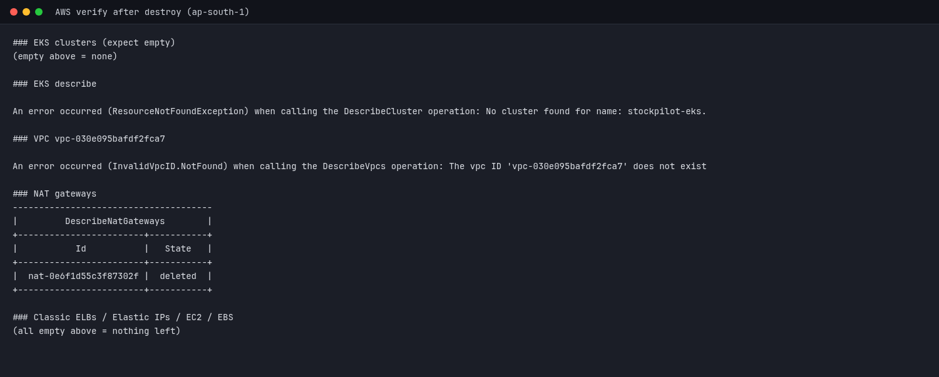
Infrastructure as code with Terraform
68
Terraform output: EKS cluster and VPC
AWS resources, all from code
Rebuild the whole cloud in one command
Tear it down when idle to save cost
After teardown: nothing left running
Notes:
Terraform describes our network and cluster as code: version-controlled, reviewable, repeatable. We can create everything for a demo and destroy it after, so we only pay while it's running.

Slide 10
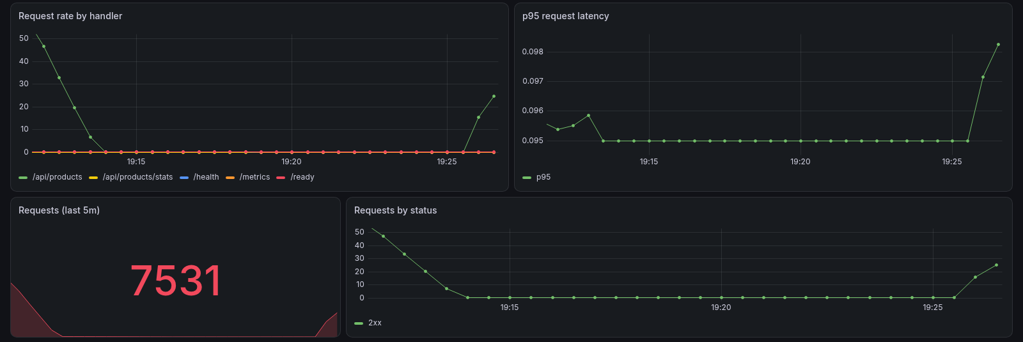


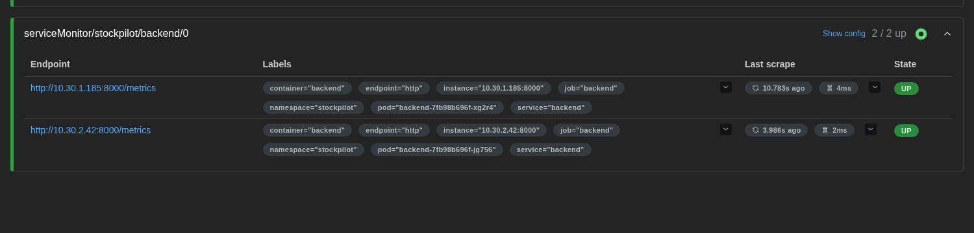
Monitoring with Prometheus & Grafana
Prometheus
Collects metrics from every backend pod
Grafana
Turns metrics into live dashboards
Grafana: traffic, latency and status codes
Why
Open source, the standard for Kubernetes
Notes:
The backend exposes a /metrics endpoint. Prometheus finds each pod automatically and scrapes it; Grafana visualises request rate, latency and errors so we can spot problems quickly.

Slide 11




Why this stack?
Simple
Automated
Secure
Repeatable
Popular, well-documented tools the team could learn fast
Push to production in minutes, no manual steps
Scanned, non-root containers by default
Infrastructure as code; build up or tear down anytime
Thank you — questions?
Notes:
To sum up: a simple app on an industry-standard, automated, secure and repeatable platform.

