Slide 1
Basic Concepts:
Data Structures

Slide 2
Algorithm:a process or set of rules to be followed in calculations or other problem-solving operations, especially by a computer.
Pseudo-code:One of the most common tools for defining algorithms is pseudocode, which is part English, part structured code.
In computer science, pseudocode is a plain language description of the steps in an algorithm or another system. Pseudocode often uses structural conventions of a normal programming language, but is intended for human reading rather than machine reading.
ADT:An abstract data type (ADT) refers to a set of data values and associated operations that are specified accurately, independent of any particular implementation

Slide 3
Data Structure is a way of collecting and organising data in such a way that we can perform operations on these data in an effective wa
Data means value or set of values or Data is a collection of raw facts

Slide 4
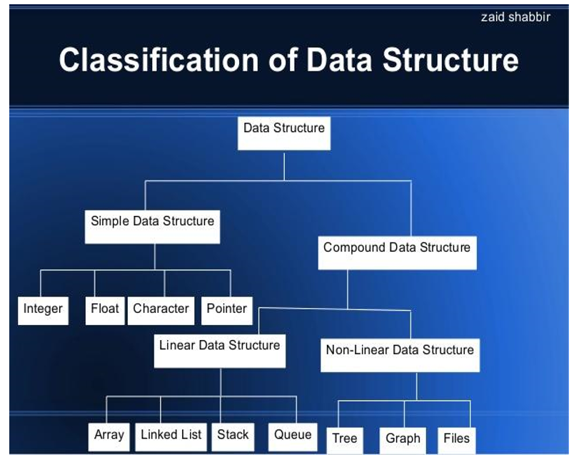
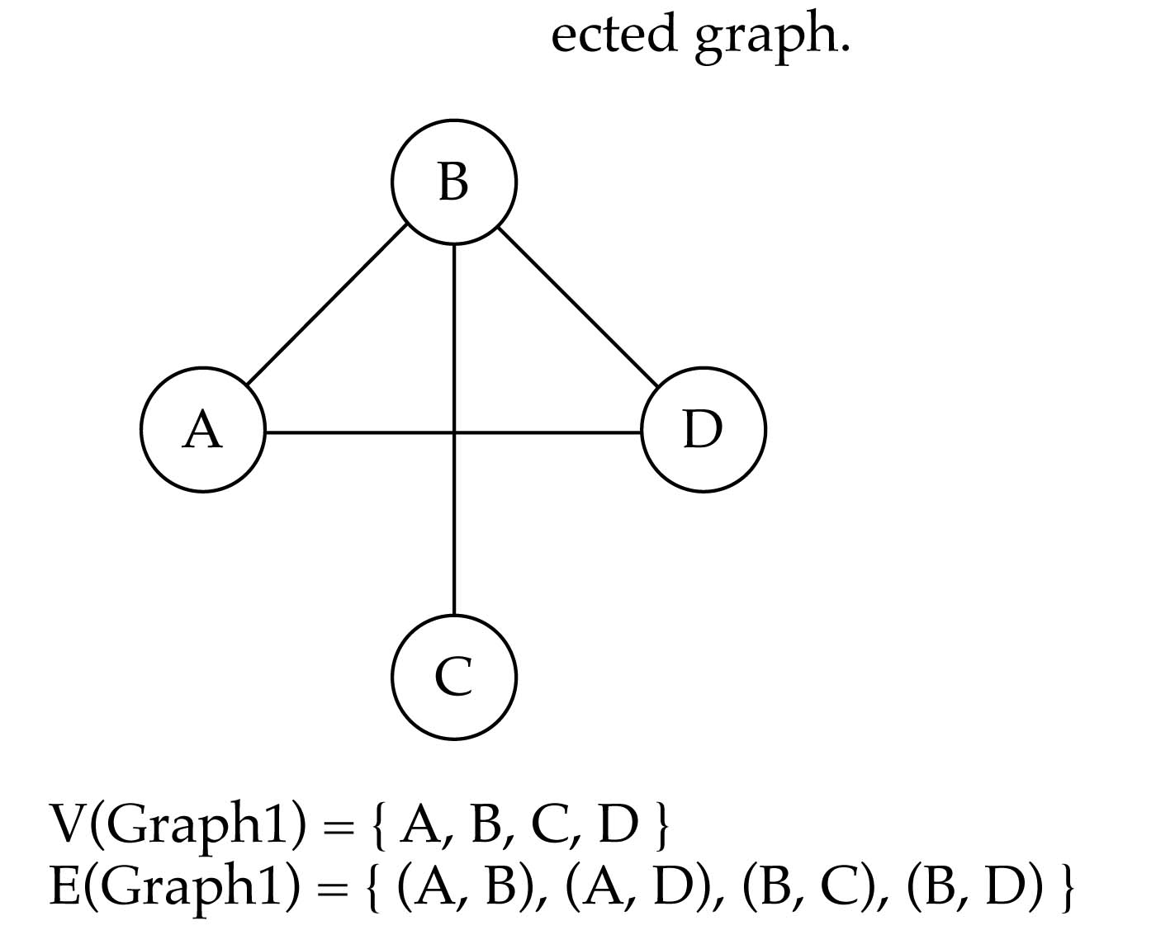
Directed vs. undirected graphs
When the edges in a graph have no direction, the graph is called undirected

Slide 5
Algorithm Analysis
we generally discuss the algorithm’s efﬁciency as a function of the number of elements to be processed.
If a function is linear—that is, if it contains no loops or recursions—its efﬁciency is a function of the number of instructions it contains
f(n) = efﬁciency
Linear Loops Let us start with a simple loop. We want to know how many times the body of the loop is repeated in the following code:
for (i = 0; i < 1000; i++) f(n) = n
for (i = 0; i < 1000; i += 2) application code
f(n) = n / 2
If you were to plot either of these loop examples, you would get a straight line. For that reason they are known as linear loops.

Slide 6
Logarithmic Loops
Multiply Loops
for (i = 0; i < 1000; i *= 2)
application code
Divide Loops
for (i = 0; i < 1000; i /= 2)
application code
Generalizing the analysis, we can say that the iterations in loops that multiply or divide are determined by the following formula:
f(n) = logn

Slide 7
Nested Loops
Iterations = outer loop iterations x inner loop iterations
Linear Logarithmic The inner loop in the following code is a loop that multiplies. To see the multiply loop, look at the update expression in the inner loop.
for (i = 0; i < 10; i++)
for (j = 0; j < 10; j *= 2)
application code
f(n) = nlogn
Quadratic In a quadratic loop, the number of times the inner loop executes is the same as the outer loop. Consider the following example
for (i = 0; i < 10; i++)
for (j = 0; j < 10; j++)
application code
f (n²)
Dependent Quadratic In a dependent quadratic loop, the number of iterations of the inner loop depends on the outer loop. Consider the nested loop shown in the following example
for (i = 0; i < 10; i++)
for (j = 0; j < i; j++)
application code

Slide 8
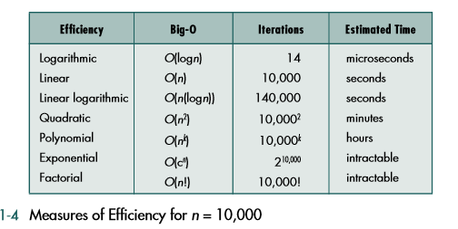
Big-O Notation
This simpliﬁcation of efﬁciency is known as big-O analysis. For example, if an algorithm is quadratic, we would say its efﬁciency is O(n²)

Slide 9
Recursion
In general, there are two approaches to writing repetitive algorithms. One uses iteration; the other uses recursion.
Recursion is a repetitive process in which an algorithm calls itself.
In general, we can express the factorial function as follows:
n! = n * (n-1)!
Is this correct? Well… almost.
The factorial function is only defined for positive integers. So we should be a bit more precise:
n! = 1 (if n is equal to 1)
n! = n * (n-1)! (if n is larger than 1)

Slide 10
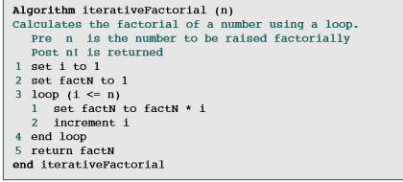
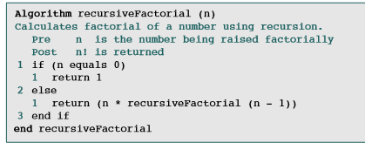
factorial function
Iterative Factorial Algorithm Recursive Factorial

Slide 11
Linked-list implementation

