Slide 1
Recursion

Slide 2
Example 2: factorial function
In general, we can express the factorial function as follows:
n! = n * (n-1)!
Is this correct? Well… almost.
The factorial function is only defined for positive integers. So we should be a bit more precise:
n! = 1 (if n is equal to 1)
n! = n * (n-1)! (if n is larger than 1)

Slide 3
factorial function
Assume the number typed is 3, that is, numb=3.
fac(3) :
  3 <= 1 ? No.
  fac(3) = 3 * fac(2)
  fac(2) :
    2 <= 1 ? No.
    fac(2) = 2 * fac(1)
    fac(1) :
      1 <= 1 ? Yes.
      return 1
int fac(int numb){
if(numb<=1)
return 1;
else
return numb * fac(numb-1);
}
    fac(2) = 2 * 1 = 2
    return fac(2)
  fac(3) = 3 * 2 = 6
  return fac(3)
fac(3) has the value 6

Slide 4
factorial function
For certain problems (such as the factorial function), a recursive solution often leads to short and elegant code. Compare the recursive solution with the iterative solution:
Iterative solution
int fac(int numb){
int product=1;
while(numb>1){
product *= numb;
numb--;
}
return product;
}
Recursive solution
int fac(int numb){
if(numb<=1)
return 1;
else
return numb*fac(numb-1);
}

Slide 5
Example 3: Fibonacci numbers
//Calculate Fibonacci numbers using recursive function.
//A very inefficient way, but illustrates recursion well
int fib(int number)
{
if (number == 0) return 0;
if (number == 1) return 1;
return (fib(number-1) + fib(number-2));
}
int main(){ // driver function
int inp_number;
cout << "Please enter an integer: ";
cin >> inp_number;
cout << "The Fibonacci number for "<< inp_number
<< " is "<< fib(inp_number)<<endl;
return 0;
}

Slide 6
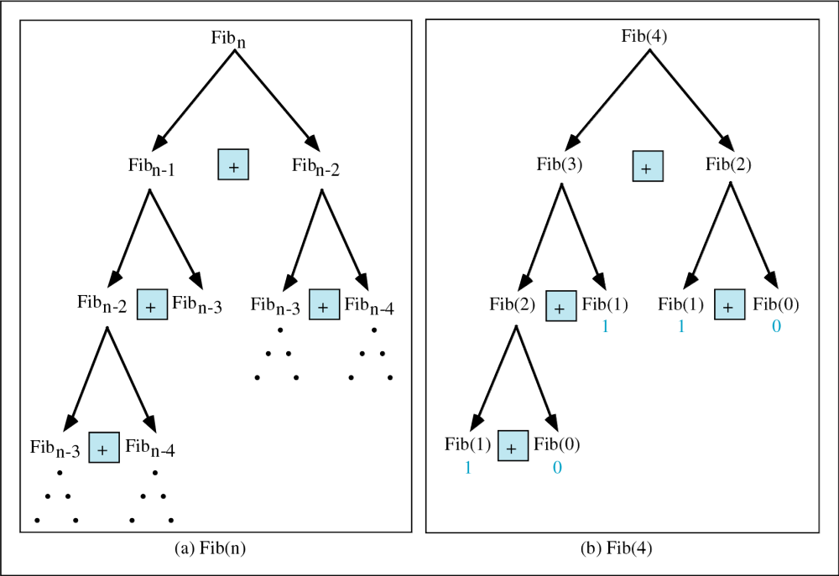
Copyright © 2000 by Brooks/Cole Publishing Company
A division of International Thomson Publishing Inc.

Slide 7
Trace a Fibonacci Number
int fib(int num)
{
if (num == 0) return 0;
if (num == 1) return 1;
return
(fib(num-1)+fib(num-2));
}
Assume the input number is 4, that is, num=4:
fib(4):
  4 == 0 ? No; 4 == 1? No.
  fib(4) = fib(3) + fib(2)
  fib(3):
    3 == 0 ? No; 3 == 1? No.
    fib(3) = fib(2) + fib(1)
    fib(2):
      2 == 0? No; 2==1? No.
      fib(2) = fib(1)+fib(0)
    fib(1):
    1== 0 ? No; 1 == 1? Yes.
    fib(1) = 1;
    return fib(1);

Slide 8
Trace a Fibonacci Number
fib(0):
    0 == 0 ? Yes.
    fib(0) = 0;
    return fib(0);
    fib(2) = 1 + 0 = 1;
    return fib(2);
  fib(3) = 1 + fib(1)
fib(1):
    1 == 0 ? No; 1 == 1? Yes
    fib(1) = 1;
    return fib(1);
  fib(3) = 1 + 1 = 2;
  return fib(3)

Slide 9
Trace a Fibonacci Number
fib(2):
      2 == 0 ? No; 2 == 1? No.
      fib(2) = fib(1) + fib(0)
      fib(1):
    1== 0 ? No; 1 == 1? Yes.
    fib(1) = 1;
    return fib(1);
    fib(0):
    0 == 0 ? Yes.
    fib(0) = 0;
    return fib(0);
    fib(2) = 1 + 0 = 1;
    return fib(2);
  fib(4) = fib(3) + fib(2)
  = 2 + 1 = 3;
  return fib(4);

Slide 10
Example 4: Fibonacci number w/o recursion
//Calculate Fibonacci numbers iteratively
//much more efficient than recursive solution
int fib(int n)
{
int f[100];
f[0] = 0; f[1] = 1;
for (int i=2; i<= n; i++)
f[i] = f[i-1] + f[i-2];
return f[n];
}

Slide 11
Recursion General Form
How to write recursively?
Designing Recursive Algorithms
1. First, determine the base case.
2. Then determine the general case.
3. Combine the base case and the general cases into an algorithm.
Limitations of Recursion
You should not use recursion if the answer to any of the following
questions is no:
Is the algorithm or data structure naturally suited to recursion?
2. Is the recursive solution shorter and more understandable?
3. Does the recursive solution run within acceptable time and space limits?

Slide 12
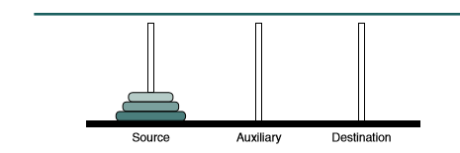
The Towers of Hanoi
The Towers of Hanoi is a classic recursion problem that is relatively easy to follow, is efﬁcient, and uses no complex data structures.
1. Only one disk could be moved at a time. A larger disk must never be stacked above a smaller one.
2. One and only one auxiliary needle could be used for the intermediate storage of disks.
Towers of Hanoi—Start Position

Slide 13
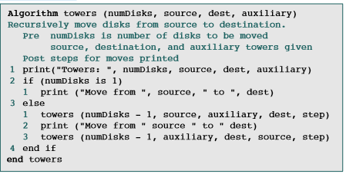
Towers of Hanoi

Slide 14
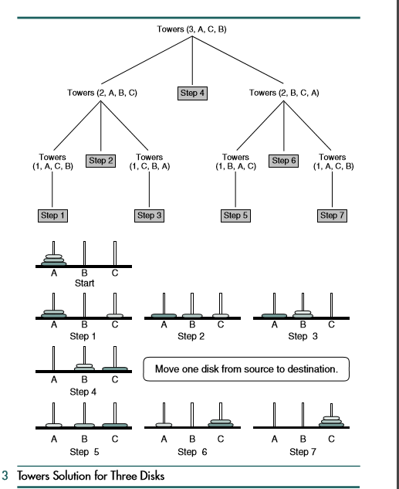
Problem Solving Using Recursion

Slide 15
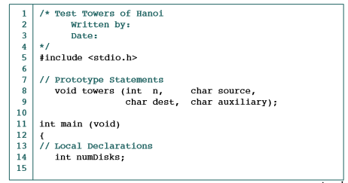
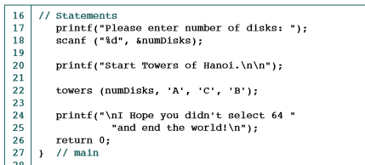

Slide 16
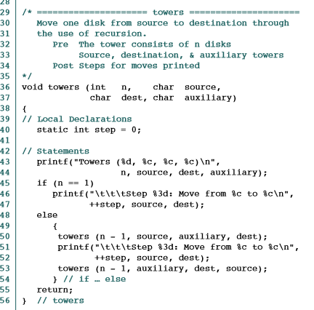

Slide 17


