Slide 1
Module 4: Switching techniques

Slide 2
A switched network consists of a series of interlinked nodes, called switches.
Switches are devices capable of creating temporary connections between two or more devices linked to the switch.
In a switched network, some of these nodes are connected to the end systems (computers or telephones, for example).Others are used only for routing.

Slide 3
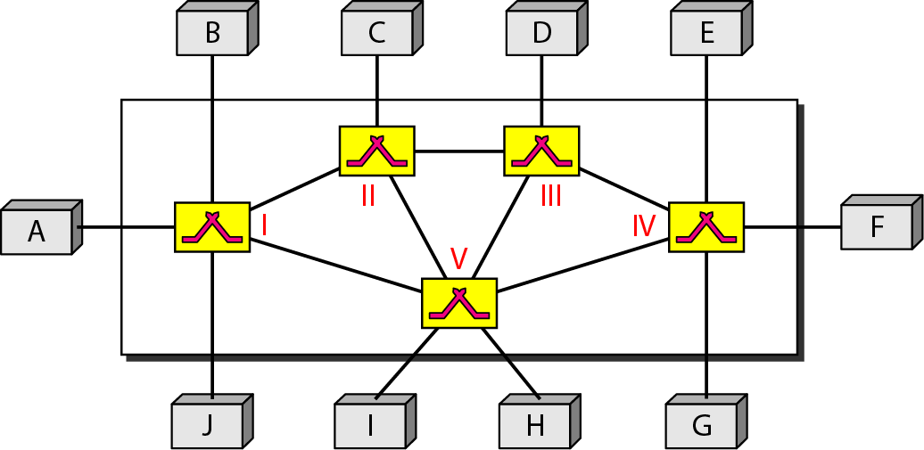
Figure 8.1 Switched network

Slide 4
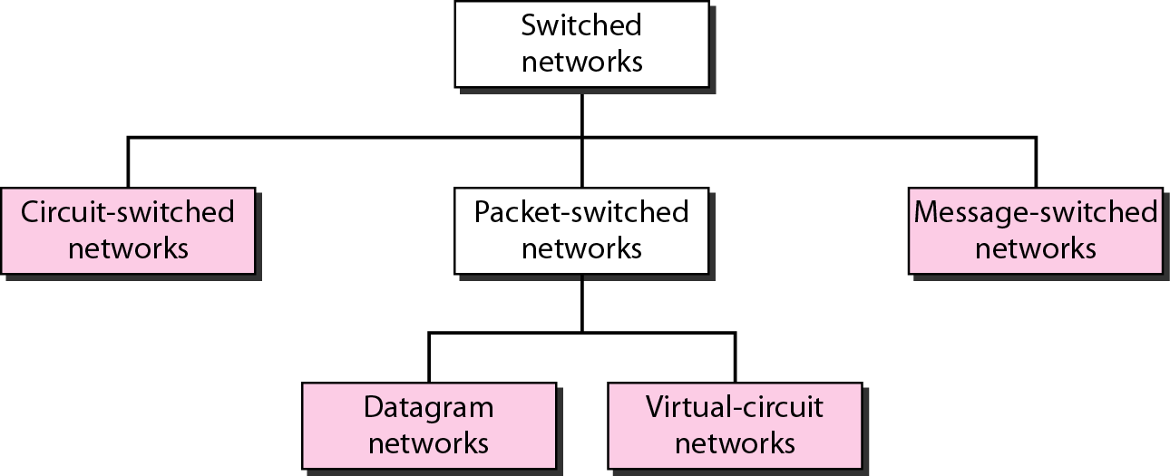
Figure 8.2 Taxonomy of switched networks

Slide 5
Switched Communications Networks

Slide 6
Switched Communications Networks
For example; data from station A intended for station F are sent to node 4. They may then be routed via nodes 5 and 6 or nodes 7 and 6 to the destination.
Important observations:
1. Some nodes connect only to other nodes (e.g., 5 and 7). Their sole task is the internal (to the network) switching of data. Other nodes have one or more stations attached as well; in addition to their switching functions, such nodes accept data from and deliver data to the attached stations.
2. Node-station links are generally dedicated point-to-point links. Node-node links are usually multiplexed, using either frequency division multiplexing (FDM) or time division multiplexing (TDM).
3. Usually, the network is not fully connected; that is, there is not a direct link between every possible pair of nodes. However, it is always desirable to have more than one possible path through the network for each pair of stations. This enhances the reliability of the network.

Slide 7
CIRCUIT-SWITCHED NETWORKS
A circuit-switched network consists of a set of switches connected by physical links. A connection between two stations is a dedicated path made of one or more links. However, each connection uses only one dedicated channel on each link. Each link is normally divided into n channels by using FDM or TDM.
Topics discussed in this section:
Three Phases Efficiency Delay

Slide 8

Note
A circuit-switched network is made of a set of switches connected by physical links, in which each link is divided into n channels.

Slide 9
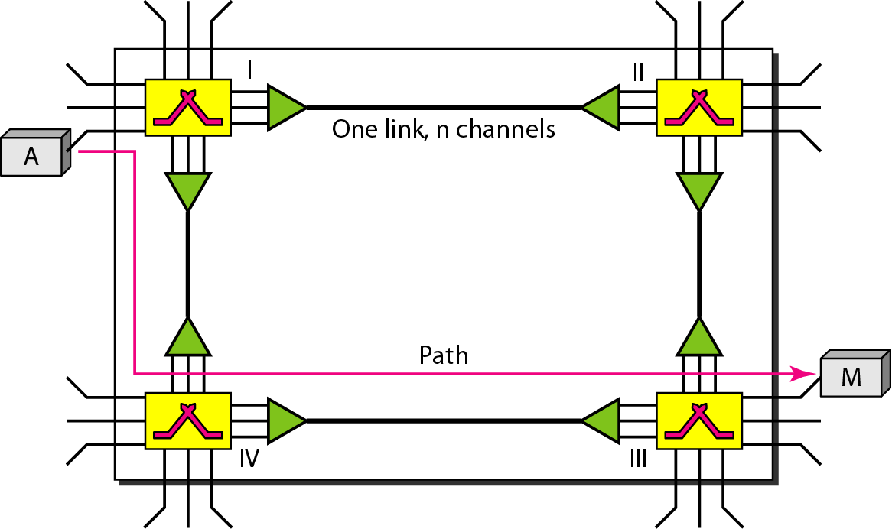
Figure 8.3 A trivial circuit-switched network

Slide 10
Note
In circuit switching, the resources need to be reserved during the setup phase; the resources remain dedicated for the entire duration of data transfer until the teardown phase.

Slide 11
Example 8.1
As a trivial example, let us use a circuit-switched network to connect eight telephones in a small area. Communication is through 4-kHz voice channels. We assume that each link uses FDM to connect a maximum of two voice channels. The bandwidth of each link is then 8 kHz. Figure 8.4 shows the situation. Telephone 1 is connected to telephone 7; 2 to 5; 3 to 8; and 4 to 6. Of course the situation may change when new connections are made. The switch controls the connections.

Slide 12
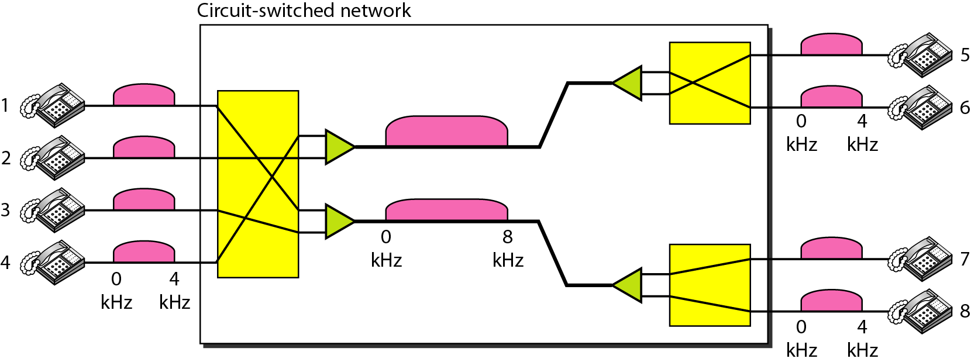
Figure 8.4 Circuit-switched network used in Example 8.1

Slide 13
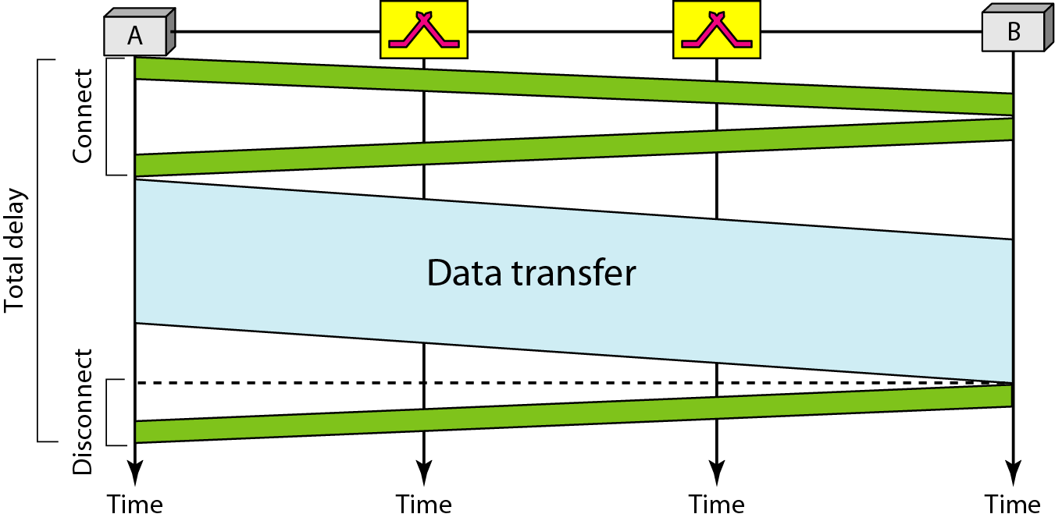
Figure 8.6 Delay in a circuit-switched network

Slide 14
Note
Switching at the physical layer in the traditional telephone network uses
the circuit-switching approach.

