Slide 1
Circuit switching concepts
A network built around a single circuit-switching node consists of a collection of stations attached to a central switching unit.
The central switch establishes a dedicated path between any two devices that wish to communicate.
The dotted lines inside the switch symbolize the connections that are currently active.

Slide 2
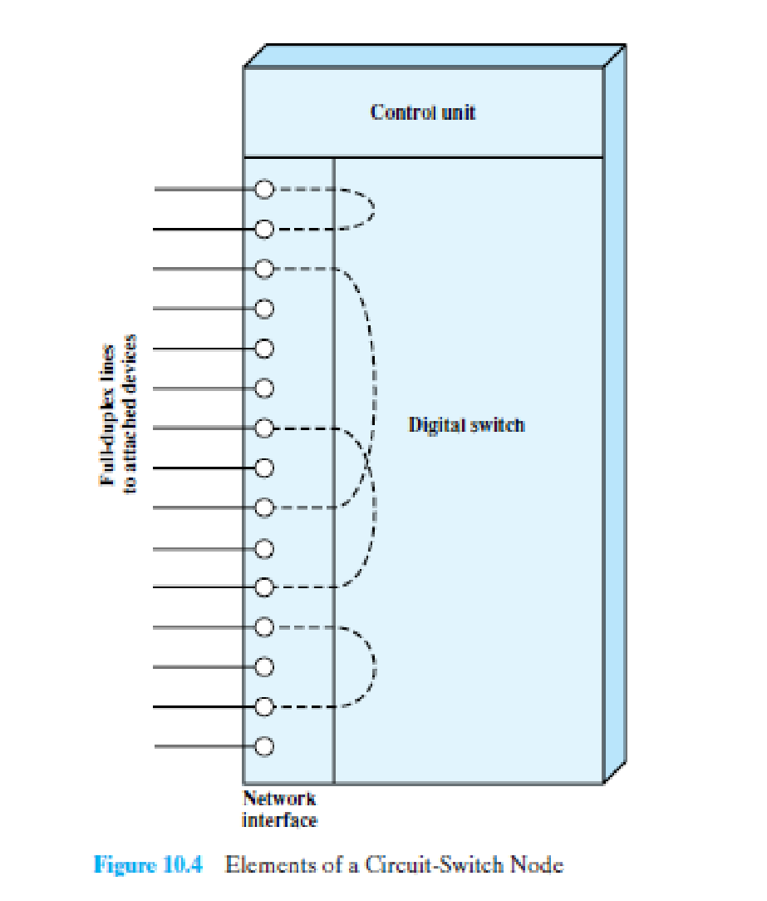
The dotted lines inside the switch symbolize the connections that are currently active.

Slide 3
Circuit switching concepts
Heart of a modern system -> digital switch.
Function of the digital switch -> provide a transparent signal path between any pair of attached devices.
The path is transparent in that it appears to the attached pair of devices that there is a direct connection between them.
Typically, the connection must allow full-duplex transmission.

Slide 4
Circuit switching concepts
Network Interface
Network interface element represents the functions and hardware needed to connect digital devices, such as data processing devices and digital telephones, to the network.
Analog telephones can also be attached if the network interface contains the logic for converting to digital signals.
Trunks to other digital switches carry TDM signals and provide the links for constructing multiple-node networks.

Slide 5
Circuit switching concepts
Control unit
performs three general tasks.
1) it establishes connections.
This is generally done on demand, that is, at the request of an attached device.
To establish the connection, the control unit must handle and acknowledge the request, determine if the intended destination is free, and construct a path through the switch.
2) the control unit must maintain the connection.
Because the digital switch uses time division principles, this may require ongoing manipulation of the switching elements.
However, the bits of the communication are transferred transparently
3) the control unit must tear down the connection, either in response to a request from one of the parties or for its own reasons.

Slide 6
Blocking or nonblocking
Blocking occurs when the network is unable to connect two stations because all possible paths between them are already in use.
a nonblocking network permits all stations to be connected (in pairs) at once and grants all possible connection requests as long as the called party is free.

Slide 7
switching techniques internal to a single circuit-switching node
Space Division Switching:
signal paths are physically separate from one another (divided in space).
Each connection requires the establishment of a physical path through the switch that is dedicated solely to the transfer of signals between the two endpoints.
The basic building block of the switch is a metallic crosspoint or semiconductor gate that can be enabled and disabled by a control unit.

Slide 8
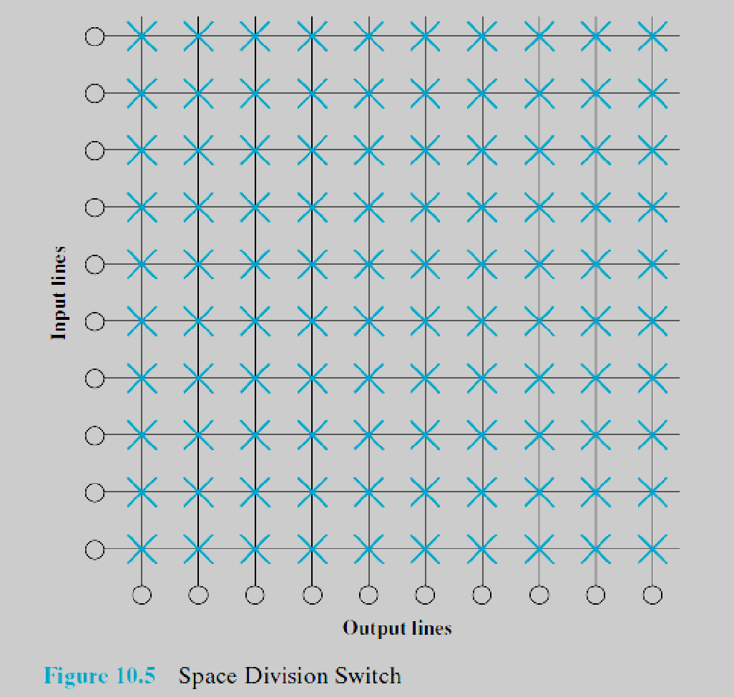

Slide 9
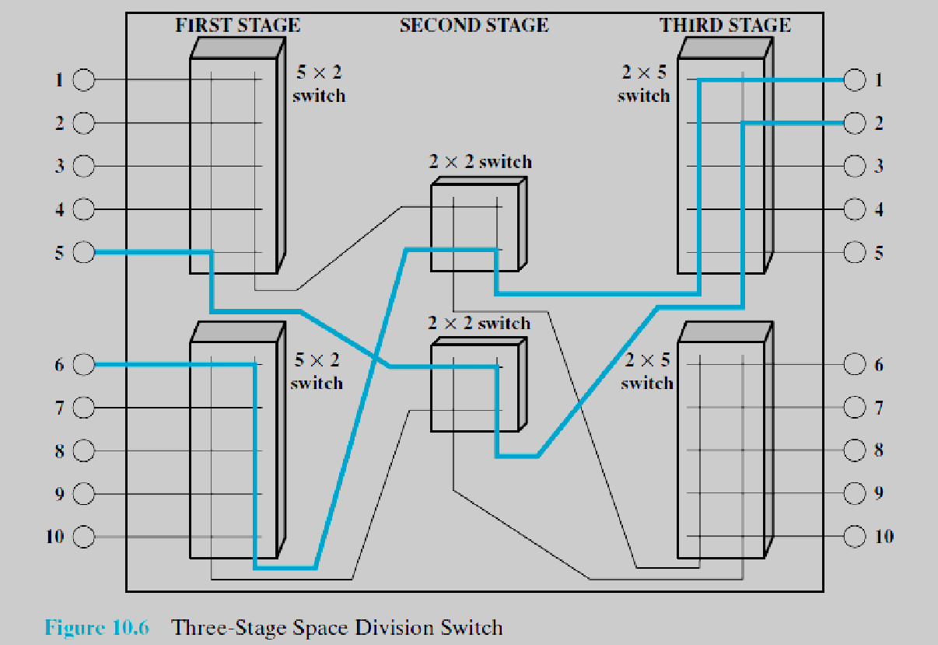
switching techniques internal to a single circuit-switching node
Space Division Switching:

Slide 10
switching techniques internal to a single circuit-switching node
Time Division Switching:
Virtually all modern circuit switches use digital time division techniques for establishing and maintaining “circuits.”
Time division switching involves the partitioning of a lower-speed bit stream into pieces that share a higher-speed stream with other bit streams.
The individual pieces, or slots, are manipulated by control logic to route data from input to output.

Slide 11
switching techniques internal to a single circuit-switching node
Time Division Switching:
Virtually all modern circuit switches use digital time division techniques for establishing and maintaining “circuits.”
Time division switching involves the partitioning of a lower-speed bit stream into pieces that share a higher-speed stream with other bit streams.
The individual pieces, or slots, are manipulated by control logic to route data from input to output.

Slide 12
SOFTSWITCH ARCHITECTURE
Softswitch is a general-purpose computer running specialized software that turns it into a smart phone switch.
Softswitches cost significantly less than traditional circuit switches and can provide more functionality.
In particular, in This opens up a number of options for transmission, including the increasingly popular voice over IP (Internet Protocol) approach.
In any telephone network switch, the most complex element is the software that controls call processing.
This software performs call routing and implements call-processing logic for hundreds of custom calling features.
Typically, this software runs on a proprietary processor that is integrated with the physical circuit-switching hardware.
Eg. Skype Call

Slide 13
X.25
interface between attached devices and the network.
packet-switching networks, the attached stations must organize their data into packets for transmission.
This requires a certain level of cooperation between the network and the attached stations.
This cooperation is embodied in an interface standard.
The standard used for traditional packet-switching networks is X.25.

Slide 14
X.25
X.25 is an ITU-T standard that specifies an interface between a host system and a packet-switching network.
The functionality of X.25 is specified on three levels:
• Physical level
• Link level
• Packet level

Slide 15
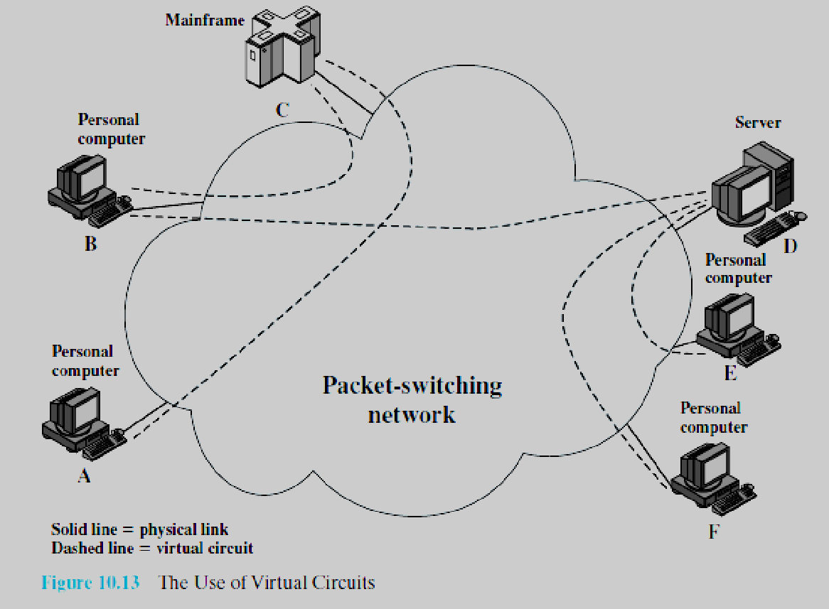

Slide 16
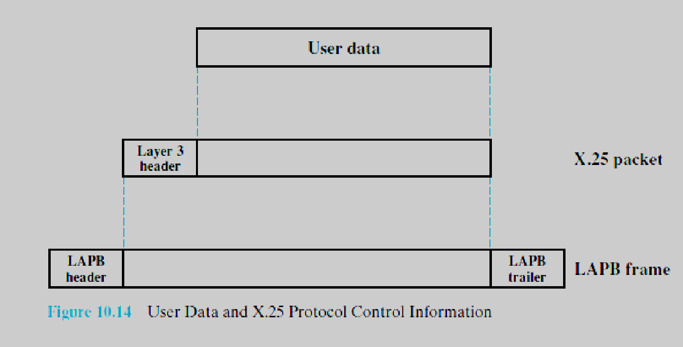
X.25

Slide 17
X.25
User data are passed down to X.25 level 3, which appends control information as a header, creating a packet.
This control information serves several purposes, including
1. Identifying by number a particular virtual circuit with which this data is to be associated
2. Providing sequence numbers that can be used for flow and error control on a virtual circuit basis

Slide 18
X.25
The entire X.25 packet is then passed down to the LAPB entity, which
appends control information at the front and back of the packet, forming a LAPB frame.
Again, the control information in the frame is needed for the operation of the LAPB protocol.
Each X.25 data packet includes send and receive sequence numbers.
The send sequence number, P(S), is used to number sequentially all outgoing data packets on a particular virtual circuit.
The receive sequence number, P(R), is an acknowledgment of packets received on that virtual circuit.

Slide 19
18-1 FRAME RELAY
Frame Relay is a virtual-circuit wide-area network that was designed in response to demands for a new type of WAN in the late 1980s and early 1990s.
Topics discussed in this section:
Architecture Frame Relay Layers
Extended Address
FRADs
VOFR
LMI

Slide 20
18-1 FRAME RELAY
Some drawbacks of X.25:
X.25 has low speed.
Flow and error control at both layers create a large overhead and slow down transmissions.
requires acknowledgments for both data link layer frames and network layer
packets that are sent between nodes and between source and destination.
if the Internet wants to use X.25, the Internet must deliver its network layer packet, called a datagram, to X.25 for encapsulation in the X.25 packet.

Slide 21
18-1 FRAME RELAY
Some advantages of frame relay over X.25:
Frame Relay is less expensive than other traditional WANs.
Frame Relay has error detection at the data link layer only. There is no flow control or error control.
There is not even a retransmission policy if a frame is damaged; it is silently dropped.
Frame Relay was designed in this way to provide fast transmission capability for more reliable media and for those protocols that have flow and error control at the higher layers.

Slide 22
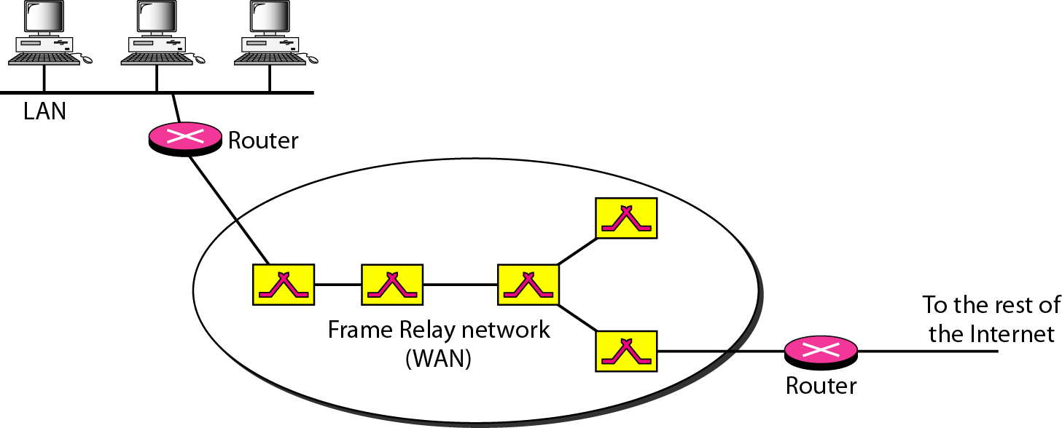
Figure 18.1 Frame Relay network
Frame Relay provides permanent virtual circuits and switched virtual circuits.

Slide 23

Note
VCIs in Frame Relay are called data link connection identifier (DLCIs).

Slide 24
Permanent Versus Switched Virtual Circuits:
PVC: The corresponding table entry is recorded for all switches by the administrator. An outgoing DLCI is given to the source, and an incoming DLCI is given to the destination.
Drawback:costly because two parties
pay for the connection all the time even when it is not in use. Second, a connection is created from one source to one single destination.

Slide 25
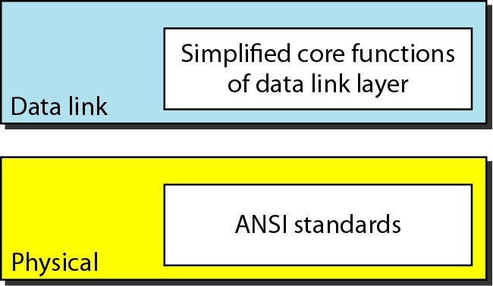
Figure 18.2 Frame Relay layers

Slide 26
Note
Frame Relay operates only at the physical and data link layers.

Slide 27
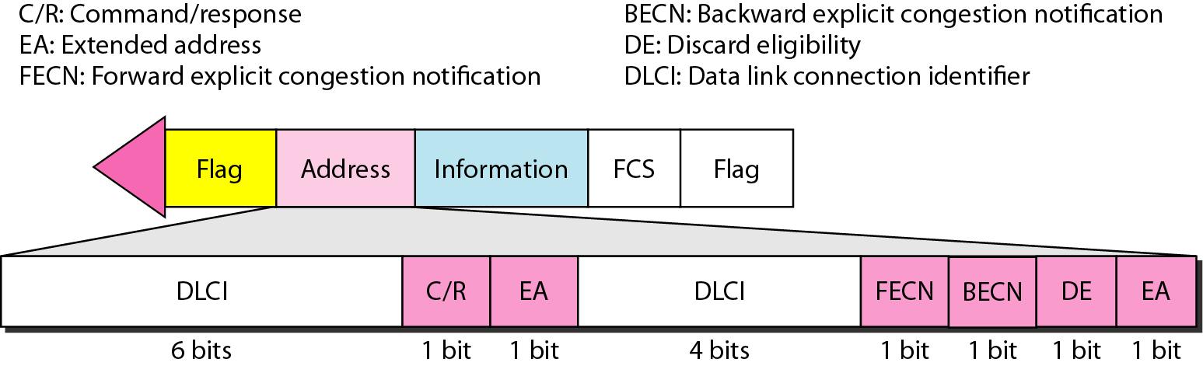
Figure 18.3 Frame Relay frame
frame check sequence (FCS) is an error-detecting code

Slide 28
Note
Frame Relay does not provide flow or error control; they must be provided
by the upper-layer protocols.

Slide 29
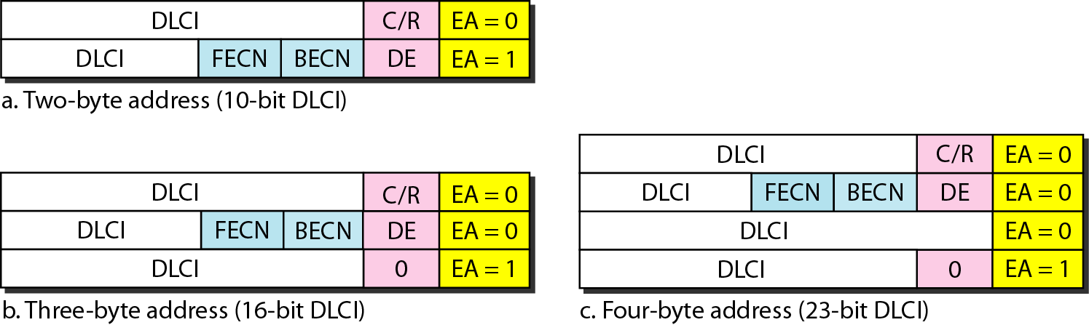
Figure 18.4 Three address formats

Slide 30
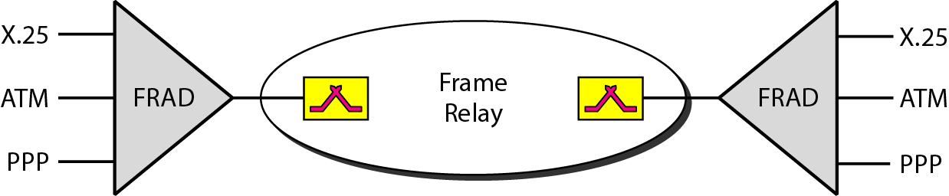
Figure 18.5 FRAD

Slide 31
VOFR
Frame Relay networks offer an option called Voice Over Frame Relay (VOFR) that
sends voice through the network.
Voice is digitized using PCM and then compressed.
The result is sent as data frames over the network. This feature allows the inexpensive sending of voice over long distances.
LMI
Frame Relay was originally designed to provide PVC connections. There was not,
therefore, a provision for controlling or managing interfaces. Local Management Information (LMI) is a protocol added recently to the Frame Relay protocol to provide more management features. In particular, LMI can provide
A keep-alive mechanism to check if data are flowing.
A multicast mechanism to allow a local end system to send frames to more than one remote end system.
A mechanism to allow an end system to check the status of a switch (e.g., to see if the switch is congested).

Slide 32
18-2 ATM
Asynchronous Transfer Mode (ATM) is the cell relay protocol designed by the ATM Forum and adopted by the ITU-T.
Topics discussed in this section:
Design Goals Problems Architecture
Switching
ATM Layers

Slide 33
18-2 ATM
Design Goals:
High-data-rate transmission media, in particular optical fiber.
interface with existing systems
implemented inexpensively
connection-oriented to ensure accurate and predictable
Delivery.
move as many of the functions to hardware as
possible (for speed) and eliminate as many software functions as possible (again
for speed).

Slide 34
18-2 ATM
Frame Networks
Mixed Network Traffic

Slide 35
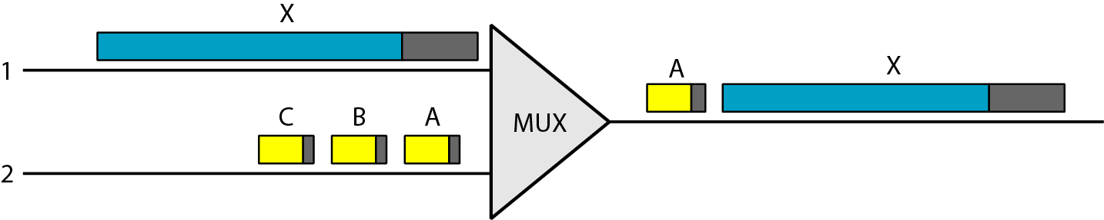
Figure 18.6 Multiplexing using different frame sizes

Slide 36
Note
A cell network uses the cell as the basic unit of data exchange.
A cell is defined as a small, fixed-size block of information.

Slide 37
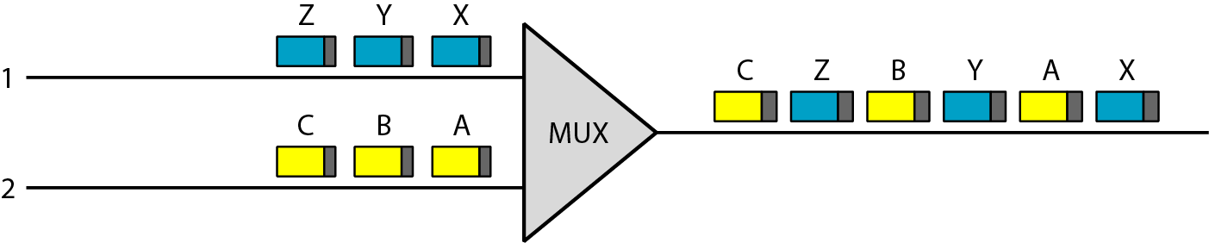
Figure 18.7 Multiplexing using cells

Slide 38
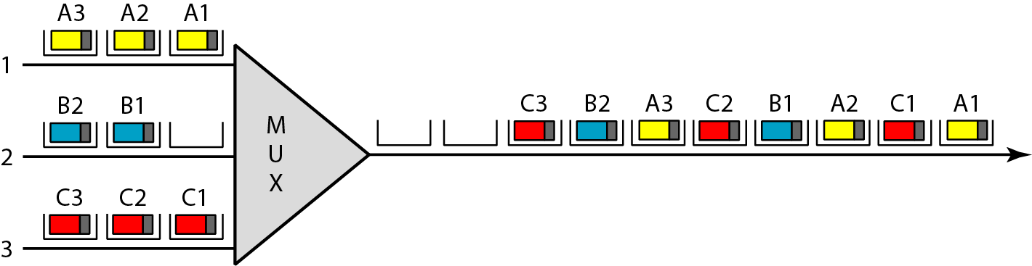
Figure 18.8 ATM multiplexing

Slide 39
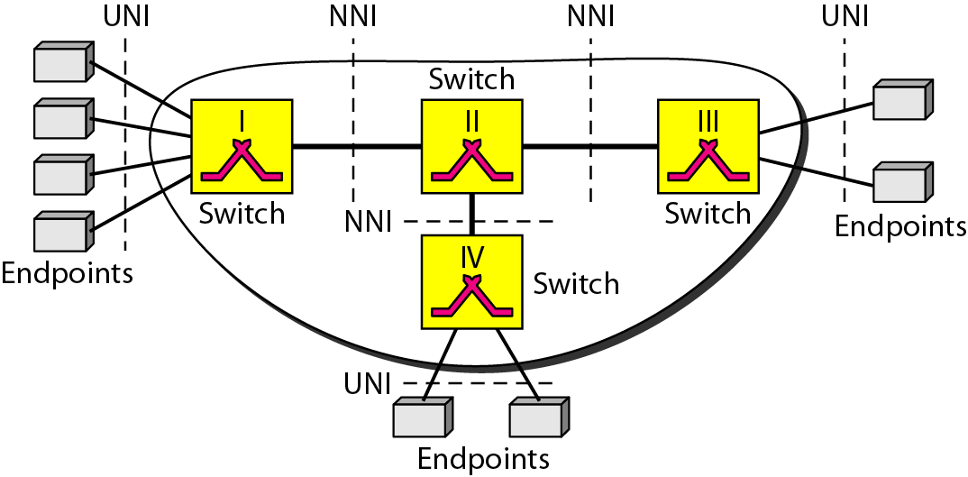
Figure 18.9 Architecture of an ATM network

Slide 40
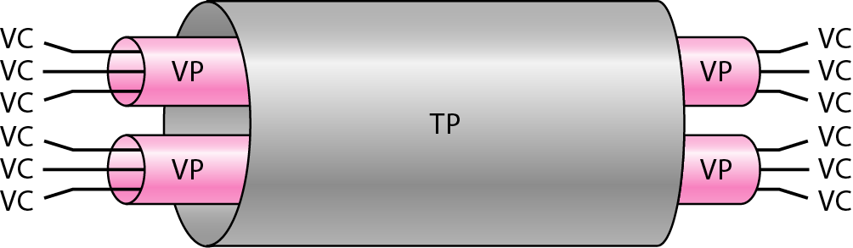
Figure 18.10 TP, VPs, and VCs
Transmission path=Physical connection

Slide 41
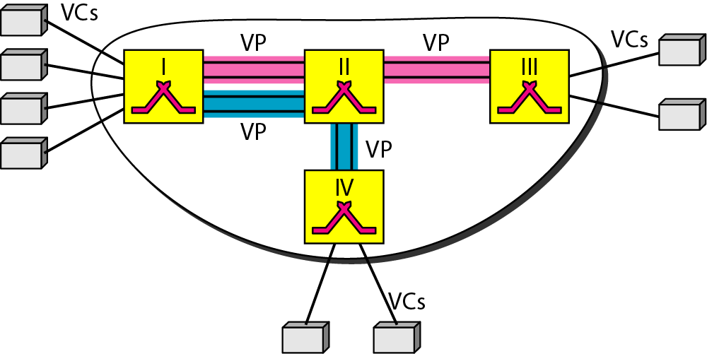
Figure 18.11 Example of VPs and VCs

Slide 42
Note
Note that a virtual connection is defined by a pair of numbers: the VPI and the VCI.

Slide 43
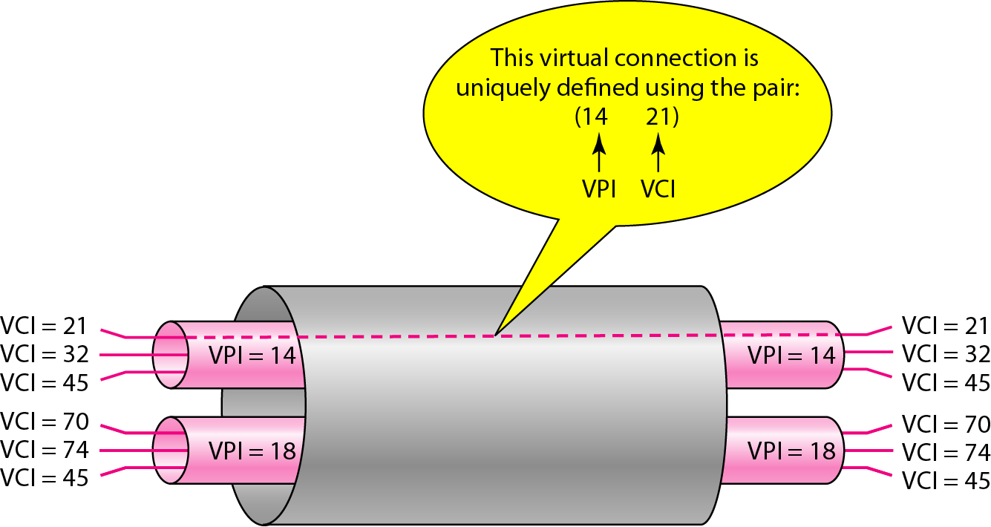
Figure 18.12 Connection identifiers

Slide 44
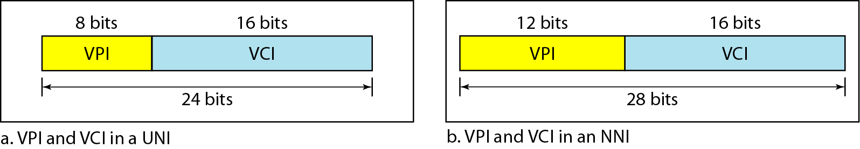
Figure 18.13 Virtual connection identifiers in UNIs and NNIs

Slide 45
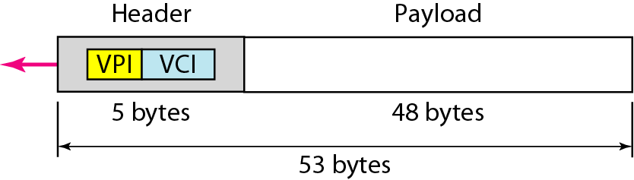
Figure 18.14 An ATM cell

Slide 46
ATM
Connection Establishment and Release
PVC
SVC
Switching:
arrival interface number,incoming VPI, incoming VCI, corresponding outgoing interface number, the new
VPI, and the new VCL

Slide 47
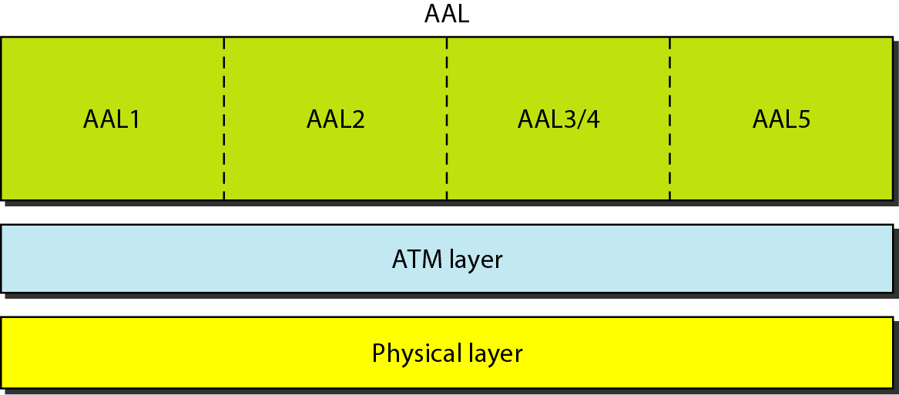
Figure 18.16 ATM layers
Application Adaptation layer
ATM Layer: provides routing, traffic management, switching, and multiplexing
services. It processes outgoing traffic by accepting 48-byte segments from the AAL
sublayers and transforming them into 53-byte cells by the addition of a 5-byte header

Slide 48
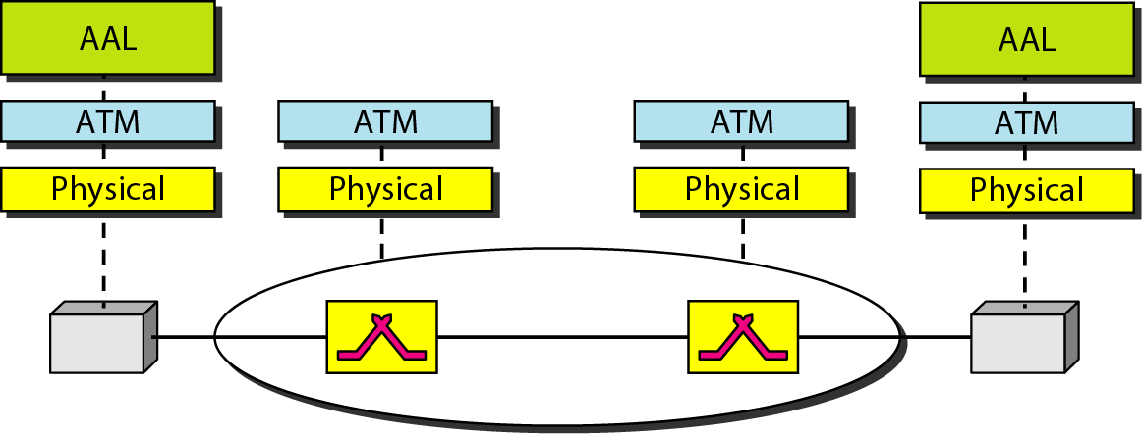
Figure 18.17 ATM layers in endpoint devices and switches

Slide 49
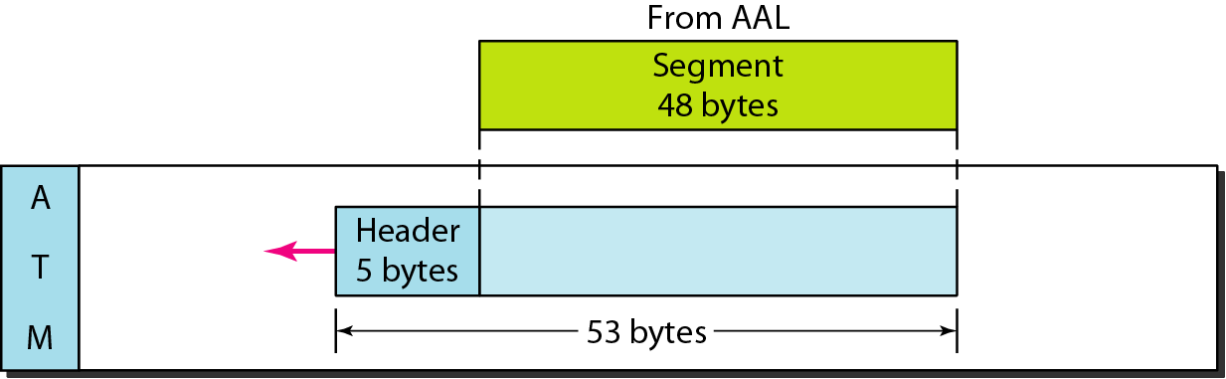
Figure 18.18 ATM layer

Slide 50
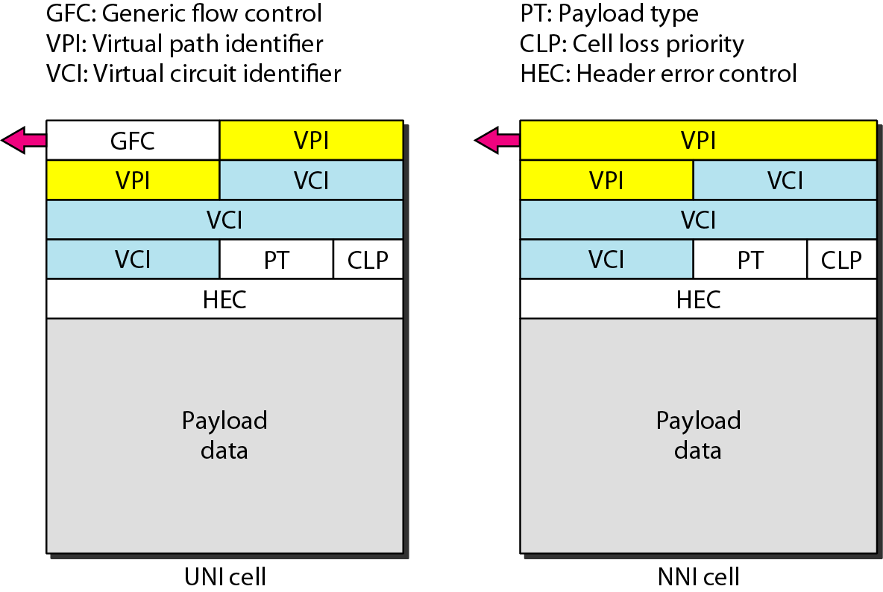
Figure 18.19 ATM headers

Slide 51
ATM headers
Generic flow control (GFC). The 4-bit GFC field provides flow control at the
UNI level.
The VPI is an 8-bit field in a UNI cell and a 12-bit field in an NNI cell
Virtual circuit identifier (VCI). The VCI is a 16-bit field in both frames.
Payload type (PT). In the 3-bit PT field, the first bit defines the payload as user
data or managerial information. The interpretation of the last 2 bits depends on the
first bit.
Cell loss priority (CLP). The I-bit CLP field is provided for congestion control.
Header error correction (HEC). The HEC is a code computed for the first
4 bytes of the header. It is a CRC with the divisor x8 + x2 + x + 1 that is used to
correct single-bit errors and a large class of multiple-bit errors.

Slide 52
Application Adaptation Layer
AAL1 supports applications that transfer information at constant bit rates,
such as video and voice. It allows ATM to connect existing digital telephone networks
AAL2 was intended to support a variable-data-rate bit stream, but it
has been redesigned. It is now used for low-bit-rate traffic and short-frame traffic such as audio (compressed or uncompressed), video, or fax.
AAL3 was intended to support connection-oriented data services and
AAL4 to support connectionless services.
AAL 5: simple and efficient adaptation layer (SEAL). AALS assumes that all cells belonging to a single message travel sequentially and that control functions are included in the upper layers of the sending application.

Slide 53
Routing in ARPANET
References:
https://www.youtube.com/watch?v=dmS1t2twFrI

