Slide 1
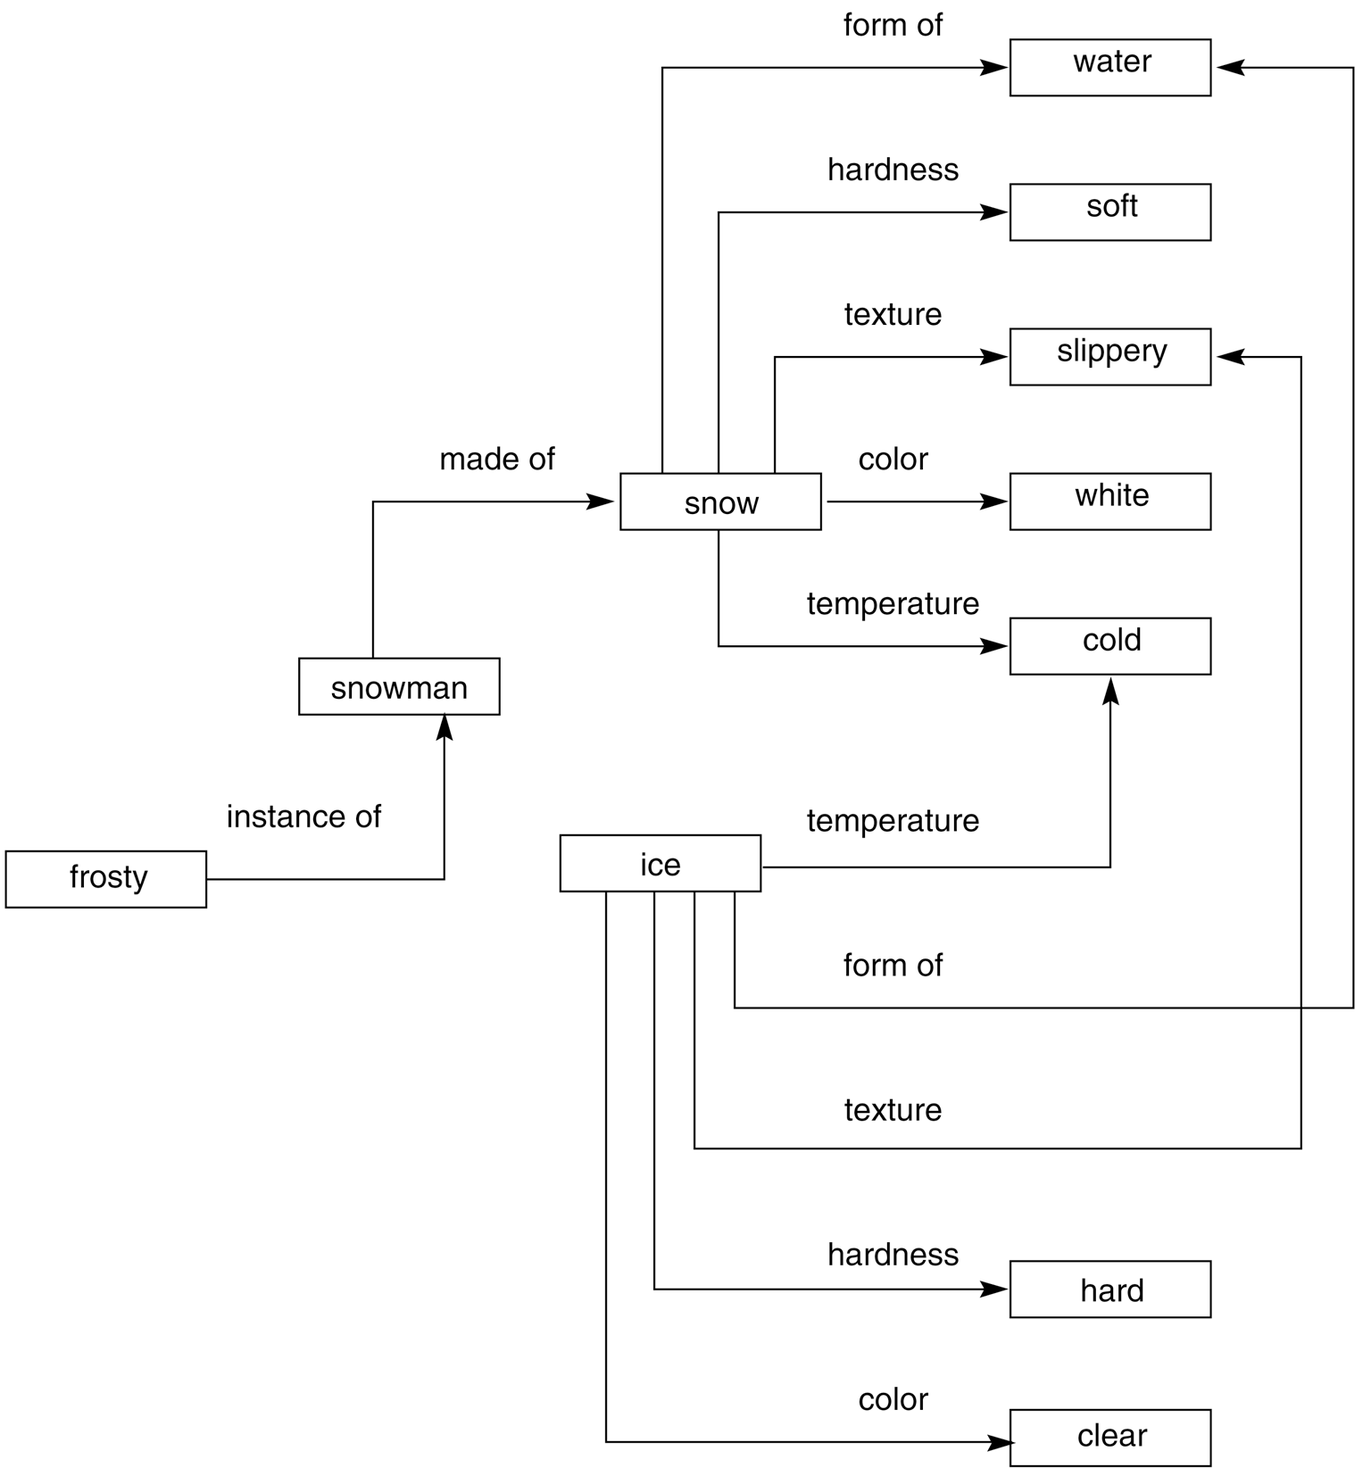
A brief look at semantic networks
A semantic network is an irregular graph that has concepts in vertices and relations on arcs.
Relations can be ad-hoc, but they can also be quite general, for example, “is a” (ISA), “a kind of” (AKO), “an instance of”, “part of”.
Relations often express physical properties of objects (colour, length, and lots of others).
Most often, relations link two concepts.

Slide 2
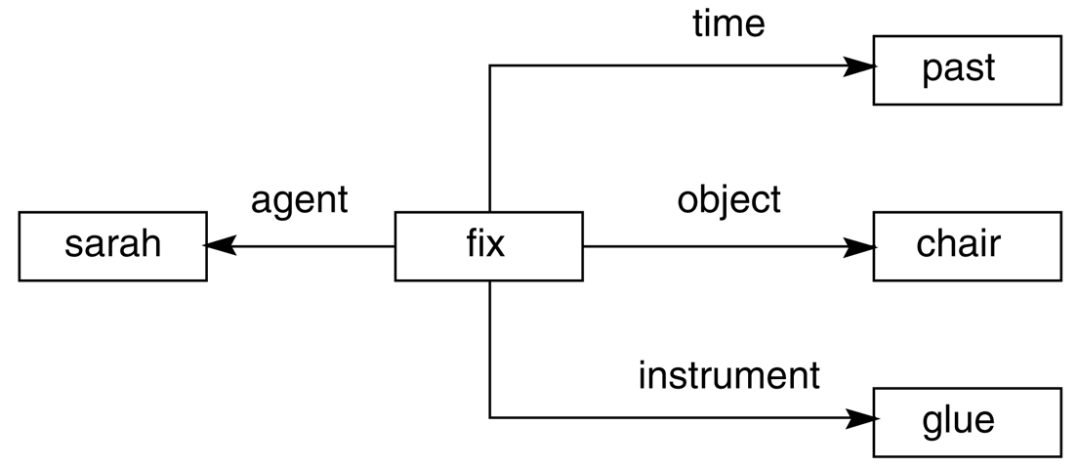
... semantic networks (2)
General semantic relations help represent the meaning of simple sentences in a systematic way.
A sentence is centred on a verb that expects certain arguments.
For example, verbs usually denotes actions (with agents) or states (with passive experiencers, for example, “he dreams” or “he is sick”).

Slide 3
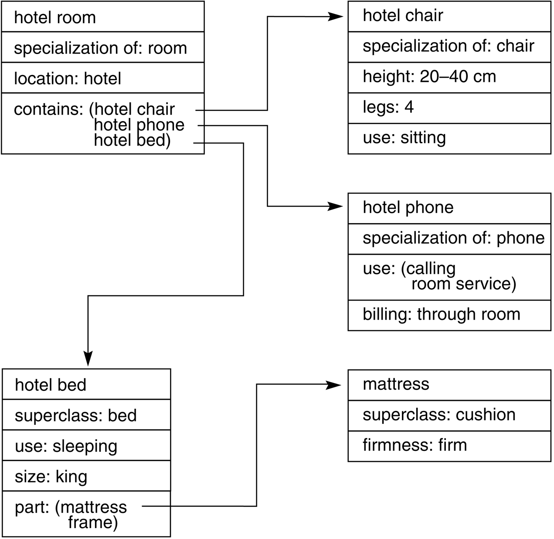
Frames and frame systems
A frame represents a concept;
a frame system represents an organization of knowledge about a set of related concepts.
A frame has slots that denote properties of objects. Some slots have default fillers, some are empty (may be filled when more becomes known about an object).
Frames are linked by relations of specialization/generalization and by many ad-hoc relations.

Slide 4
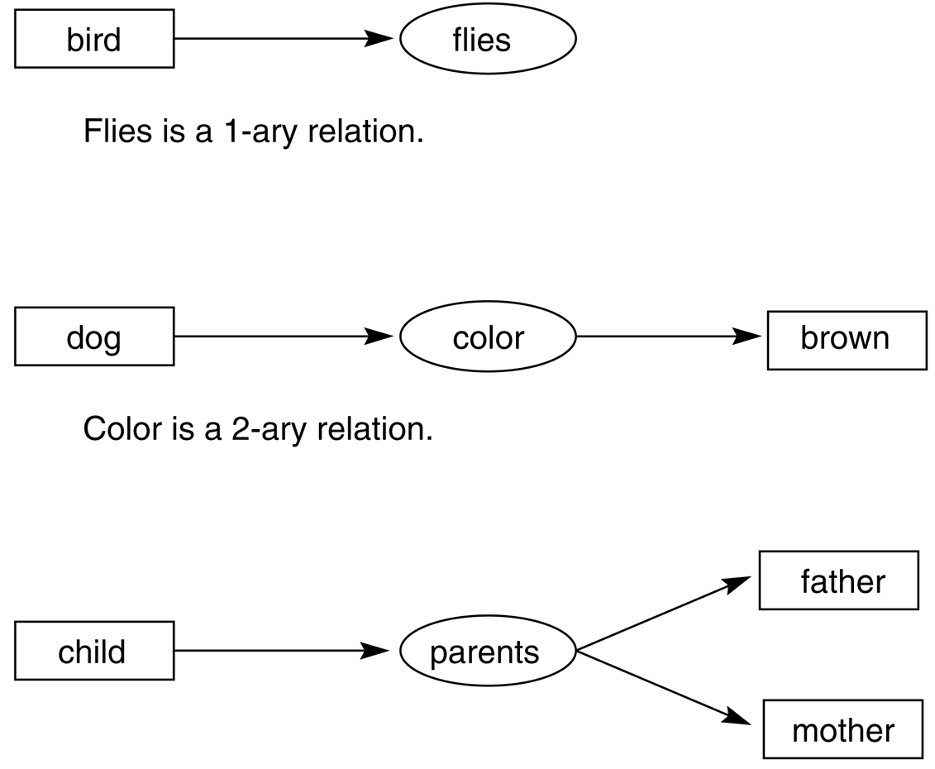
Conceptual graphs
John Sowa created the conceptual graph notation in 1984. It has substantial philosophical and psychological motivation.
It is still quite a popular knowledge representation formalism, especially in semantic processing of language, and a topic of interesting research.
Conceptual graphs can be expressed in first-order logic but due to its graphical form it may be easier to understand than logic.
Parents is a 3-ary relation.

Slide 5
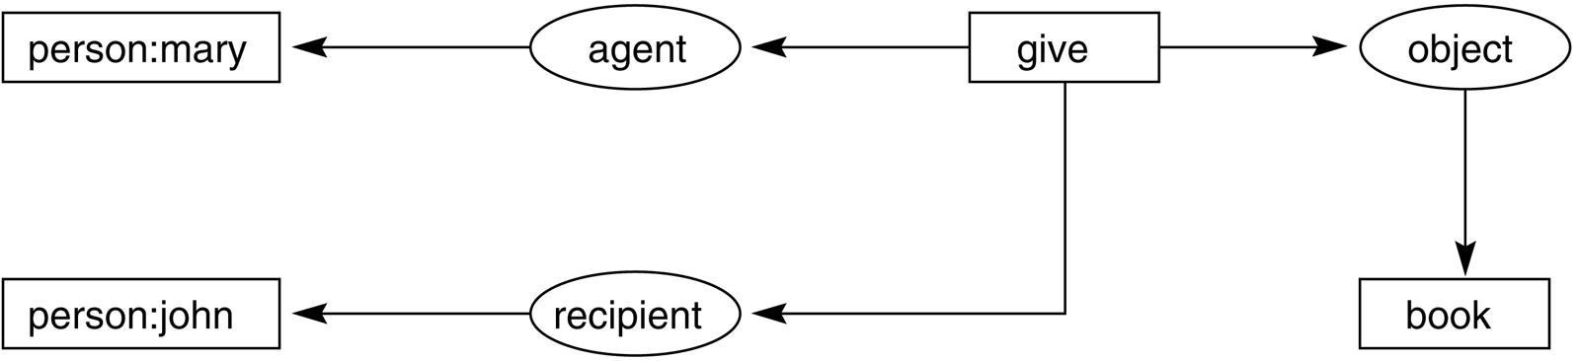
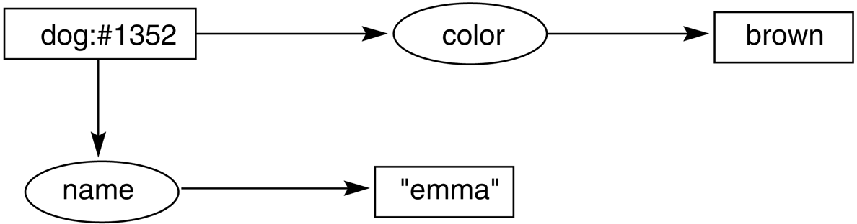
Conceptual graphs (2)

Slide 6
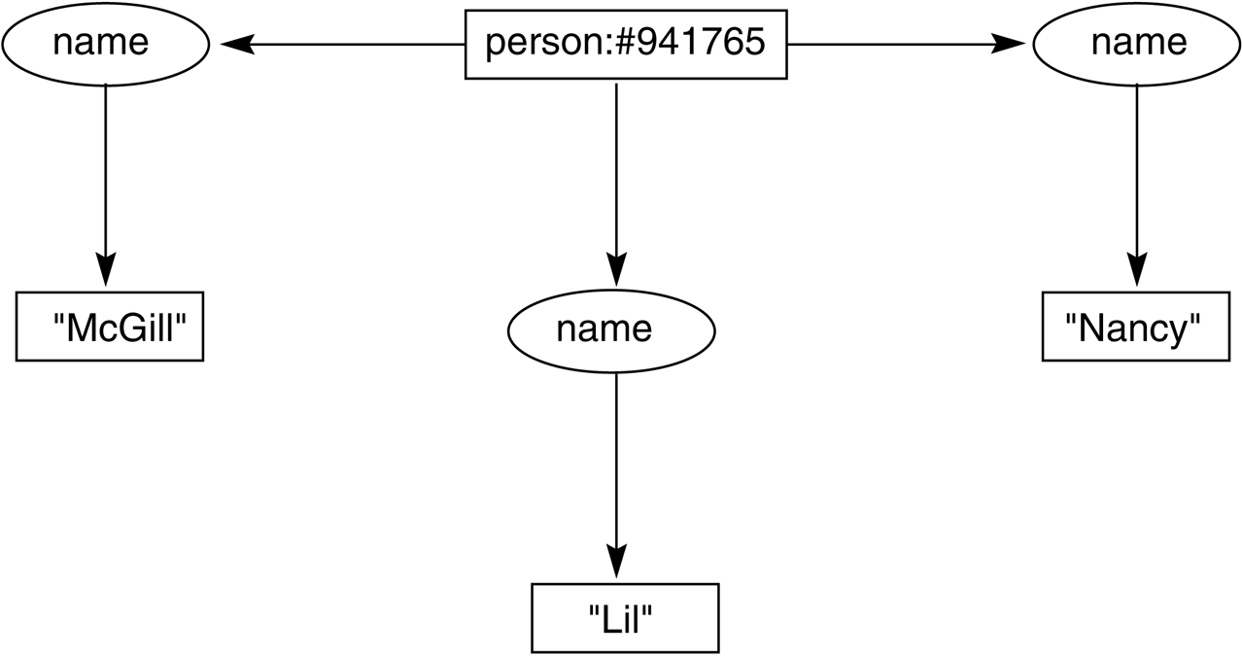

Conceptual graphs (3)
Her name was Magill, and she called herself Lil,
but everyone knew her as Nancy.
Lil

Slide 7
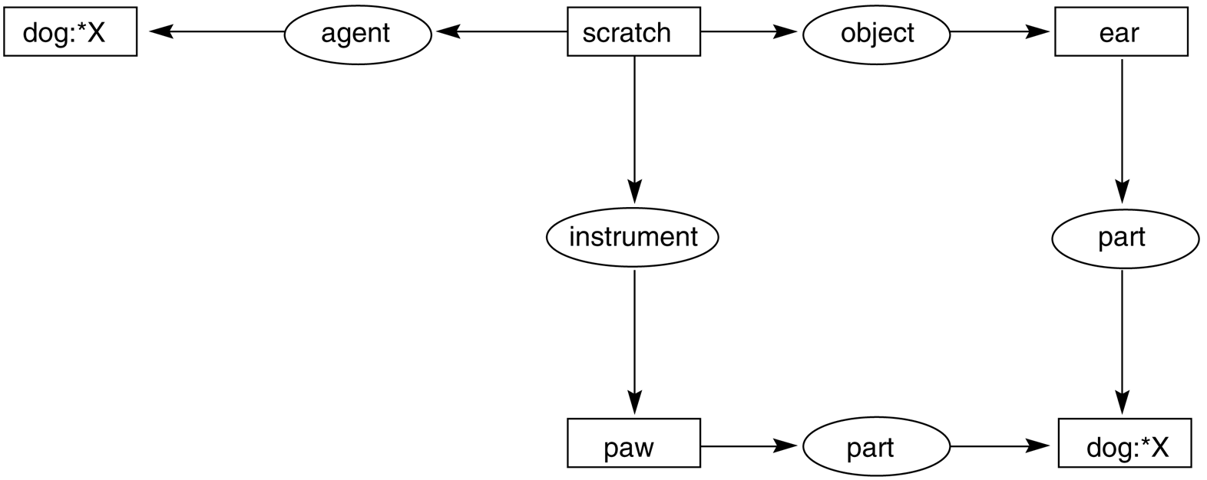
Conceptual graphs (4)
Variables allow us to express the identity of an individual.

Slide 8
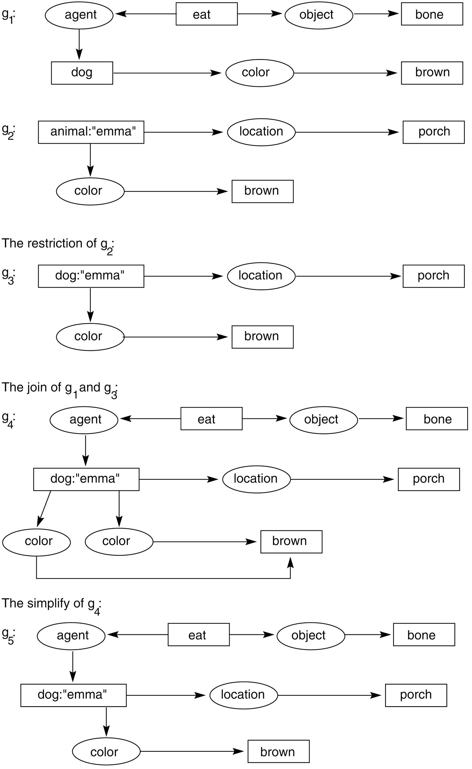
Conceptual graphs (5)
Specialization and type hierarchy
dogs are animals
(g₁) A brown dog eats a bone.
(g₂) ... Emma, the brown animal on the porch...
(g₃) ... Emma, the brown dog on the porch...
(g₄) Emma, the brown dog on the porch, eats a bone.
The challenge is to get this from text!

Slide 9
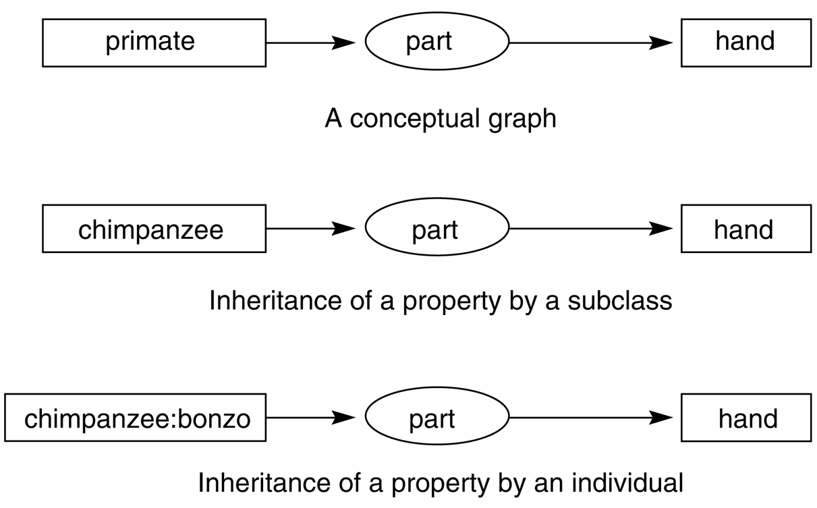
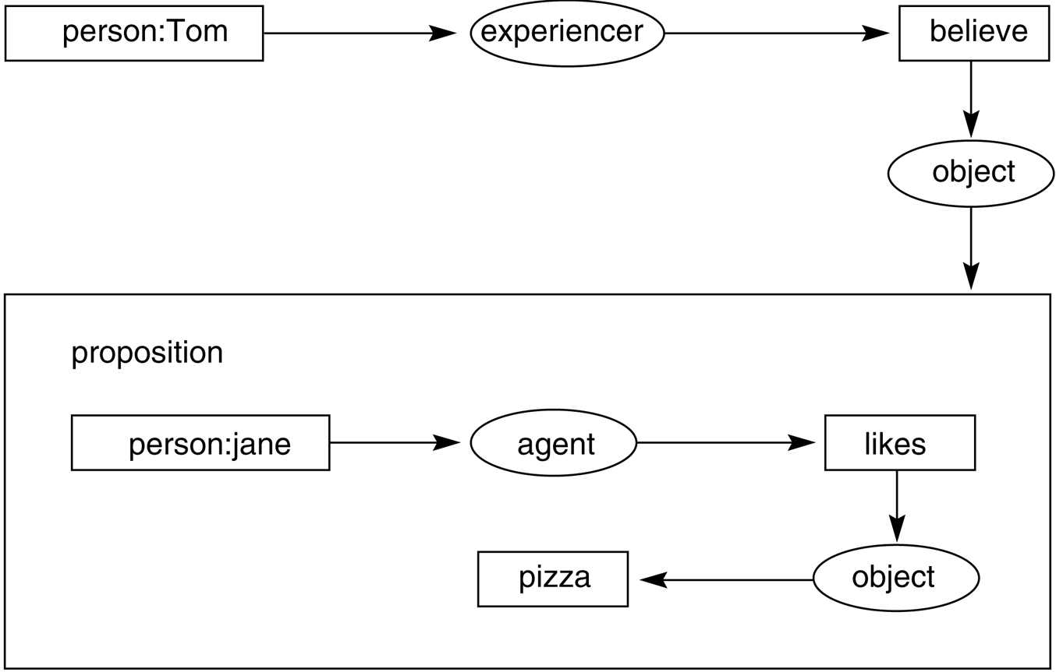
Conceptual graphs (6)
Beyond first-order logic
Inheritance

Slide 10
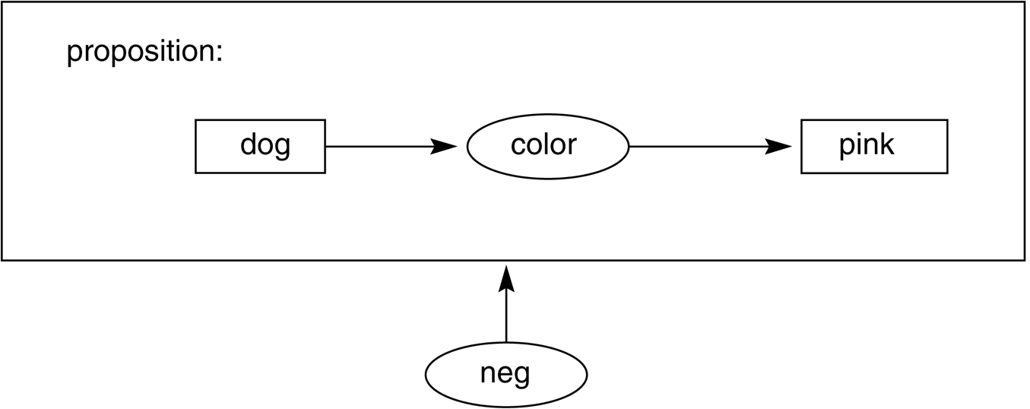
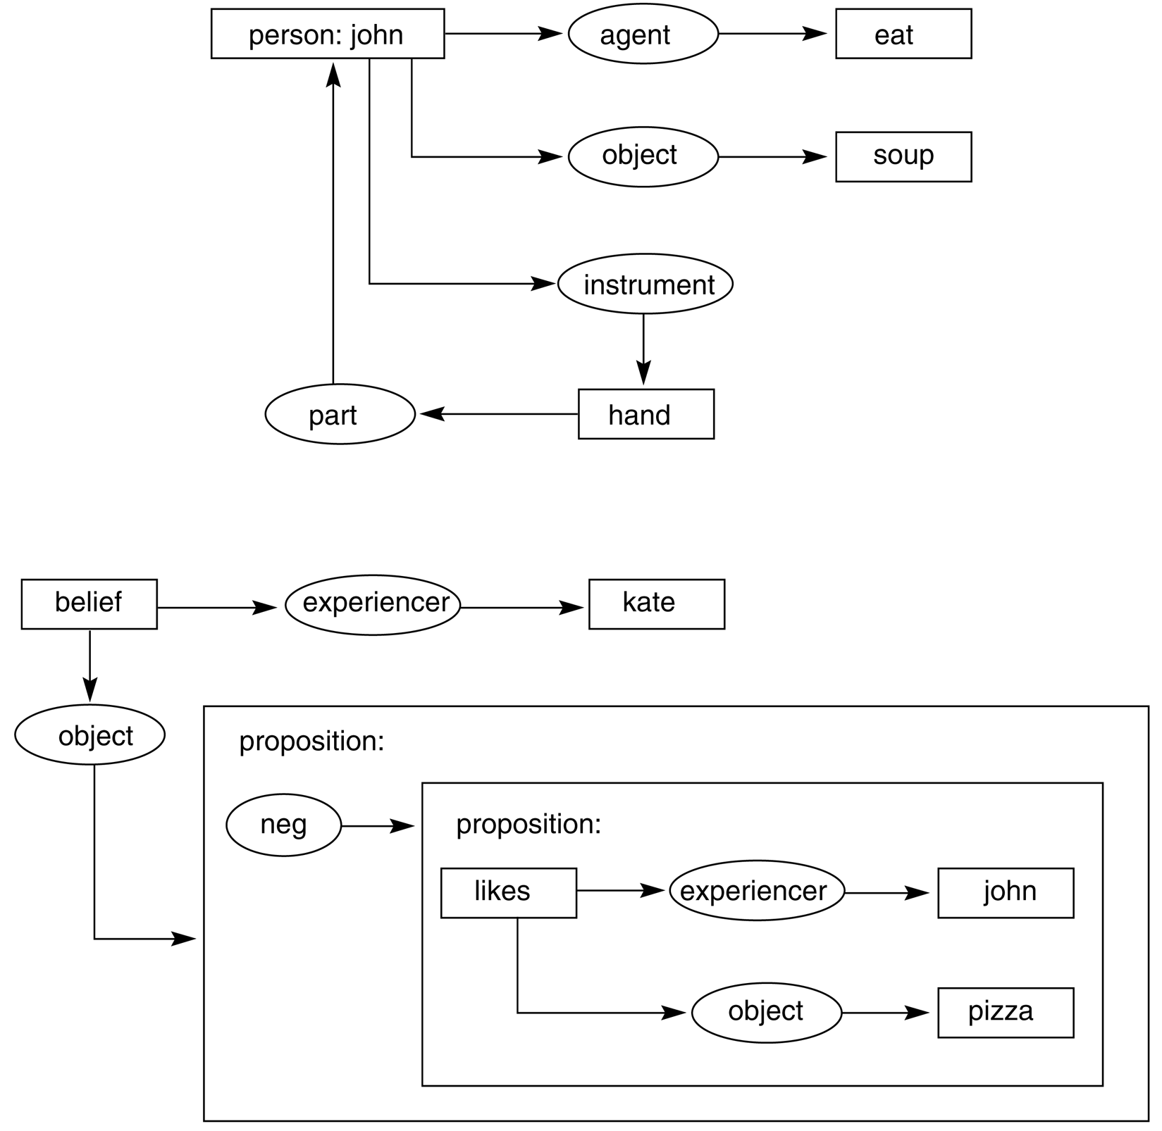
Conceptual graphs (7)
Negation and quantification
Two simple puzzles

