Slide 1
Heuristic Search

Slide 2
Agenda
Introduction
Why Heuristics ?
Heuristic Value / Function
Euclidean distance
Manhattan distance
4. Applications

Slide 3
Introduction
Heuristics are approximation used to minimize the search process.
Heuristic search may or may not be optimal but many times gives good results although sometimes ends up in failure result.
Informed search uses Heuristics to reach the goal state.
Heuristic search attempts to optimize a problem using a heuristic function, so search which uses heuristic function is heuristic search.
Heuristic function is a function that gives an estimation on the cost of getting from node n to the goal state.
In short, it is a technique designed to solve problems quickly.

Slide 4
Why Heuristics ?
Computational Efficiency: Heuristics provide shortcuts that save computational resources, enabling algorithms to find solutions more quickly.
Handling Large Search Spaces: Heuristics guide algorithms through vast solution spaces, focusing on promising paths to avoid exhaustive exploration.
Approximate Solutions: Heuristics yield quick, good-enough solutions, bypassing the need for optimal but computationally expensive solutions.
Problem-Specific Knowledge: Heuristics incorporate domain expertise, tailoring algorithms to the specific characteristics of the problem at hand.
Examples of algorithms that uses heuristic search:
A* Algorithm, Greedy Best-First Search, etc.

Slide 5
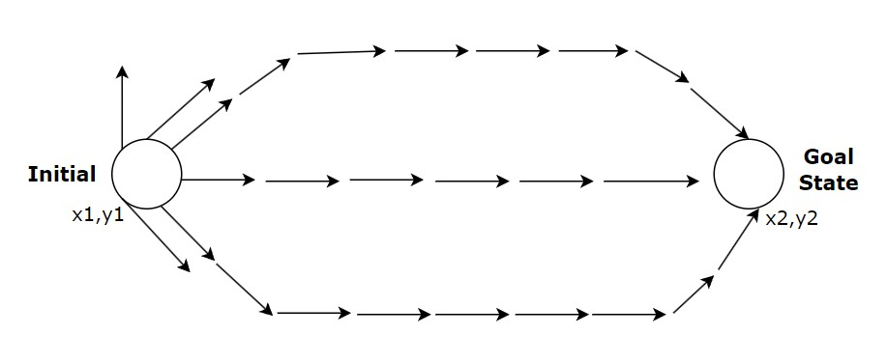

Heuristic Value / Function
The heuristic function is also known as evaluation function, is a function that estimates the cost or distance from given state to the goal state.
It provides a numerical value that guides the search algorithm in selecting the most promising paths.
Euclidean distance:
straight line distance
$\sqrt{{(x2−x1)}^{2}+{(y2−y1)}^{2} }$

Slide 6
Heuristic Value / Function
Manhattan distance:
Used to find out horizontal distance. For example 8-puzzle problem.
Initial State Goal State
0 + 1 + 1 + 1 + 1 + 3 + 0 + 2
2. Number of misplaced blocks / tiles
1 | 3 | 2
 | 6 | 7
4 | 8 | 5
1 | 2 | 3
4 | 5 | 6
7 | 8

Slide 7
Applications
Most common application of heuristic search is in the field of AI and computer science, particularly in the development of algorithm for problem solving and optimization :
Pathfinding in Robotics
Network Routing
Video Game Design
Natural Language Processing
Optimization Problems
Traffic Management and Control
Resource Allocation in Cloud Computing, etc.

