Slide 1

State Space Search
Notes:
NOTE:
To change the image on this slide, select the picture and delete it. Then click the Pictures icon in the placeholder to insert your own image.

Slide 2
Introduction
Before an AI problem can be solved it should be represented as a state space.
The state space is then searched to find a solution to the problem.
A state space essentially consists of a set of nodes representing each state of the problem, arcs between nodes representing the legal moves from one state to another, an initial state and a goal state.
Each state space takes the form of a tree or a graph.

Slide 3
Definition
SP: [S, s, A, G]
S is set of states, S={initial, goal,........}
s is the initial state or start state
A is set of actions
G is a set of Goal states

Slide 4
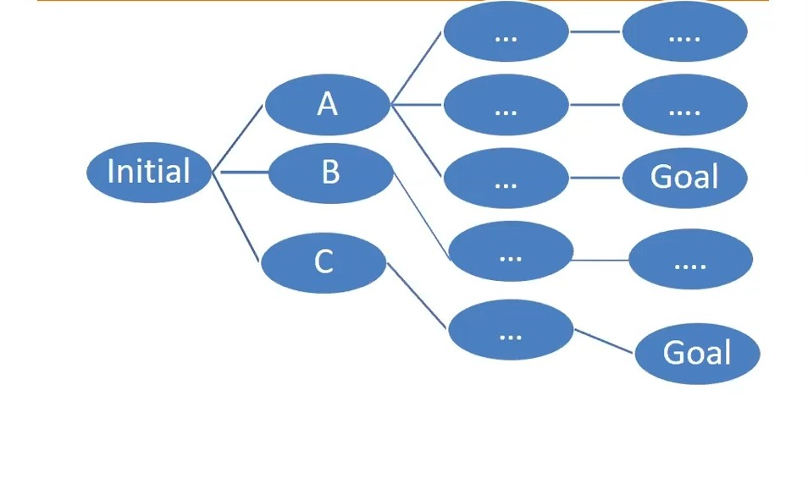
Solution paths

Slide 5
Uninformed and Informed search
Uninformed
Search without information
No Knowledge
Time consuming
More complexity(time, space)
DFS, BFS etc.
Informed
Search with Information
Use knowledge to find steps to solutions.
Quick solution
Less complexity (time, space)
A*, Heuristic BFS, Best first search

Slide 6
Thank you…!

