Slide 1

UNINFORMED SEARCH ALGORITHMS
BY DR. UMESH CHAVAN

Slide 2
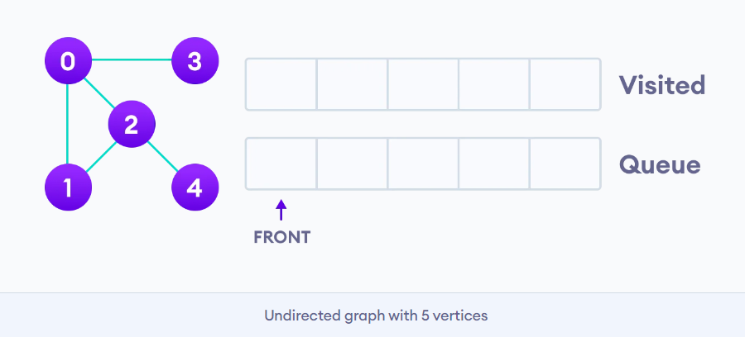
TYPES OF UNINFORMED SEARCH ALGORITHMS:
Breadth-first Search
Depth-first Search
Depth-limited Search
Iterative deepening depth-first search
Uniform cost search
Bidirectional Search

Slide 3
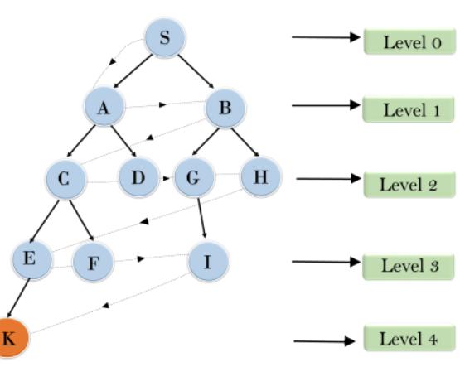
BREADTH FIRST SEARCH
The algorithm works as follows:
Start by putting any one of the graph's vertices at the back of a queue.
Take the front item of the queue and add it to the visited list.
Create a list of that vertex's adjacent nodes. Add the ones which aren't in the visited list to the back of the queue.
Keep repeating steps 2 and 3 until the queue is empty.

Slide 4
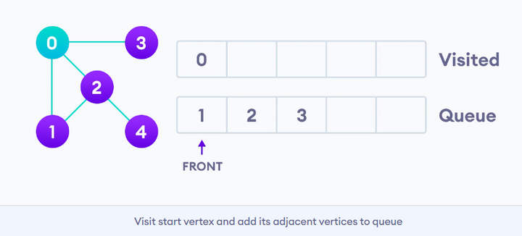
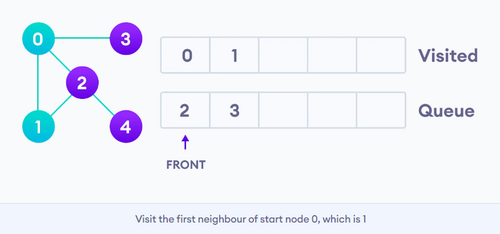
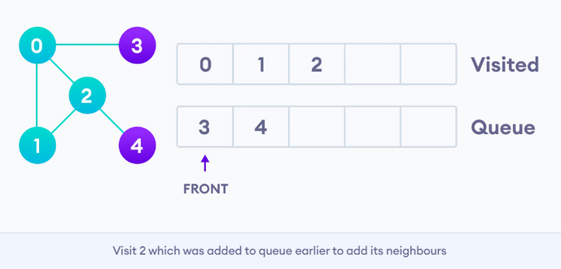
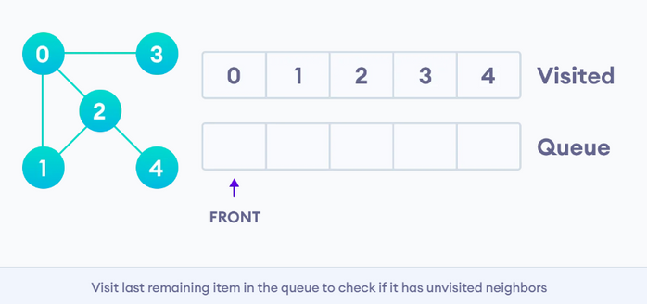
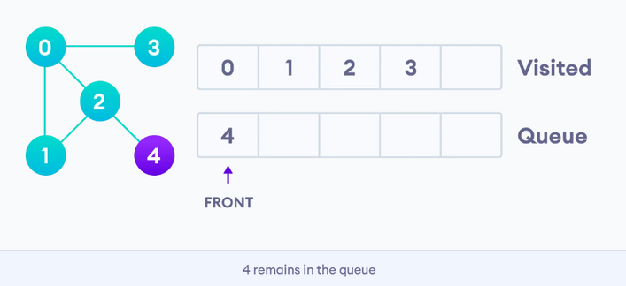
BFS ALGORITHM STEPS

Slide 5
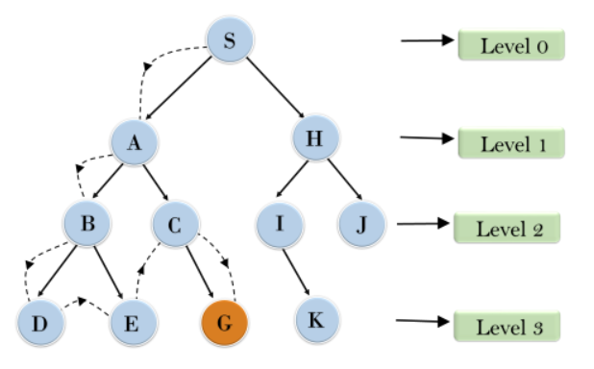
DEPTH FIRST SEARCH
The DFS algorithm works as follows:
Start by putting any one of the graph's vertices on top of a stack.
Take the top item of the stack and add it to the visited list.
Create a list of that vertex's adjacent nodes. Add the ones which aren't in the visited list to the top of the stack.
Keep repeating steps 2 and 3 until the stack is empty.

Slide 6
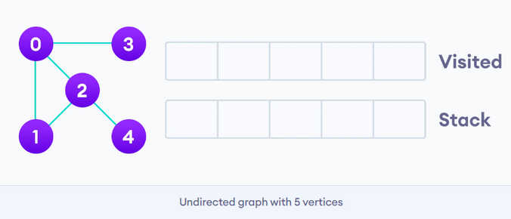
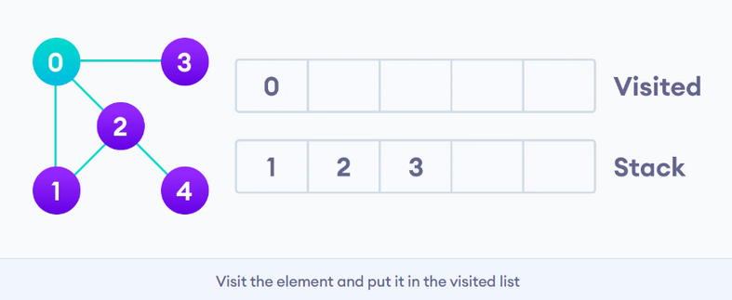
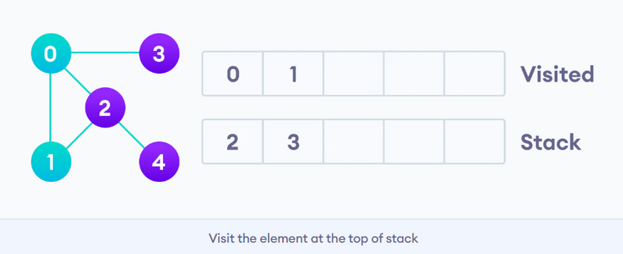
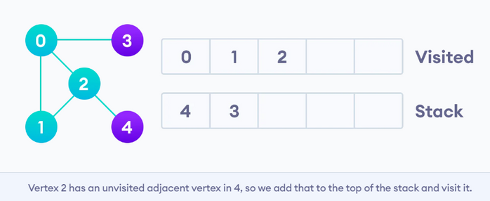
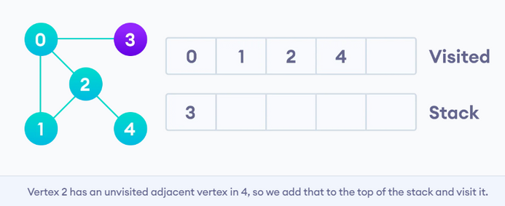
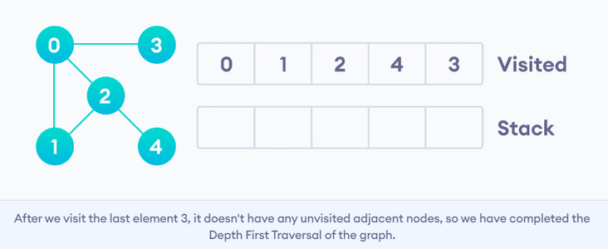
DFS ALGORITHM STEPS

Slide 7
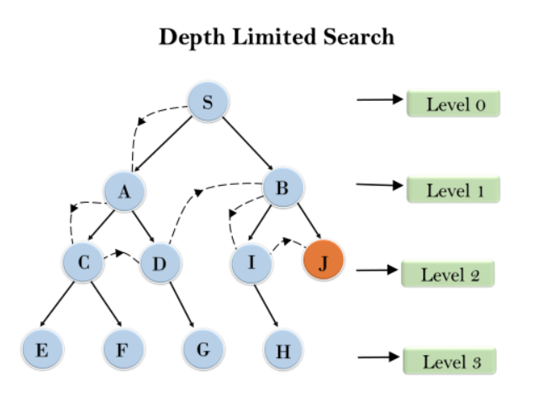
DEPTH-LIMITED SEARCH
The DLS algorithm works as follows:
Start with a stack and put the initial vertex on top.
Create a visited list and initialize it with the starting vertex.
Set a depth limit (maximum depth to explore).
Repeat until the stack is empty or the depth limit is reached:
Pop the top item from the stack and add it to the visited list.
If the depth is within the limit:
Create a list of adjacent nodes.
Add unvisited nodes to the top of the stack.
Continue until the stack is empty or the exploration reaches the depth limit.

Slide 8
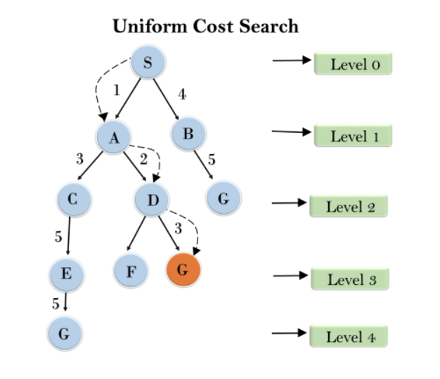
UNIFORM COST SEARCH
The DLS algorithm works as follows:
Create an empty priority queue.
Enqueue the start node with a cost of 0.
While the priority queue is not empty:
Dequeue the node with the lowest cost.
If the dequeued node is the goal, print the cost and path, then exit.
Otherwise, mark the node as visited.
Explore its neighbors:
If a neighbor is not visited or has a lower cost through the current node:
Enqueue the neighbor with the updated cost.
Continue until the priority queue is empty.

Slide 9
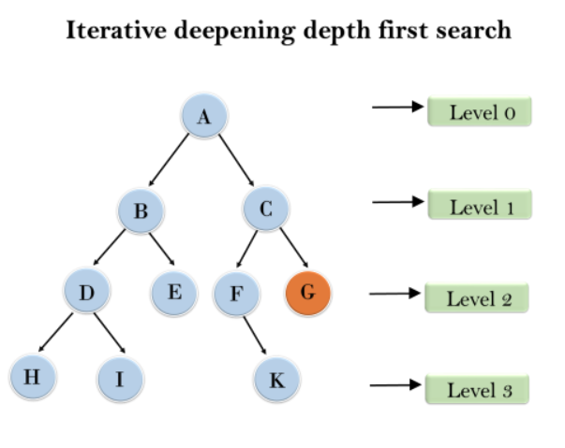
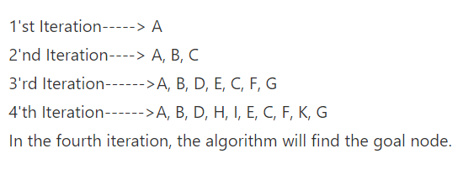
ITERATIVE DEEPENING DEPTH-FIRST SEARCH
Iterative Deepening Depth-First Search (IDDFS):
Start with a depth limit of 0.
Repeat until the goal is found:
Perform Depth-First Search with the current depth limit.
If the goal is found, exit and return the solution.
Increment the depth limit for the next iteration.

Slide 10
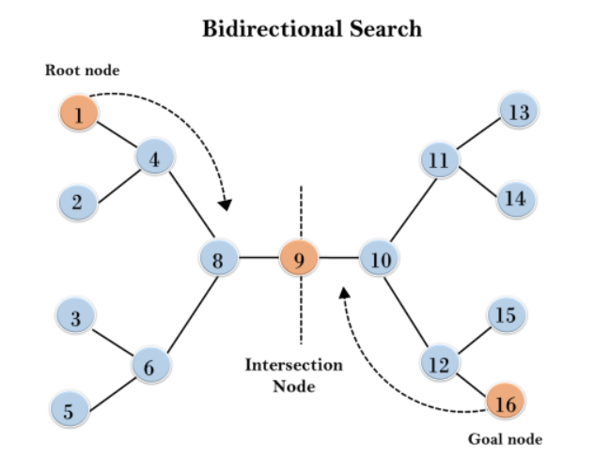
BIDIRECTIONAL SEARCH ALGORITHM
bidirectional search algorithm :
Enqueue the initial state in the forward queue and the goal state in the backward queue.
While both queues are not empty:
Expand a state from the forward queue.
If it's in the backward queue, a meeting point is found; return the path.
Enqueue successors of the state into the forward queue.
Expand a state from the backward queue.
If it's in the forward queue, a meeting point is found; return the path.
Enqueue predecessors of the state into the backward queue.

Slide 11
THANK YOU

