Slide 1
Perceptrons

Slide 2
Artificial Neuron at a Glance
A neuron is a mathematical function model on the working of biological neurons.
It is an elementary unit in an artificial neural network.
Inputs are summed and passed through a nonlinear function to produce output.
Every neuron holds an internal state called activation signal.
Each connection link carries information about the input signal.
Every neuron is connected to another neuron via connection link.

Slide 3
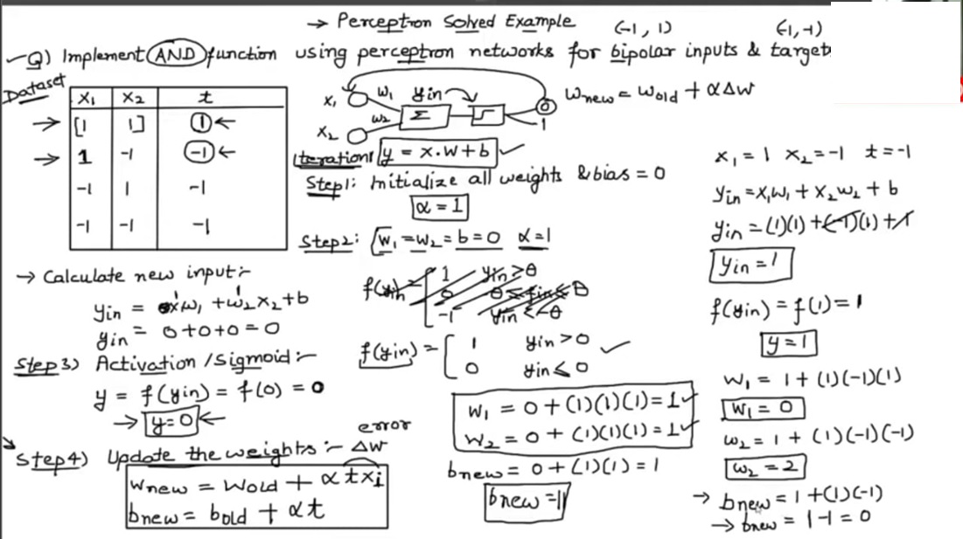

Slide 4
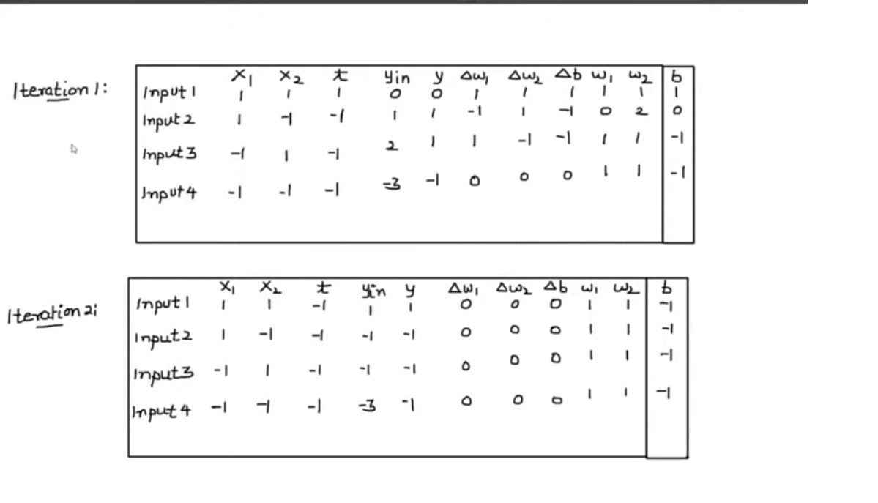

Slide 5
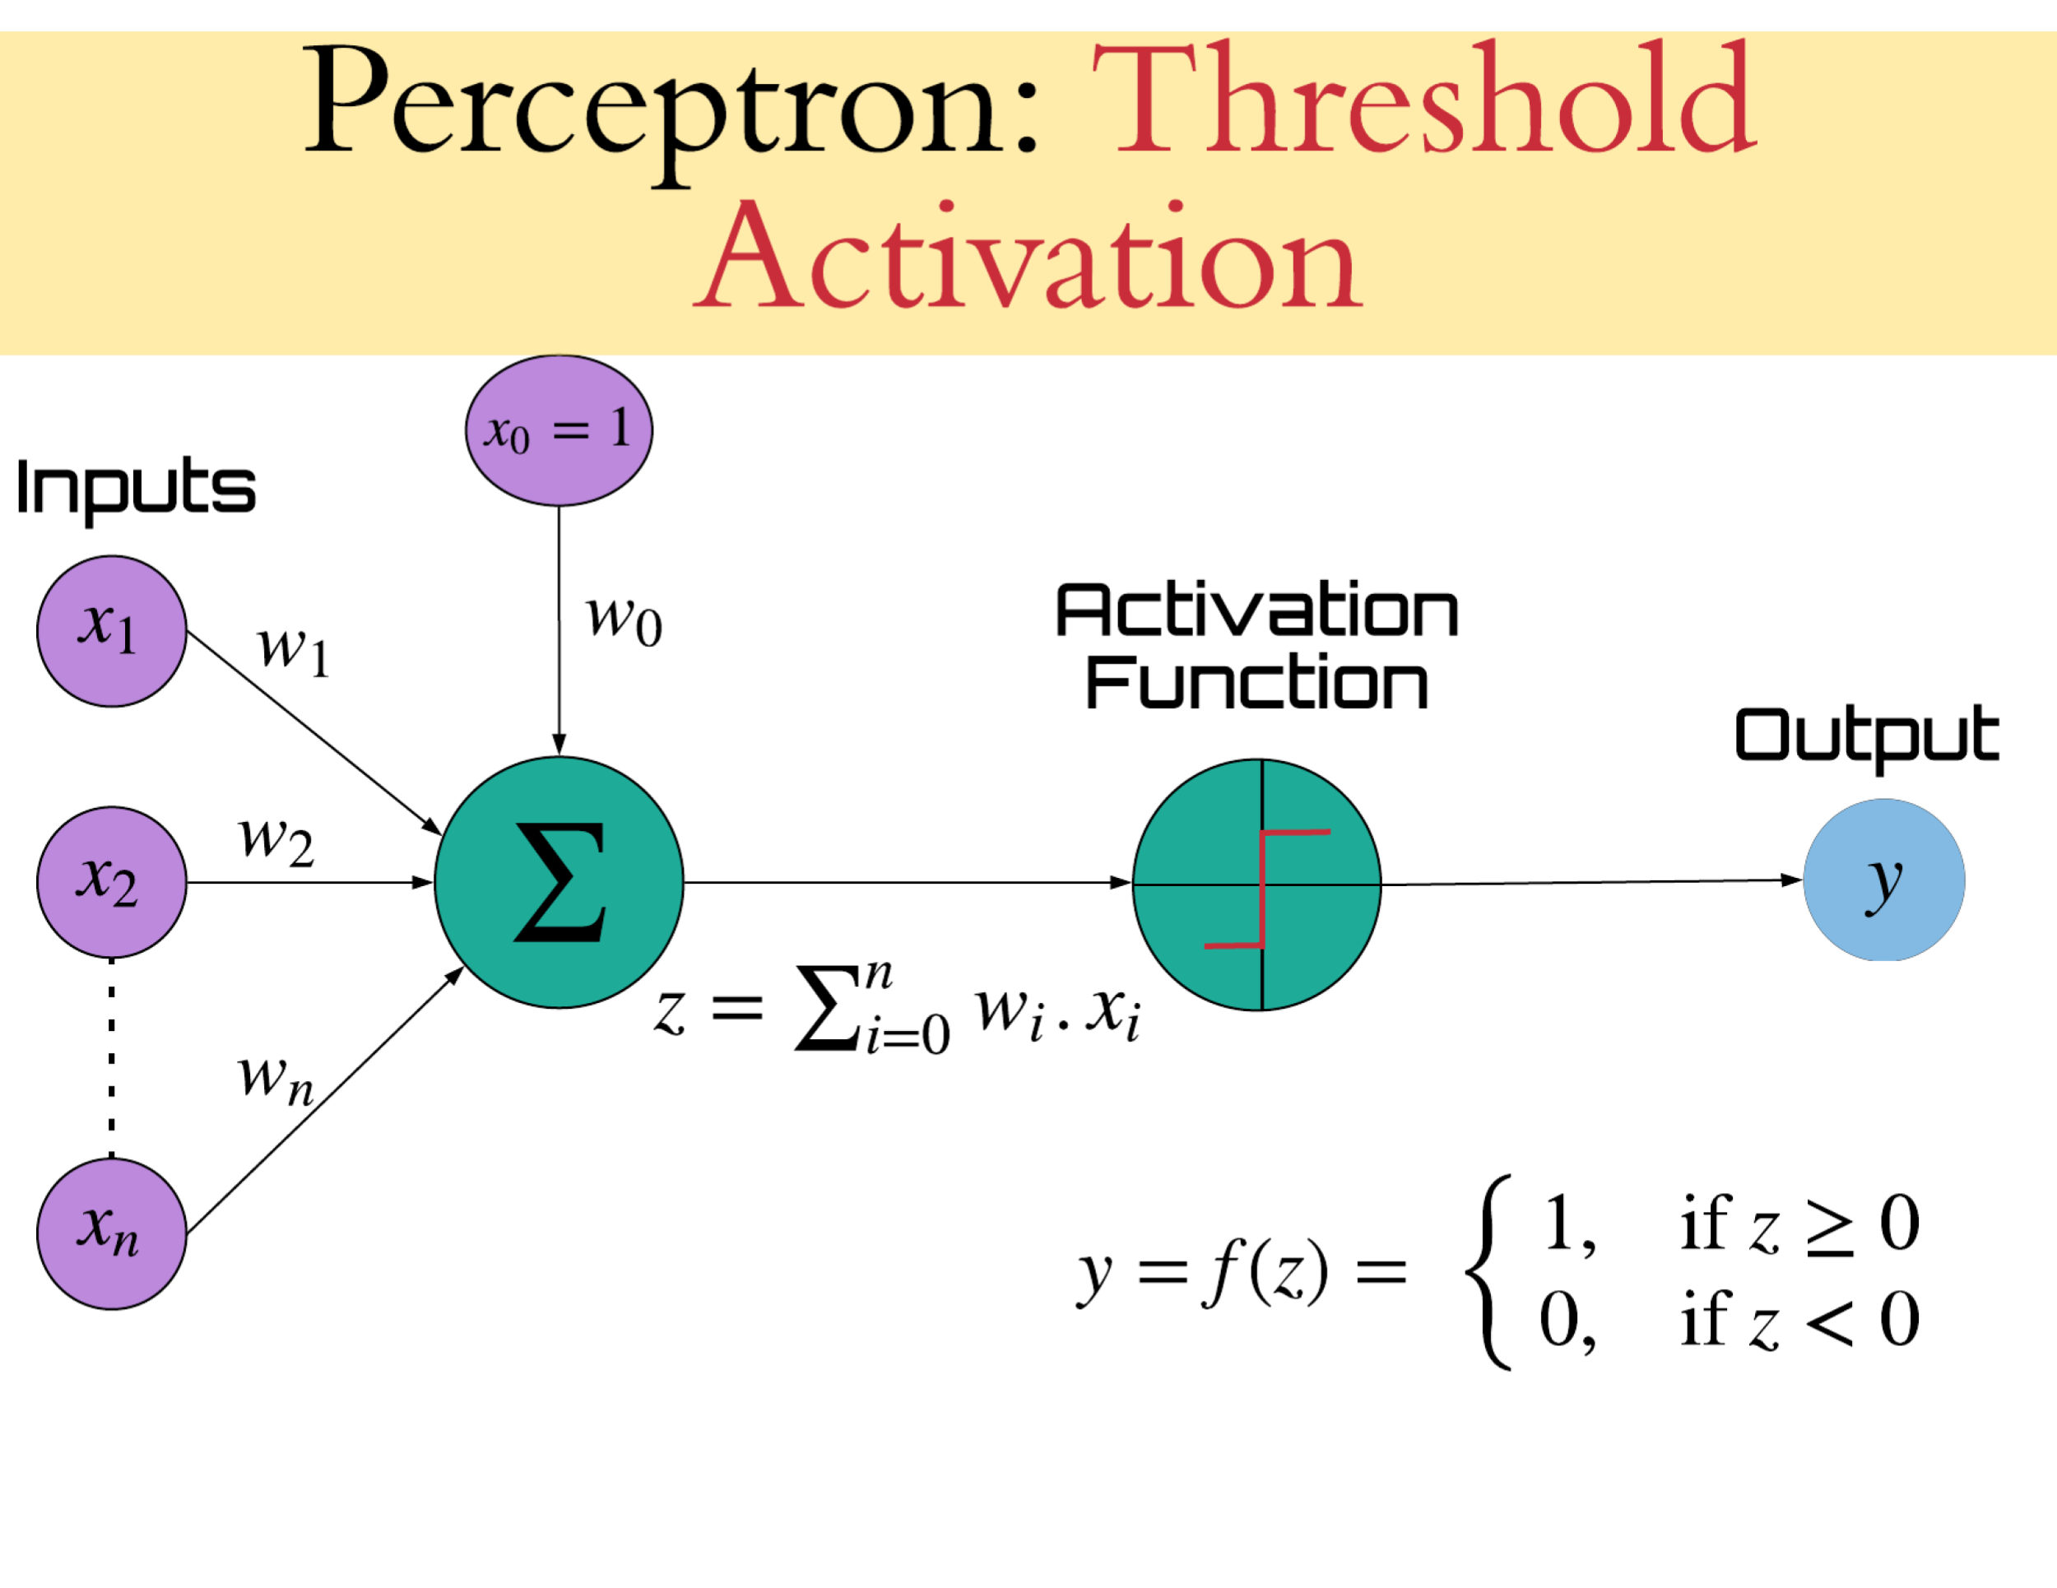
Perceptron
A perceptron is a neural network unit (an artificial neuron) that, has the ability to learn and solve complex problems.
It’s a simple, limited (single layered models) and binary classification algorithm.
It’s an algorithm for supervised learning of binary classifiers.

Slide 6
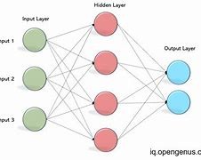
Types of perceptron
Single layer
- Perceptron can learn only linearly separable patterns.
Multilayer perceptron or Feed forward neural networks
- It is group of perceptrons, organized in multiple layers, that can accurately answer complex questions.
- Each perceptron in the first layer sends signals to all the perceptrons in the second layer and so on. An multilayer perceptron contains an input layer, at least one hidden layer and an output layer.
connections

Slide 7
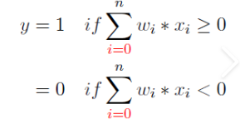
Perceptron Learning
Here algorithm would automatically learn the optimal weight coefficients.
The input/s are multiplied with the weights to determine if a neuron fires or not.
The perceptron receives multiple input signals, and if the sum of the input signals exceeds a certain threshold, it either outputs a signal or does not return an output.
This enables to distinguish between the two linearly separable classes 1 and 0.
Each iteration through the training set is an epoch.
Training until total training set error ceases to improve.

Slide 8
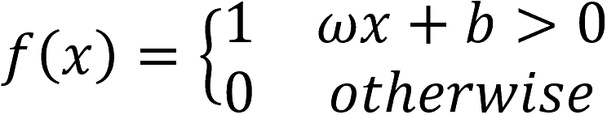

Perceptron Function
Perceptron is a function that maps its inputs “x”, which is multiplied with the learned weight coefficient; an output value “f(x)” is generated.
“w” = vector of real-valued weights.
“b” = bias (an element that adjusts the boundary away from origin without any dependence on the input value).
“x” = vector of input x values.
“m” = number of inputs to the perceptron.
The output can be represented as “1” or “0”.
It can also be represented as “1” or “-1” depending on which activation function is used.

Slide 9
Working of perceptron
Attributes of dataset i.e. features for an example are given as input to the perceptron.
These input features get multiplied by corresponding weights.
The summation is computed for the value we get after multiplication of each feature with the corresponding weight.
The value of the summation is added to the bias.
The activation function is applied to the new value.

Slide 10
Inputs of a perceptron
All the features become the input for a perceptron.
Input is denoted by [x₁, x₂, x₃, …, x_{m}], where x represents the feature value and m represents the total number of features.
This is a special kind of input called the bias, we have taken the value of the BIAS as 1.
A Boolean output is based on inputs such as pass, married, vegan, etc. It has only two values: Yes or No and True or False. The summation function “∑” multiplies all inputs of “x” by weights “w” and then adds them up as follows:
w₀ + w₁x₁ + w₂x₂ + … +w_{m}x_{m}
Initially, we start the value of weights with some initial value and these values get updated for each training error.

Slide 11
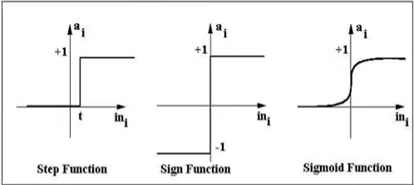
Activation Functions of Perceptron
The activation function applies a step rule (convert the numerical output into +1 or -1) to check if the output of the weighting function is greater than zero or not.
- Step function gets triggered above a certain value of the neuron output; else it outputs zero.
- Sign function outputs +1 or -1 depending on whether neuron output is greater than zero or not.
- Sigmoid is the S-curve and outputs a value between 0 and 1.

Slide 12
Output of perceptron
The weighted summation is passed to the step/activation function and whatever value we get after computation is our predicted output.
Weights:
- W_{i} : contribution of input x_{i} to the perceptron output;
- W₀: bias or threshold
If ∑w.x > 0, output is +1, else -1.
The neuron gets triggered only when weighted input reaches a certain threshold value.
An output of +1 specifies that the neuron is triggered. An output of -1 specifies that the neuron did not get triggered.

Slide 13
Error in perceptron
In the Perceptron Learning Rule, the predicted output is compared with the known output.
If it does not match, the error is propagated backward to allow weight adjustment to happen.

Slide 14
Perceptron overview
It’s an algorithm for supervised learning of single layer binary linear classifier.
Optimal weight coefficients are automatically learned.
Weights are multiplied with the input features and decision is made if the neuron is fired or not.
Activation function applies a step rule to check if the output of the weighting function is greater than zero.
Linear decision boundary is drawn enabling the distinction between the two linearly separable classes +1 and -1.
If the sum of the input signals exceeds a certain threshold, it outputs a signal; otherwise, there is no output.
Types of activation functions include the sign, step and sigmoid functions.

Slide 15
Thank You!

