Slide 1
Perceptron Implementation

Slide 2
Perceptron Example
Implementation 1
Implementation 2
Activation Function
Agenda
Prediction
Making perceptron learn
Hyperparameter
Weight Update Rule
Update constructor
Training dataset
Code

Slide 3
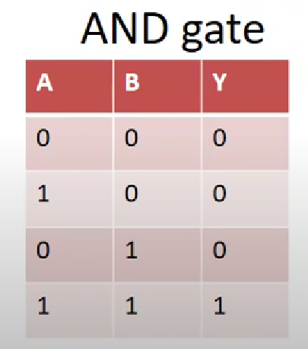
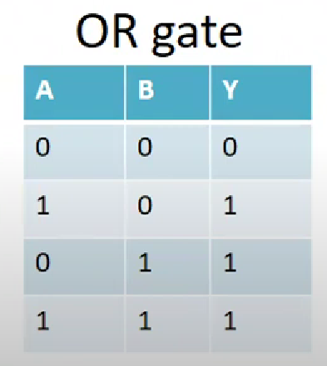
Perceptron Example
Consider the logic gates in the table below:
We can create perceptrons that act like gates: they take 2 binary inputs and produce a single binary output.

Slide 4
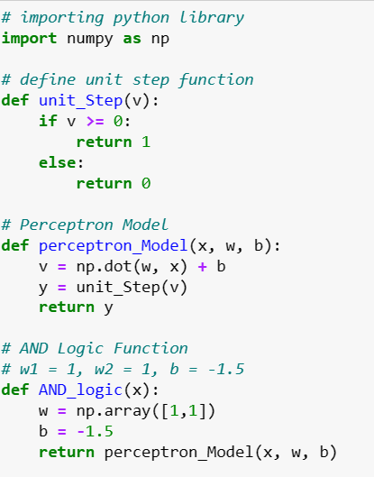
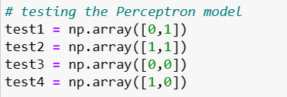

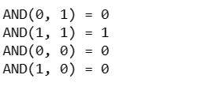
Implementation 1
Output:

Slide 5
Implementation 2
Need to know how many inputs there are to create weight vector.
Add one to the input size to include the bias in the weight vector.
import numpy as np
class Perceptron(object):
def__init__(self, input_size):
self.W = np.zeros(input_size+1)

Slide 6
Activation Function
Return 1 if the input is greater than or equal to 0 and 0 otherwise.
def activation_fn(self, x):
return 1 if x >= 0 else 0

Slide 7
Prediction
Function to run an input through the perceptron and return an output.
Conventionally, this is called the prediction.
Add the bias into the input vector. Then we can simply compute the inner product and apply the activation function.
def predict(self, x):
x = np.insert(x, 0, 1)
z = self.W.T.dot(x)
a = self.activation_fn(z)
return a

Slide 8

Making perceptron learn
w <-- w + w
Need to determine a good w
Define the error as the difference between the desired output d and the predicted output y.
e = d - y
When d and y are the same (both are 0 or both are 1), we get 0, but when they are different, (0 and 1 or 1 and 0), we can get either 1 or -1.
Multiply this with the input to change weight vector in proportion to input.
w<--w+n. e. x

Slide 9
Hyperparameter
w<--w+n. e. X
where, n is a hyperparameter called the learning rate. It is a scaling factor that determines how large the weight vector updates should be.
This is a hyperparameter because it is not learned by the perceptron (there is no update rule for), but we select this parameter.

Slide 10
Weight update rule
Create a function to keep applying weight update rule until perceptron can correctly classify all of the inputs.
Need to keep iterating through training data until it is trained.
One epoch is when perceptron has seen all of the training data once.
Usually, learning algorithm is run for multiple epochs.

Slide 11
Update constructor
def __init__(self, input_size, lr=1, epochs=10):
self.W = np.zeros(input_size+1)
# add one for bias
self.epochs = epochs
self.lr = lr
The numpy.zeros() function returns a new array of given shape and type, with zeros.
lr is the learning rate.

Slide 12
Prediction
def fit(self, X, d):
for_ in range(self.epochs):
for i in range(d.shape[0]):
y = self.predict(X[i])
e = d[i] - y
self.W = self.W + self.lr * e * X

Slide 13
Training dataset
Easy set of training data for AND gate.
Here is a set of inputs and outputs.
if __name__ == ‘__main__’:
X = np.array([[0,0], [0,1], [1,0], [1,1]])
d = np.array([0,0,0,1])
perceptron = Perceptron(input_size=2)
perceptron.fit(X, d)
print(perceptron.W)

Slide 14
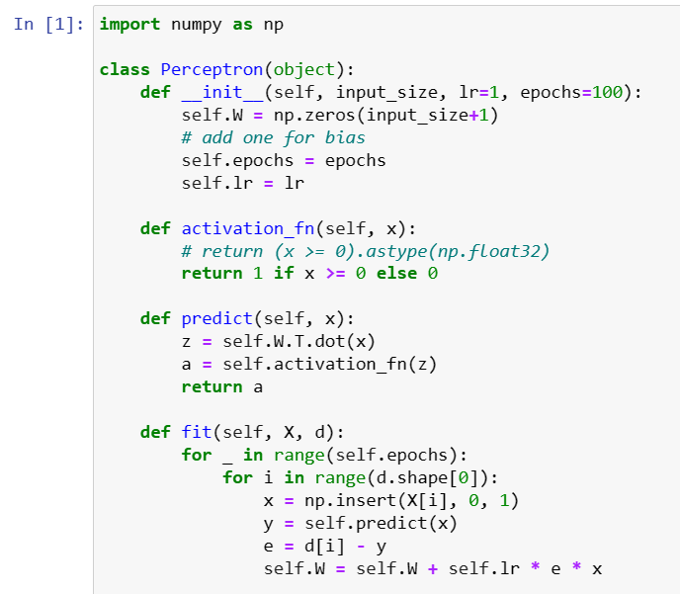
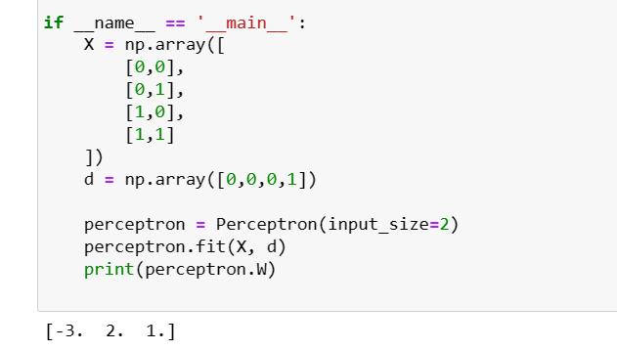
Code

Slide 15


