Slide 1


Walchand College Of Engineering, Sangli
(Academic year 2023-24)
Department Of Information Technology
Introduction

Slide 2
Contents
Introduction​
Turing Test
Application

Slide 3
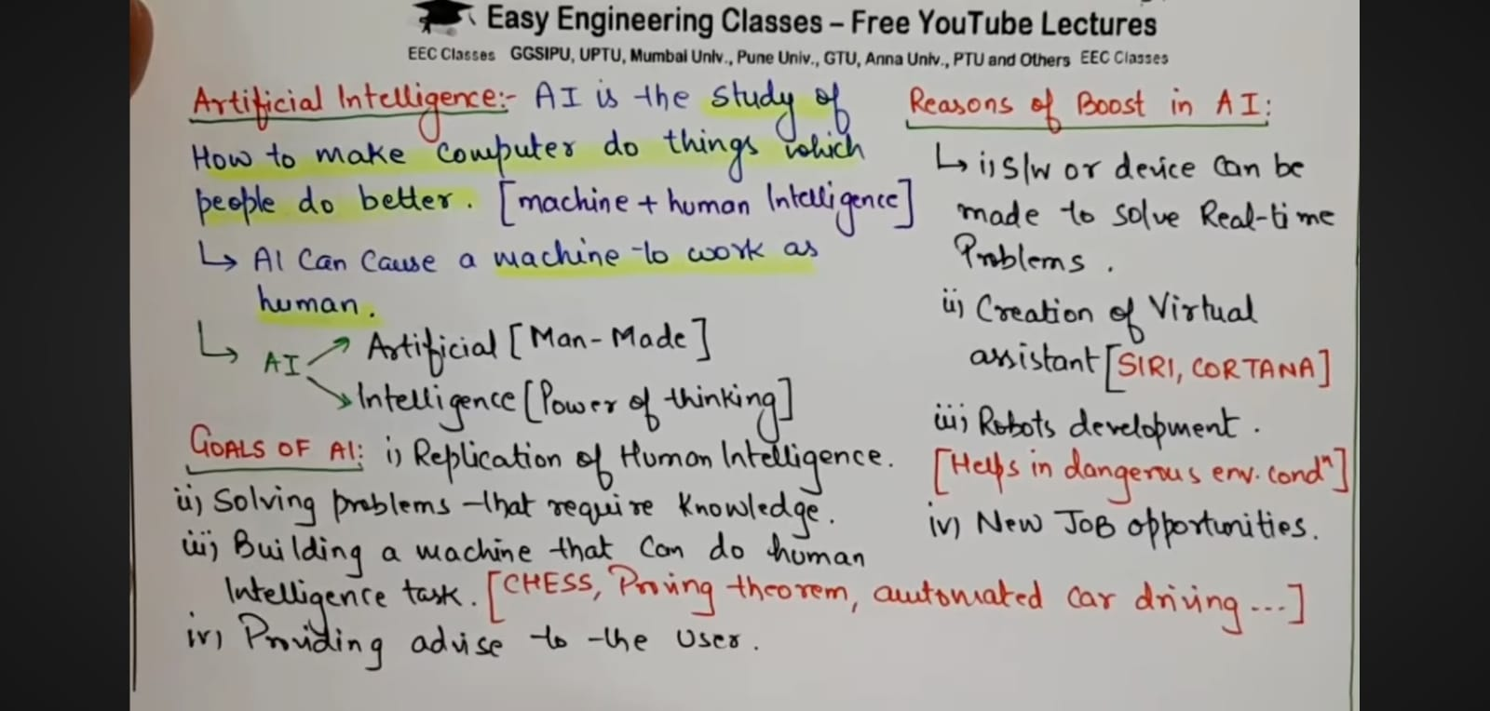
Introduction​

Slide 4
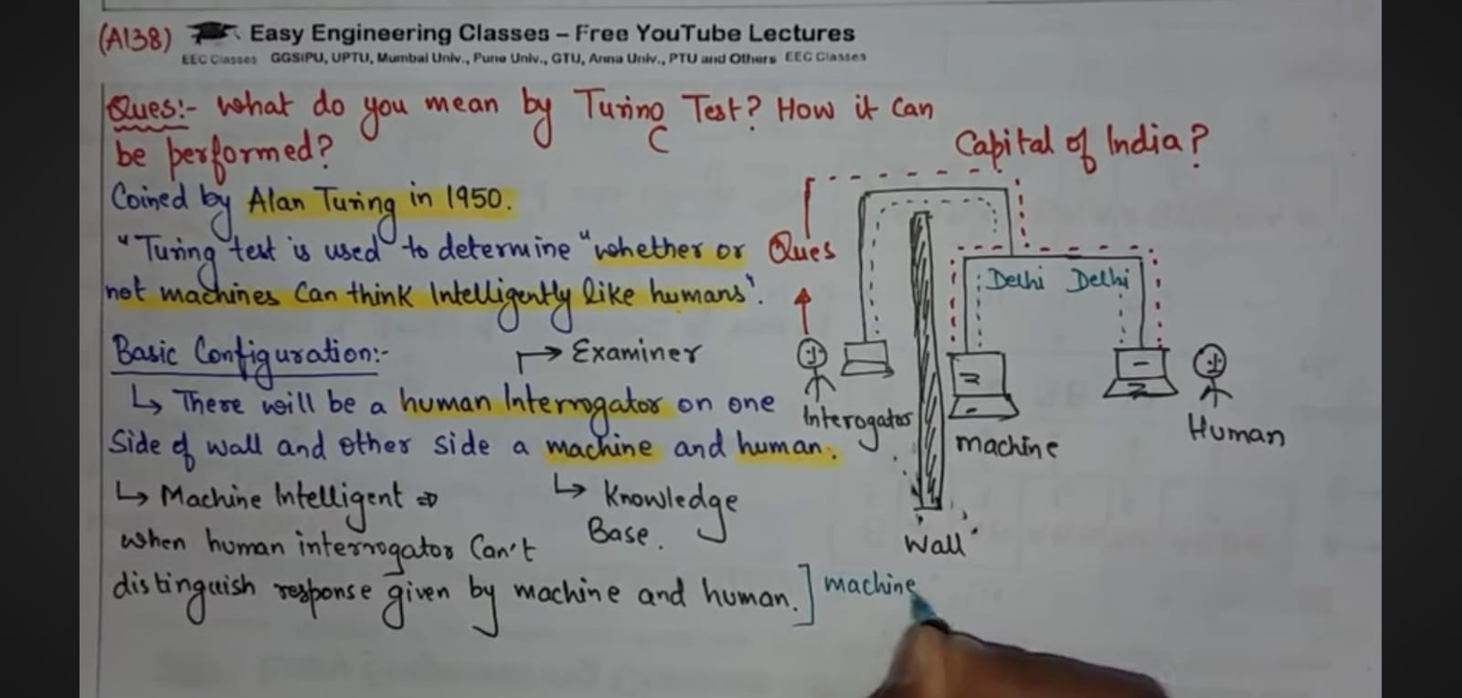
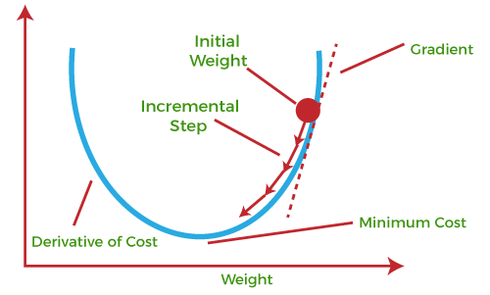
​

Slide 5
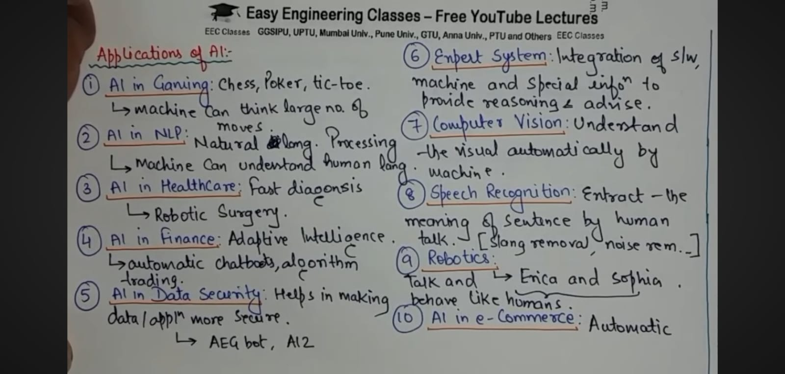

Slide 6
Thank you

